Slide 1
Future-Proofing Global Connectivity
BalticNOG 2025
Trends, Threats, and Tactics for a Resilient Network
Timur Pertenava
Commercial Director, Nordic & Baltic

Slide 2
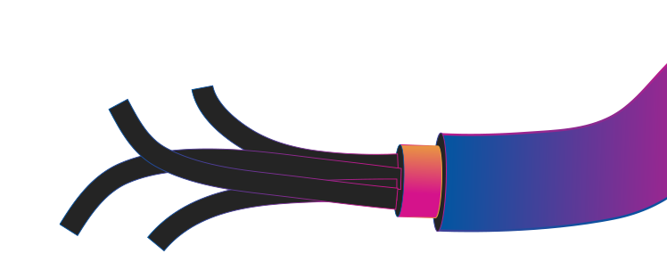
The 99% myth
The Myth: Submarine cables account for over 99% of intercontinental data traffic.
Conclusion: True, but precise calculations are not possible due to lack of data for intercontinental traffic.
Status:
CONFIRMED
Source: Telegeography
2

Slide 3
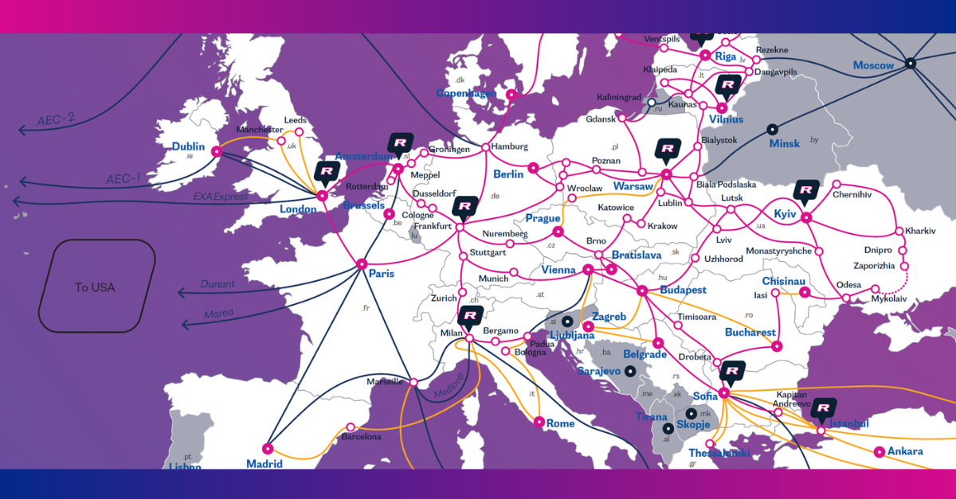
RETN: building network for 20 years
140.000 km
Total Network Length
970+
PoPs
99,6 Tbps
IP/MPLS Network Capacity
10th
According to Caida AS Rank*

Slide 4

Black Swan and
Grey Rhino events:
COVID pandemic followed by
War in Ukraine followed by
Red sea cable cuts followed by
Asia cable cuts followed by
Baltic Sea cable cuts followed by
More Red sea cable cuts
…

Slide 5
Network Security a.k.a. Protecting data in transmission by ensuring:
1.
2.
3.
It arrives where it should
availability
& resilience
It cannot be stolen on the way
confidentiality
It is not modified on route
integrity

Slide 6
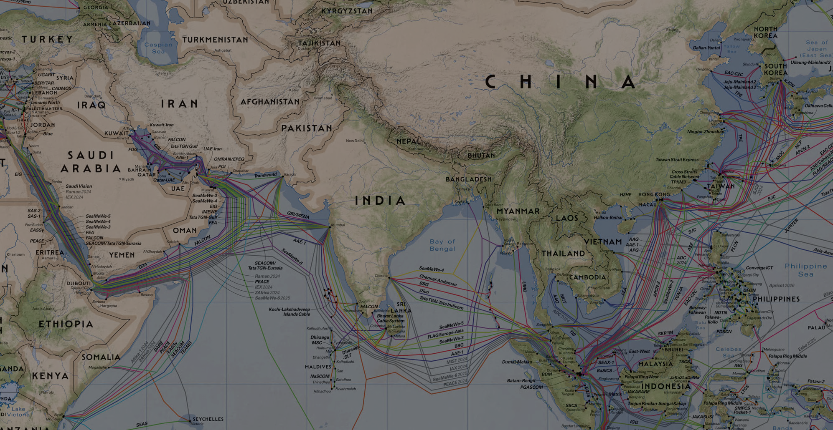
Key submarine systems and SPoFs
Cable systems in the Red Sea
Cable systems laid around Singapore
Connectivity around Taiwan
Map: Telegeography

Slide 7
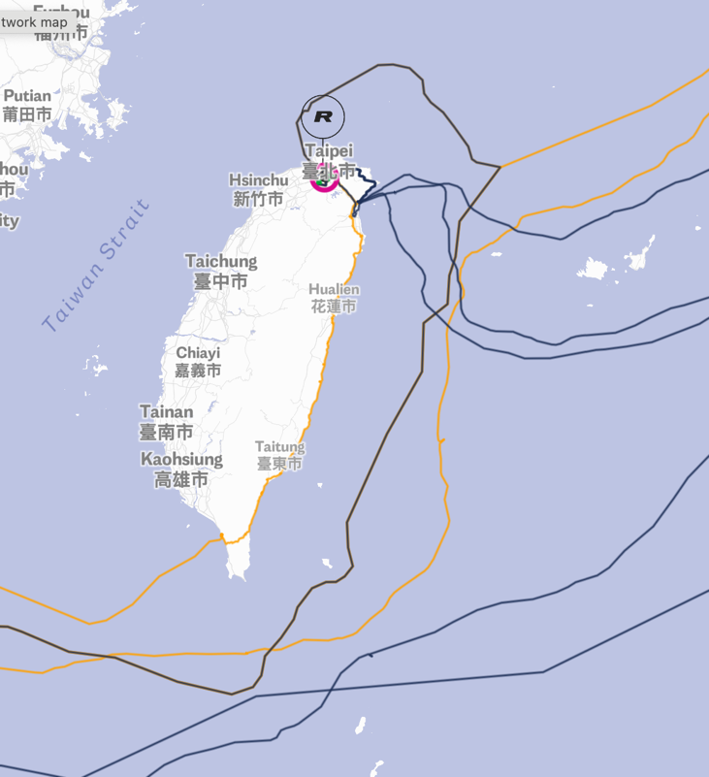
Taiwan cable cuts 2025
EAC
Tokyo – Taiwan RNAL cable since 06.01.2025 (fixed 25.08.2025 in 212 days)
Hong-Kong – Taiwan C2C cable since 10.07.2025
Hong-Kong – Taiwan RNAL cable since 06.07.2025
Hong-Kong – Taiwan EAC cable since 22.08.2025
Cable maintenance Hong-Kong– Taiwan APG cable August 2025
Cable maintenance Tokyo – Taiwan RNAL cable August 2025
RNAL
RNAL
C2C
Map: www.retn.net/network/network-map

Slide 8
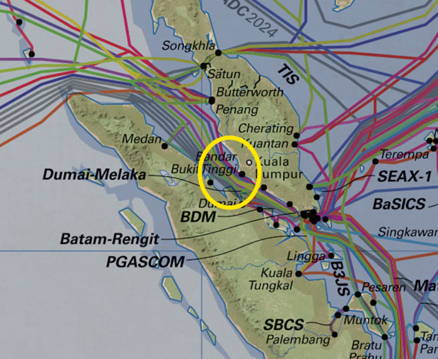
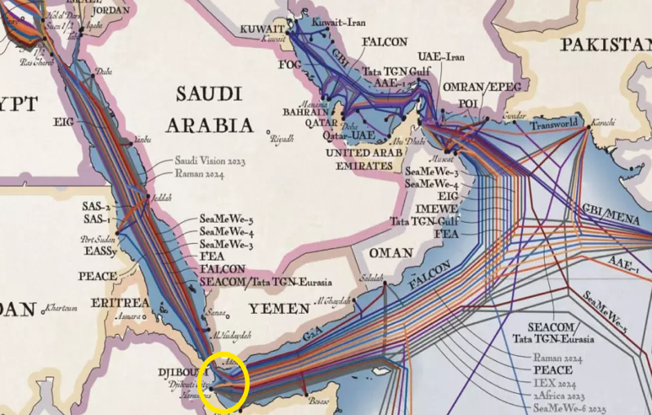
2024 Europe-Asia cable incident
Up to 70% Europe to Asia traffic impacted
SEACOM, TGN, AAE-1 and EIG cables were out of service due to fiber cut since 24 February 2024.
On 19 April 2024, there was another interruption on SMW5 between Singapore and Europe.
No more direct submarine cable options between Europe and Singapore with big throughput were left.
SMW5 fixed ~ 28 June, 70 days downtime
AAE1 fixed ~17 July, 146 days downtime

Slide 9
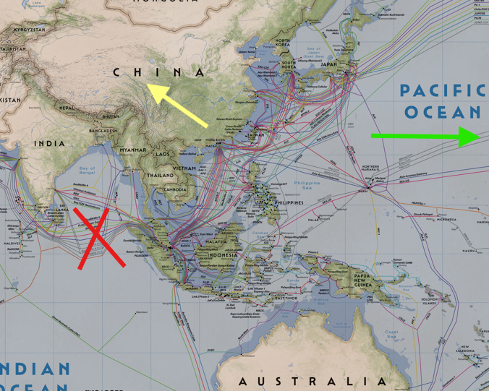
Red Sea cuts: How to mitigate?
Terrestrial routes Asia to Europe
Multiple cable system capacity Europe to Asia and within Asia
Example: Hong-Kong – Frankfurt before the cut and different rerouting options
Route | RTT HK-FKT
Normal (over the Red Sea) | 165 ms
Long (over US) | 274 ms
Terrestrial (over TRANSKZ and Baltics) | 143 ms

Slide 10
Pain points in Baltics
Most of the routes towards Poland go via Suwałki (25 km from Belarus)
All the cables towards Sweden and Finland susceptible to incidents/sabotage
Major connectivity hubs in 3 capital cities: Sõle 14, TVT, J13
No hyperscaler- grade DCs as a potential driver for the route's diversity

Slide 11
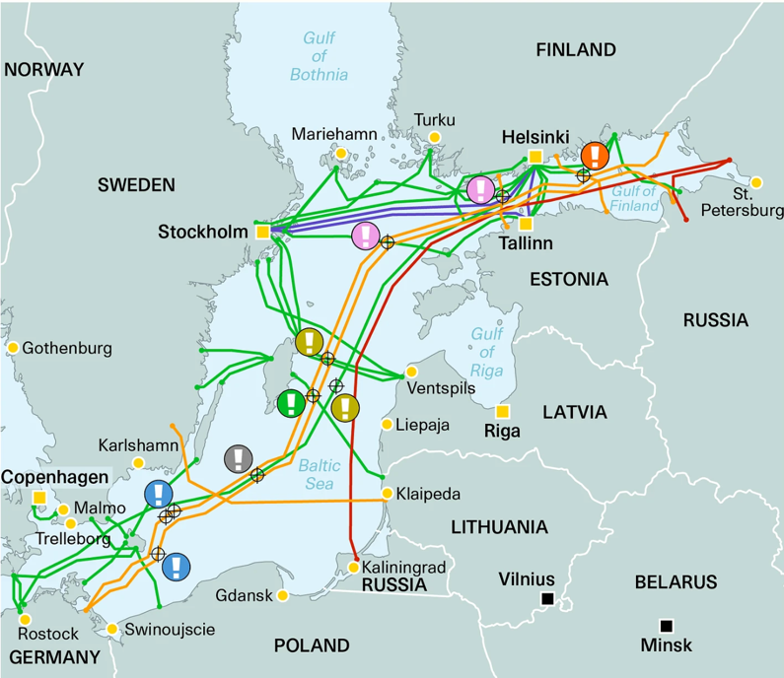
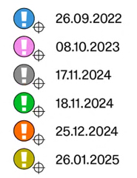
2022-2025 Baltic sea cable cuts
26.09.2022 Nord Stream I & II, no damage to the telecom infrastructure
08.10.2023 Balticconnector gas pipeline + telecom cable Finland-Estonia
17.11.2024 BCS East-West Interlink Lithuania-Sweden
18.11.2024 C-Lion 1 Finland-Germany
25.12.2024 (4xfiber cables, 1xEstlink, 1xRostelecom) Estonia-Finland
26.01.2025 LVRTC Latvia-Sweden
Image: Kate O’Riordan / the Brussels Institute for Geopolitics

Slide 12
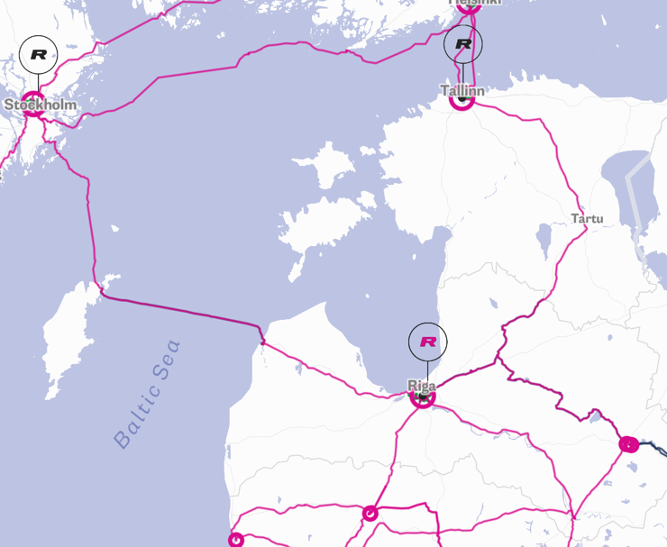
26.01.2025 LVRTC cable damage
Caused no interruption for RETN Internet backbone
Caused no interruption for protected capacity services
By 27.01.2025 all unprotected capacity services were rerouted (thanks to FLEX grid system less than 24 hours needed)
Cable was restored 28.02.2025 (32 days)
Map: www.retn.net/network/network-map

Slide 13
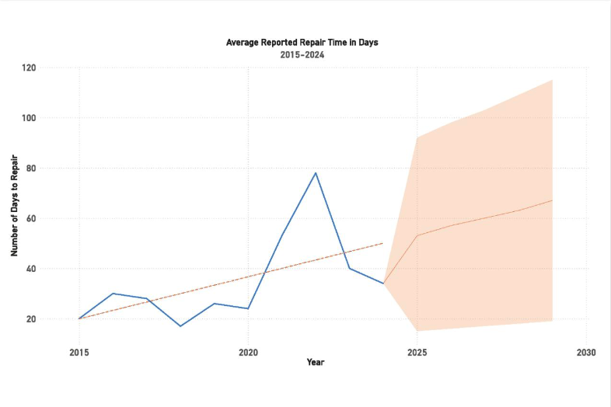
Terrestrial vs Submarine cable fault management
 | Amount of cable faults | MTTR
Terrestrial cable | Often | 4-12 hours
Submarine cable | Seldom | Weeks to months
MTTR
1 subsea fault: 40days (if lucky)
1 terrestrial cable cut: 4-12 hours subject to severity
Terrestrial cable: Most of the available Trans-Eurasia terrestrial cable systems offer protection to minimise the impact of cable cuts due to the long distance.
Terrestrial routes offer better capacity scalability (HW upgrade, shorter regeneration segments)
Source: Submarine telecom industry report 2024/25

Slide 14
Rethink route planning
From apparent redundancy to true diversification

Slide 15
Survival tips for DWDM network operators
Ensure route, PoP and vendor diversity
Prioritise equipment interoperability
Understand the supporting infrastructure (power and environment at ILA PoPs)
Maintain spare parts inventory; plan logistics in advance
Keep operational teams engaged and informed

Slide 16
Major takeaways from the massive submarine cable cuts
Everyone missing a lot of capacity - causes traffic spikes due to other’s networks malfunction
Cable maintenance vessels are scarce – you can be the last in the line. MTTR growing from weeks to months
Capacity demand spikes on survived routes – be ready to wait for the delivery
More routes – increased services survival rate

Slide 17
Reference and further reading:
Submarine telecom industry report
https://issuu.com/subtelforum/docs/submarine_telecoms_industry_report_issue_13/28?ff
TeleGeography submarine cable map
https://submarine-cable-map-2025.telegeography.com
Submarine cable cut on AAE-1 cable
https://www.datacenterdynamics.com/en/news/at-least-one-subsea-fiber-cable-damaged-in-the-red-sea-some-reports-blame-houthi-rebels/
RETN Building the Networks of tomorrow https://retn.net/trending/Building_the_networks_of_tomorrow
Geopolitics of Baltic Subsea Infrastructure
https://big-europe.eu/publications/2025-04-11-geopolitics-of-baltic-subsea-infrastructure

Slide 18


Thank You
BUILD WITH INTENT. NOT ASSUMPTION.

Slide 20
Internet backbone is a DWDM backbone

Slide 21
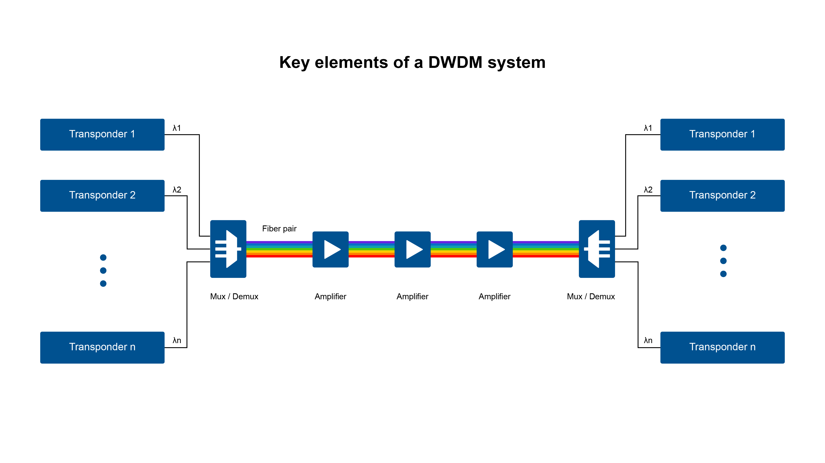
How DWDM works

Slide 22
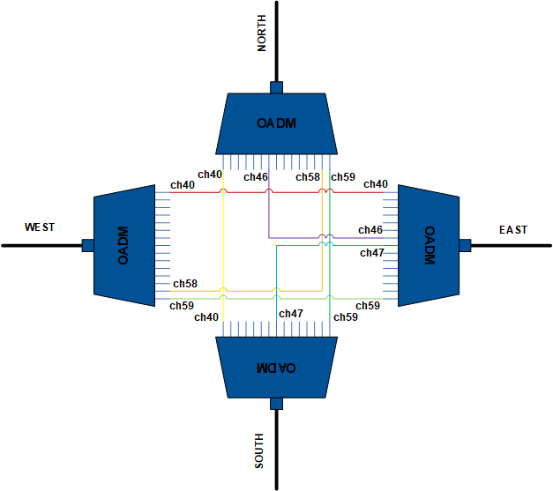

Multiplexing and demultiplexing
Fixed Optical Add-Drop Multiplexers (FOADM)
Early OAMD
Fixed wavelength grid
Manual add-drop only
Fixed signal width
Vendor lock
Powered by
Athermal arrayed wave guide (AWG)
Thin film filter (TFF)

Slide 23
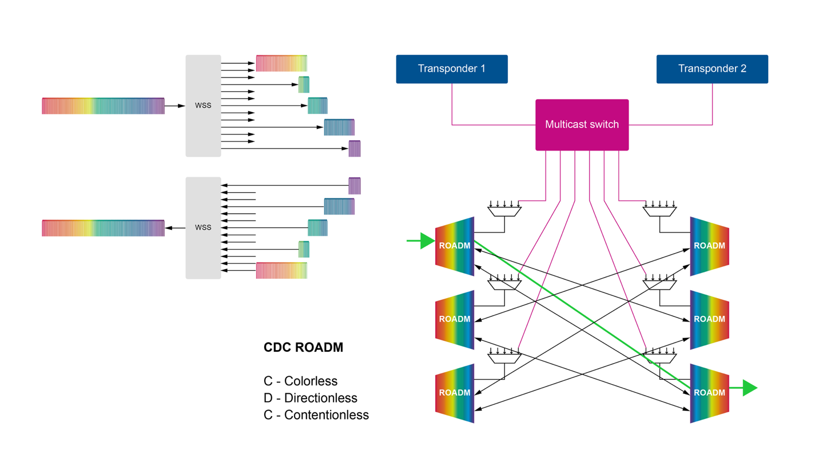
Flexible-grid WSS - a heart of modern ROADM

Slide 24
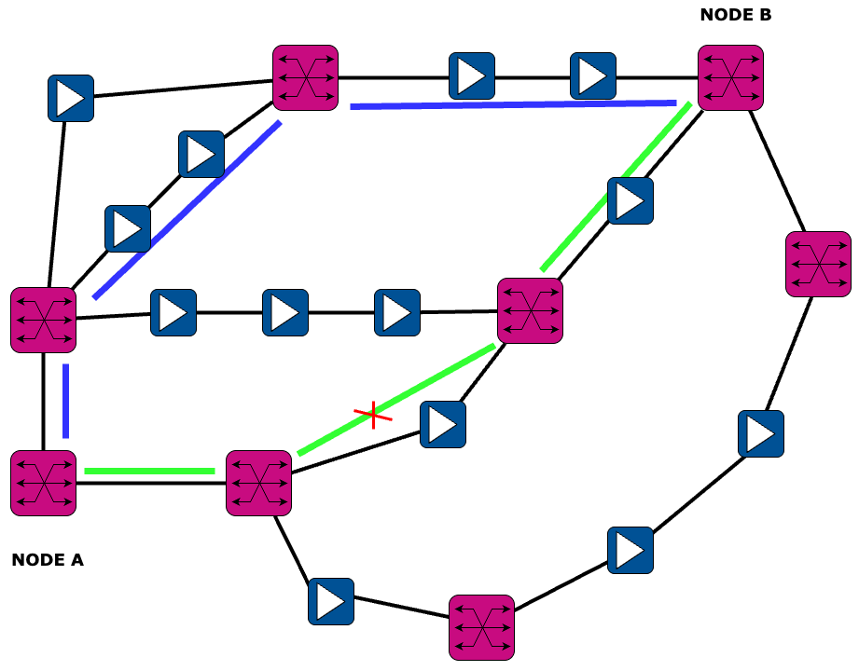
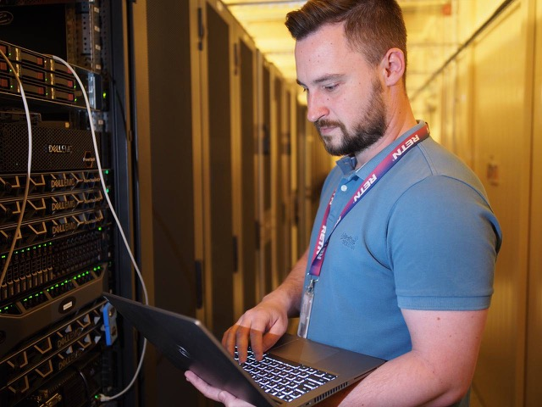
Power of Flexibility
Benefits of FLEX Grid systems

Slide 25
