Slide 1

Building Trustworthy Network Automation, From Principles to Practice
Damien Garros, OpsMill
Notes:
How many of you here design and build infrastructure or networks?
How many of you have some level of automation for those networks?

Slide 2




About me : Damien Garros
Co-Founder and CEO of OpsMill
Creator of Infrahub, a next generation Infrastructure data management platform (Source of Truth)
Focused on Infrastructure as Code, Automation & Observability for 12+ years
Previously leading Technical Architecture at
Network to Code
damiengarros
@dgarros

Slide 3

Introduction
Notes:
How many of you here design and build infrastructure or networks?
How many of you have some level of automation for those networks?

Slide 4
Trust
is essential for successful network automation adoption.

Slide 5

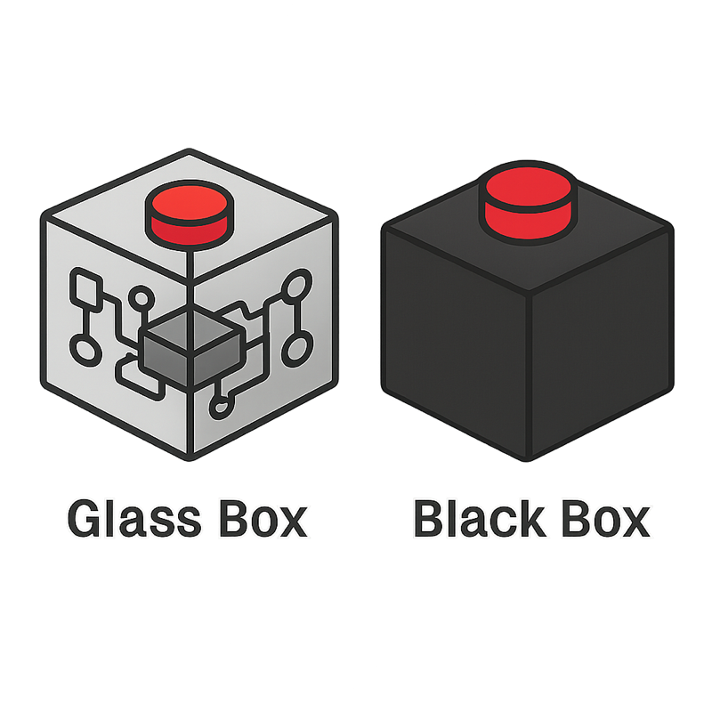
Press the button
to upgrade
your network
Software Upgrade
Automation
User

Slide 6
The person who developed it probably has a completely different perspective on it
Automation
Developer
Software Upgrade

Slide 7

Effort to build automation workflows
What we often focus on
What is required to build Trust
Working
Playbook
Reliable
Predictable
Manageable
Human Friendly
Simple
Transparent

Slide 8


Which cars do you trust the most ?
Another perspective on this topic
Manageable
Reliable
Human Friendly
Predictable

Slide 9
Main Principles to build Trust
Predictable
Automation should produce consistent and repeatable outcomes every time it runs.
Manageable
Systems and workflows should be easy to configure, control, and update without hidden complexity.
Transparent
Automation should clearly show what it will do and what it has done — no surprises.
Simple
Solutions should avoid unnecessary complexity, making them easier to understand, audit, and maintain.
Reliable
Automation must handle failures gracefully and ensure that critical operations complete successfully.
Human Friendly
Interfaces and experiences should be designed with people in mind — intuitive, safe, and supportive of decision-making.
Trust comes from visibility, control, and graceful failure handling — not just from correct execution.

Slide 10

Built on Mistakes. Refined by Experience.
This presentation present some hard-earned knowledge based on years of trying and making mistakes.
Building automation that’s predictable, manageable, transparent, and reliable isn’t easy.
It takes time, and it takes care — but every step forward matters.

Slide 11
Design Principles of Trustworthy Automation
Notes:
How many of you here design and build infrastructure or networks?
How many of you have some level of automation for those networks?

Slide 12
Idempotency
Definition
running the same operation multiple times
has the same effect
as running it once.
Idempotency is one of the cornerstone of reliability and simplicity in automation systems.
Notes:
Source image
https://thetightlycoupled.wordpress.com/2020/02/15/whats-an-idempotent-api-and-why-you-should-care/

Slide 13


Example of Idempotency in networking
I need an IP address ->
<- 10.0.0.1
NOT
idempotent
I need an IP address ->
<- 10.0.0.2
I need an IP address ->
<- 10.0.0.3
I need an IP address ->
Idempotent
<- 10.0.0.1
I need an IP address ->
<- 10.0.0.1
I need an IP address ->
<- 10.0.0.1
Notes:
Source image
https://thetightlycoupled.wordpress.com/2020/02/15/whats-an-idempotent-api-and-why-you-should-care/

Slide 14
Example of Idempotency in networking
Idempotency uses a declarative approach to move the complexity of managing the state from the client .. to the server
The laptop doesn’t need to know the current state of the system.
The complexity is managed within the server to understand what needs to be done.
My name is Bob and I need an IP address ->
<- 10.0.0.1
My name is Bob and I need an IP address ->
Bob = 10.0.0.1
<- 10.0.0.1
Notes:
Source image
https://thetightlycoupled.wordpress.com/2020/02/15/whats-an-idempotent-api-and-why-you-should-care/

Slide 15
Dry Runs
Definition
Show users exactly what will change before anything is executed
Builds confidence and reduces fear of unintended consequences.
Notes:
Source image
https://thetightlycoupled.wordpress.com/2020/02/15/whats-an-idempotent-api-and-why-you-should-care/

Slide 16

Dry Run mode (AKA check mode)
Before executing any changes, the automation shows exactly what it would do, without actually doing it.
This gives the operator a chance to review, approve, and catch mistakes early.
Apply
Dry Run
“Here’s the diff - do you want to proceed?”

Slide 17


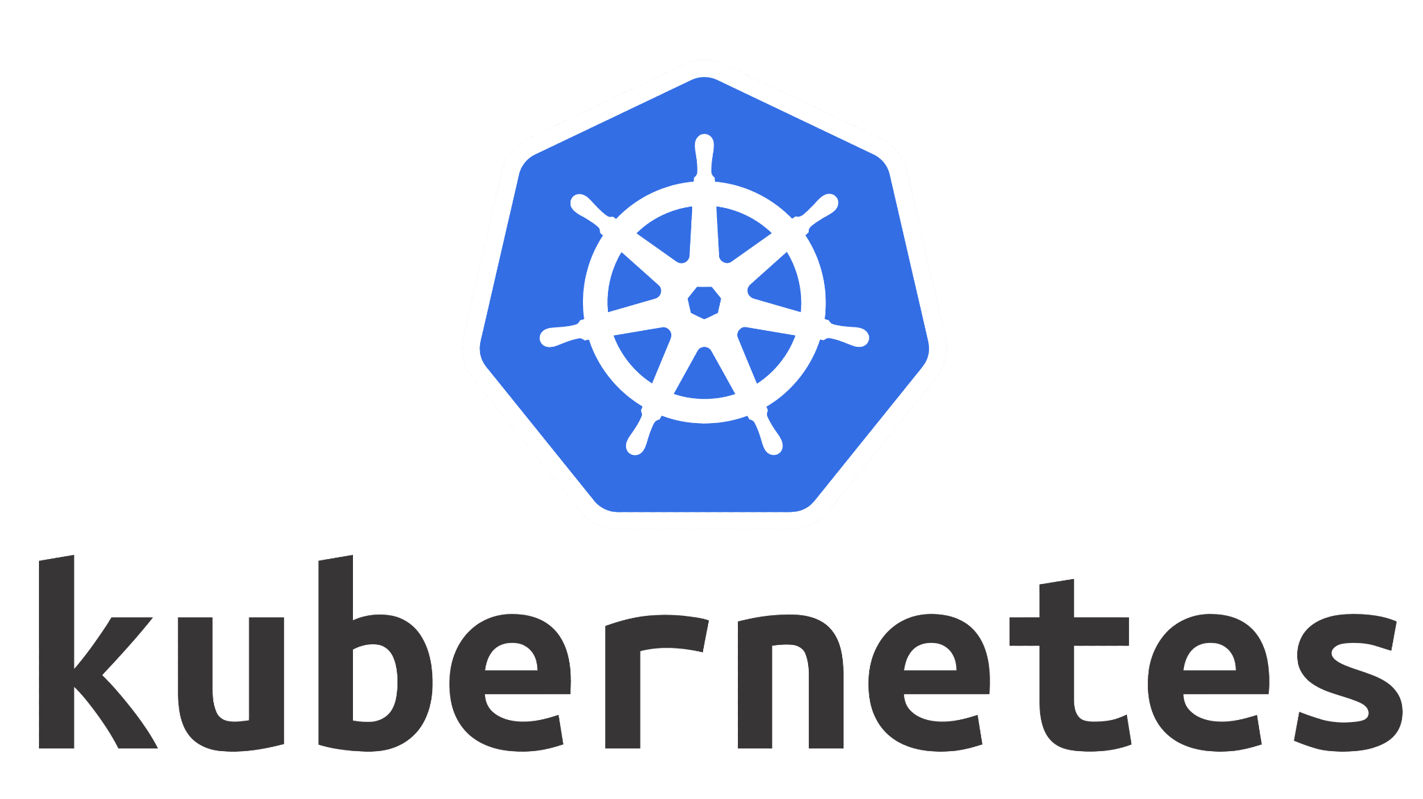
Dry Run mode - examples
Ansible includes 2 options
--diff & --check
Check each modules for support
@@ -7,7 +7,7 @@
access-list 101 permit tcp any host 192.168.1.1 eq 80
access-list 101 permit tcp any host 192.168.1.1 eq 443
-access-list 101 permit ip any any
+access-list 101 deny ip any any
access-list 101 remark End of ACL
# aws_instance.example will be created
+ ami = "ami-abc123"
+ instance_type = "t3.micro"
Terraform plan, a built-in feature that is supported on all providers
kubectl diff or ArgoCD show diffs between current cluster state and the desired YAML.
spec:
replicas: 2 -> 3

Slide 18
Transactional
Definition
Group changes so they either all succeed or can be rolled back cleanly if something fails.
Prevents partial or broken changes
Notes:
Source image
https://thetightlycoupled.wordpress.com/2020/02/15/whats-an-idempotent-api-and-why-you-should-care/

Slide 19
Transactional
Transactional automation means grouping a set of changes so they either:
All succeed (commit) → and the system moves to the new desired state
Or none are applied (rollback) → leaving the system unchanged if something fails
If failure occurs partway through,
the automation ensures no “half-applied” or “broken” states remain.
Rollback capabilities extend this by allowing the system to revert changes after they have been committed if issues are detected later.

Slide 20
Design Principles to build Trust
Predictable
Manageable
Transparent
Main
Principles
Simple
Reliable
Human Friendly
Design
Principles
Idempotent
Dry Run
Transactional

Slide 21
Virtuous circle of Design Principles
Idempotent
Dry Run
Transactional

Slide 22

Tools and Technologies that enable Trustworthy Automation
Notes:
How many of you here design and build infrastructure or networks?
How many of you have some level of automation for those networks?

Slide 23
Tools and Technologies to build Trust
Predictable
Manageable
Transparent
Main
Principles
Simple
Reliable
Human Friendly
Design
Principles
Idempotent
Dry Run
Transactional
Tools and Technologies
Declarative
Vs Imperative
Version Control
Testing

Slide 24
Declarative
Vs Imperative
Imperative
HOW
Focuses on actions
Declarative - WHAT
Declarative
WHAT
Focuses on outcomes
Notes:
Source image
https://thetightlycoupled.wordpress.com/2020/02/15/whats-an-idempotent-api-and-why-you-should-care/

Slide 25
Declarative Vs Imperative
configure terminal
interface GigabitEthernet0/1
switchport access vlan 10
exit
Exit
write memory
interface:
name: GigabitEthernet0/1
vlan: 10
Imperative - HOW
Declarative - WHAT
Manually describe the step-by-step recipe.
If something goes wrong halfway, state may be inconsistent.
Focuses on actions
You describe the desired end state, not how to get there.
Easier to make idempotent and retry safely.
Focuses on outcomes

Slide 26



Declarative Vs Imperative
CLI
Configs
Declarative
Imperative

Slide 27
Imperative Method
Workflow A
Workflow B
Workflow C
Workflow D
Switch
Vendor C
Cloud G
Firewall
Vendor F
Router
Vendor J
Firewall
Vendor P

Slide 28
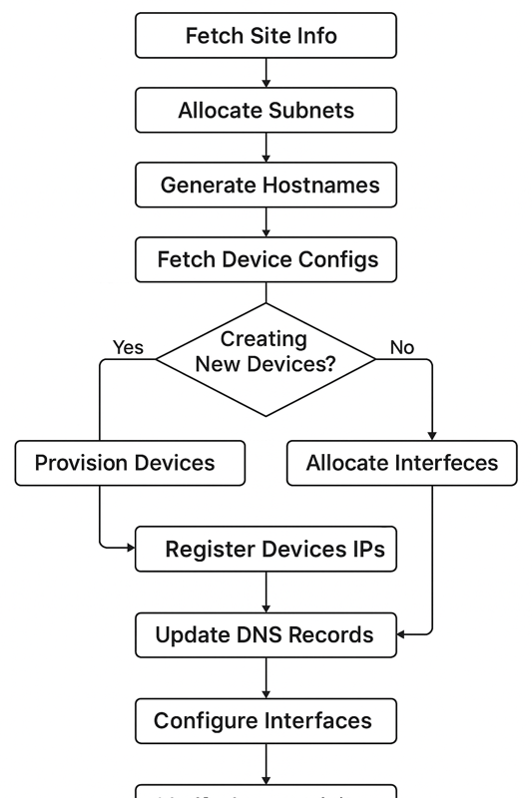
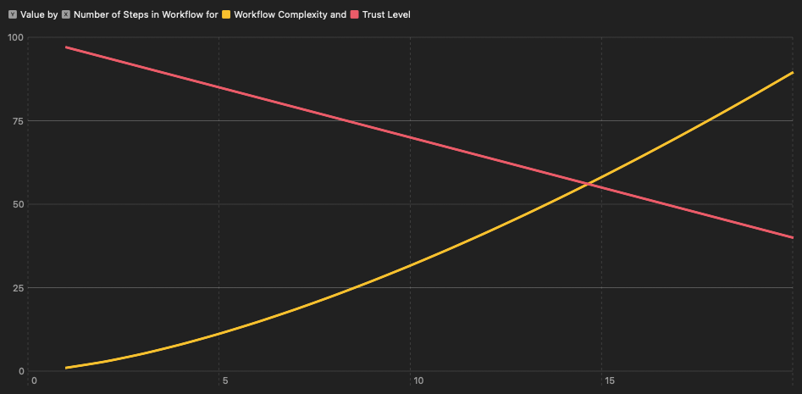
Declarative Vs Imperative
Imperative workflows are composed of multiple steps,
the more steps, the higher the complexity
Number of steps in a workflow

Slide 29
Declarative Method
Workflow A
Workflow B
Workflow C
Workflow D
Intent Store / Source of Truth
Agent
Agent
Agent
Agent
Agent
Switch
Vendor C
Cloud G
Firewall
Vendor F
Router
Vendor J
Firewall
Vendor P

Slide 30
Comparison with Design Principles
 | Imperative | Declarative
Idempotent | Hard | Easy
Dry Run | Hard | Easy
Transactional | No | Easy

Slide 31
Version Control
Version control allows changes to be:
Prepared in isolation
Safely validated
Reviewed
and only then integrated into the main automation environment.
Notes:
Source image
https://thetightlycoupled.wordpress.com/2020/02/15/whats-an-idempotent-api-and-why-you-should-care/

Slide 32











Changes are done in a branch
Change
Test / Verify
Review
Deploy
Deploy
Change
Test / Verify
Review

Slide 33




Main benefits of Version Control
See who changed what, when, and why.
Essential for post-mortems and compliance
Makes operations more transparent and safe
Auditability and Traceability
Collaboration and Review
(Change Management)
Team members can propose changes via PR
Prevents risky or unreviewed changes from being pushed directly into production.
Automation workflows can be triggered automatically
Changes can be tested and validated automatically before being deployed
CI/CD Pipelines
Changes are grouped and committed as a single unit.
There is no “partial change” state
Atomic changes

Slide 34
Comparison with Design Principles
 | Version Control
Idempotent | Easy
Dry Run | Built in
Transactional | Built in

Slide 35
Testing
Testing pushes you to design applications and workflows that are modular, observable, and deterministic.
It encourages clear boundaries, clean inputs and outputs, and repeatable behaviors.
Testable systems are a design choice
Notes:
Source image
https://thetightlycoupled.wordpress.com/2020/02/15/whats-an-idempotent-api-and-why-you-should-care/

Slide 36

Testing can be your superpower or your kryptonite
As the complexity of the project increase, investment in testing are paying off exponentially
Testing will become your development environment
Proper tests allows to refactor with confidence
Too many tests early on can be a burden to manage and slow things down
No
tests
Too many tests

Slide 37




Testing
Function
Workflow / API
UI
Devices
End 2 End tests
Integration tests
Unit tests

Slide 38
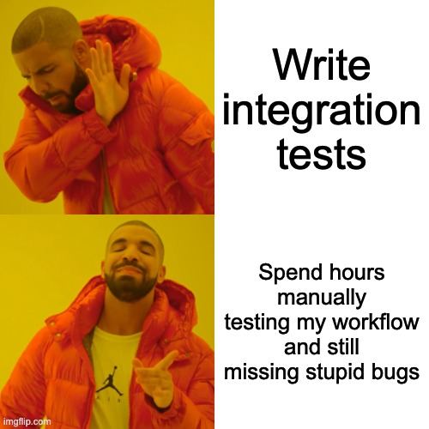
Automation workflow testing
Reduce
the complexity of your workflow
Increase
the test coverage

Slide 39

Practical Patterns for Building Trust
Notes:
How many of you here design and build infrastructure or networks?
How many of you have some level of automation for those networks?

Slide 40
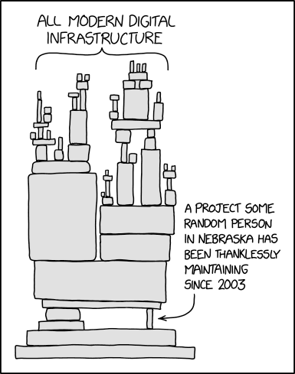
Integrate what you CAN
Build what you MUST
Notes:
Source image
https://thetightlycoupled.wordpress.com/2020/02/15/whats-an-idempotent-api-and-why-you-should-care/

Slide 41
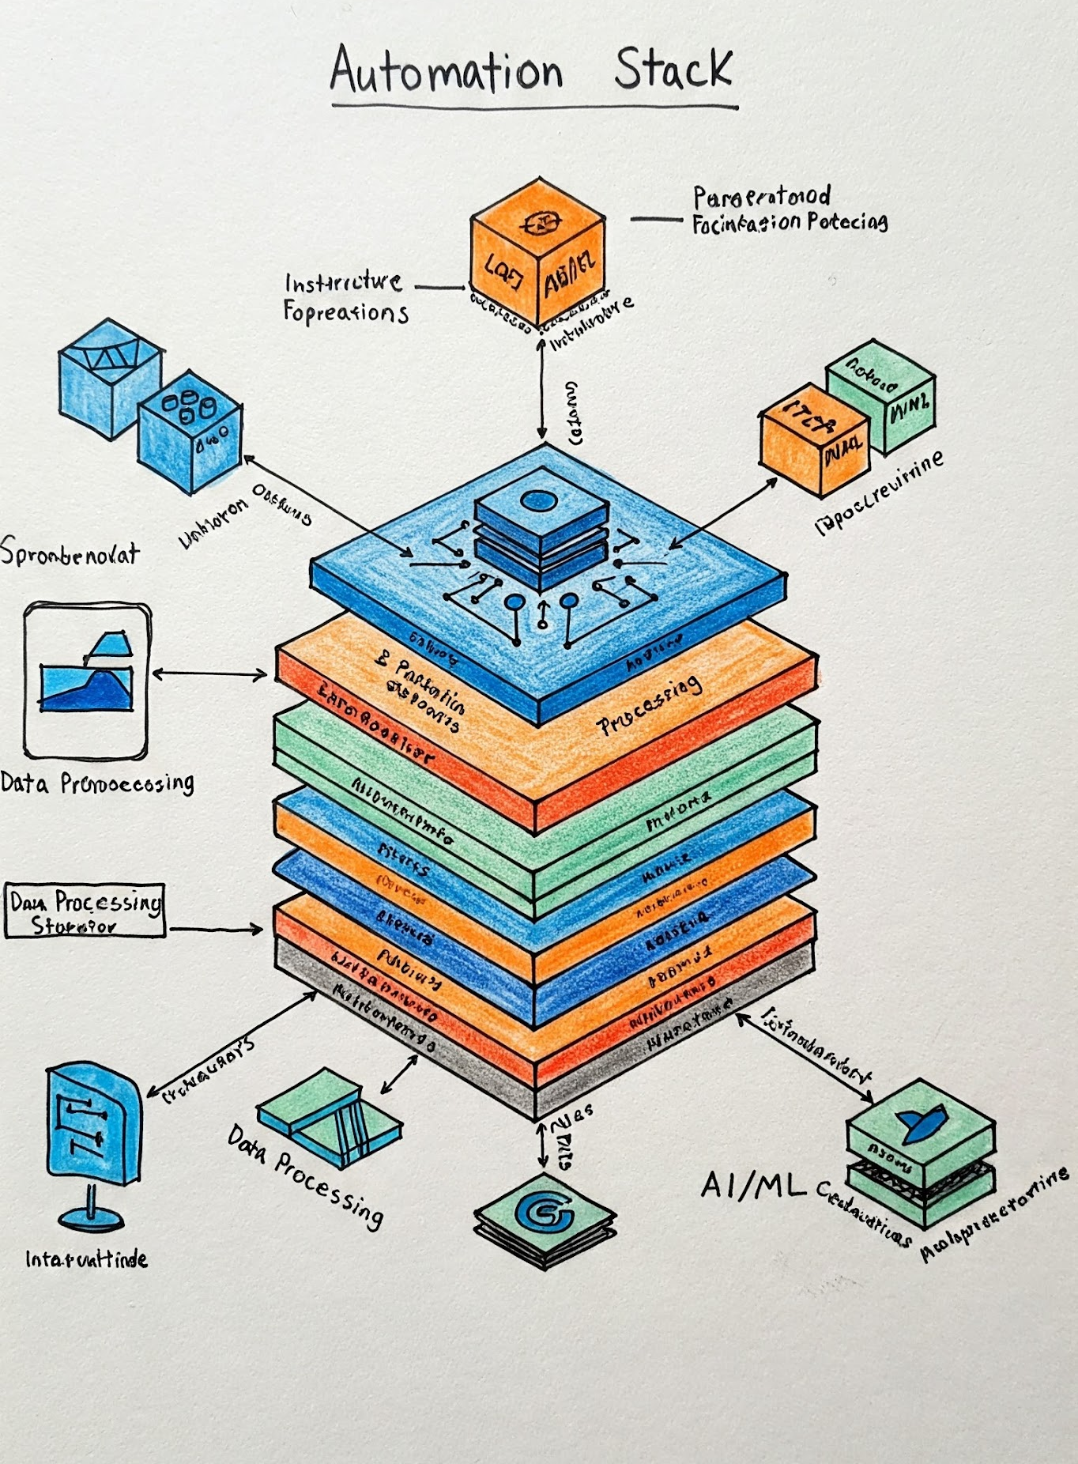
Select the right stack
Ensure the libraries / tools you are dependent on provides
Programmable interfaces
Declarative behavior
Idempotency
Test friendly interfaces
Developer
Experience
Traceability
& Logging

Slide 42
The 3 primary attributes, classify your data
Role
Capture the primary function of an object
Status
Capture all the stages of the lifecycle of an object
Kind
Capture the nature of an object

Slide 43
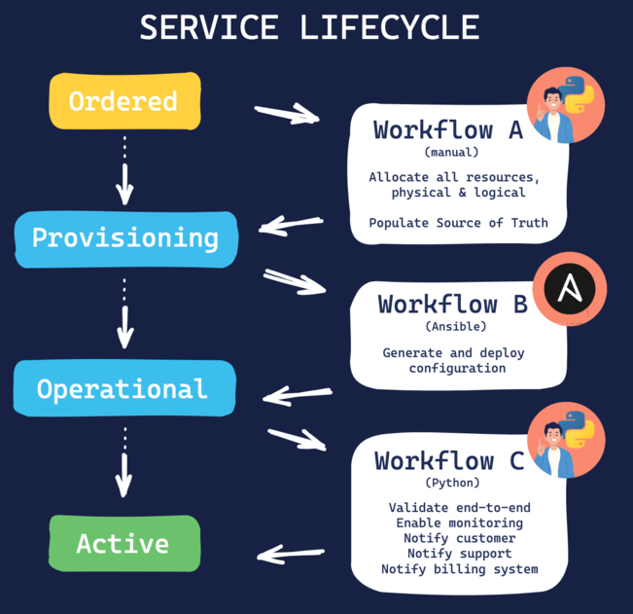
Enforce business processes as part of your automation workflows
Maintenance windows are designed to ensure that no disruptive actions will be applied during business hours.
Similar rules should be embedded directly within your playbook
Ideally filter the valid target devices at the inventory level
Only arista devices
that are in maintenance mode

Slide 44
Enforce business processes as part of your automation workflows
Option 1 - Limited Inventory
Option 2 - Inline Validation
---
- name: "Upgrade Software image on Arista Devices"
hosts: platform_arista:&status_maintenance
gather_facts: false
tasks:
- name: "Upgrade Software image"
...
---
- name: "Upgrade Software image on Arista Devices"
hosts: platform_arista
gather_facts: false
tasks:
- name: "Validate if the device is in maintenance mode"
meta: "end_play"
run_once: true
when:
- "device.status != 'maintenance'"

Slide 45
Provide safe default options
Prepare the change
ansible-playbook pb.policies.yml -–check –-diff
Apply the change
ansible-playbook pb.policies.yml
Create different playbook for the same workflow but with different outcome.
- Call out safe playbooks explicitly
- Ensure default values are always Safe
- Activate diff mode by default
─ fortinet
├── pb.policies.apply.yml
├── pb.policies.check.yml
─ load_balancers_external
├── pb.config.vips.apply.yml
├── pb.config.vips.check.yml

Slide 46
Thank You

Slide 47
Abstract
Building Trustworthy Network Automation, From Principles to Practice
Trust is essential for successful network automation adoption.
When automation platforms exhibit predictable behaviors and transparent processes, teams can confidently delegate critical network operations. Building trustworthy automation doesn't happen by itself, it needs to be baked into the design of every workflows. This technical session examines core principles that build trust, including idempotency, declarative workflows, and robust version control. Using practical examples from production environments, we'll analyze how specific technical decisions affect automation reliability and team confidence. The presentation covers key implementation patterns like state verification, diff-based changes, and failure handling. Attendees will learn concrete approaches for building automation platforms that network teams can trust and rely on daily.

