Slide 1

The Network Automation Blueprint
A Practical Guide to Vendor Neutral
Network Automation
Basem Al-Sabri

Slide 2


Brief Introduction
14 years in network engineering
4 years at Amazon Web Services
7 years in network automation
Founded Netomate

Slide 3

Context & Case for Change
The State of Networking Today
Why Network Automation?
Agenda
Foundations & Challenges
Pre-requisites
The Dilemma
Path to Adoption
Adoption Roadmap
Antipatterns & Pitfalls
Approach
What can we automate?
Orchestrators
Native Network as Code
Metrics & Impact
Measuring Success

Slide 4
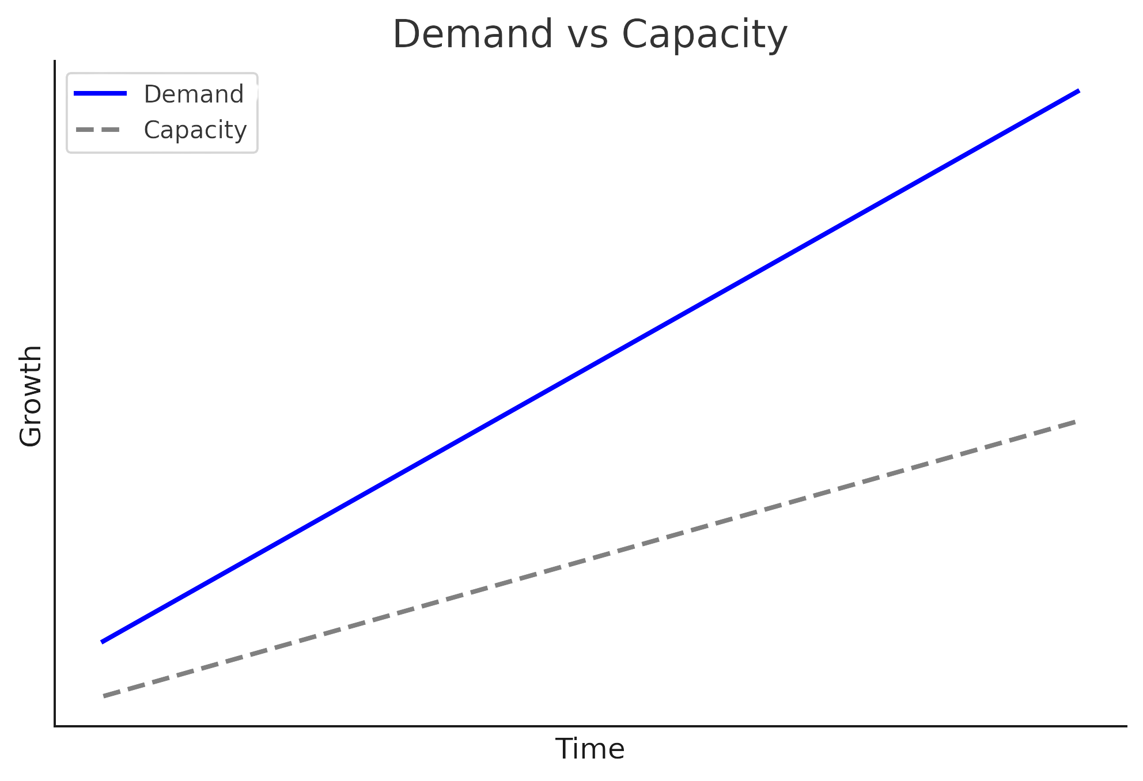
The State of Networking Today
Demand Drivers
Internet of Things
IPv6
Telemetry
Distributed Denial of Service
Network
Automation
Traffic Engineering
Capacity Limitations
Command Line
ClickOps
Siloed Tooling

Slide 5



Why Network Automation?
Deploy Faster
Reduce costs
Minimize Risk
85%
55%
66 - 80% downtime due to
human error
reduction in time to launch
reduction in OPEX
Pre-checks & post-checks
Progressive rollouts

Slide 6






Pre-Requisites
Organizational
Technical
Automation is only possible once repeatable patterns and processes are in place.
Skills Development
Training on automation
Automation
Leadership Buy-in
Defined Processes
Executive support & resources
Standards
Adaptable processes
Workflows that evolve with automation
Patternization

Slide 7

The Dilemma
Just code it
Design-Driven
✅Low barrier to entry
❌Higher barrier to entry
✅Quick Wins
❌Longer Time to Delivery
❌Fragmented
✅Easy to scale
❌Scaling limits
✅Easily maintained

Slide 8

Simplified Adoption Roadmap

Slide 9
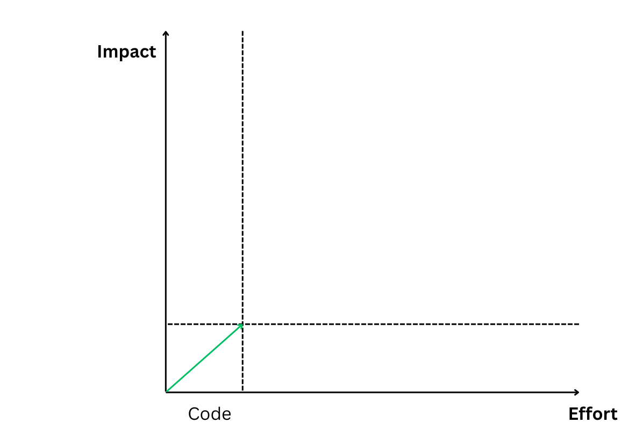
Simplified Adoption Roadmap

Slide 10
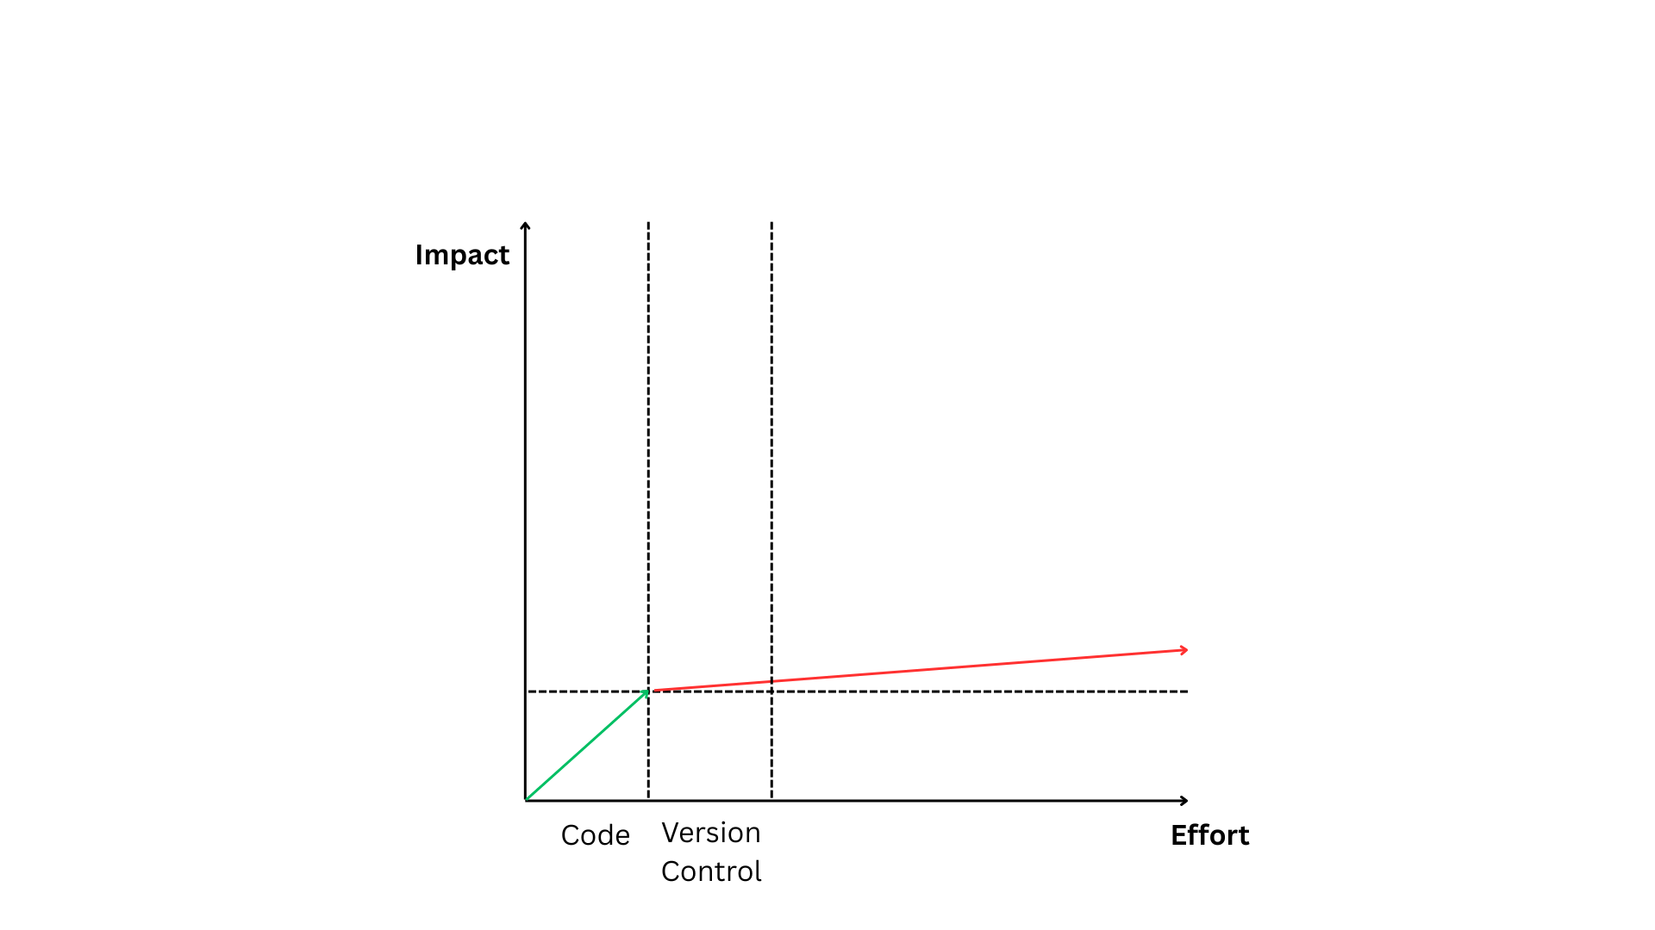
Simplified Adoption Roadmap

Slide 11
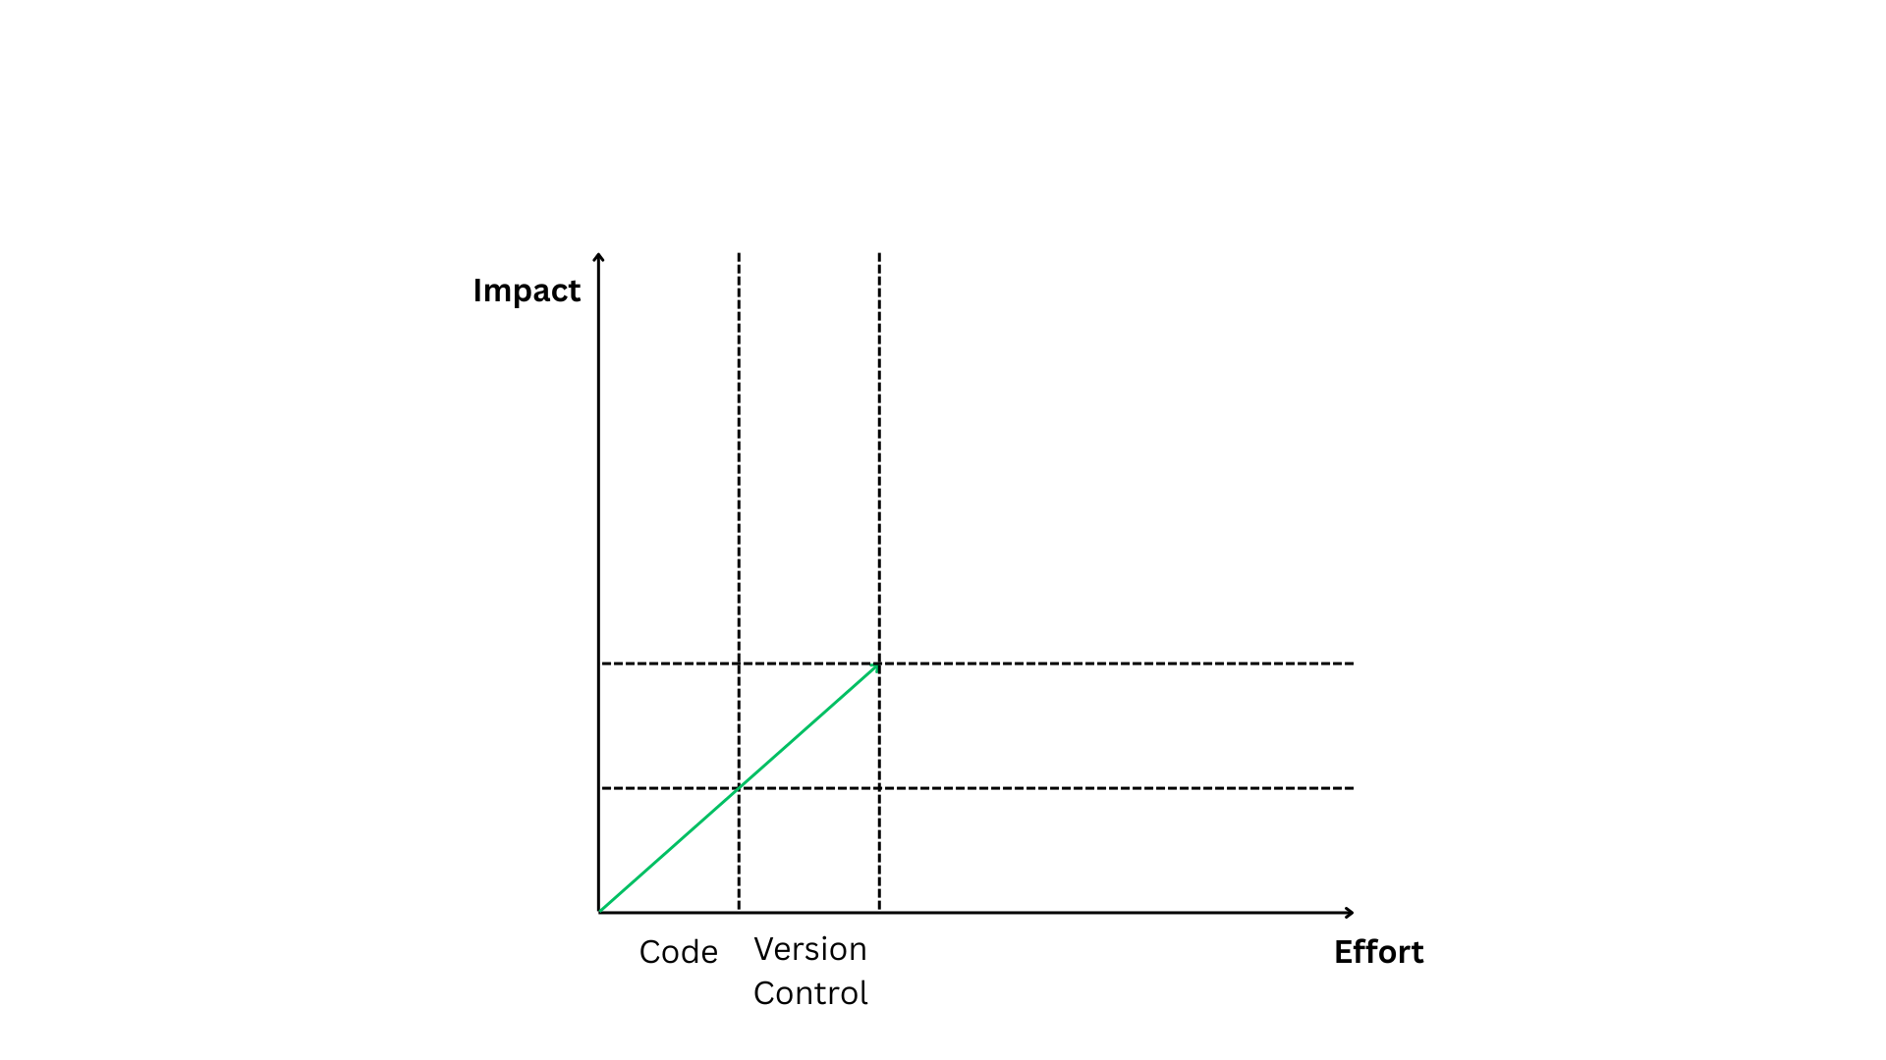
Simplified Adoption Roadmap

Slide 12
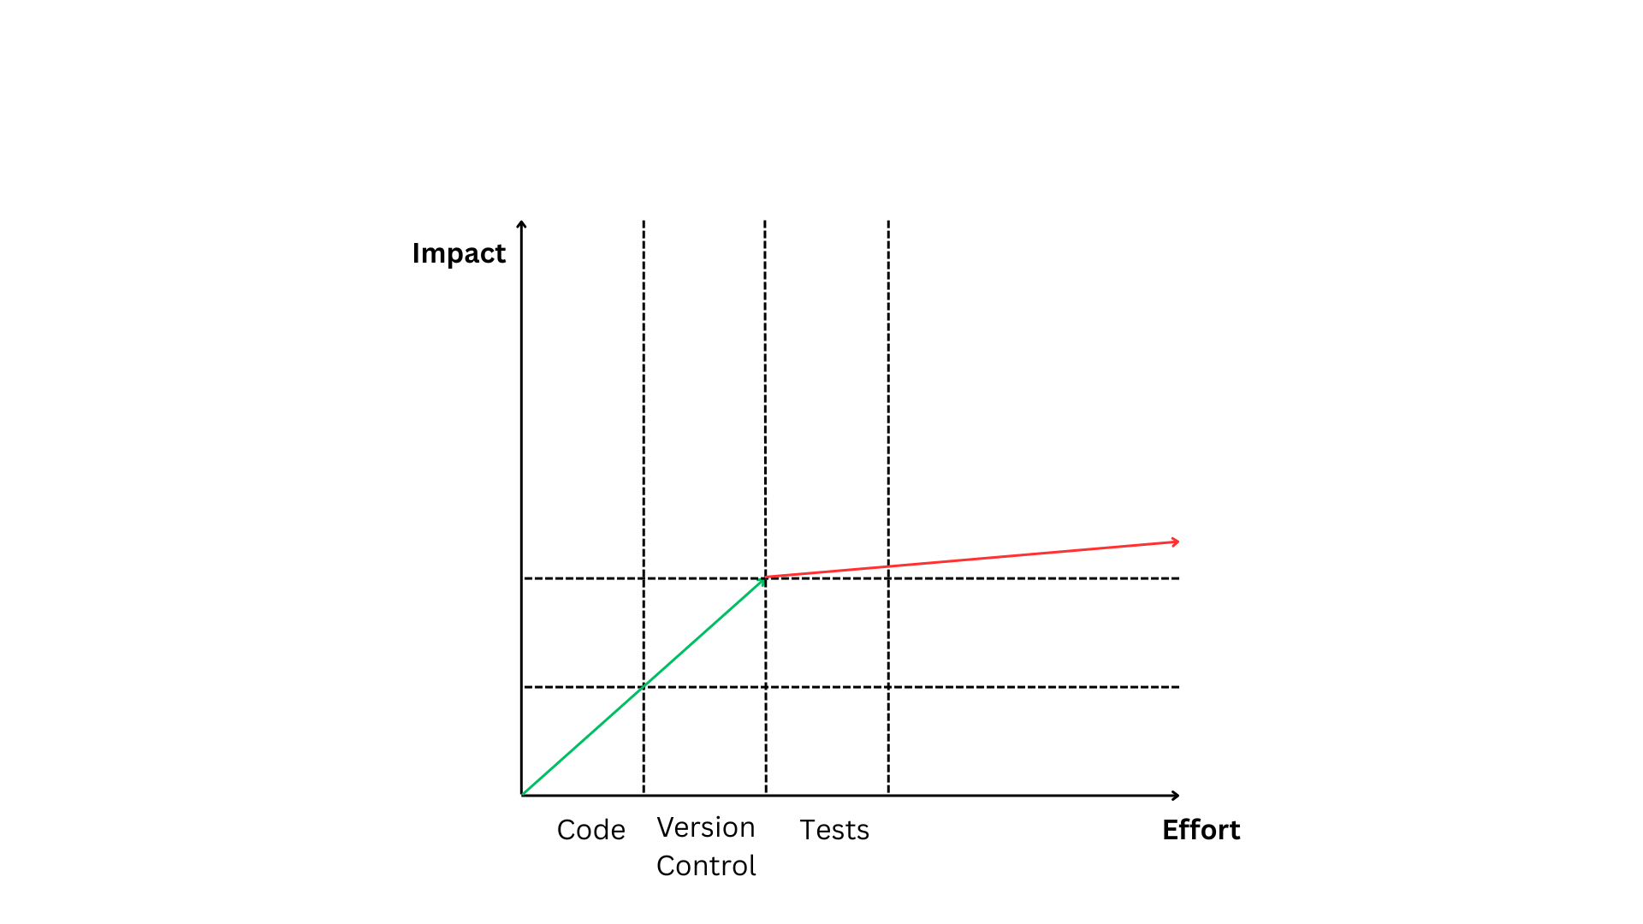
Simplified Adoption Roadmap

Slide 13
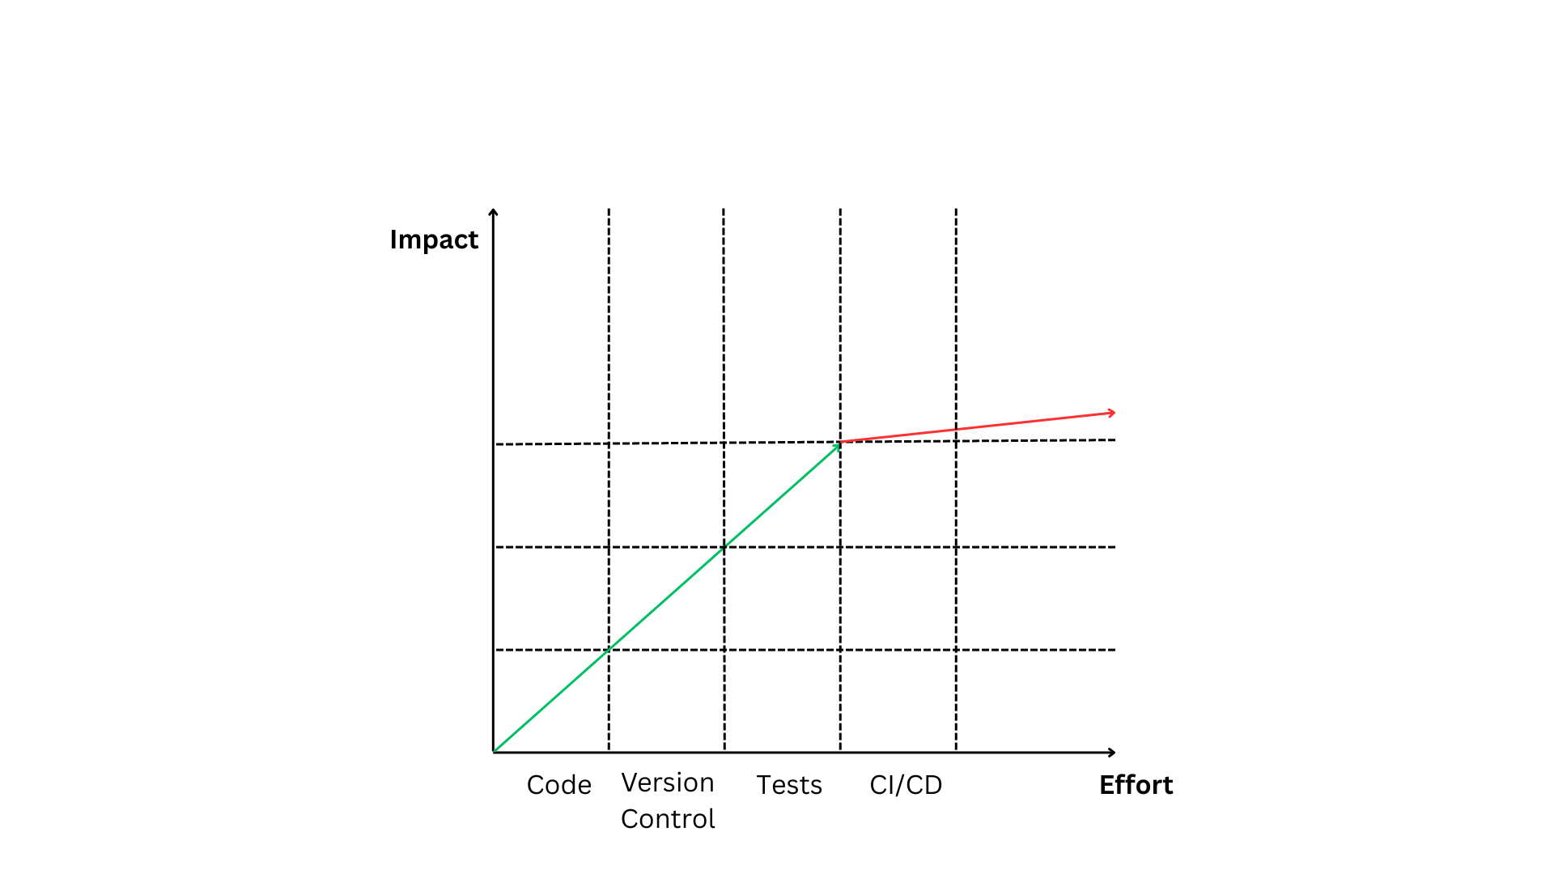
Simplified Adoption Roadmap

Slide 14
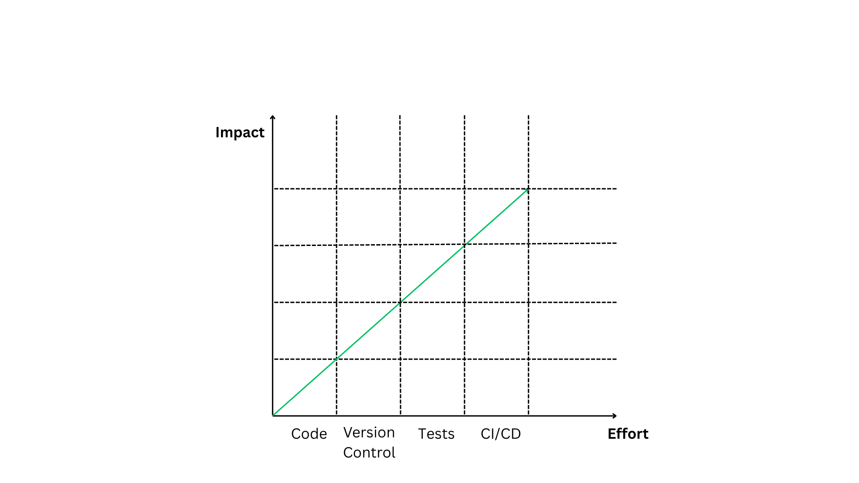
Simplified Adoption Roadmap

Slide 15
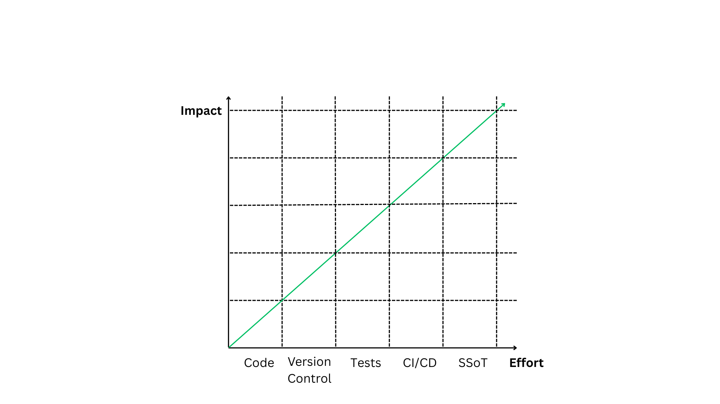
Simplified Adoption Roadmap

Slide 16





Anti-Patterns &Pitfalls
Scope
Automate everything at once
Start small, high-impact use cases
Approach
Waiting for the perfect tool or architecture
Start with good enough, iterate
Purpose
Chasing trends / shiny tools
Focus on solving real business problems

Slide 17


Config Deployment

Slide 18

Beyond Config Deployment: Broader Automation Opportunities
Low Effort
Optimize
Medium Effort
High Effort
Advanced
Self Healing
Traffic Engineering
Start
Expand
Config Generation
Config Deployment
Guardrails
Security Policies
Pre-checks & post-checks
OS Upgrades
Allocations & Reservations
Interfaces
Tooling Integration
Vlans
IP Address Management
VXlans
Authentication - TACACs
IP addresses
Networking Monitoring
BGP
Telemetry

Slide 19


Orchestrators
What They Are
Common Pitfalls
A platform to coordinate and execute automated workflows
20+ clicks to make a simple change
5+ API calls required for one action
Works across multiple network domains, devices, and tools
No one-click rollback
Intended to deliver consistent services or changes
Poorly documented and inconsistent APIs

Slide 20


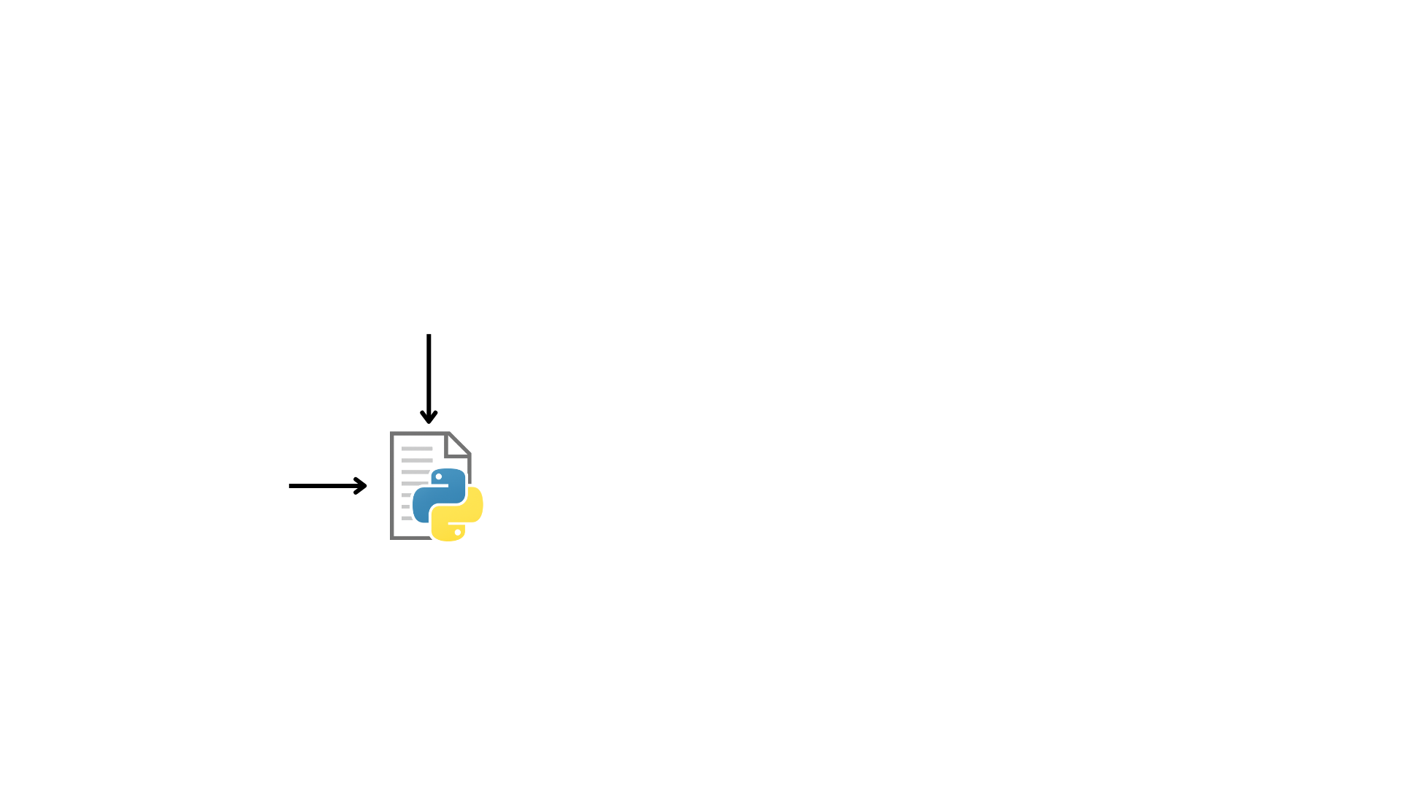
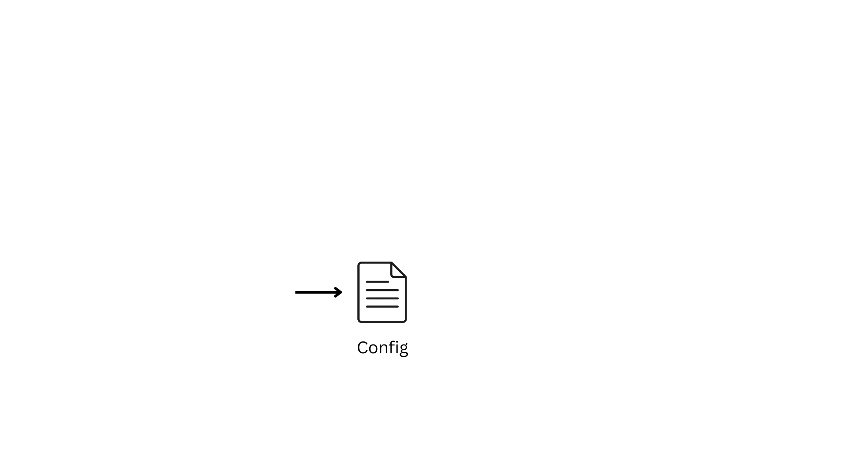

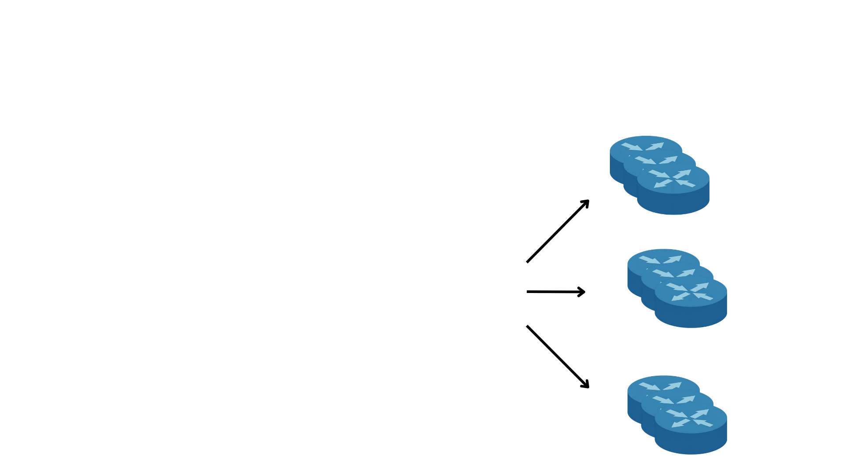
Native Network as Code - NaC

Slide 21




Measuring Success - Always benchmark before you automate
Efficiency
Financial Impact
Coverage
Safety
Time
Saved
Cost
Reduction
Automation Coverage
Automated Network Tests
Reduction in deployment time
Decrease in
Operational costs
Percentage of changes automated
Pre-checks & post-checks implemented

Slide 22


Key Takeaways
1
Start small, scale smart
2
Balance quick wins with long term strategy
3
Choose simple over complex solutions
4
Automation is a capability, not a one-off project

Slide 23

THANK YOU
Email
basem.alsabri@netomate.com.au
LinkedIn
https://www.linkedin.com/in/basemalsabri

