Slide 1
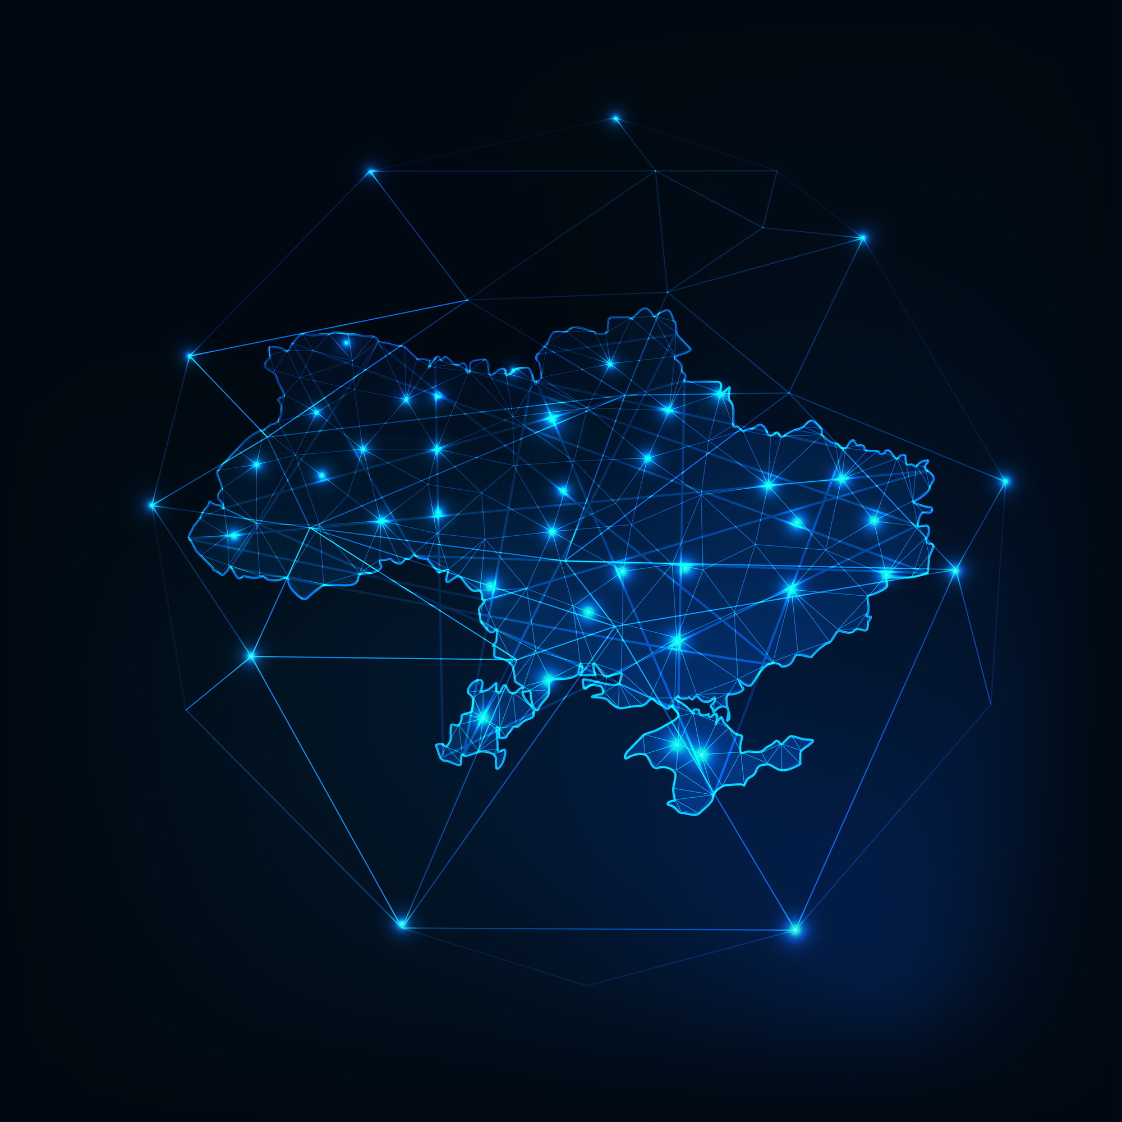

INTERNET UNDER ATTACK: THE RESILIENCE OF UKRAINIAN PROVIDERS
SPEAKER: OLENA KUSHNIR
FOR BALTICNOG 2025

Slide 2



The main challenges
ISPs face every day:
  MISSILE ATTACKS
  DANGEROUS WORKING CONDITIONS
  BLACKOUTS
  DESTROYED INFRASTRUCTURE
  CYBER ATTACKS
  MOBILIZATION OF EMPLOYEES
  THEFT OF UA RESOURCES
FOR BALTICNOG 2025

Slide 3

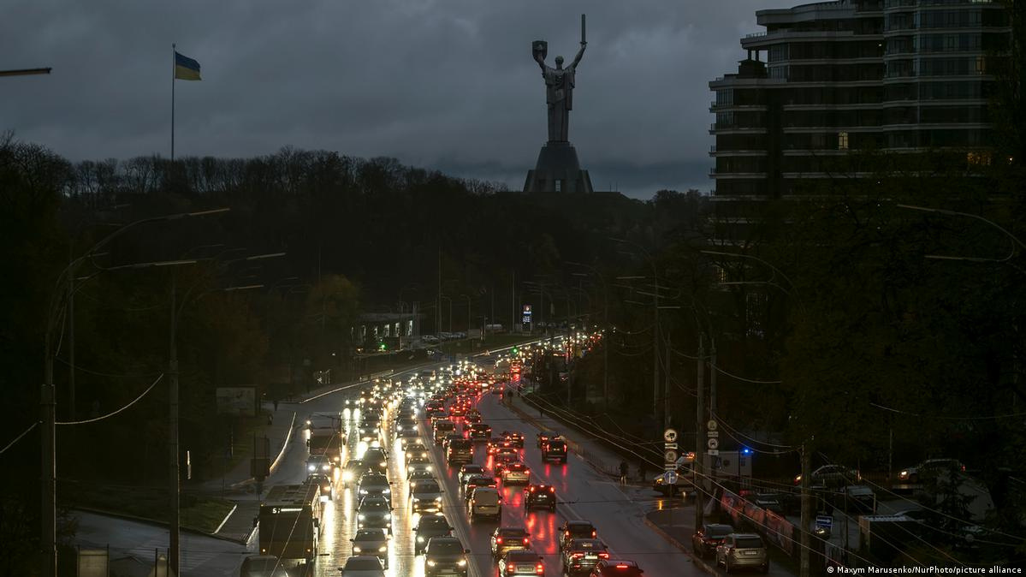
WHO HOLDS THE MOST POWER?
• Wikipedia: “I know everything.”
• Google: “I can find anything and anyone.”
• Social media: “I know everyone.”
• The INTERNET: “WITHOUT ME, YOU'RE NOTHING.”
• ELECTRICITY: [LAUGHS] “NICE TRY”
FOR BALTICNOG 2025

Slide 4




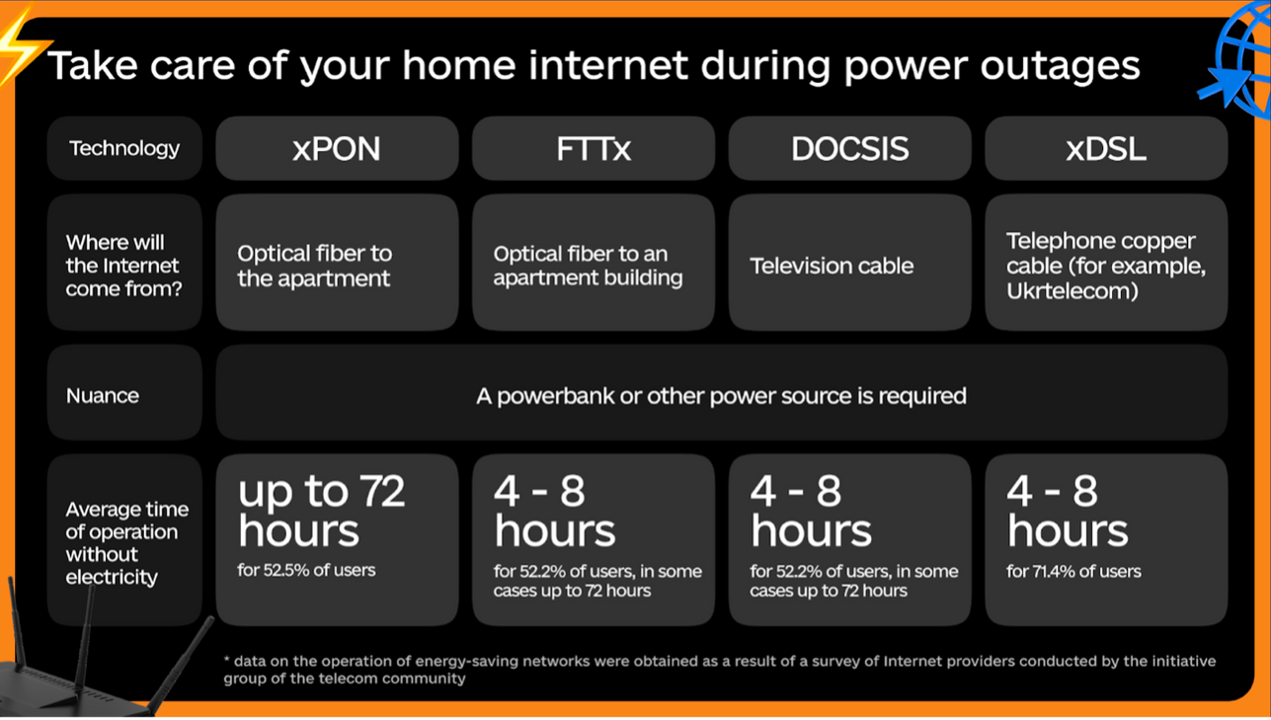
FOR BALTICNOG 2025

Slide 5
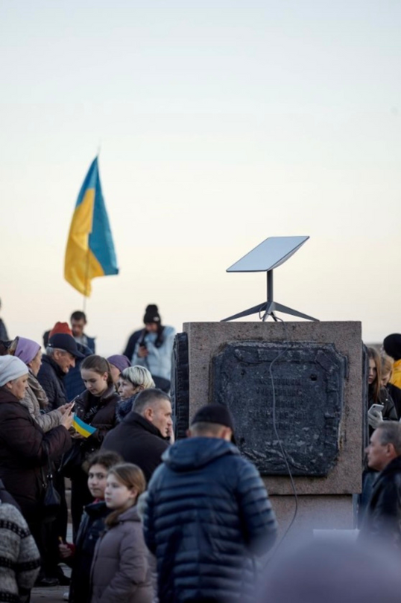
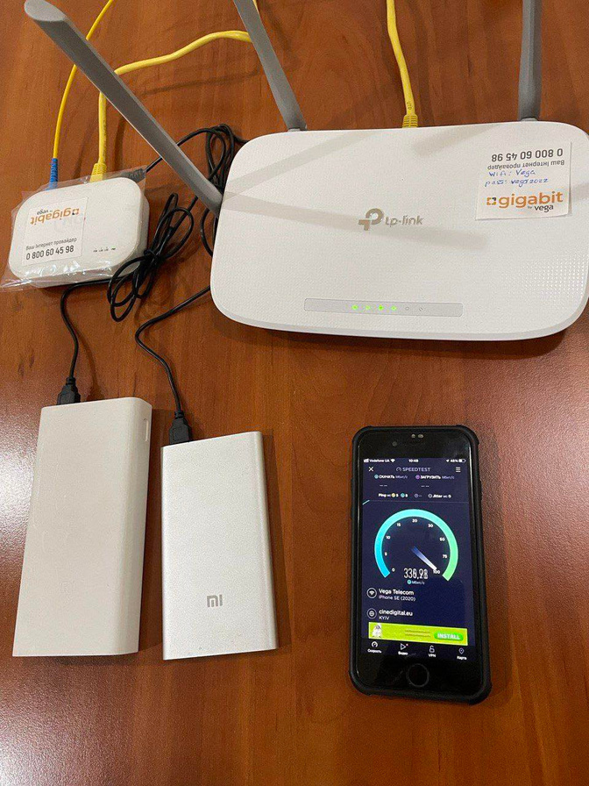

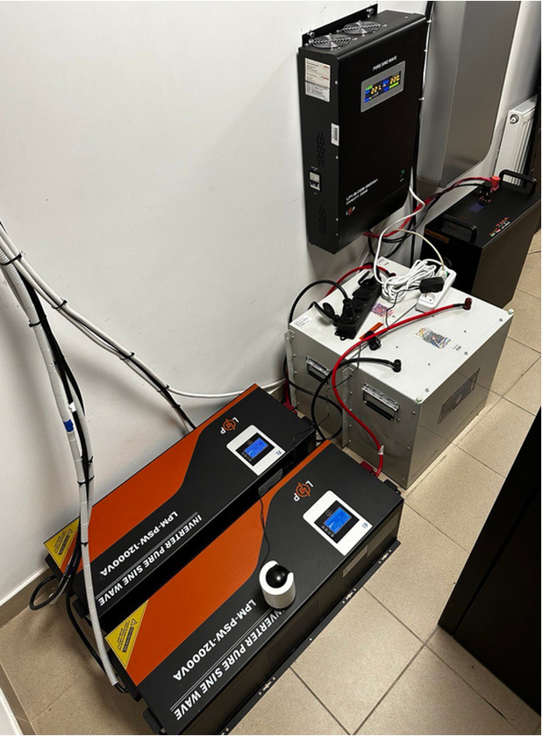
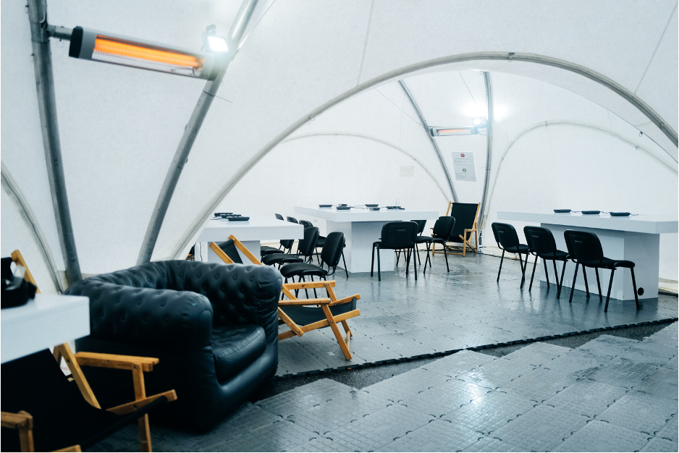
ALTERNATIVE ENERGY SOURCES
TRAINING COURSES FOR THE POPULATION
PON NETWORKS AND STARLINKS
UNBREAKABLE SHELTERS
FOR BALTICNOG 2025

Slide 6


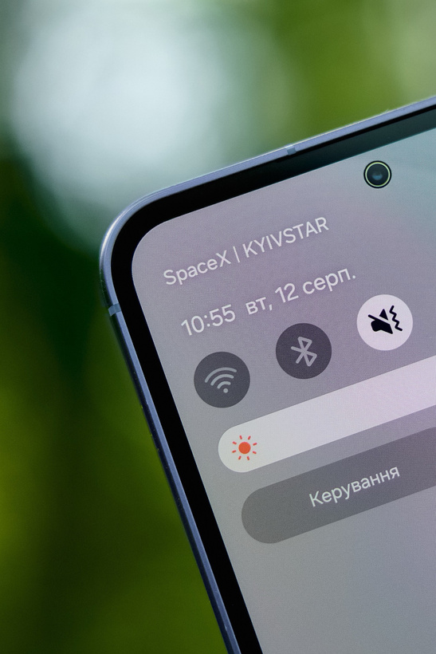
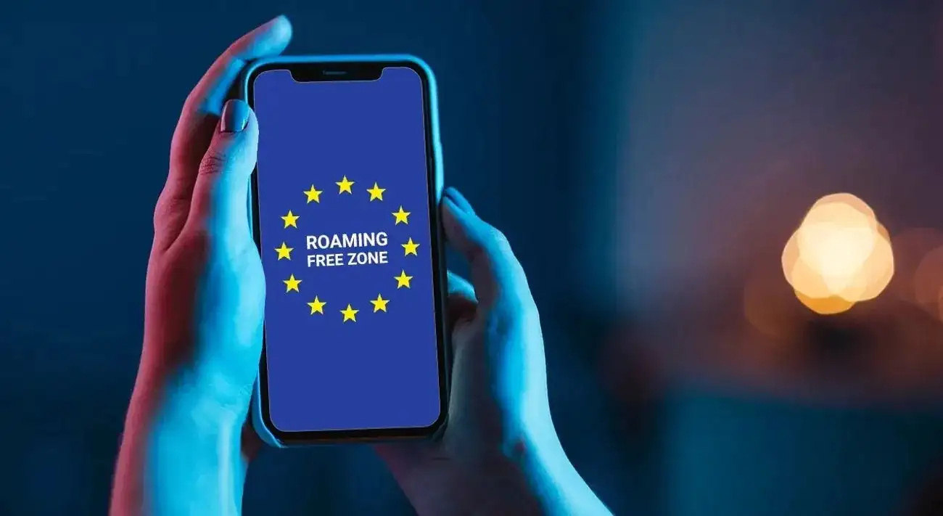

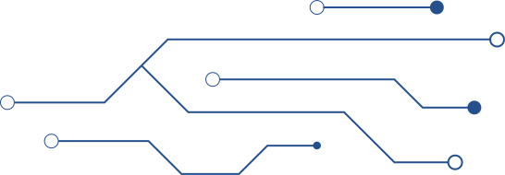
STARLINK
DIRECT TO CELL
NATIONAL
MOBILE ROAMING
NEW
TECHNOLOGIES
&PROGRAMS
ROAM LIKE
AT HOME (RLAH)
1.01.2026
FOR BALTICNOG 2025

Slide 7

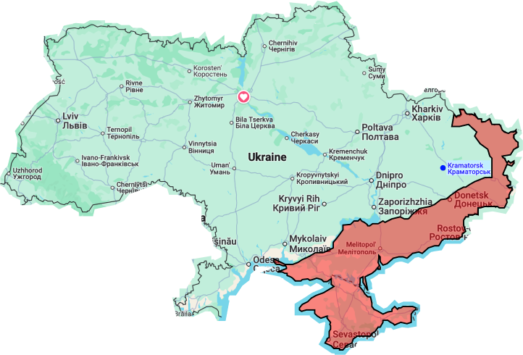
FOR BALTICNOG 2025

Slide 8
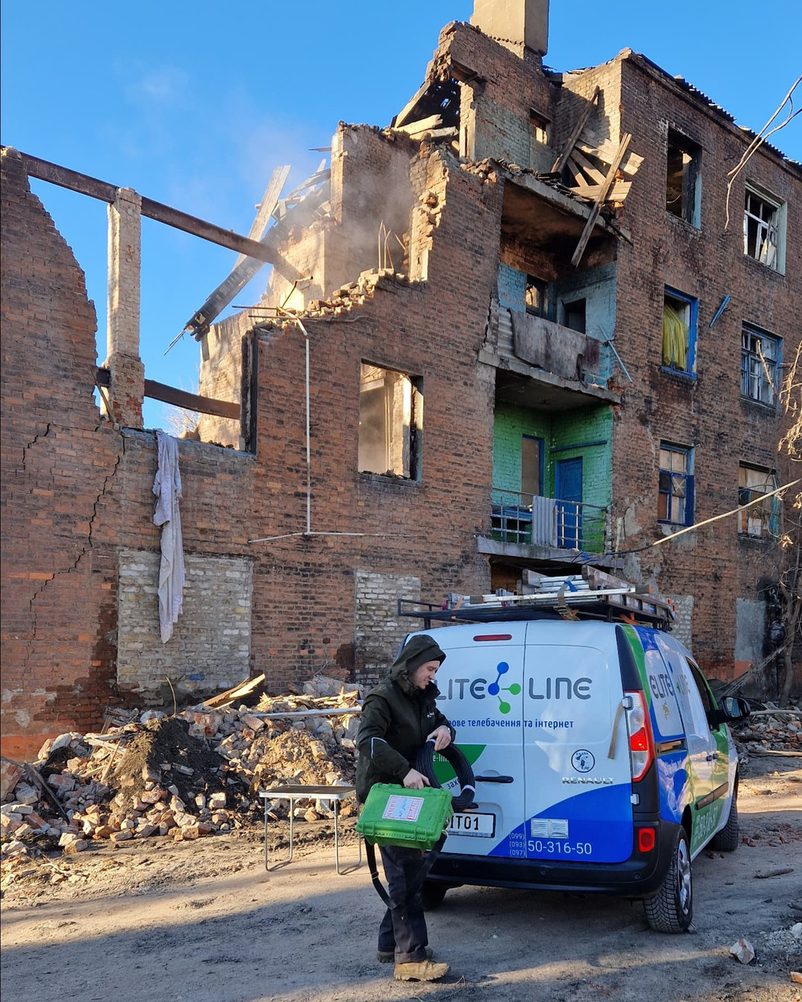


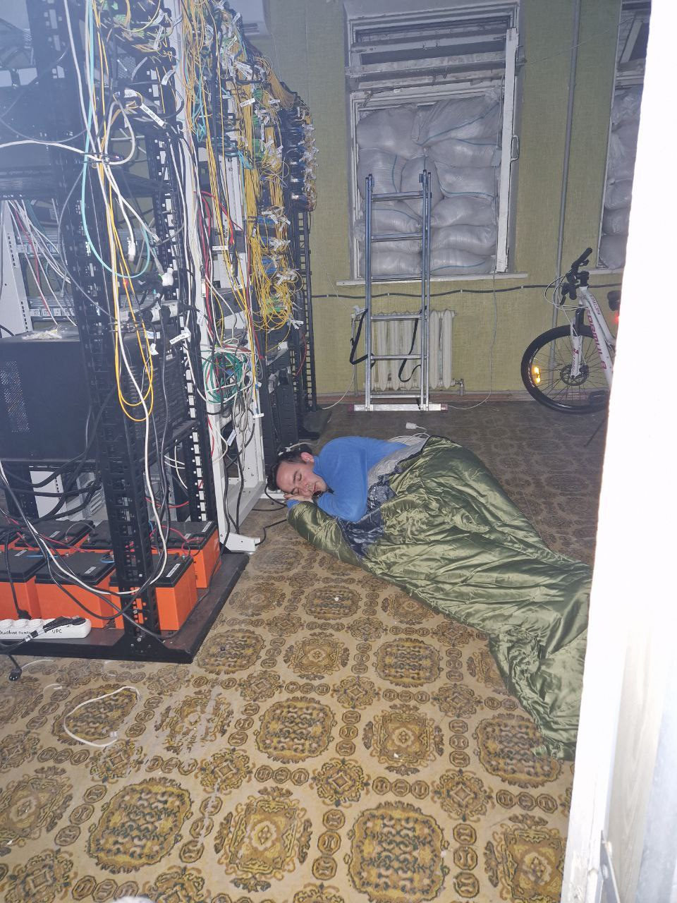







FOR BALTICNOG 2025

Slide 9
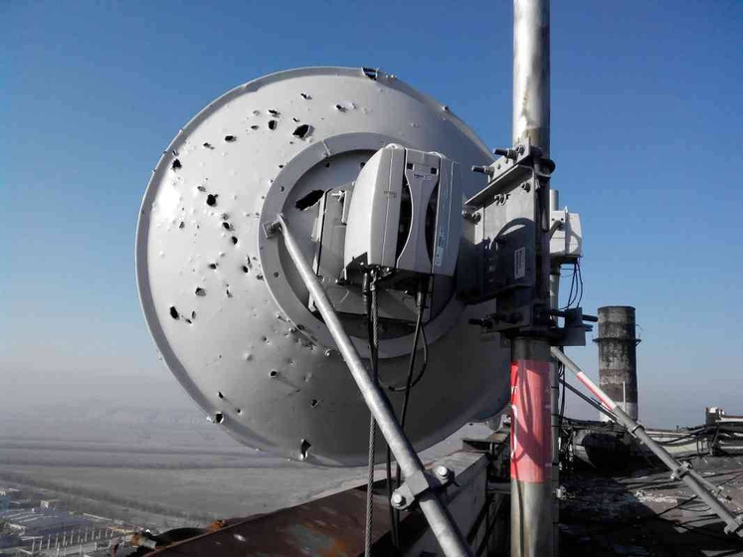
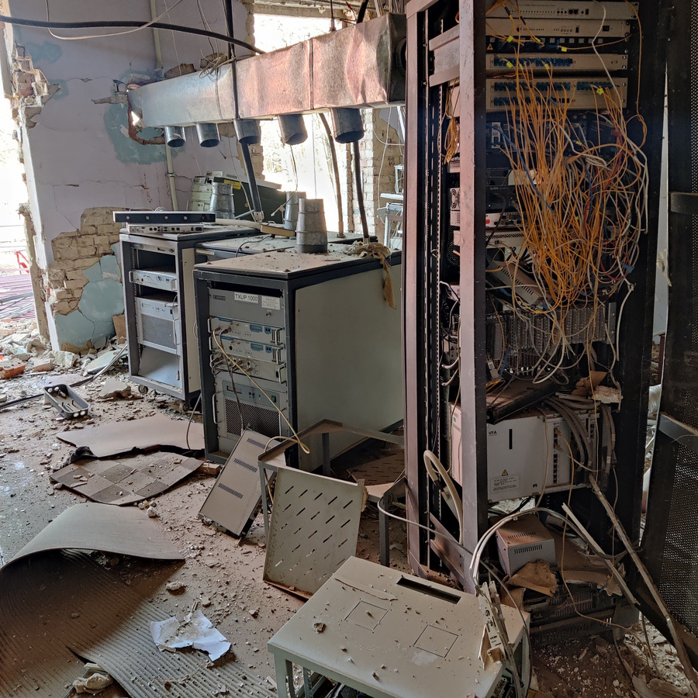
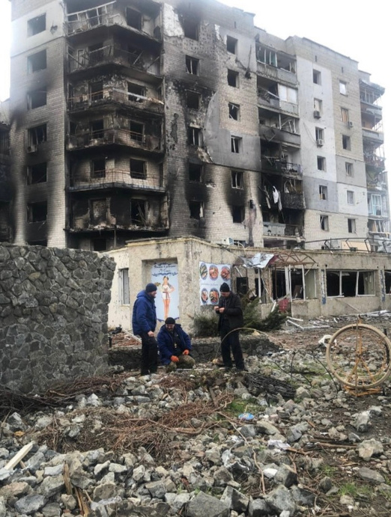

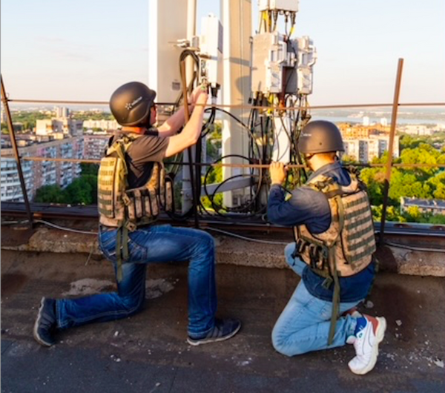
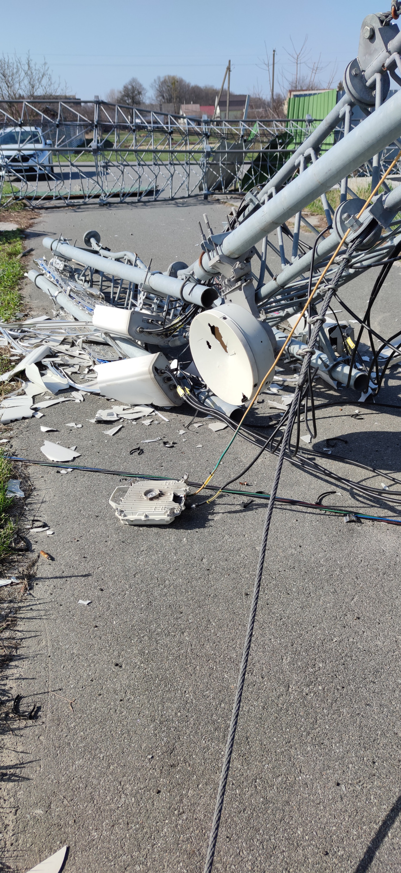
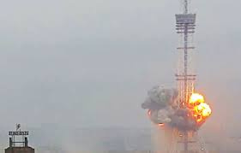
ACCORDING TO THE WORLD BANK, THE LOSSES OF THE UKRAINIAN TELECOM SECTOR AMOUNT TO 2.5 BILLION DOLLARS IN 2023
In 2025, the Ukrainian telecom sector faces significant challenges and opportunities as it recovers from the war. While the sector has demonstrated resilience, with a large portion of pre-war capacity remaining operational, the cost of rebuilding and modernizing infrastructure is estimated at $4.7 billion over the next decade.
The digital sector’s indirect losses (lost revenues, etc.) are estimated over $19 billion
FOR BALTICNOG 2025

Slide 10
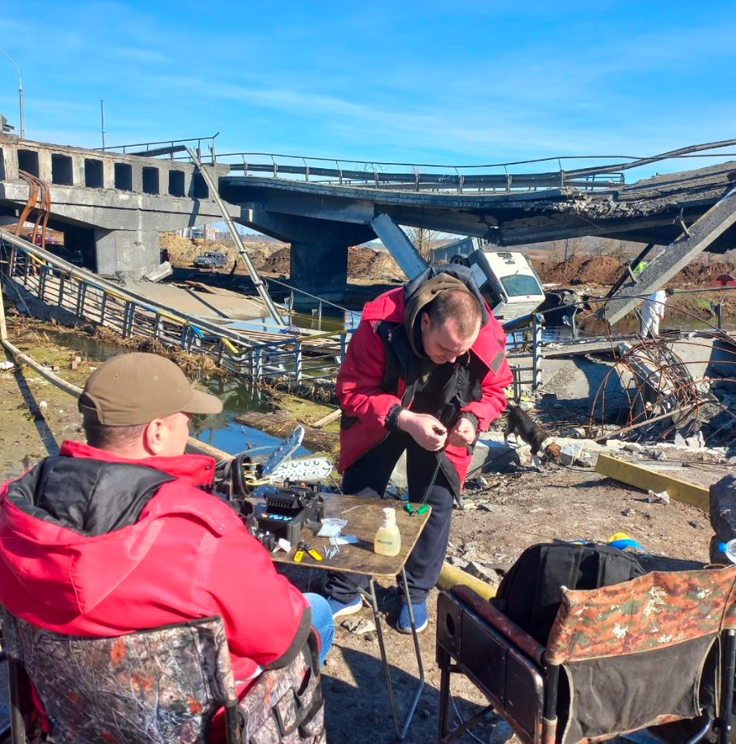
WHAT TO DO?
  EXPANSION OF BACKBONE INFRASTRUCTURE THROUGH ADDITIONAL FIBER HIGHWAYS
  REDUNDANCY THROUGH DUPLICATED COLOCATION FACILITIES, IXPS, AND DATA CENTERS
  IMPLEMENTATION OF DUAL-RING TOPOLOGIES IN MAJOR URBAN CENTERS
  DEPLOYMENT OF RIVER CROSSINGS THAT AVOID ELEVATED INFRASTRUCTURE (E.G., OVERPASSES)
  DEVELOPMENT OF ALTERNATIVE ROUTES ACROSS MAJOR RIVERS TO ENSURE CONTINUITY AND RESILIENCE
  UNDERGROUND CONSTRUCTION OF COMMUNICATION LINES IS MORE RELIABLE
FOR BALTICNOG 2025

Slide 11
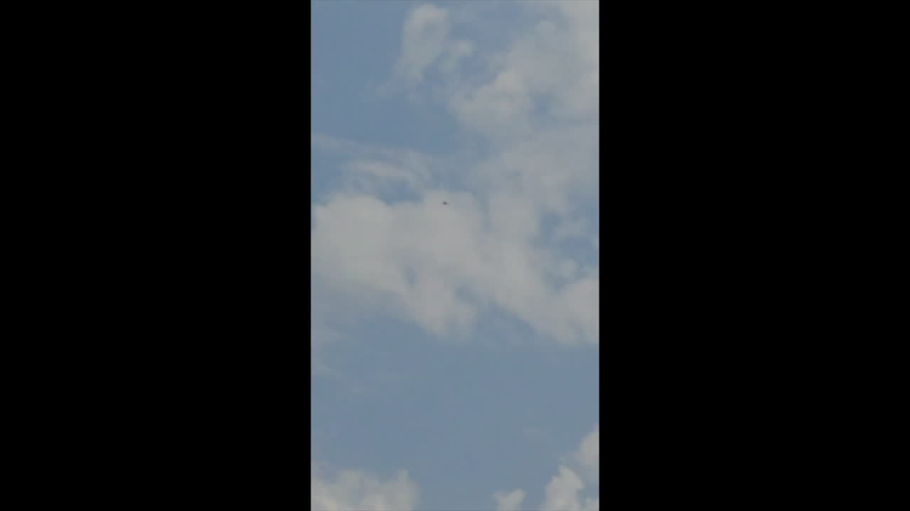
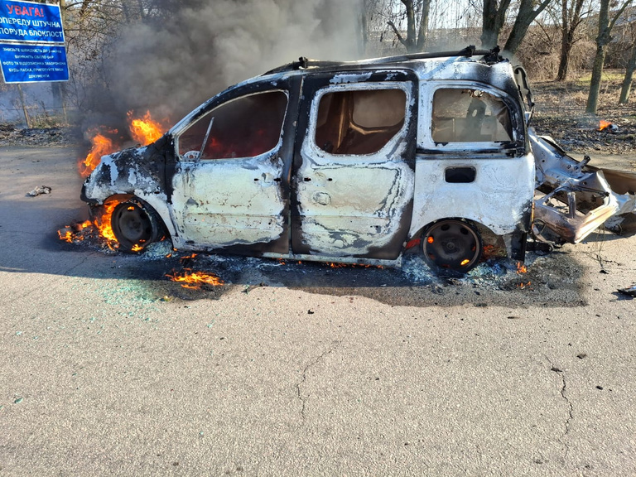
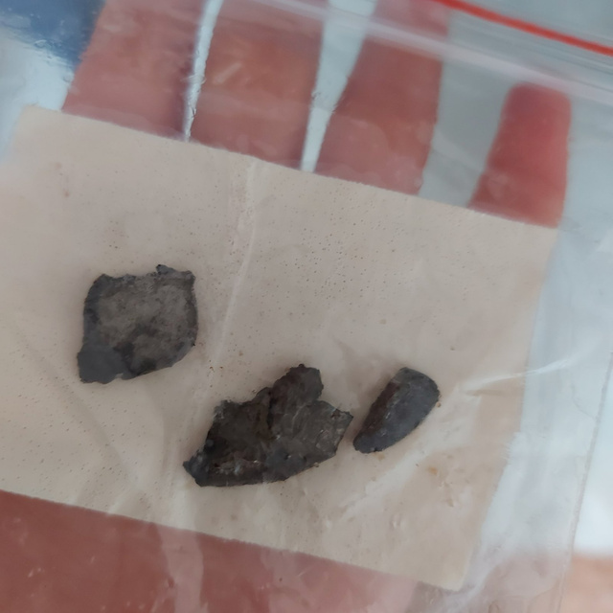
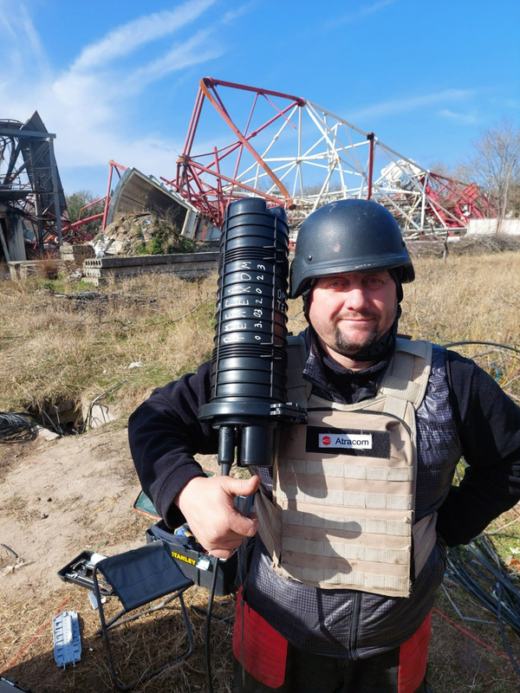
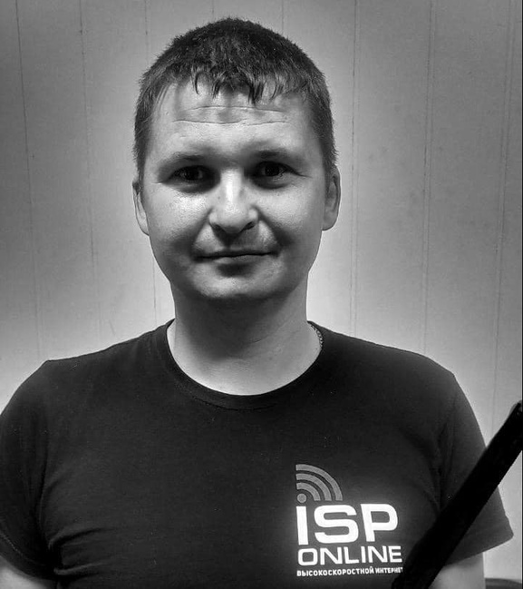
DANGEROUS WORKING CONDITIONS
FOR BALTICNOG 2025

Slide 12
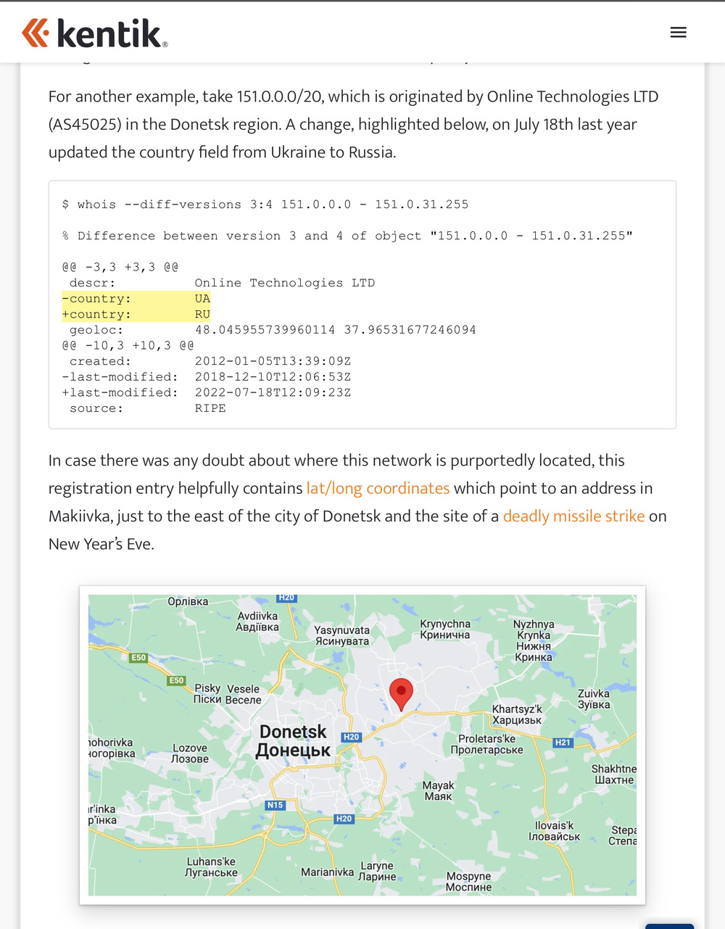
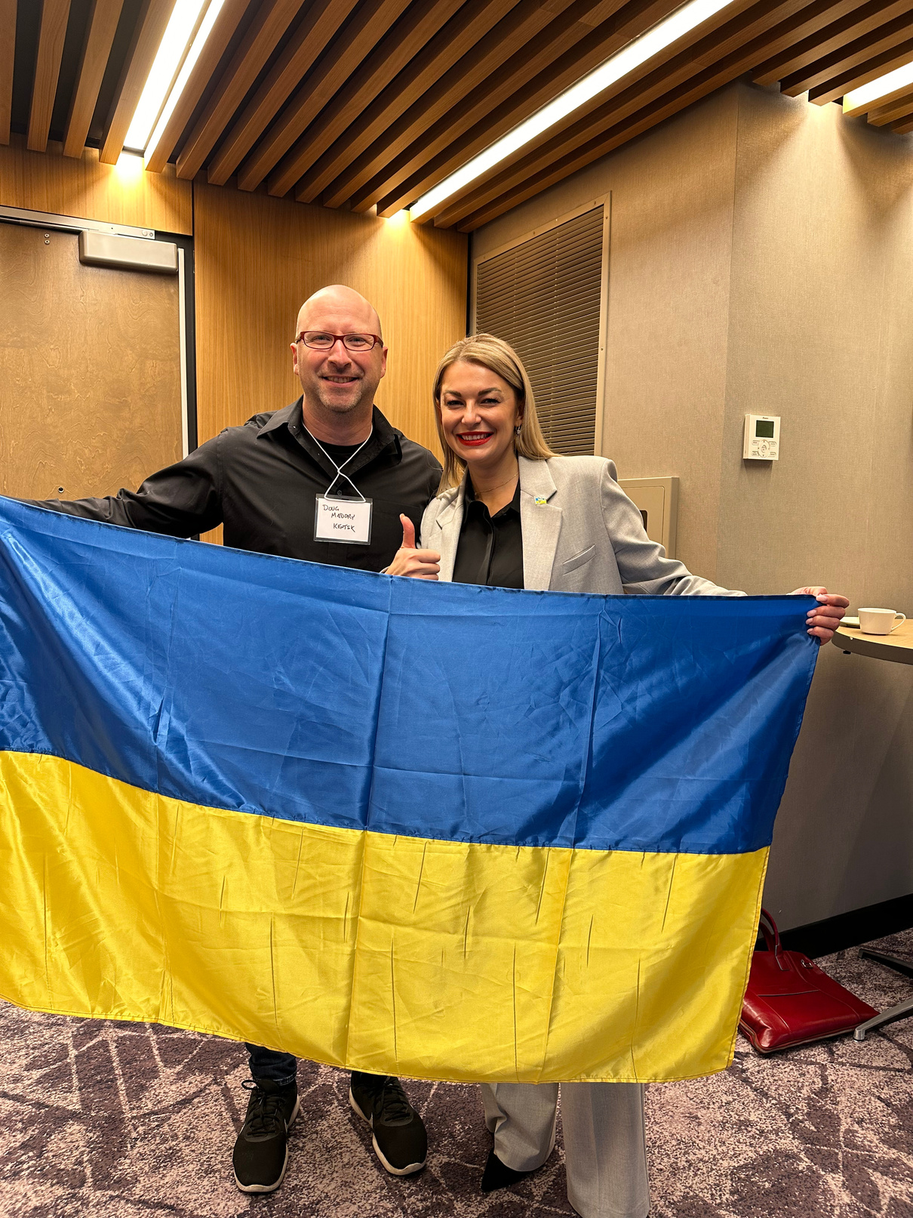
THEFT OF UA RESOURCES
23 February 2023 г.
“THE RUSSIAN GOVERNMENT WANTS
THE WORLD TO BELIEVE THESE INTERNET
SERVICE PROVIDERS ARE OPERATING ON
RUSSIAN SOIL. CHANGING THE REGISTRATIONS
OF THESE IP RANGES TO REFLECT THAT WORLDVIEW IS PART OF A WIDER EFFORT OF THE RUSSIFICATION OF CAPTURED UKRAINIAN TERRITORIES.”
23 February 2023
FOR BALTICNOG 2025

Slide 13
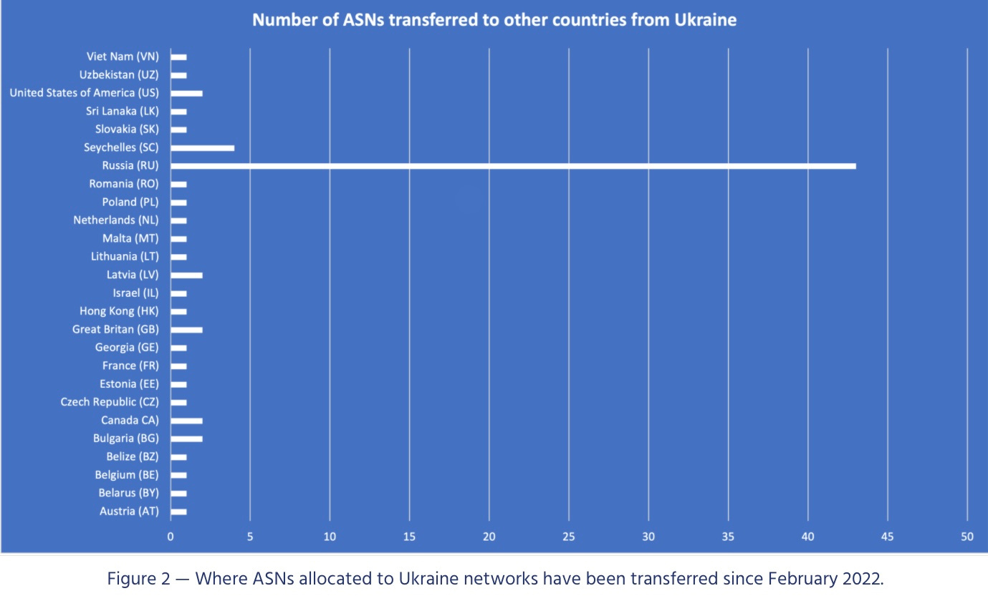
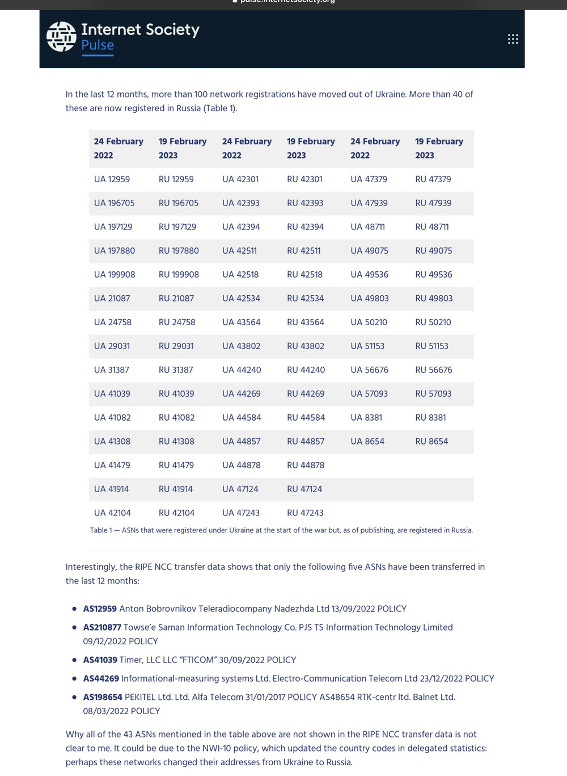
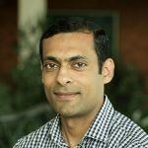
FOR BALTICNOG 2025
Aftab Siddiqui
23 February 2023 г.

Slide 14
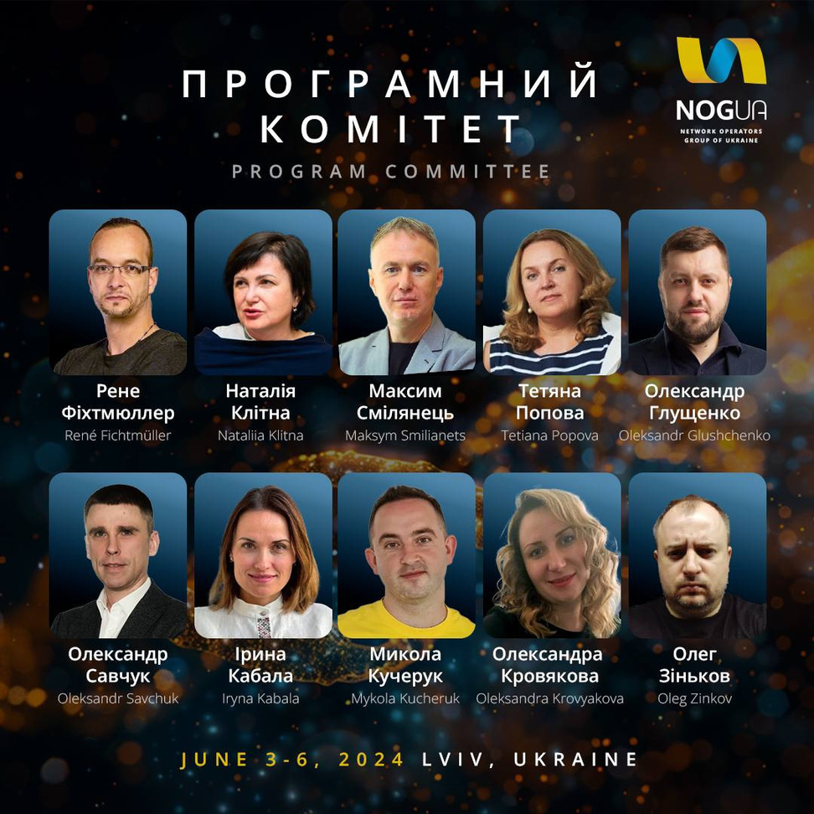
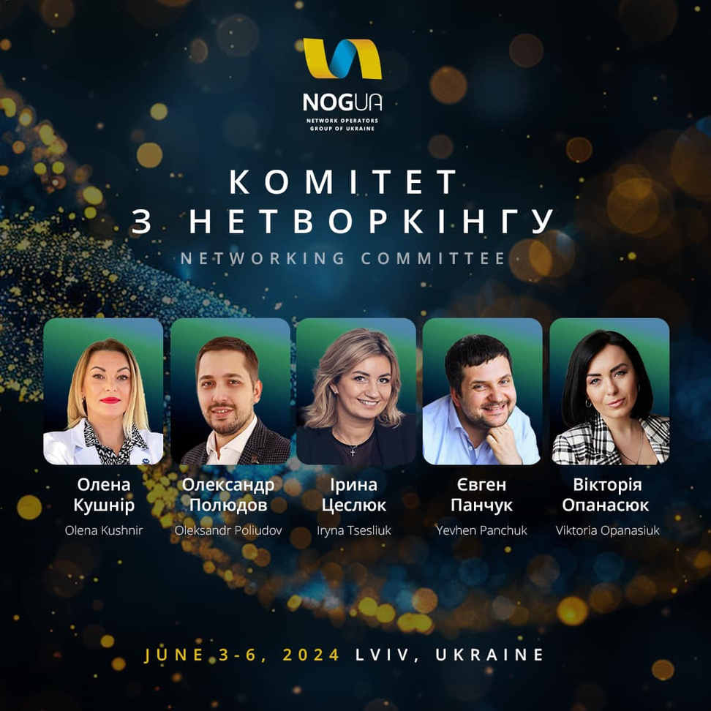
PROGRAM COMMITEE
NETWORKING COMMITEE
FOR BALTICNOG 2025

Slide 15

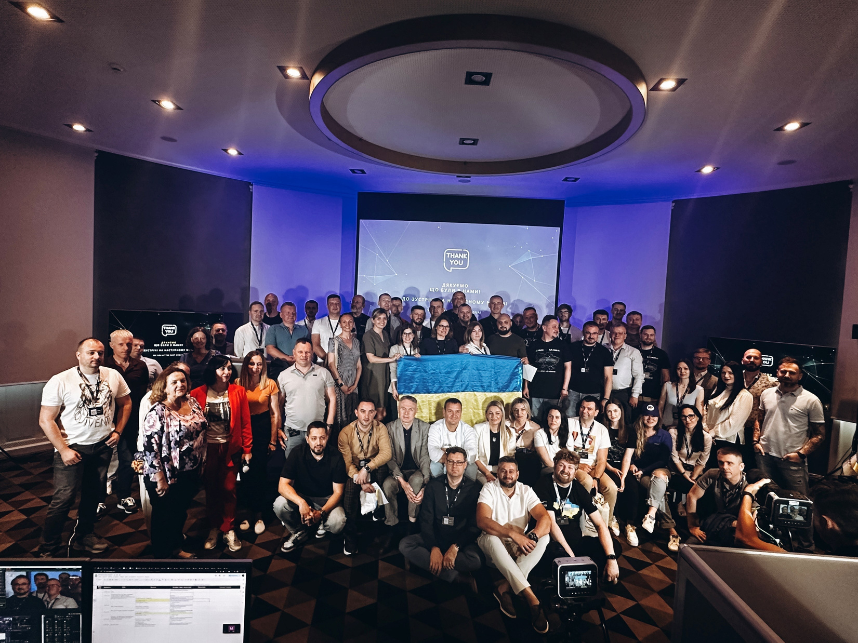
NOGUA IN NUMBERS
150+
ONSITE
PARTICIPANTS
30+
ONLINE
PARTICIPANTS
90+
DIFFERENT
COMPANIES
9+
DIFFERENT
COUNTRIES
FOR BALTICNOG 2025

Slide 16




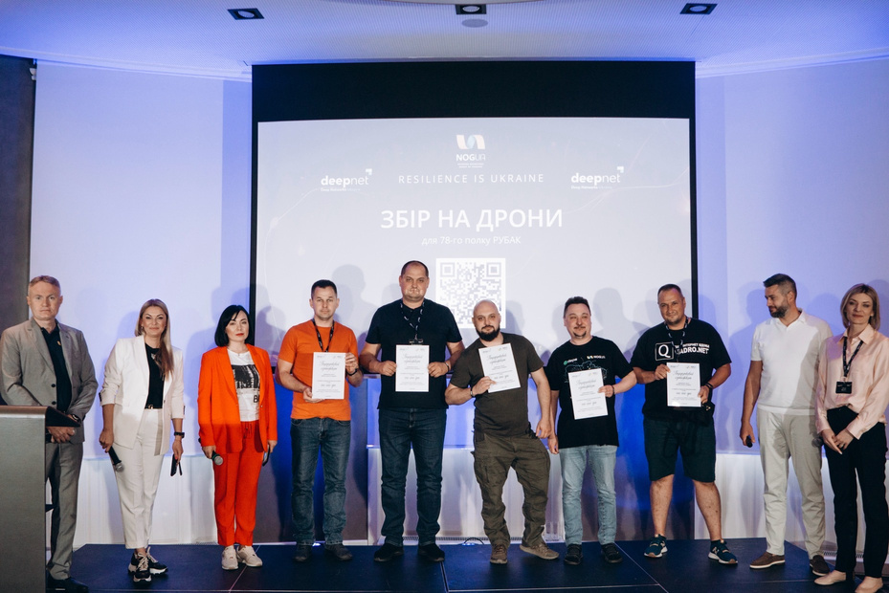
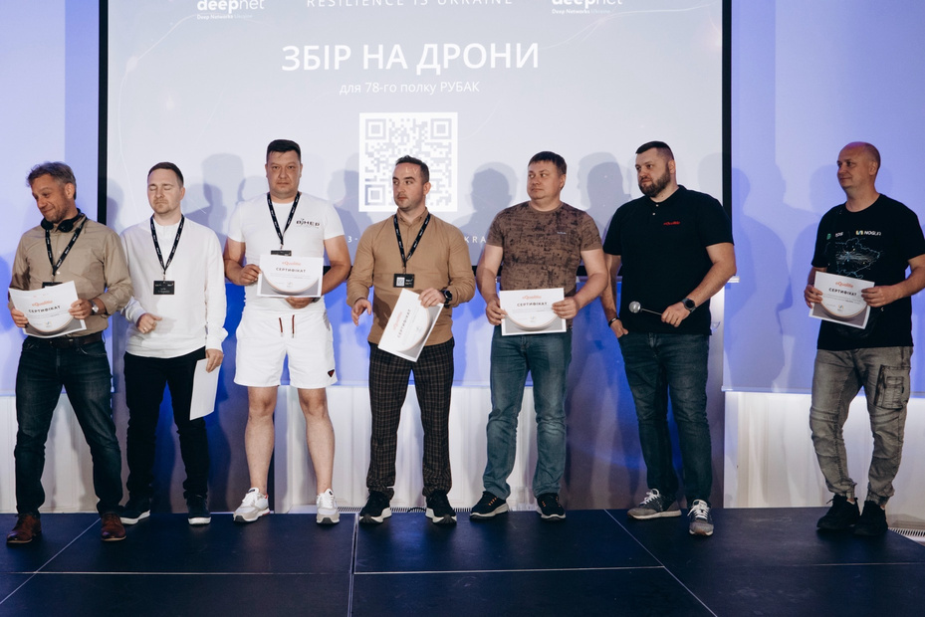
MAIN GOALS: CHARITY AND AID FOR ISPs
ISP
FROM FRONTLINE
AREAS
Free participation for visiting all conference official part and social events, hotel accommodation
5 Grants of 2,500 EUR each from both General Sponsor and general conference fund for ISPs
10%
FROM ALL
Sent to general conference fund for aid for ISPs from
frontline areas
7 certificates from Canadian donor each of 6,5 km of fiber
optic cable
TICKETS
FOR BALTICNOG 2025

Slide 17
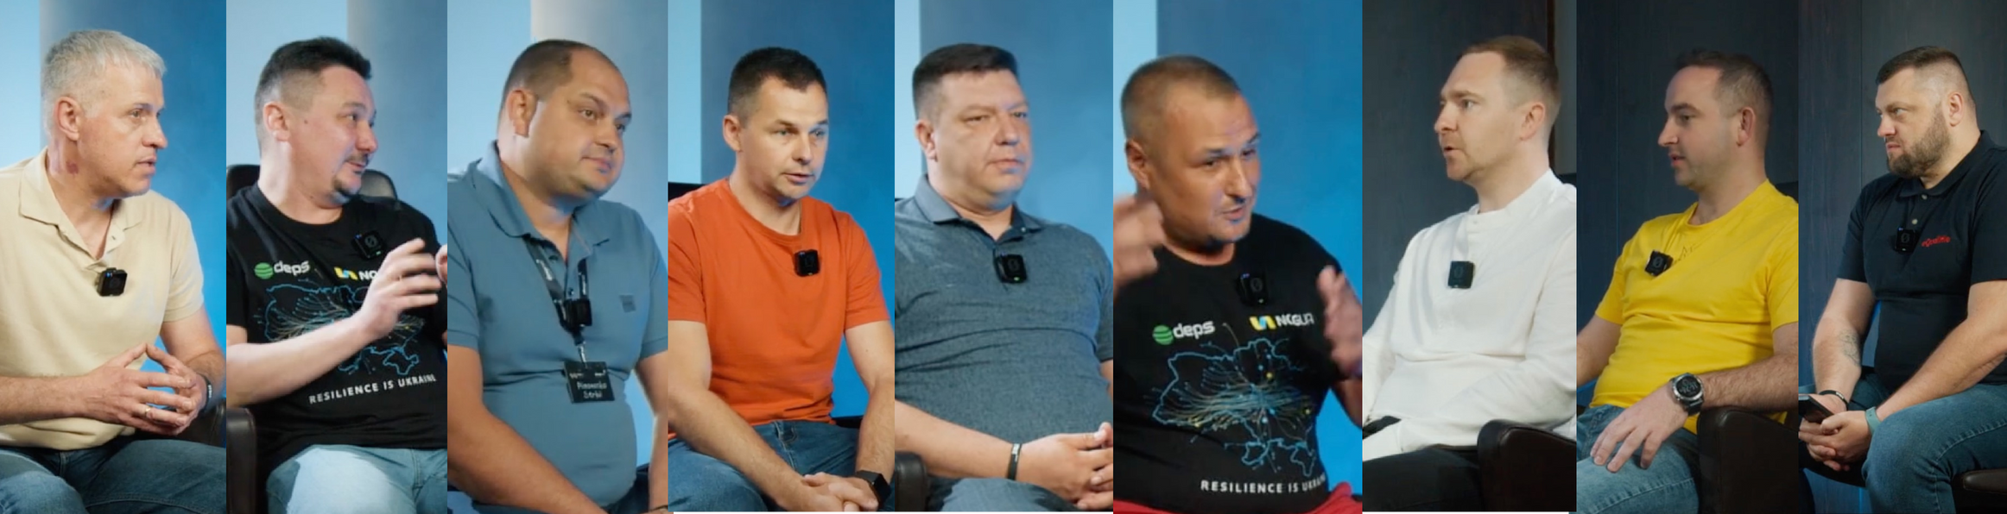

DOCUMENTING OPERATORs’EXPERIENCE
8 unique interviews
wererecordedduringNOGUAwithISPsfromfrontline areas: Kherson, Symu, Donetsk, Dnipro and Kyiv regions.
watch video here
FOR BALTICNOG 2025

Slide 18


























SUPPORTED BY
FOR BALTICNOG 2025

Slide 19






RESILIENCE IS UKRAINE
THANKS EVERYONE FOR YOUR SUPPORT!
QUESTIONS
www.nogua.com.ua org@nogua.com.ua

