Slide 1

Community Network tools – All at No-Cost
- To Save and Improve Human Lives as a Community
Sorry, not QUAD7
Team Cymru Community Outreach Team
outreach@cymru.com
Notes:
Some of you may be wondering why we called it OGRE
It’s simply because it is based on Tor, aka the Onion Router, and as we all know…

Slide 2
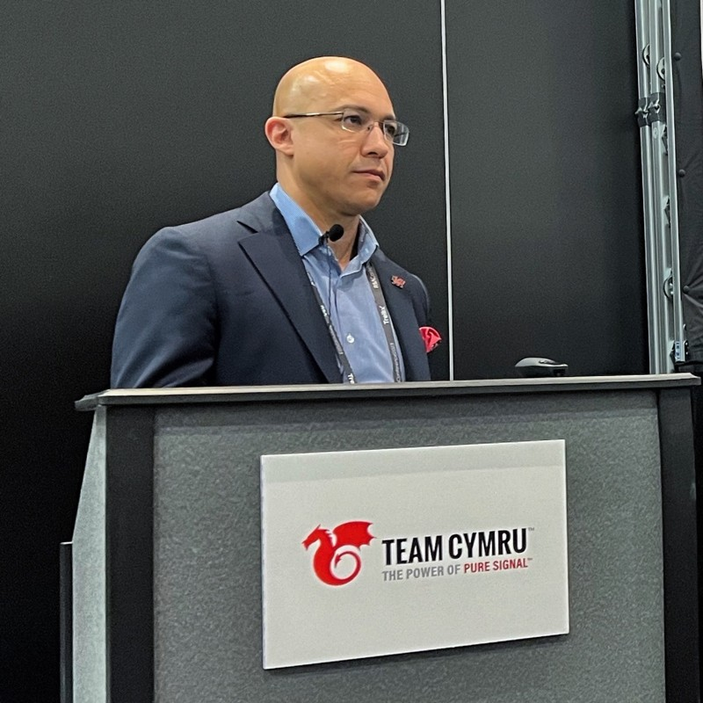
Scott Fisher
Outreach Team
13+ years at Team Cymru – Senior Principal Engineer
Previously roles at TC: System Engineer, Team Lead of Datacenter Operations, Director of Sales Engineering
Prior: AAA/RADIUS/WAP for cellular networks
Team Cymru’s Mission: To Save and Improve Human Lives

Slide 3
Mission

Slide 4

BOGONS
The original list
BOGON and MARTIAN lists – Updated hourly
BOGONS: IANA unallocated + RFC reserved space
FULL BOGONS: adds unassigned by RIRs
Available over HTTP(s), BGP, RIPE NCC, RADb, DNS
Most convenient is BGP peering
Notes:
Totally Free!
Big enough to have an impact
You agree to blackhole route received prefixes
We do prefix validation
Others null route prefixes you advertise

Slide 5

IP-TO-ASN
BGP-based Whois lookup
Enter IP addresses or CIDR blocks
Returns advertising AS
Yes, sometimes multiple ASNs advertise same IPs
Delivered over WHOIS, DNS, and HTTPS
WHOIS is the most popular
Bulk Mode Available – please use with netcat*
Notes:
Totally Free!
Big enough to have an impact
You agree to blackhole route received prefixes
We do prefix validation
Others null route prefixes you advertise

Slide 6

CSIRT Assistance Program (CAP)
Free service for Government & National CSIRT/CERTs
IP reputation data
Regional or National CSIRT
Contains our filtered set of threat intelligence - specific to “jurisdiction”
Actionable Intelligence – Assists in Victim Notification
Notes:
Totally Free!
Big enough to have an impact
You agree to blackhole route received prefixes
We do prefix validation
Others null route prefixes you advertise

Slide 7

DNB
Dragon News Bites
Free Email List
Hand curated – by TC Staff, need to know information
Daily reading for many in InfoSec community
Prepended with 13 unique category tags for easy mail filtering
Notes:
Totally Free!
Big enough to have an impact
You agree to blackhole route received prefixes
We do prefix validation
Others null route prefixes you advertise

Slide 8

Malware Hash Registry - MHR
Malware Validation
Malware detection & validation
Searches against 30+ antivirus databases
WHOIS, DNS, HTTPS support; HTTPS - hash.cymru.com
REST API support requires signup
Built into ZEEK - https://docs.zeek.org/en/current/scripts/policy/frameworks/files/detect-MHR.zeek.html

Slide 9
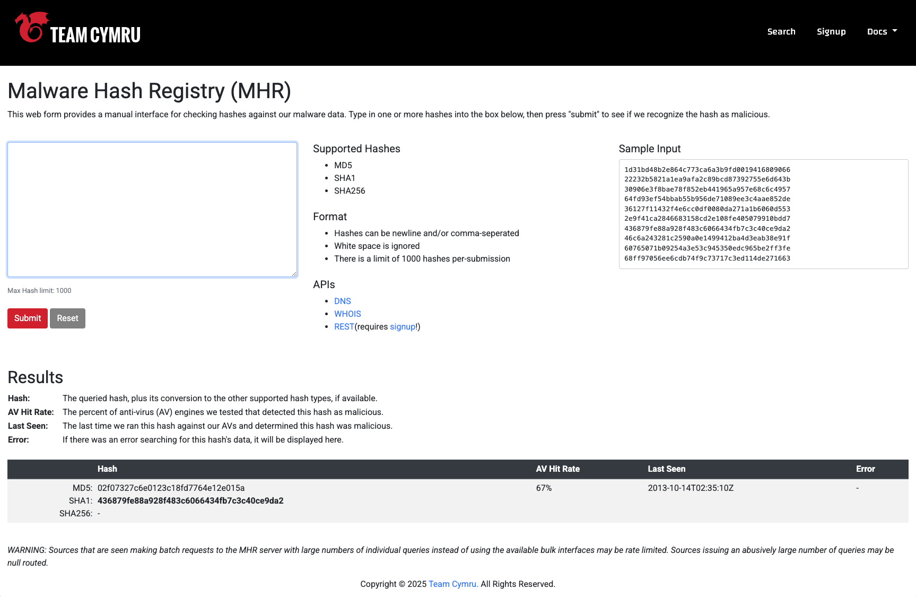
Malware Hash Registry - MHR
Malware Validation

Slide 10
DDOS Mitigation

Slide 11


Unwanted Traffic Removal Service - UTRS
Distributed RTBH
Like RTBH, but upstream and global
BGP based triggers
You send an address (/32 or /128) to blackhole
You must own the prefix for the address
You agree to blackhole route received prefixes
Over 650 partner networks
Reduces unwanted traffic hitting your peers
Flowspec supported for port-level filtering

Slide 12

ISP Protect
Netflow-based Threat detection for mid-to-large ISPs
Elasticsearch-based netflow analyzer
Matches network flows to network reputation insights & CTI context
Send specialized rules to your SIEM/XDR
Encrypted flow supported
Supports all common flow protocols & IPv6
Over 600 active ASNs partners
Notes:
Totally Free!
Big enough to have an impact
You agree to blackhole route received prefixes
We do prefix validation
Others null route prefixes you advertise

Slide 13
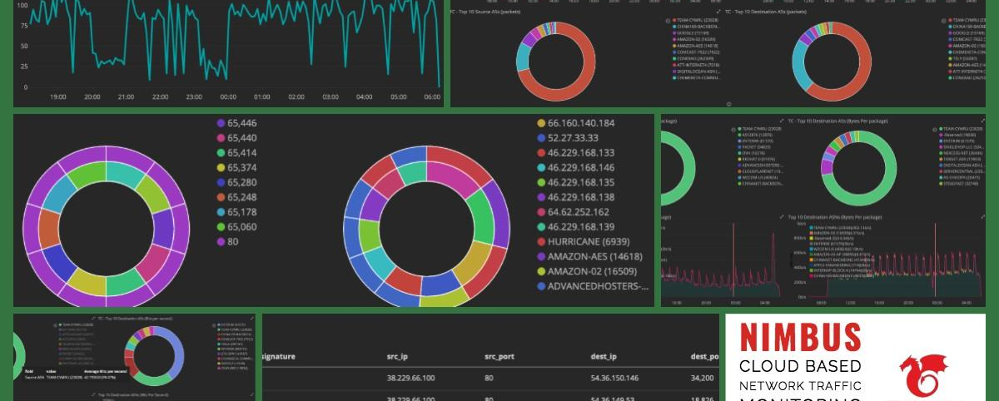
ISP Protect! / Nimbus
Netflow Analyzer
Notes:
Kibana + Elastic Search
Under the hood, we filter Netflow versus our Reputation data ($120K or something like that?)
Kibana instance is unrestricted
I can give a live demo if you’re interested at the end
The link allows you to sign up for an individual demo and there’s a video
Awesome thing about this: Your participation HELPS everyone else, and their participation helps you.

Slide 14
Protect!

Slide 15

IX Protect!
Multi-tenant Threat Monitor
Multi-Tenant Threat Monitor
View high-level context & alerts
Matches network flows to network reputation insights
Requires IX to join + each member wanting to contribute
Bad Actors Variant – Only flows to/from known malicious IPs will be saved
To opt-in: https://www.team-cymru.com/ixprotect-signup
Notes:
Totally Free!
Big enough to have an impact
You agree to blackhole route received prefixes
We do prefix validation
Others null route prefixes you advertise

Slide 16
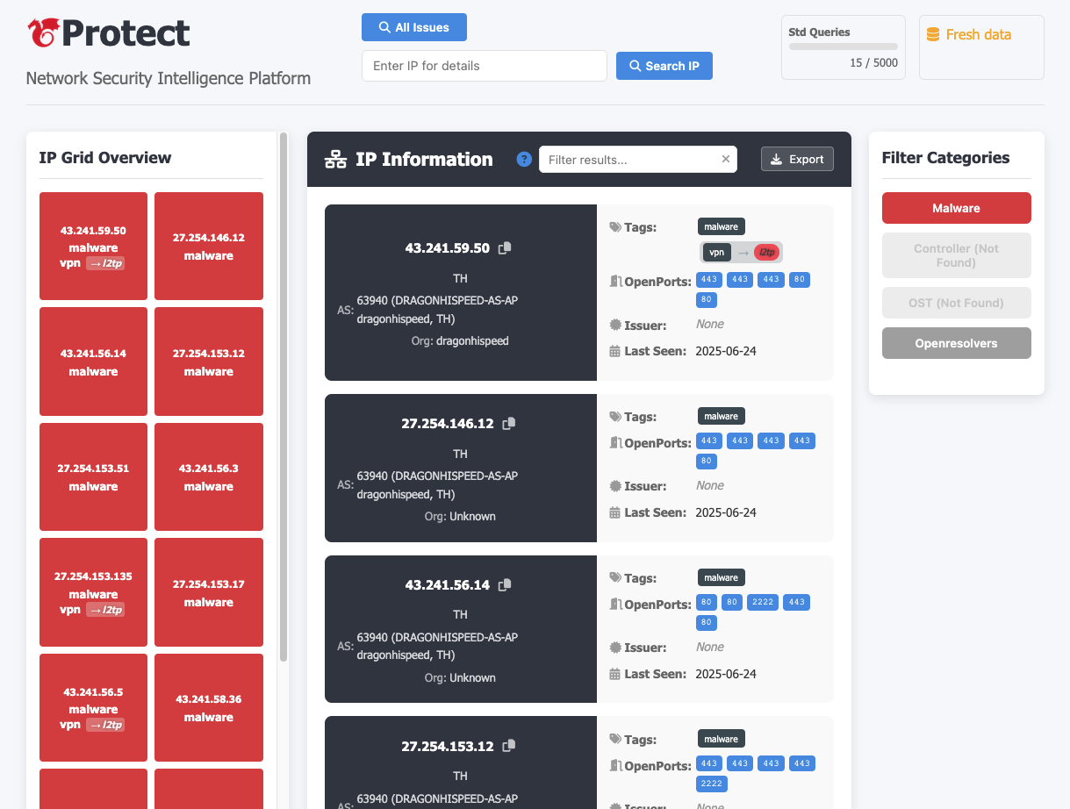
IX Protect!
Multi-tenant Threat Monitor
Notes:
Totally Free!
Big enough to have an impact
You agree to blackhole route received prefixes
We do prefix validation
Others null route prefixes you advertise

Slide 17

BPH Protect!
Multi-tenant Threat Monitor
Bulletproof Hosting Provider Block List
For hosting providers with hugely poor reputation
Extremely high confidence block-list
Only available to community members
Coming Q4 2025
Notes:
Totally Free!
Big enough to have an impact
You agree to blackhole route received prefixes
We do prefix validation
Others null route prefixes you advertise

Slide 18

EVENTS
Underground Economy
Regional Internet Security Event - RISE
Flagship Technical Events
Annual - 4-Day event
Building bridges between LEOs and InfoSec Pros
20%-35% LEOs, 50% InfoSec Pros, 15% Financial Sector, X% edu + industry
First full week of September
Past Co-Hosts: Interpol, Europol, Council of Europe, Qatar MOI, La Caixa Bank, CERT-UK, RoEduNet (Romania)
2-Day event – 3 times per year
Localized version of UE
Design to build bridges
2-300 attendees
Locations Unique per event
Notes:
Totally Free!
Big enough to have an impact
You agree to blackhole route received prefixes
We do prefix validation
Others null route prefixes you advertise

Slide 19
THANK YOU!
Questions?
sfisher@cymru.com
outreach@cymru.com

