Slide 1

The Power couple = Flow + Probe data
Combining performance metrics & flow data for optimal network insights
2025

Slide 2
Challenge: Monitor 20 ingress (transit) points

Slide 3
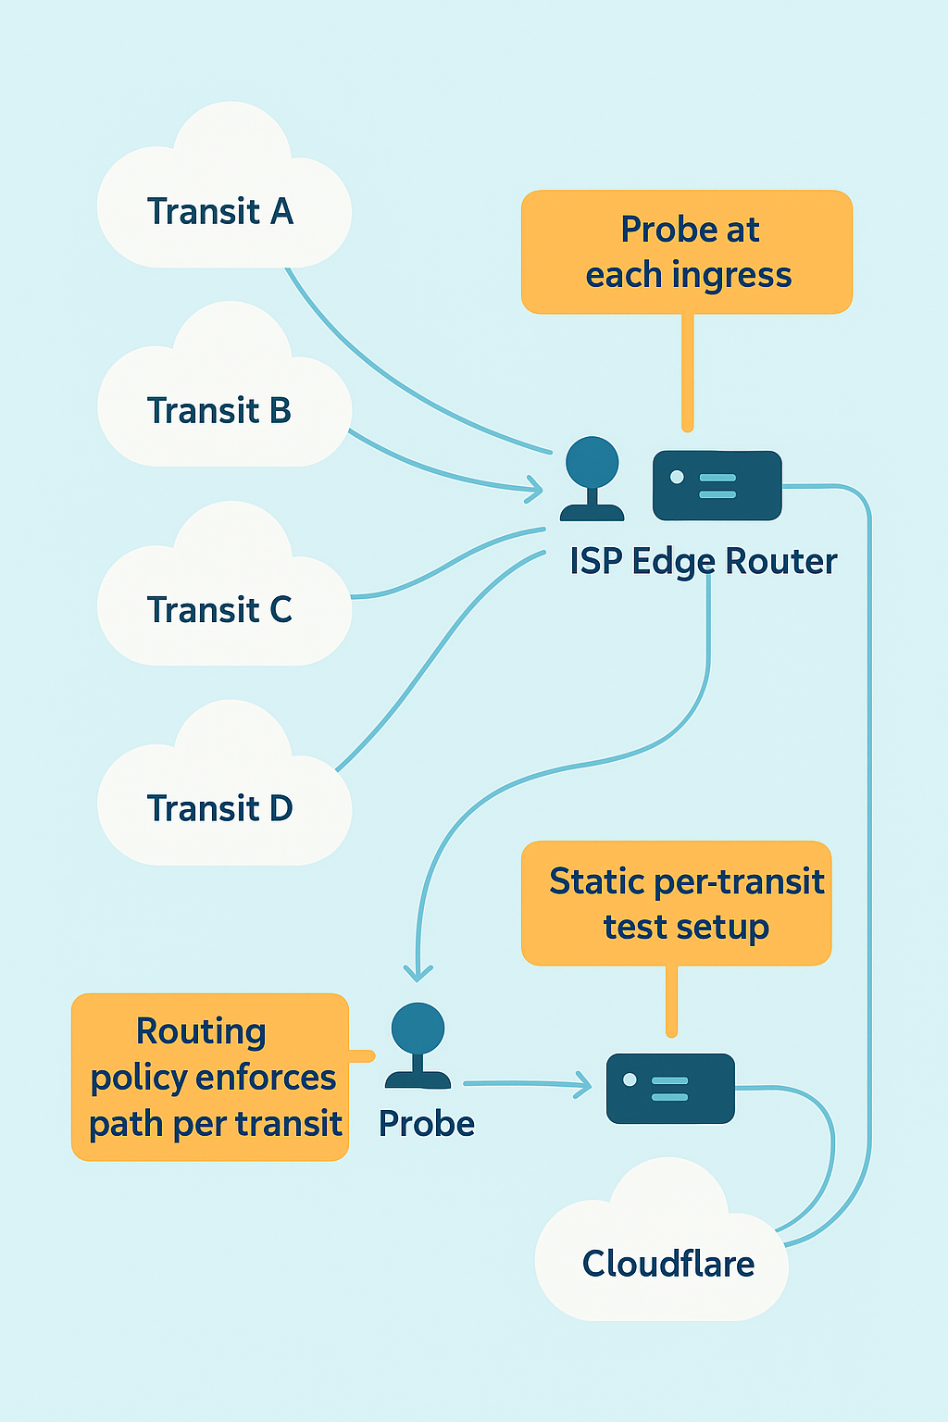
How ISPs monitor today?
There are three solutions
Hosting Provider

Slide 4

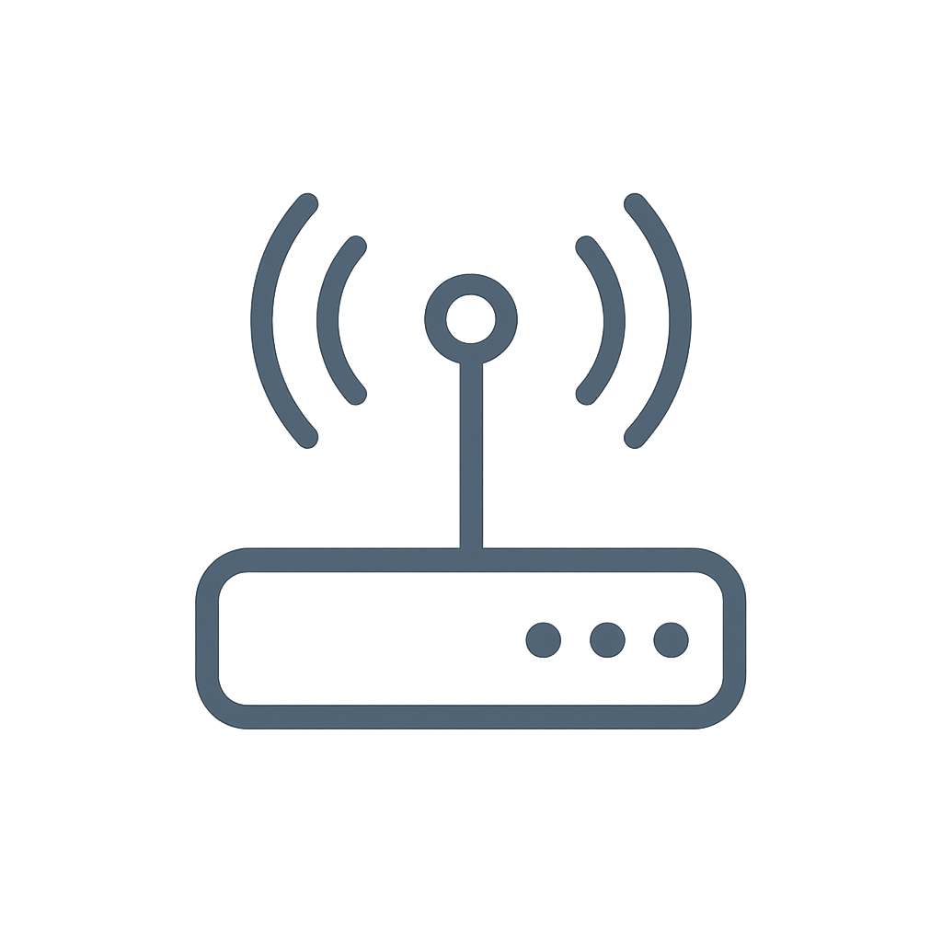

Operator-managed external probes
Ingress 1 (RETN LDN1)
Probes placed at external hosting locations
Inbound path is probabilistic (BGP decision outside operator’s control)
Require many vantage points (~50) to establish coverage
Hosting provider-1
Ingress 2 (TATA SIN2)
Central Endpoint
Hosting provider-2
Ingress 3 (Airtel BOM1)
Hosting provider-3
Probes placed at
various locations
Other ingress points

Slide 5
Third-party probe dataset providers
Ingress 1 (RETN LDN1)
Subscription based access to large probe pools
Global coverage from vendor’s vantage network
Still probabilistic for inbound transit paths
Regional ISP coverage questionable
Ingress 2 (TATA SIN2)
Central Endpoint
probe dataset provider
Ingress 3 (Airtel BOM1)
Other ingress points

Slide 6
Deterministic path selection via BGP announcements to a test host
2001:db8:1::/48
Ingress 1 (RETN LDN1)
Use 2 probes and announce a dedicated IPv6 /48 at each transit.
Each /48 is announced only via one ingress, enabling deterministic path validation to a single test host.
This setup allows broad, scalable ingress monitoring — with static per-transit routing.
2001:db8:2::/48
Probe 1
Ingress 2 (TATA SIN2)
Central Endpoint
2001:db8:3::/48
Ingress 3 (Airtel BOM1)
Probe 2
IP:s from:
2001:db8:0::/40
2001:db8:14::/48
Other ingress points

Slide 7
Comparison of three solutions
Metric | Solution 1 | Solution 2 | Solution 3
Probe Location | External hosting (self-managed) | Vendor vantage network | 2 on-premises probes
Path Control | Low / probabilistic inbound | Low / probabilistic inbound | High - deterministic via /48 per transit
Hardware Cost | Medium–High | None | Low
Ongoing Cost | VPS hosting + maintenance | Subscription fees | Minimal OPEX
Deployment Complexity | High | Low | Low
Coverage | Geographic spread improves odds | Vendor coverage improves odds | Full ingress coverage by design
Independence | High (you own probes) | Low (vendor dependency) | High

Slide 8





Limitations of probe only monitoring
High deployment & maintenance cost
Installing and managing probes at every ingress point increases hardware, provisioning, and troubleshooting workload.
Complex test orchestration
Synthetic tests must be manually configured per transit provider using static routing or BGP tweaks.
Doesn’t scale efficiently
As transit links grow, testing complexity and monitoring overhead increase exponentially.
Inflexible to change
Adding/removing a provider means reconfiguring test logic often manually.
Blind spots remain
If routing policies shift or a transit isn’t actively preferred, visibility through that ingress can disappear.
Notes:
we’ve summarized the core limitations of this method.
“First, it’s expensive and hardware-intensive. You’re looking at 20+ probes for full coverage.”
“Second, orchestrating synthetic tests per ingress is technically complex and error-prone.”
“Third, it doesn’t scale well. As you add more transit links, your monitoring matrix grows exponentially.”
“And finally, you may completely miss an underperforming path if no real traffic or tests happen to go that way.”
[Close – Tease the alternative]
“So while this model is widely used, it’s heavy, costly, and hard to maintain. And that’s exactly why we propose a radically simpler, smarter approach — using just two probes and a dedicated IPv6 prefix. I’ll show you how that works next.”

Slide 9
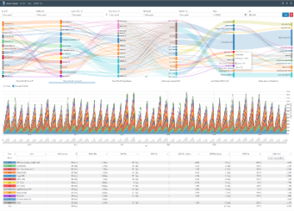
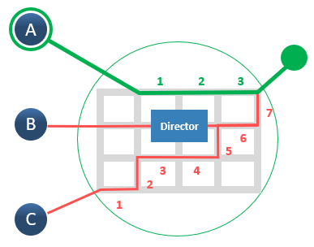
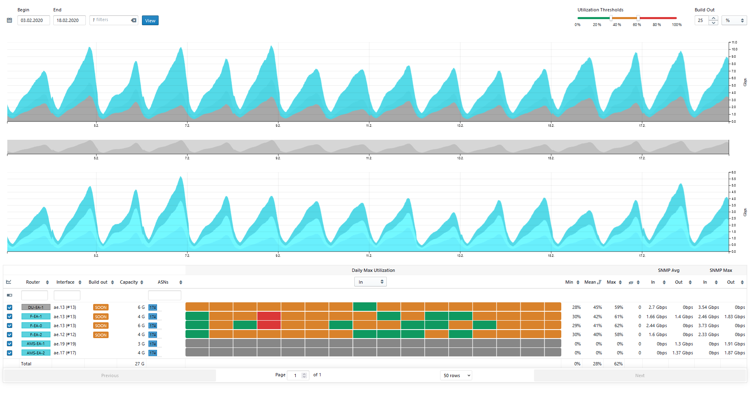
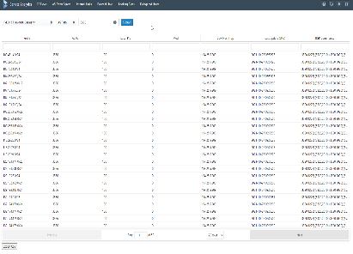
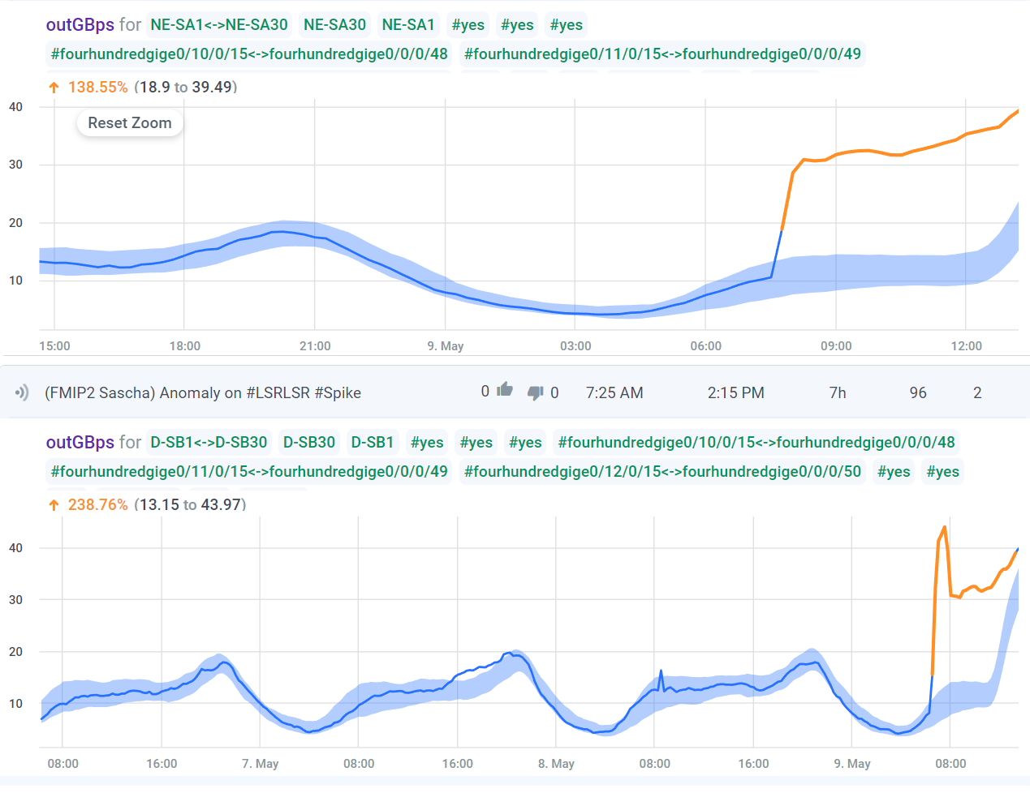

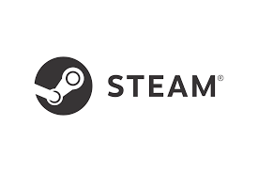



What BENOCS does:
Flow Explorer
CDN Flow Director
Netflow
SNMP
BENOCS CORE ENGINE
Capacity Planner
Looking Glass
OSPF
IS-IS
Telemetry
Our proprietary aggregation and cross correlation process requires significantly less compute power compared to competitors
Anomaly Detection
Application Monitor
DNS
BGP
PROTOCOL POOL
PROCESSING
NETWORK INTELLIGENCE
Notes:
"Some of you might have heard of us, but for those who haven’t, let me introduce BENOCS. We specialize in providing network intelligence solutions to different departments such as Peering, Network operation centers, Capacity planning and Network Engineering. Our mission is to help you gain comprehensive visibility of the traffic flowing through your network, from its origin to termination.
At BENOCS, we offer more than just a product; we also provide consultation and support to help you manage your network more efficiently and effectively. In a recent conversation with a customer, we uncovered some fascinating insights that we believed would be valuable to share in a forum like this.

Slide 10
How BENOCS correlates?
1
Probe metrics
Performance data from strategic network points provides detailed metrics on latency, packet loss and jitter.
2
Flow records
Flow analytics capture network-wide traffic statistics revealing source, handover, ingress and egress regions, volume and application data
3
BENOCS Core
Our core engine automatically links performance issues to specific traffic flows, providing complete context for every alert

Slide 11
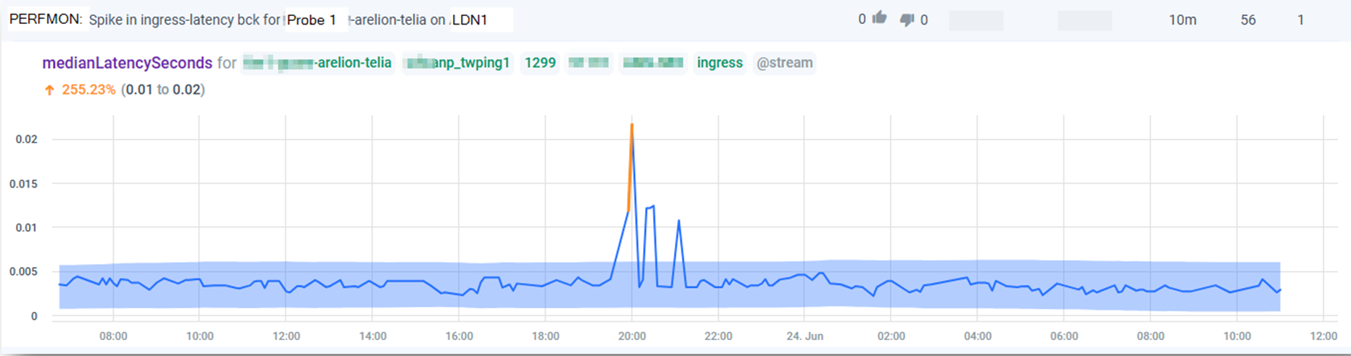
Step 1: Anomaly in the probe data
Notes:
Solution:
Use generic alert system with
a) thresholds (good enough)
b) anomaly detection (reduces noise)

Slide 12
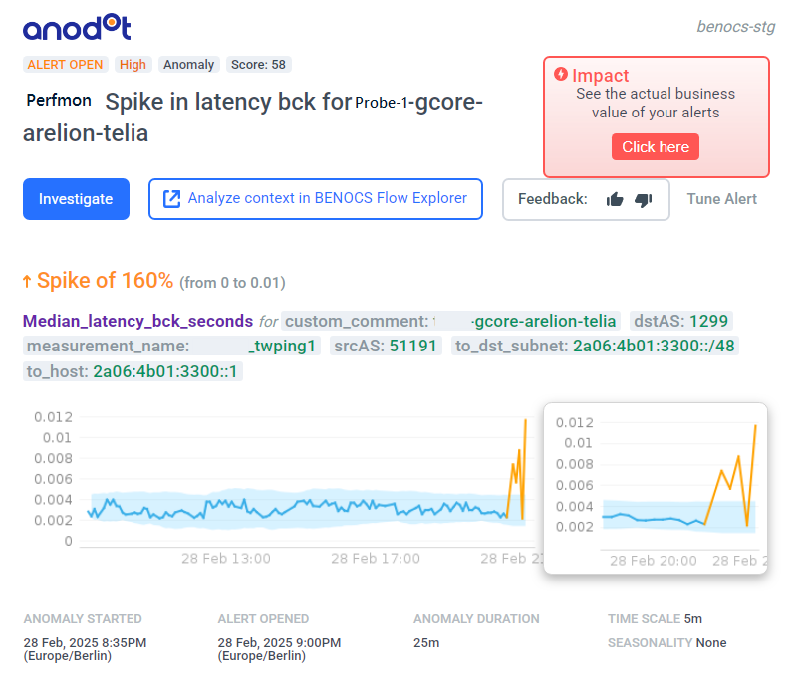
Step 1: Alert triggered
Peer and ingress router are known from the IPv6 prefix
  That gives us the key identifiers to correlate with flow data
  All traffic of the alerted ingress-point can be displayed to show full context
https://xyz.com/asflows?asFilters=%7B%22HND%22%3A%5B%221299%22%5D%2C%22INROUTER%22%3A%5B%22LDN1%22%5D%7D&customDimension=%22AS_APPLICATION%2CAS_SRC_INGRESS%2CAS_HND_INGRESS%2CROUTER_IN_INGRESS%2CROUTER_OUT_INGRESS%2CAS_NXT_INGRESS%2CAS_DST_INGRESS%22&dateRange=LAST_7_DAYS&disaggregations=%7B%7D&tagAggregations=%5B%7B%22dimension%22%3A%22ROUTER_OUT_INGRESS%22%2C%22id%22%3A4%7D%5D&tags=%5B%5D&tsDimension=AS_APPLICATION

Slide 13
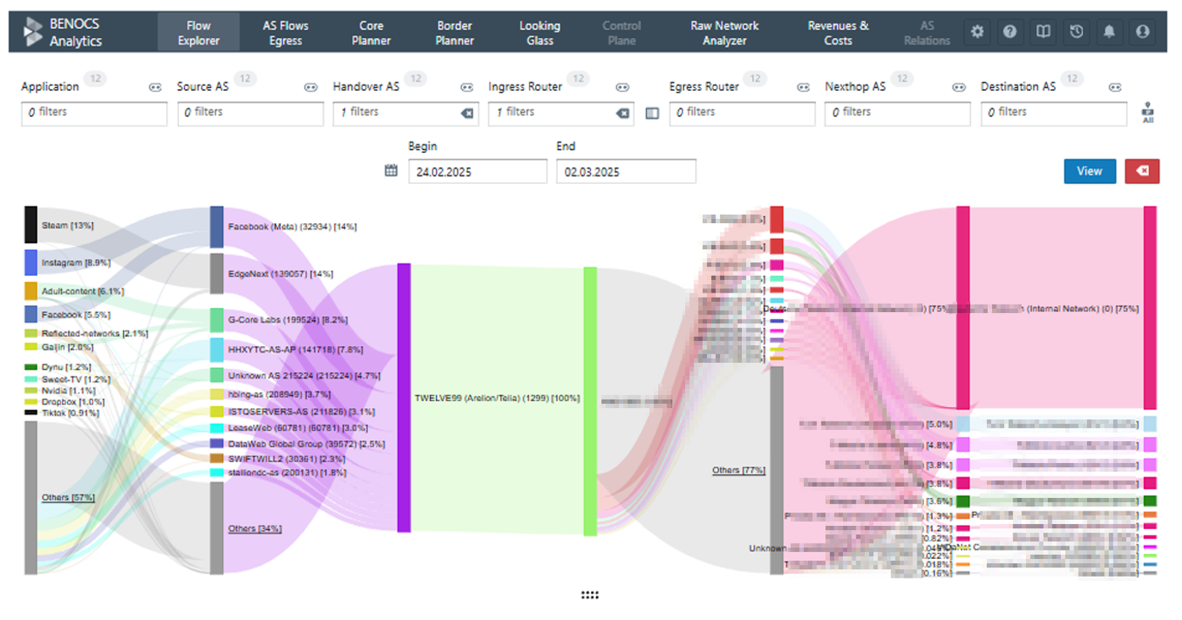
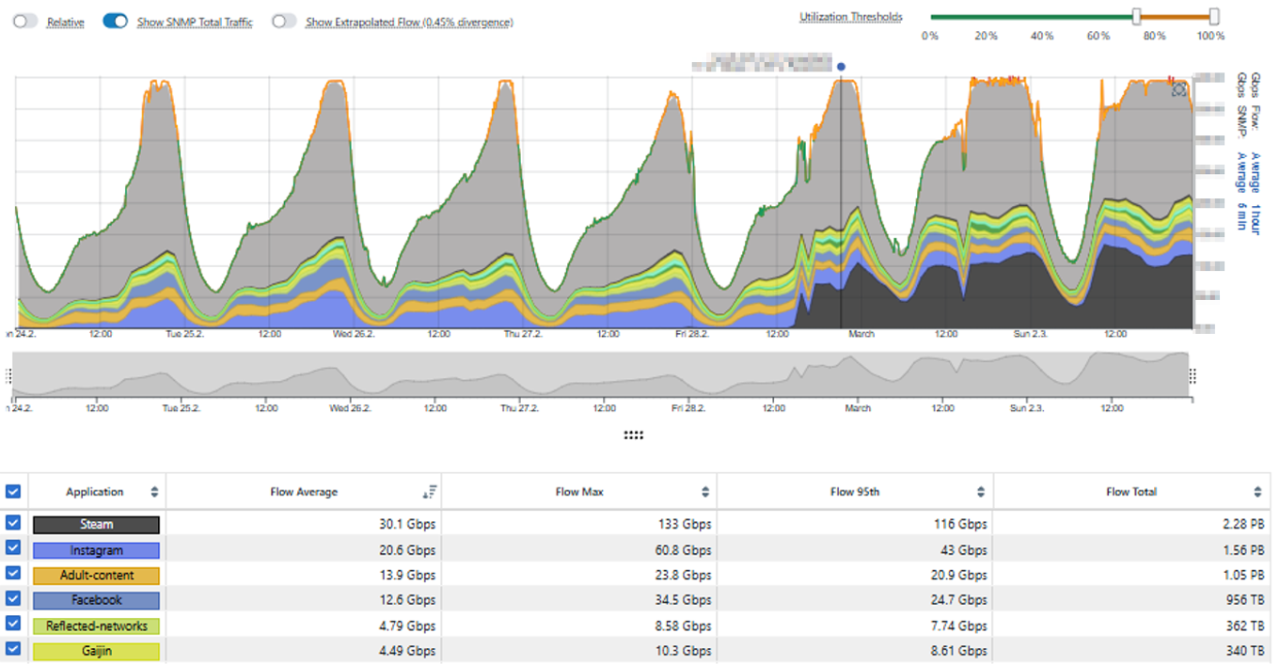
Step 2: Flow correlation
LDN1
Traffic on the affected ingress point was jammed by Steam/Valve traffic

Slide 14
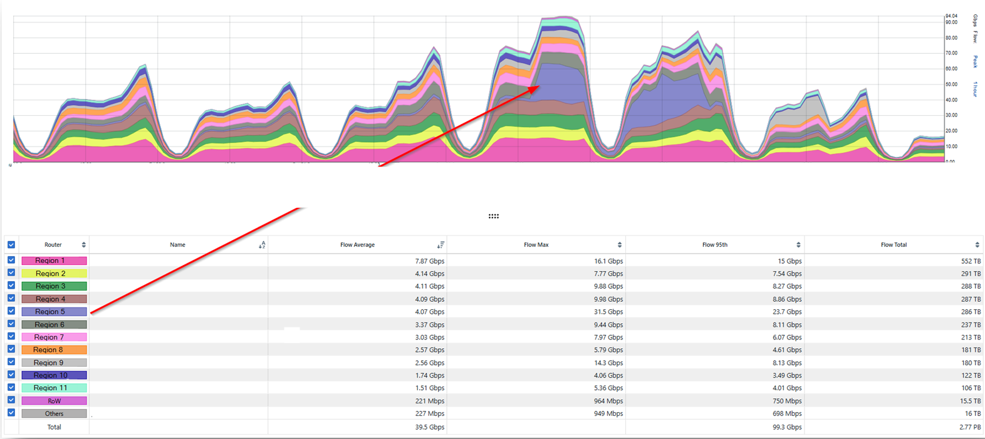
Step 3 : Detailed investigation
Additional traffic on the affected ingress point was mainly targeted at region 5

Slide 15
Real-world impact: Steam traffic
Steam hit 40,270,997 concurrent users on Feb 28, 2025, due to the massive popularity of Black Myth: Wukong which triggered multi Tbps bursts at provider ingress points
1
Anomaly alert triggered
Performance degradation detected at key ingress points
2
Flow Correlation
BENOCS instantly identified the traffic pattern and source
3
Detailed Investigation
Valve's content distribution automatically pinpointed, and the affected region spotted
4
Resolution
Traffic rerouted within minutes instead of hours

Slide 16


Power couple = Flow + Probe data
Probe → fault detection
Flow → Full context & Scope
Combined→ full visibility
Reveals performance issues such as Latency, Jitter but misses broader traffic context
Shows traffic statistics such as volume, ingress and egress specific traffic and the applications
Delivers true end-to-end visibility with both performance precision and traffic context

Slide 17
Recommendations for ISPs
1. Strengthen Network Capacity
Upgrade backbone bandwidth and core hardware
Distribute load across multiple PoPs/data centres
2. Improve Content Delivery
Peer directly with major platforms or IXPs
Host content locally via CDNs/caching partnerships
Coordinate with providers to pre-load updates
3. Optimize Traffic Flow
Prioritize gaming/streaming traffic during peaks
Use real-time monitoring and analytics
4. Enhance End-User Experience
Offer setup guides for optimal connectivity

Slide 18
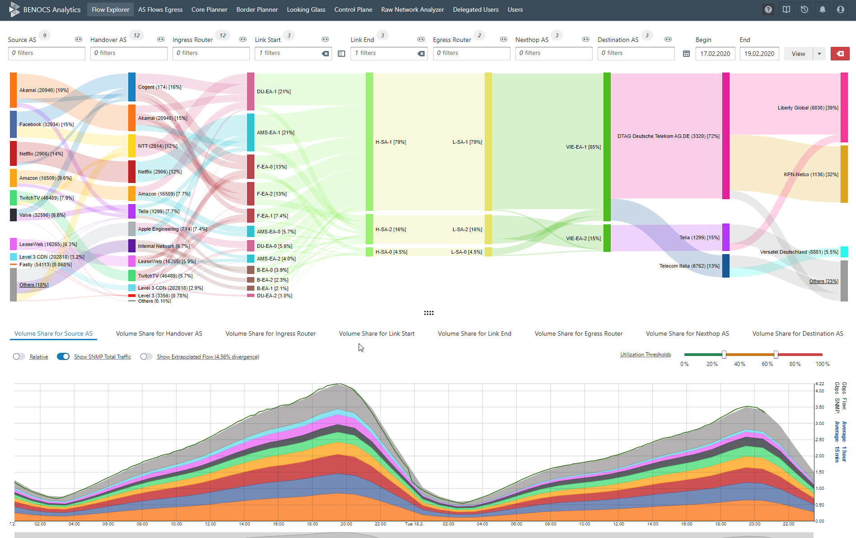

Péter György
pgyoergy@benocs.com
Thank you!
Questions?
BENOCS GmbH
Reuchlinstr. 10, 10553 Berlin
+49 30 577 000 4 – 0
benocs.com
18

