Slide 1

BALTING NOG 1 - September 25, 2025 - VILNIUS, Lithuania
Automation to Fight Piracy:
The Italian Experience
Livio Morina - CEO@Airbeam | BM@PeeringDB & AIIP
Notes:
This is the only slide where I use Comic Sans
Who am I?
and a board member of the Italian Association of ISP.
Therefore, I'm not here to discuss web chats as an outside observer; instead, we will take an in-depth look from within the industry.

Slide 2
This presentation is based on my direct, personal experience
What are we going to cover?
I serve as the legal representative of an Italian ISP
and as a board member of the national ISP association
This is not an outsider’s perspective,
we will explore the issue from within the industry
Livio Morina – BalticNOG1
Vilnius – 25/09/2025

Slide 3

The Serie A League is putting strong pressure on the Italian Government
Problem
Audiovisual piracy has resulted in an estimated
€1.7 billion in revenue losses across all sectors of the Italian economy.
€315 million – estimated acts of piracy involving the adult population
€716 million – estimated impact on the Italian GDP
9,400 – estimated jobs lost due to piracy
Livio Morina – BalticNOG1
Vilnius – 25/09/2025
Notes:
Economic and employment issues, so the Goverment decided to ACT
Strong Power: Both chambers of the Italian Parliament voted unanimously
WE NEED TO STOP IT!

Slide 4
“There is a need for a fast-blocking system”
The Serie A’s proposal
“So, we built and donated to the Government an M2M platform allowing rights holders to submit a list of assets to be blocked,
…which operators are then required to enforce.”
Livio Morina – BalticNOG1
Vilnius – 25/09/2025
Notes:
At this point the proposal from the LEGA SERIE A arrived
Through a company named SPTECH

Slide 5
May 2023: The Italian Communications Authority previewed the platform it intended to launch. It differed from the draft law under discussion in Parliament. Ultimately, Parliament amended the law to incorporate the platform's structure, as requested by rights holders.
Timeline
July 2023: Parliament unanimously approved Law 93/2023: “Prevention and suppression of the unlawful distribution of copyrighted content via electronic communications networks.”
January 2024: Launch of the technical accreditation system and publication of the technical manual by the end of the month.
February 2024: The platform went online. Compliance became mandatory
for all operators.
Livio Morina – BalticNOG1
Vilnius – 25/09/2025
Notes:
1 month to write the tool, test it and go into production

Slide 6
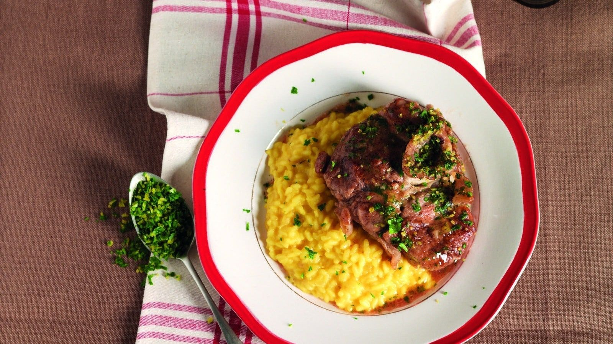

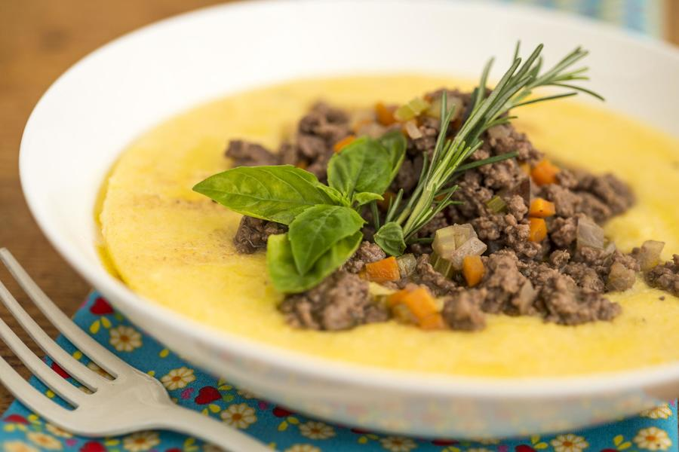





- run a “continuous PULL system”
Basics of the M2M Platform
Rights holders (private entities) define what to block
and push the list to the platform.
Please note that an IP address must be used exclusively for piracy in order for it to be blocked.
So even hosting a blog about Lombard cuisine may be enough to prevent the IP address from being blocked under the law.
- IPv4/32
- IPv6/128
Max 13k entries
Max 18k entries
- FQDN
Operators MUST:
- apply the ORDERS
- Operators MUST confirm execution via POST requests.
Livio Morina – BalticNOG1
Vilnius – 25/09/2025
Notes:
For each GET, the answer was the entire list of tickets, not only the new ones.
So hosting the Lombard cuisine Blog is enough to

Slide 7
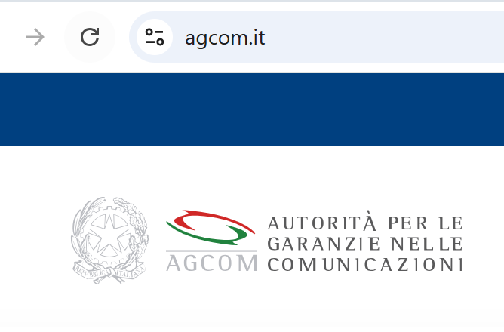






Airbeam Side
IP blackholing
VPN
Brain:
PHP / Cron
DNS Blacklist
Livio Morina – BalticNOG1
Vilnius – 25/09/2025
Notes:
Describe the tecnical stuff - One Single VPN
Alma creates 3 lists - Riflessioni: HA? Manutenzioni?

Slide 8
We have up to 30 mins to confirm the execution, so I can make a call every 10 minutes
Let’s do that!
No, we are all doing the same, so let’s add a randomized delay
Too many errors, once the GET fails, we need to run it once again in some minute
It’s a mess, let’s reduce it to Two minutes
Livio Morina – BalticNOG1
Vilnius – 25/09/2025
Notes:
At this point the proposal from the LEGA SERIE A arrived

Slide 9
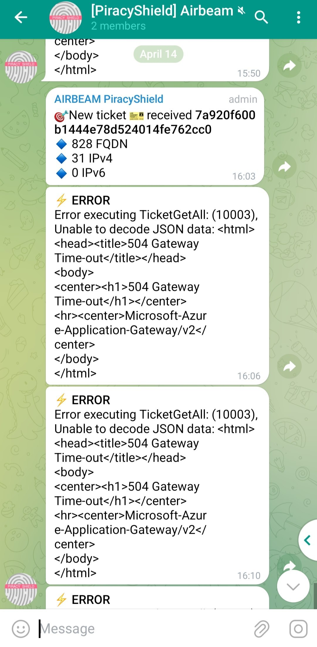
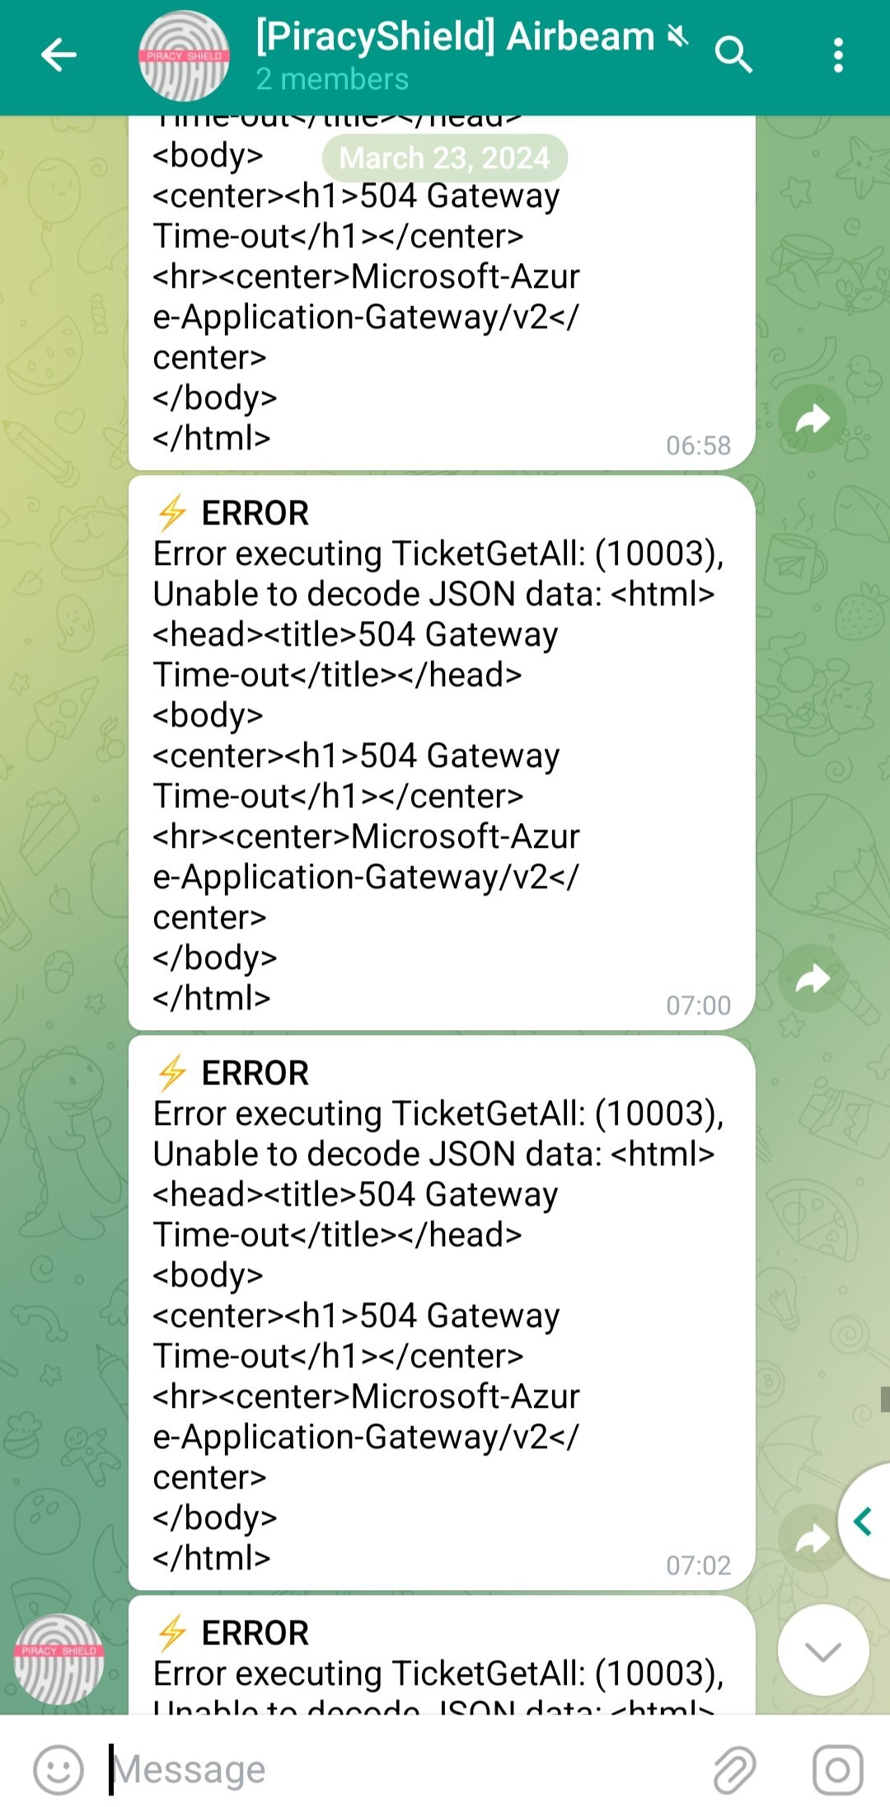
Notifications
Apr 18th 2024
818 tickets
Banned FQDN 9539
BannedIPv4 3123
Mar 23rd 2025
2976 tickets
Banned FQDN 16328
BannedIPv4 8721
Sep 20th 2025
2448 tickets
Banned FQDN 21845
BannedIPv4 11965
Livio Morina – BalticNOG1
Vilnius – 25/09/2025
Notes:
Errors, alarms…
Stats

Slide 10
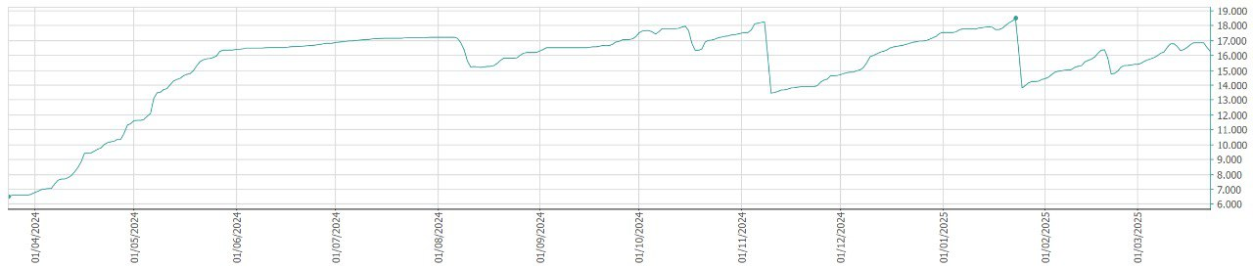
Detailed Statistics (1)
BANNED FQDN PROGRESSION
Livio Morina – BalticNOG1
Vilnius – 25/09/2025
Notes:
Last 12 months

Slide 11
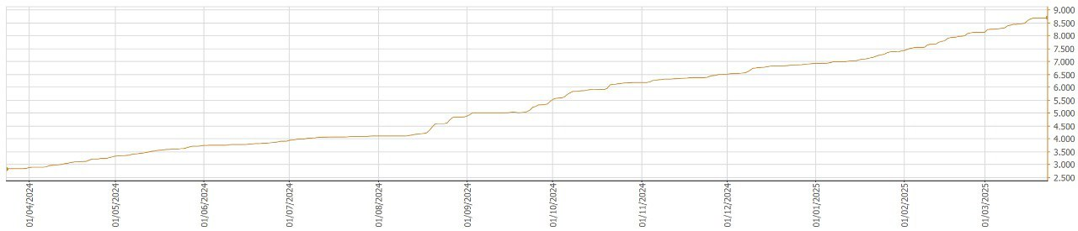
Detailed Statistics (2)
BANNED IPv4 PROGRESSION
Livio Morina – BalticNOG1
Vilnius – 25/09/2025
Notes:
Last 12 months

Slide 12
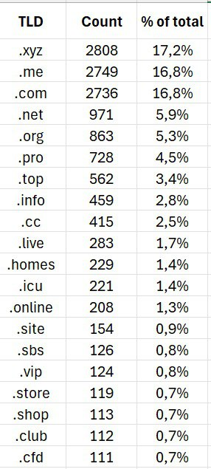
Detailed Statistics (3)
BANNED FQDN
by domain
Livio Morina – BalticNOG1
Vilnius – 25/09/2025
Notes:
March 23° 2025

Slide 13
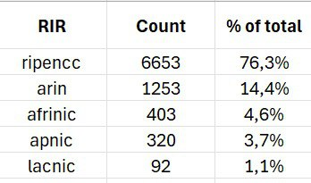
Detailed Statistics (4)
BANNED IPv4 by RIR
Livio Morina – BalticNOG1
Vilnius – 25/09/2025
Notes:
March 23° 2025

Slide 14
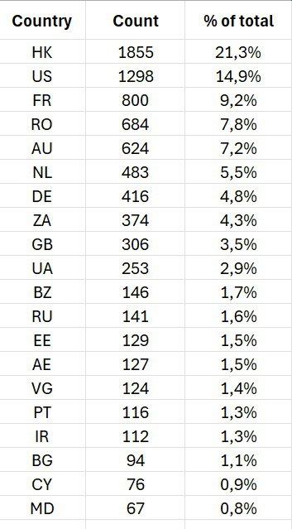
Detailed Statistics (5)
BANNED IPv4
by Country
Livio Morina – BalticNOG1
Vilnius – 25/09/2025
Notes:
March 23° 2025

Slide 15
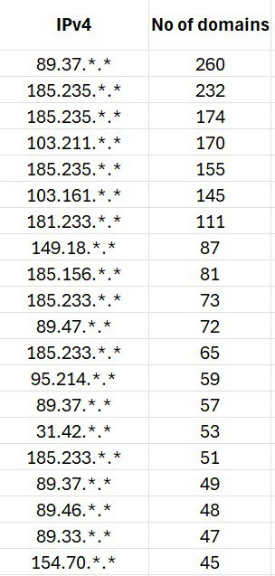
Detailed Statistics (6)
BANNED IPv4
by Linked Domains
(using dnslytics.net)
Livio Morina – BalticNOG1
Vilnius – 25/09/2025
Notes:
March 23° 2025

Slide 16
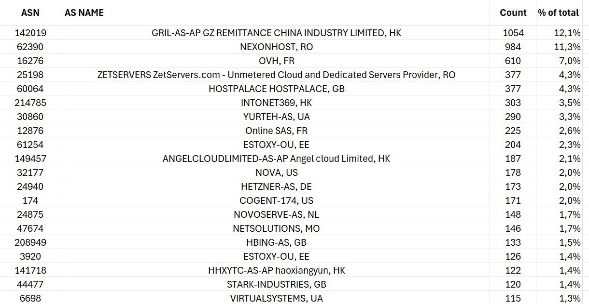
Detailed Stats (7)
BANNED IPv4 by ASN
BANNED IPv4 by ASN
Livio Morina – BalticNOG1
Vilnius – 25/09/2025
Notes:
Errors, alarms…
Stats

Slide 17
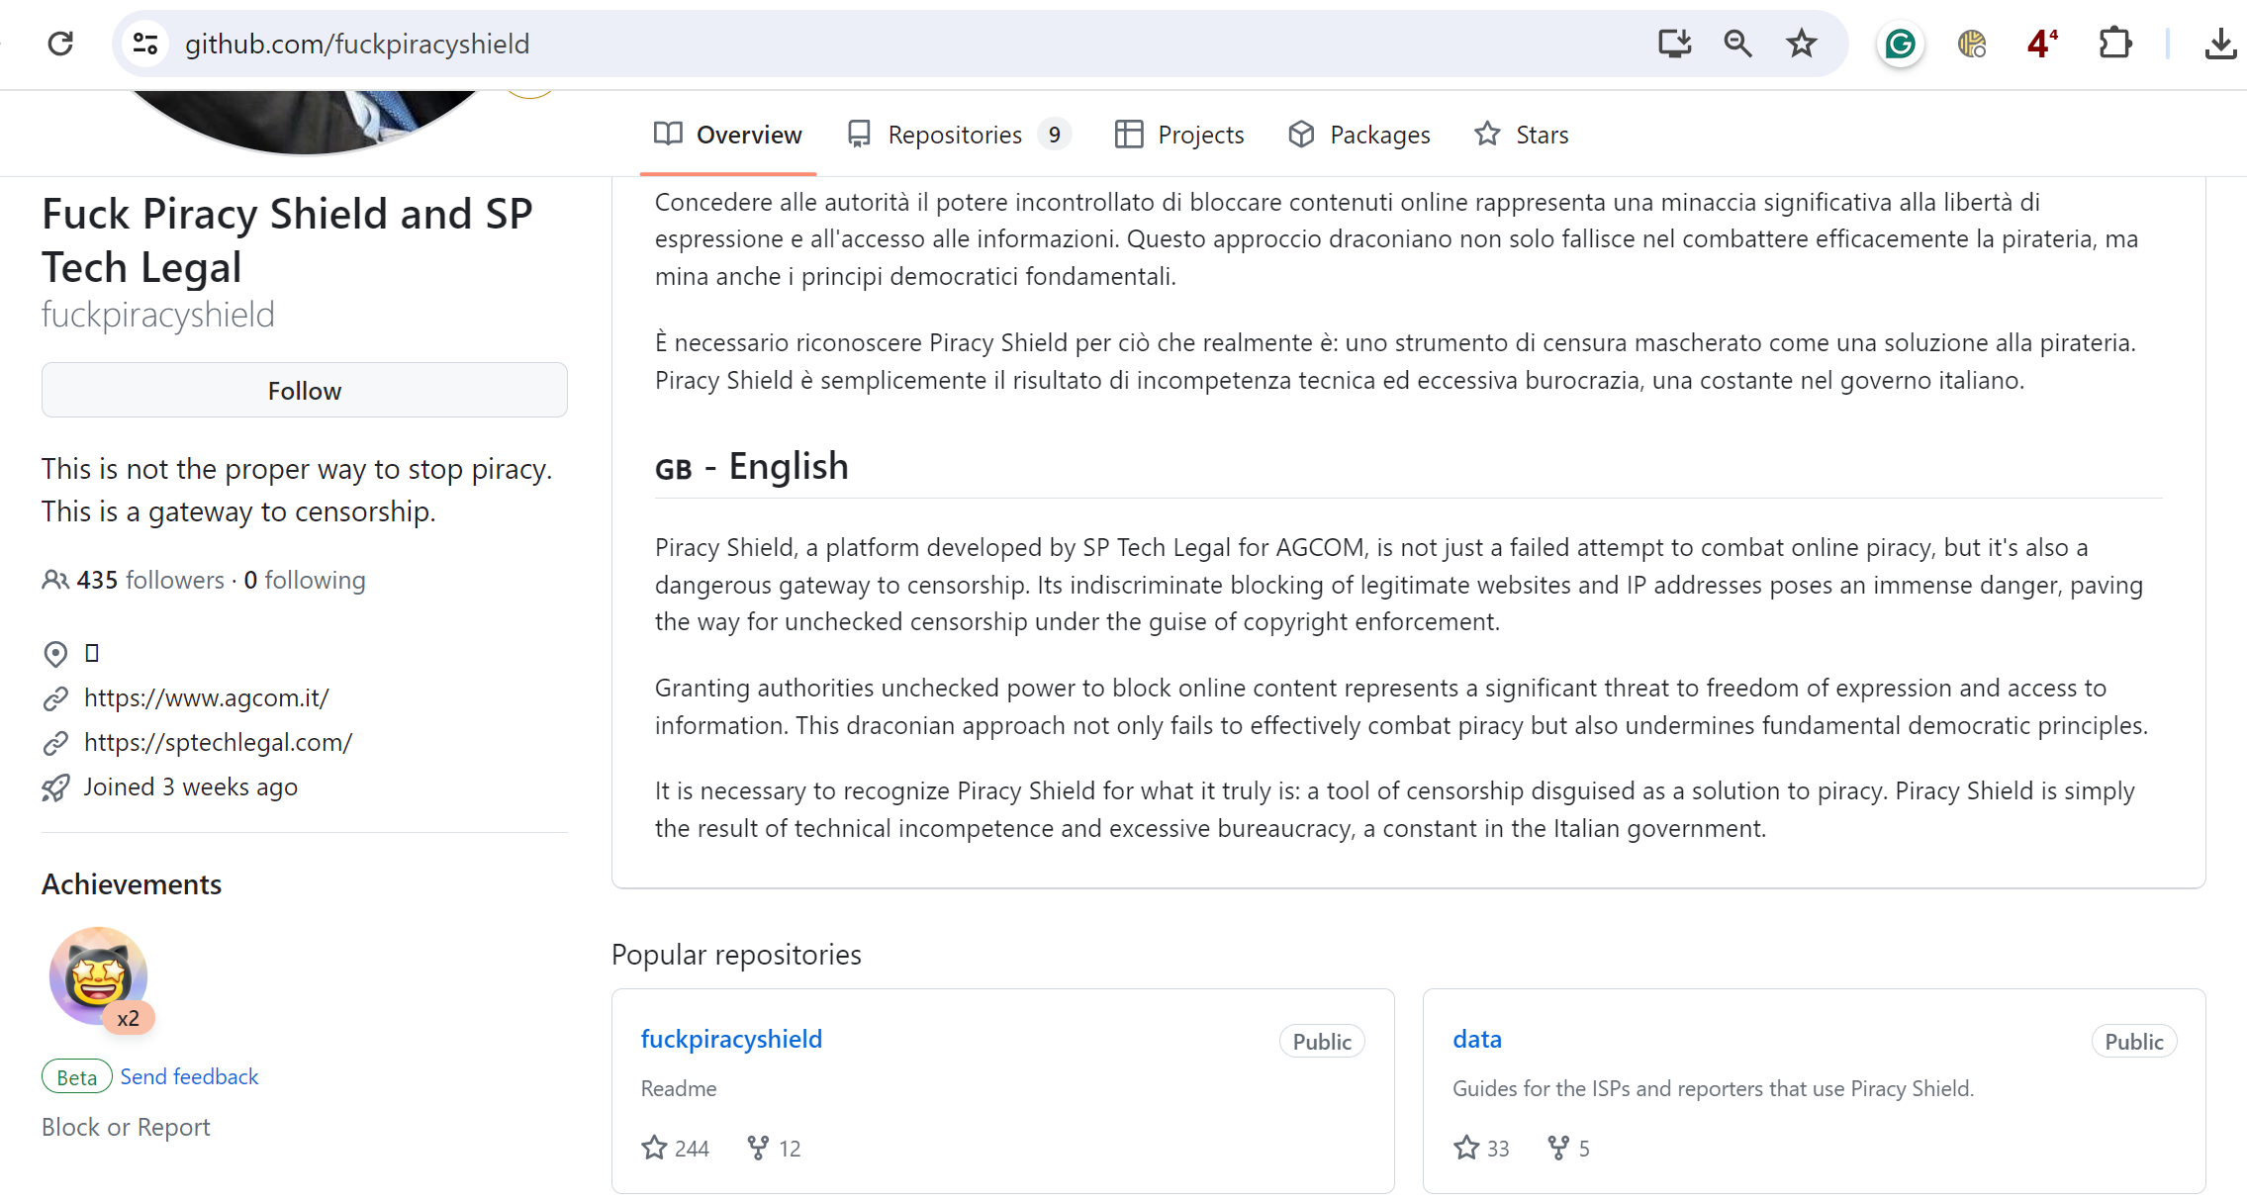
Platform Code
Livio Morina – BalticNOG1
Vilnius – 25/09/2025
Notes:
In the code there was a statement:
If the pushed records contains amazon or aws or google or… discard
But after the disclosure of the code, they removed that part

Slide 18
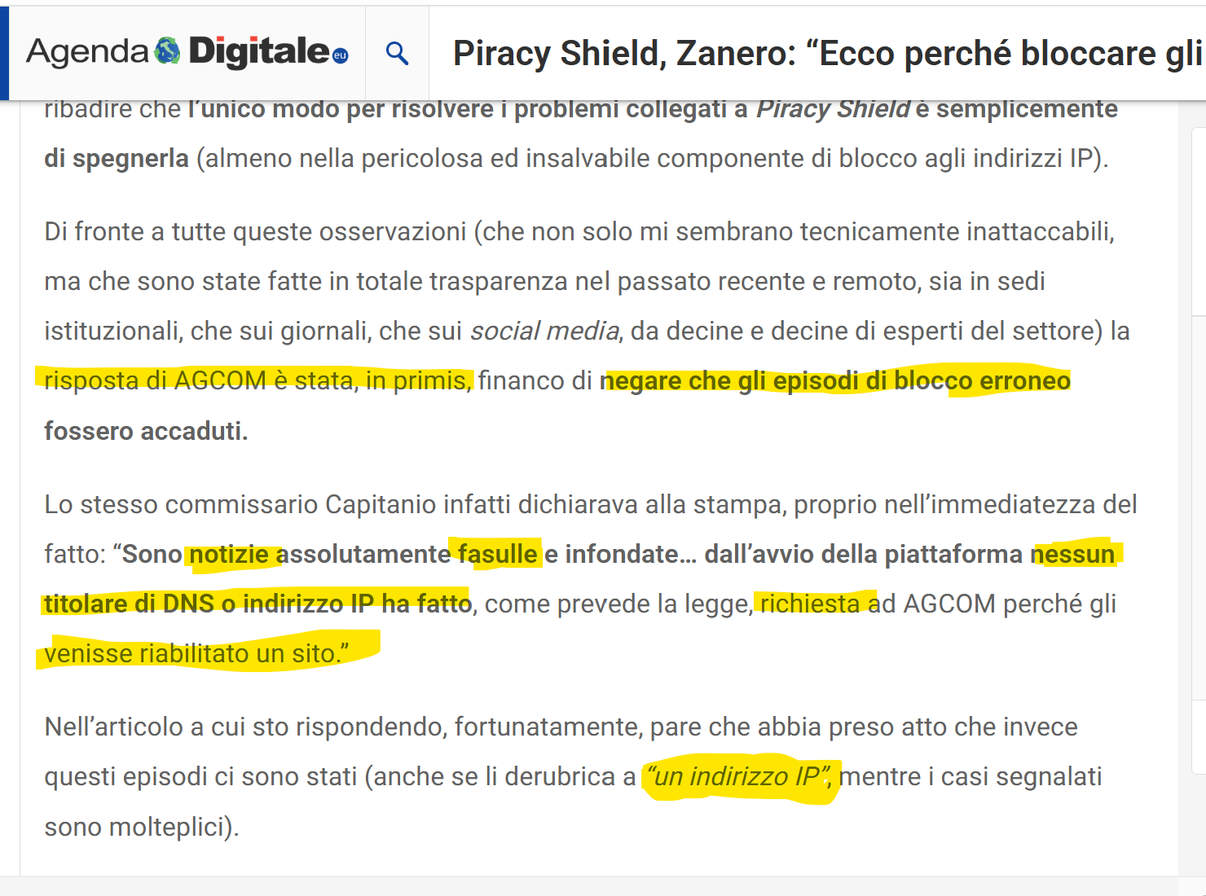
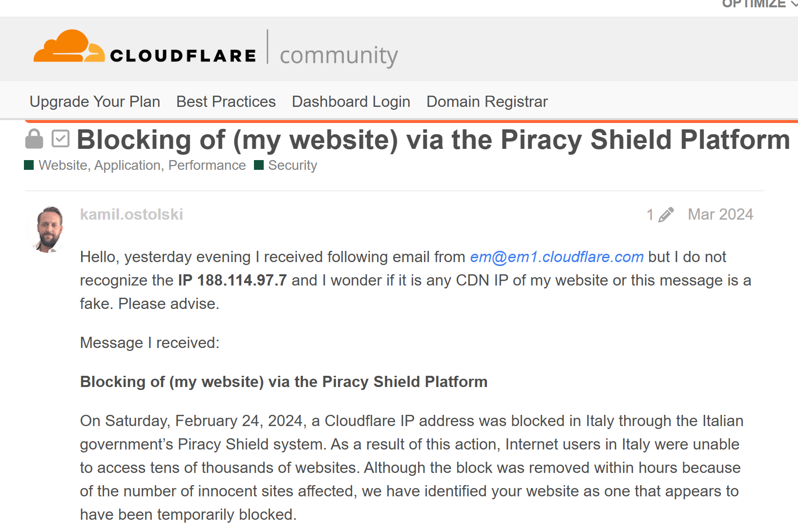
Effects
Stefano Zanero, Full Professor of Computer Security, Digital Forensics and Cybercrime at Politecnico
di Milano, responds to the remarks made by AGCOM Commissioner Massimiliano Capitanio.
Livio Morina – BalticNOG1
Vilnius – 25/09/2025
Notes:
1° big demonstration of the ISSUES was the blacklisting of a CLOUDFLARE IP – estimated 100k websites disappeared for about 2 days

Slide 19
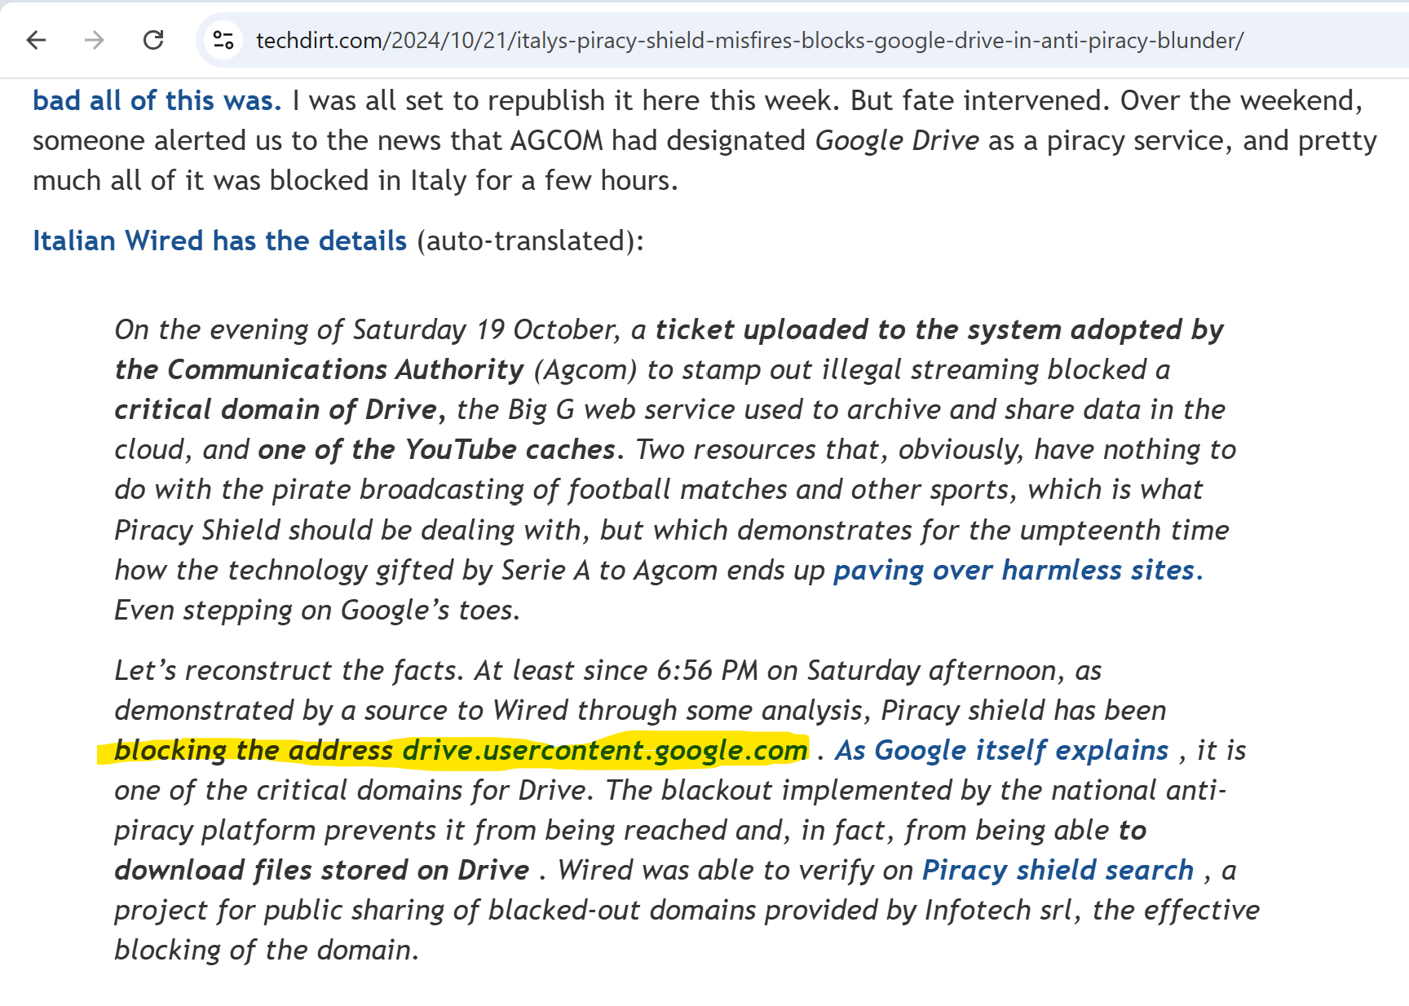
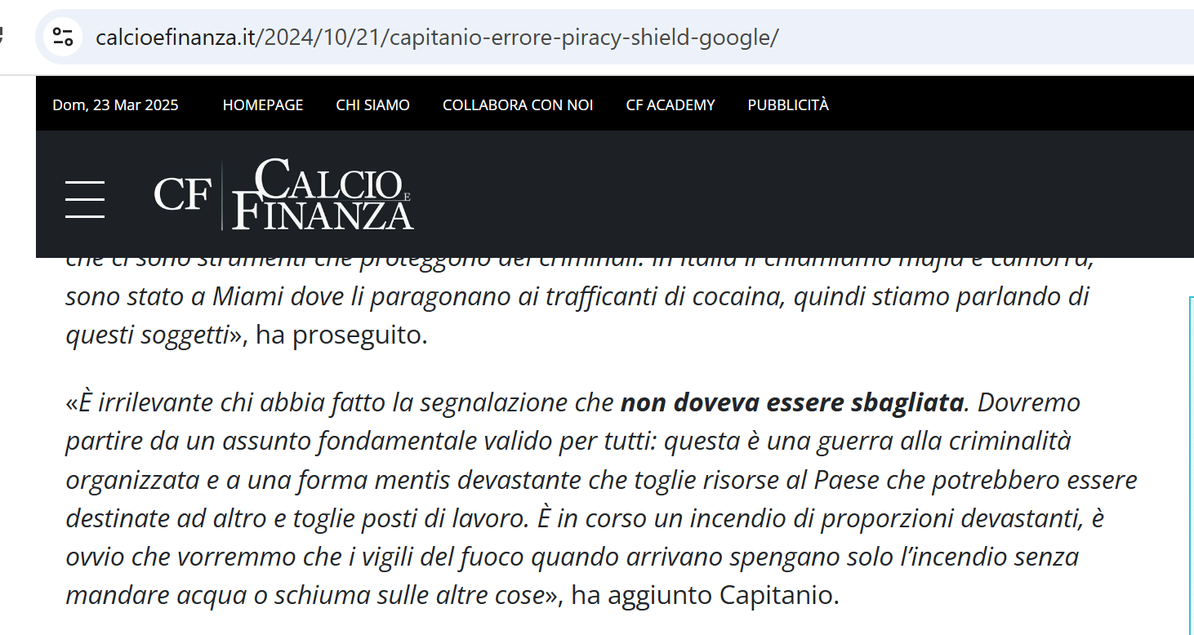
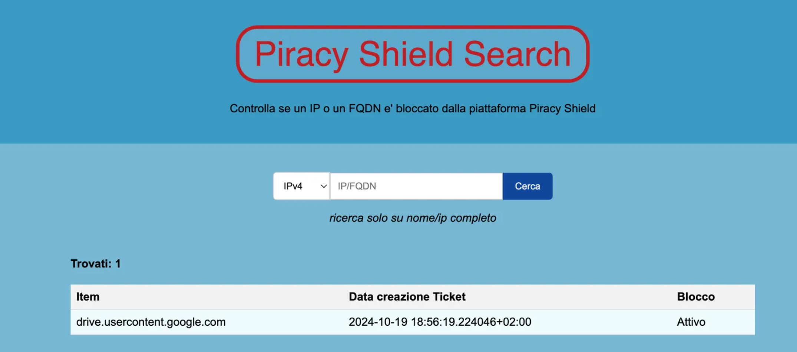
Effects
This is a war on organized crime!
Just like firefighters might douse nearby buildings to contain a fire, this system affects collateral content.
Livio Morina – BalticNOG1
Vilnius – 25/09/2025
Notes:
2nd Google drive (5 to 6 hours)
Miami - cocaine traffickers
Severity Level : WAR - How can you try to interact with such mindset?
NOTE:

Slide 20
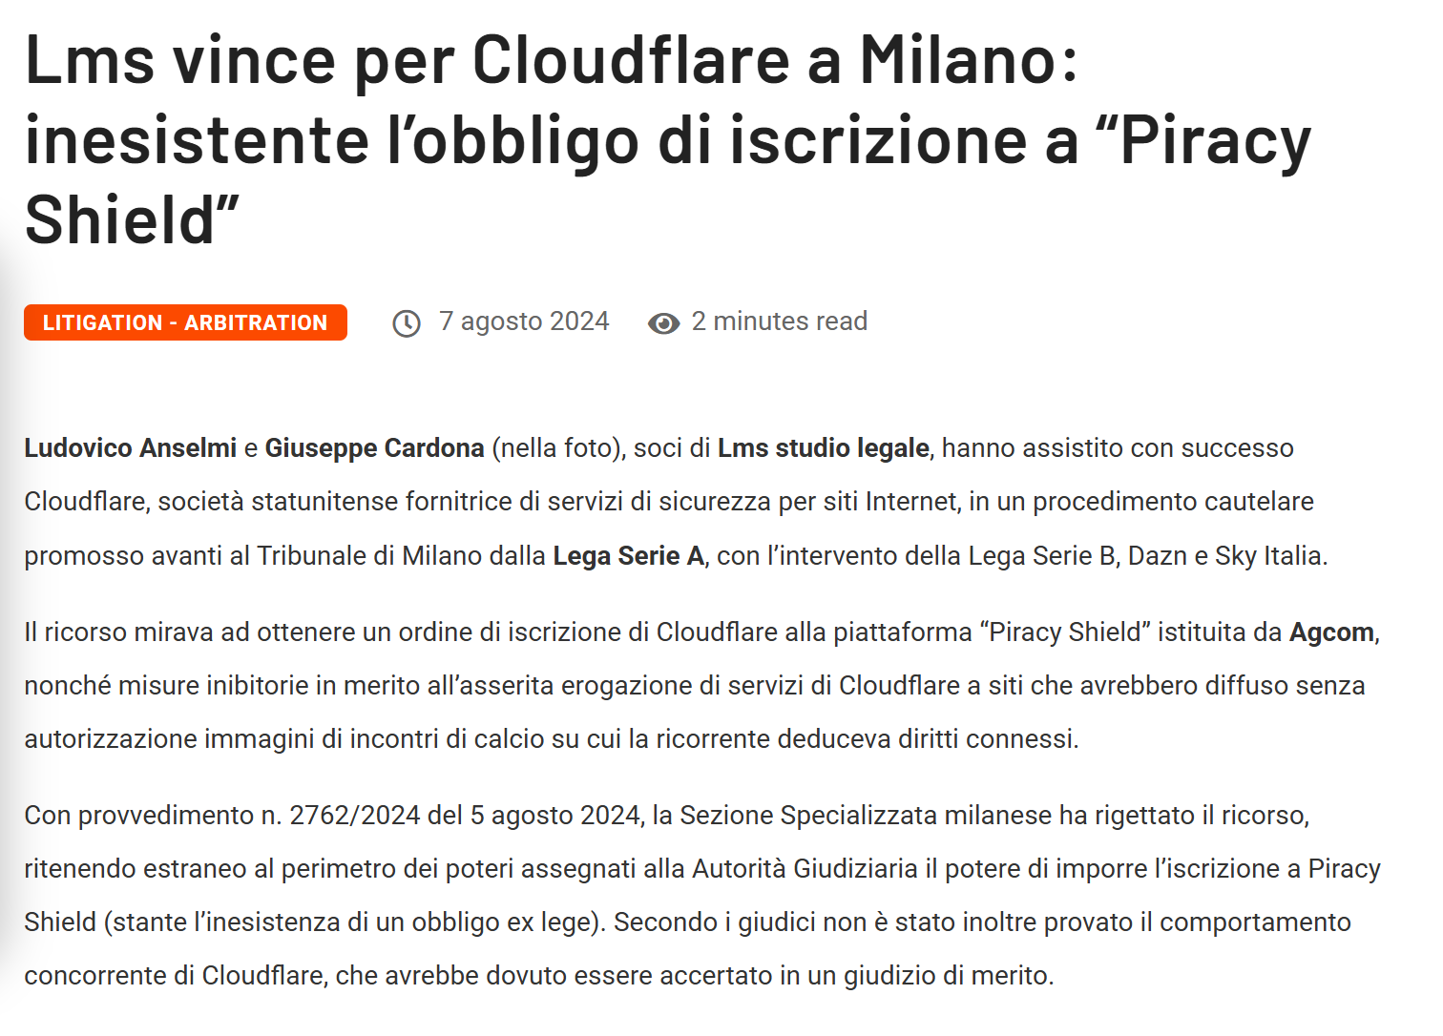
AGCOM & CLOUDFLARE
Livio Morina – BalticNOG1
Vilnius – 25/09/2025
Notes:
Agcom tried to oblige CF with PS
Imprisonment for the ISPs that don’t report subsects

Slide 21
VPN and public DNS providers are now required to comply with Piracy Shield.
Oct 1° 2024 - Decree Omnibus (Latin: Omnibus > For All)
After the first year (February 1st, 2025),
there will be no more limits on FQDNs or IPs.
The previous requirement that IPs be used exclusively for piracy no longer applies; a vague "predominantly" criterion has been introduced.
ISPs may face up to one year of imprisonment if they “know, suspect, or have reasonable grounds to suspect” that criminally relevant conduct is taking place — and fail to report it.
Livio Morina – BalticNOG1
Vilnius – 25/09/2025

Slide 22
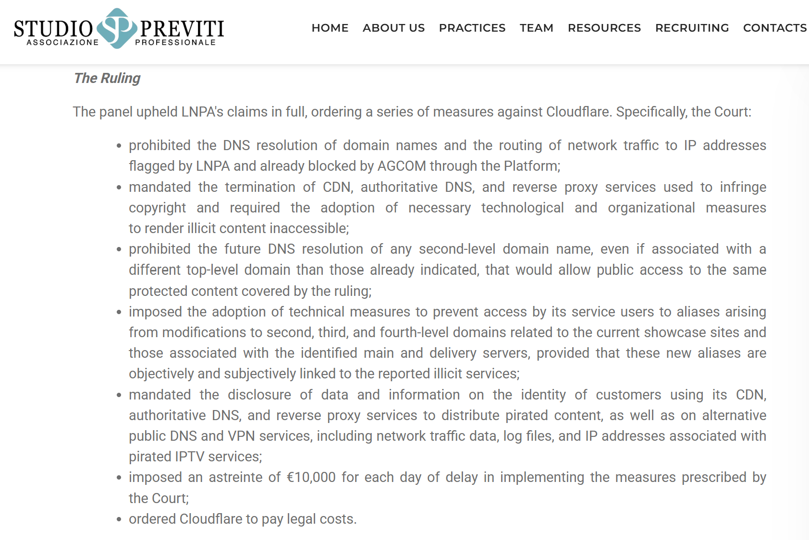
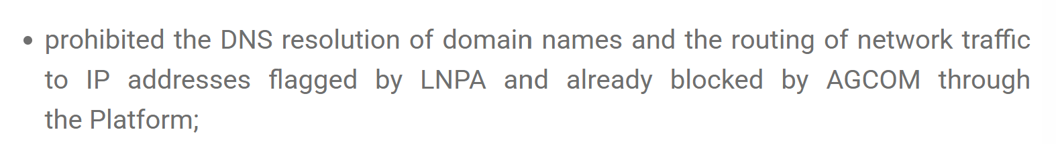
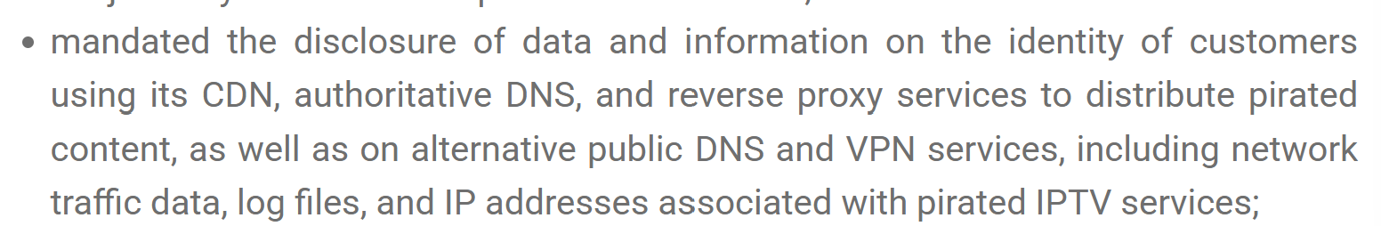
AGCOM & CLOUDFLARE – Second ACT - December 19, 2024
Livio Morina – BalticNOG1
Vilnius – 25/09/2025
Notes:
Agcom tried to oblige CF with PS
Imprisonment for the ISPs that don’t report subsects
Studio Previti Owns SPTECH

Slide 23
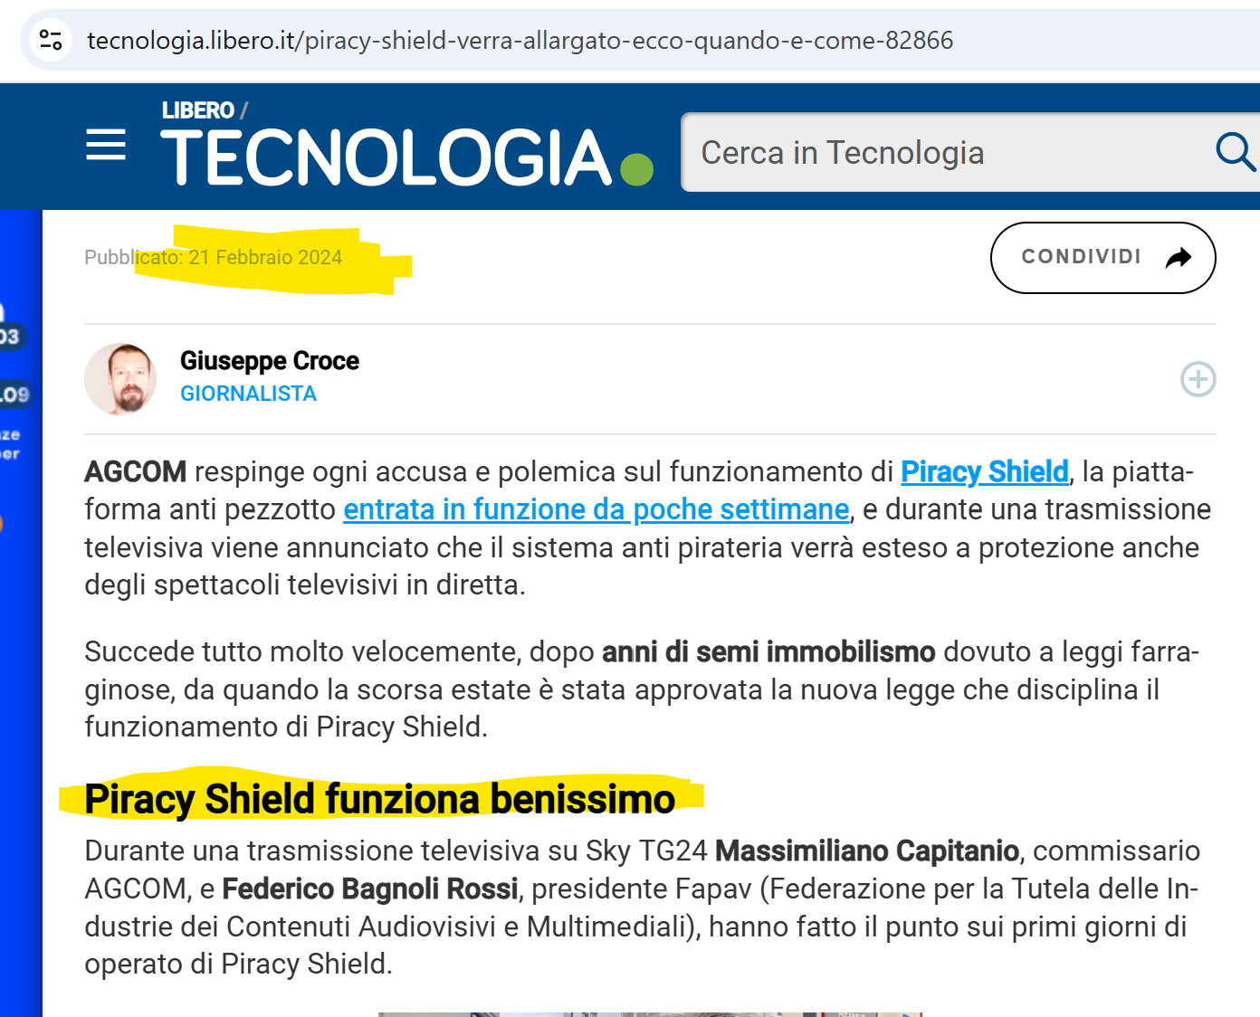
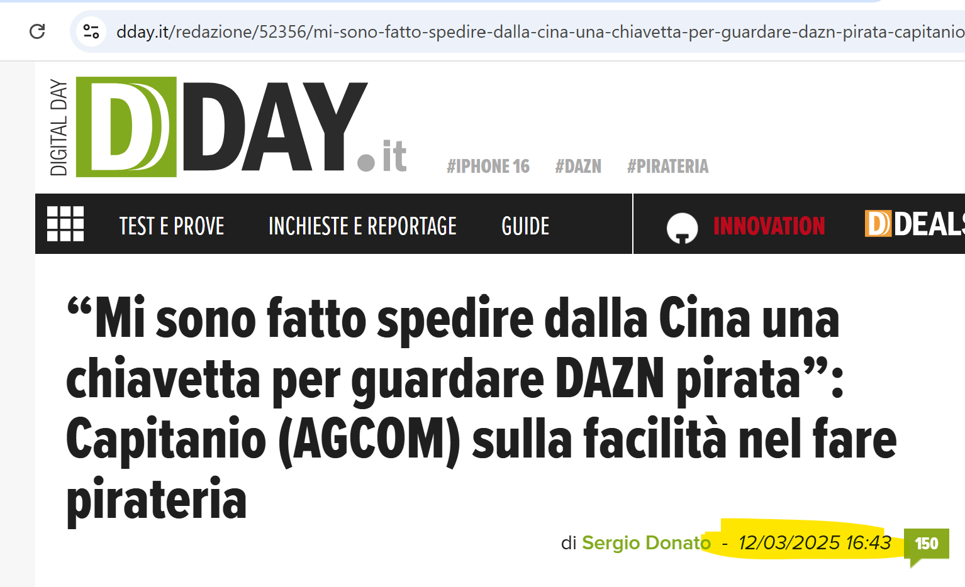
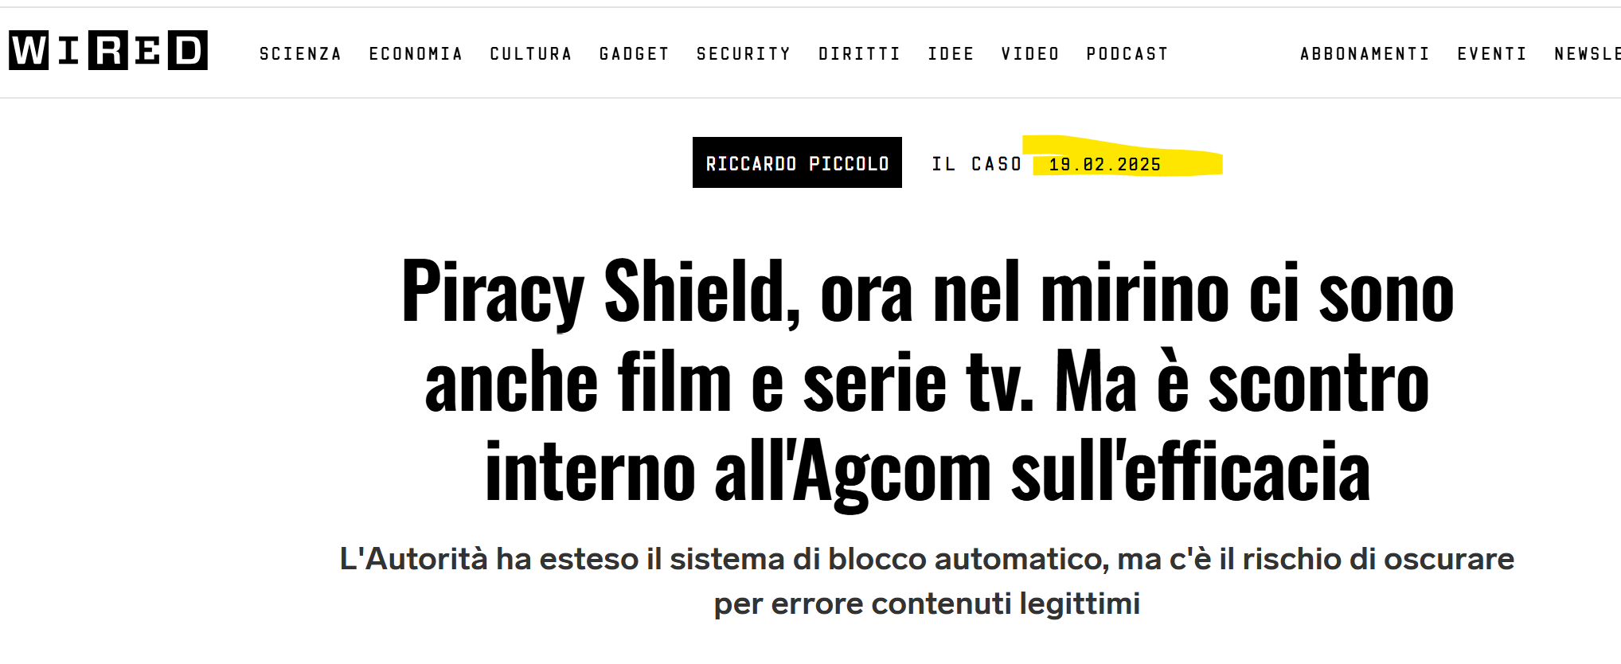
Does Piracy Shield work?
Livio Morina – BalticNOG1
Vilnius – 25/09/2025
Notes:
From day zero, the Authority stated that PS is perfect, including a live interview on SKY-TV during prime time.
It’s time to extend the Piracy Shield to other contents
But wait…
“I had a USB stick sent to me from China to watch pirated DAZN” (delivered directly to the Authority HQ)
So?

Slide 24
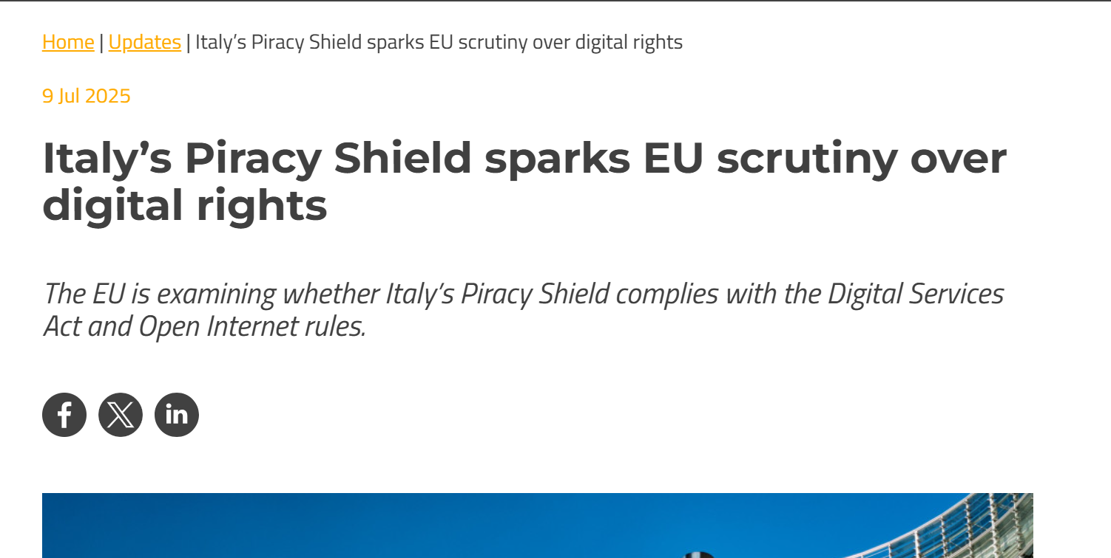
Knock, knock… It’s the European commission
Livio Morina – BalticNOG1
Vilnius – 25/09/2025

Slide 25
Knock, knock… It’s the European commission
Initiatives and Reactions
The Computer & Communications Industry Association filed a complaint with the European Union, highlighting possible violations of the Digital Services Act (DSA) and open internet rules.
AGCOM, through Commissioner Massimiliano Capitanio, defended the system, stressing that it positions Italy as a leader in the fight against illegal streaming.
Current Situation
The European Union is currently assessing whether Piracy Shield complies with the Digital Services Act and open internet rules, given the concerns raised.
Livio Morina – BalticNOG1
Vilnius – 25/09/2025

Slide 26
The first Piracy Shield was limited to ISP,
Today additional entities are required to comply:
August 2025 - Piracy Shield Extention
- Public DNS
- VPN Providers
- CDN
And also new contents protected
- Movie & TV Series
- Music
Livio Morina – BalticNOG1
Vilnius – 25/09/2025

Slide 27
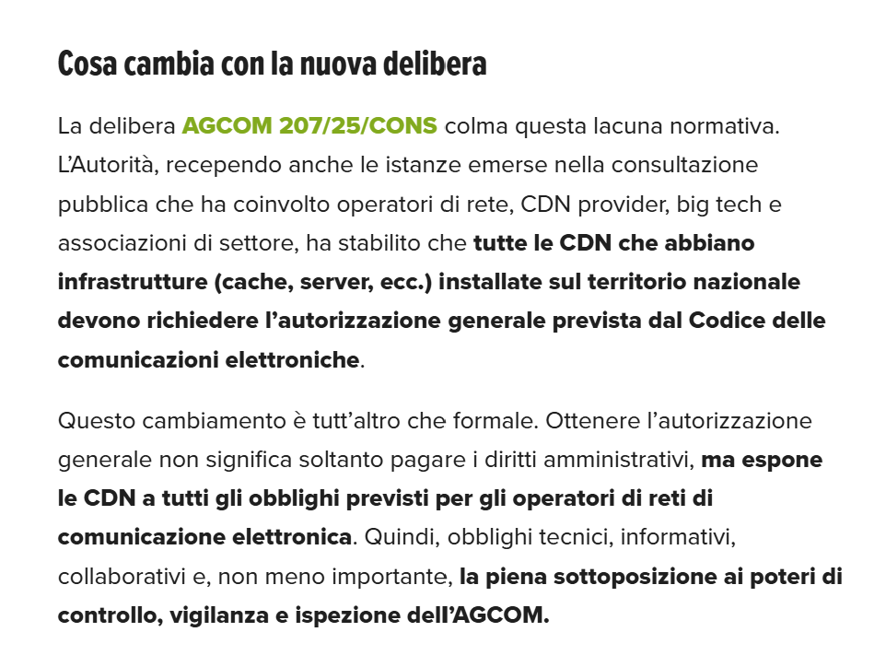
All CDNs with infrastructure (cache, servers, etc.) installed on national territory must request the general authorization required by the Electronic Communications Code.
August 2025 - Piracy Shield Extention
Obtaining general authorization does not only mean paying administrative fees, but exposes CDNs to all the obligations established for electronic communications network operators. Therefore, technical, informational, and cooperative obligations apply, and full submission to AGCOM’s powers of monitoring, supervision, and inspection.
All CDNs with infrastructure (cache, servers, etc.) installed on national territory must request the general authorization required by the Electronic Communications Code.
Livio Morina – BalticNOG1
Vilnius – 25/09/2025
Notes:
This change is far from merely formal.

Slide 28
The system poses a serious threat to internet freedom
Conclusions
It has proven ineffective.
TV rights holders have not reported any increase in subscriptions.
It imposes a significant operational burden on ISPs.
Statistics show that IPv6 is immune to piracy.
Livio Morina – BalticNOG1
Vilnius – 25/09/2025
Notes:
TV right holders: (which in the meantime have increased in cost)

Slide 29

Questions?
Mailto: livio € airbeam.it
Livio Morina – BalticNOG1
Vilnius – 25/09/2025

