Slide 1
Monitoring root DNS prefixes
BalticNOG 2025
Lefteris Manassakis, Engineering Technical Leader
  September 24-25, 2025

Slide 2
Border Gateway Protocol (BGP)
BGP
“The glue that holds the Internet together” - Why is it vulnerable to attacks?
Original specification dates back to 1989 (RFC 1105)
The Internet primarily consisted of universities, research institutions, and governmental networks that operated on mutual trust
As a result, there was no need to incorporate security mechanisms such as authentication and authorization into the protocol

Slide 3
Root DNS Servers
Authoritative name servers
Name | IPv4 | IPv6 | Operator
A-Root | 198.41.0.4 | 2001:503:ba3e::2:30 | Verisign, Inc.
B-Root | 199.9.14.201 | 2001:500:200::b | USC, Information Sciences Institute
C-Root | 192.33.4.12 | 2001:500:2::c | Cogent Communications
D-Root | 199.7.91.13 | 2001:500:2d::d | University of Maryland
…………
M-Root | 202.12.27.33 | 2001:dc3::35 | WIDE Project

Slide 4
Root DNS Server Prefixes
Motivation
Why monitor them?
Critical Internet infrastructure, worth protecting
These prefixes are heavily anycasted. BGP anomalies (e.g. exact prefix hijacks) can go largely unnoticed, due to their limited impact on the data plane

Slide 5
Root DNS Server Prefixes
Methodology
How we alert on events?
Identify the covering prefix of each root DNS server’s IP address in the Default-Free Zone (DFZ)
    For example, B-Root's IPv4 address (199.9.14.201) is covered by its announced prefix, 199.9.14.0/24
Identify the ASN that announces it
Create alert rule – “This prefix is allowed to be announced only by this ASN”

Slide 6
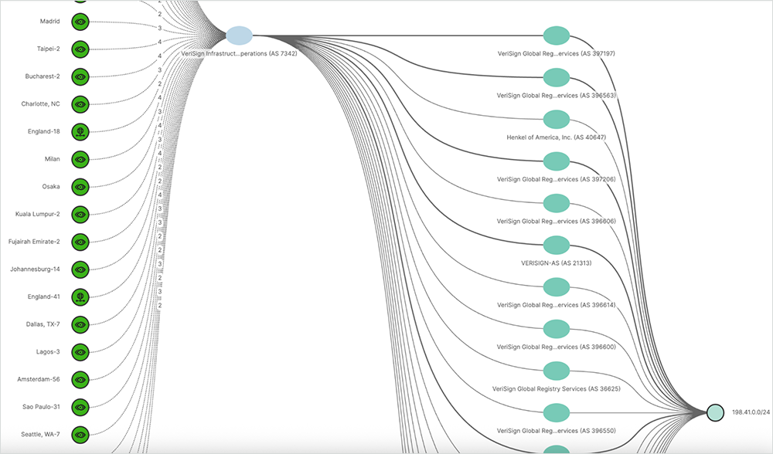
Verisign
Exception
Creating alert rules is more complex – requires use of the API
Verisign uses a unique ASN per node (RFC 6382)

Slide 7
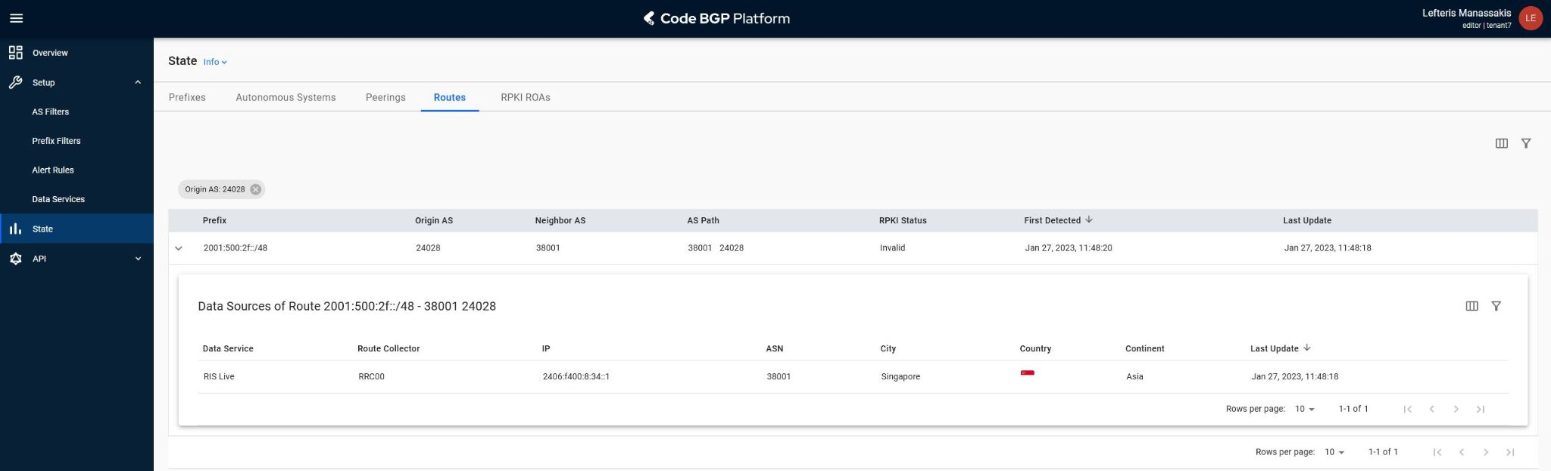
Jan 27, 2023 – F-Root
Events
AS 24028 appeared as origin of 2001:500:2f::/48 - ISC (AS 3557)

Slide 8
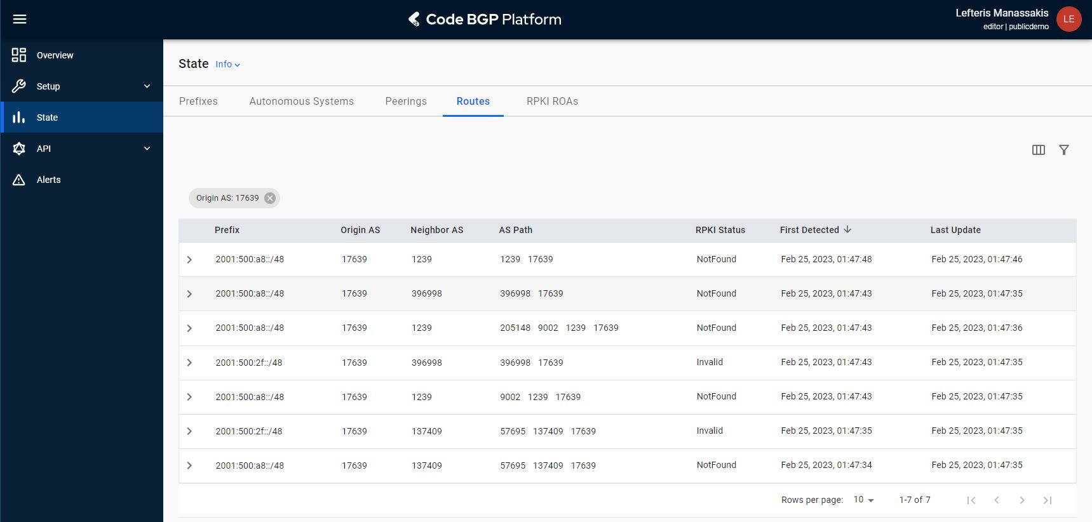
Feb 25, 2023 – E-Root and F-Root
Events
AS 17639 appeared as origin of 2001:500:a8::/48 - NASA (AS 21556)

Slide 9
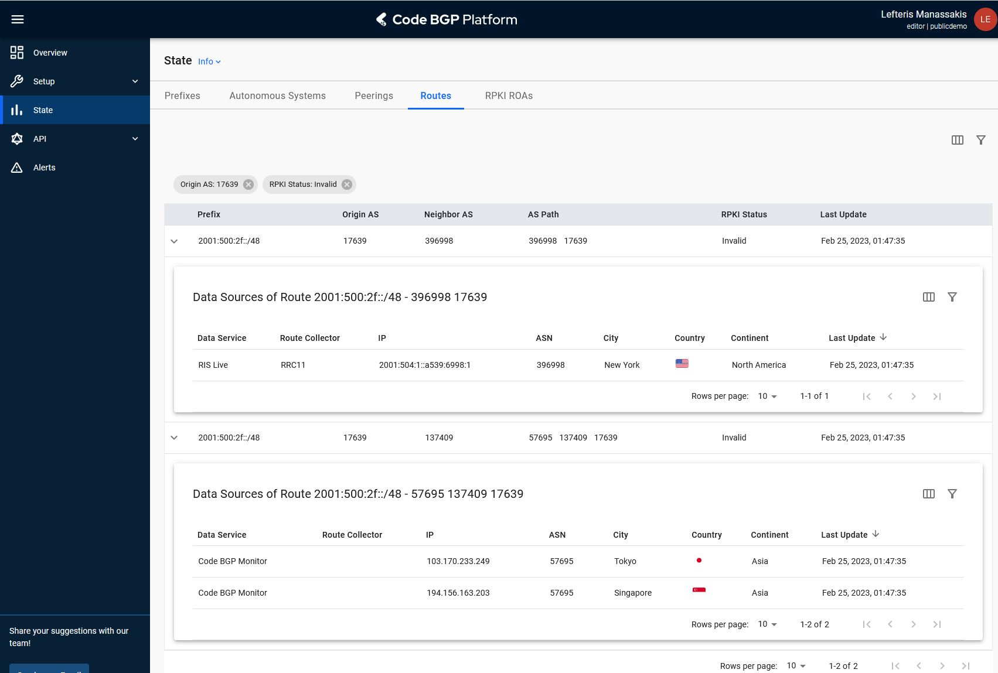
Feb 25, 2023 – E-Root and F-Root
Events
The same AS 17639 appeared as origin of 2001:500:2f::/48 - ISC (AS 3557)

Slide 10
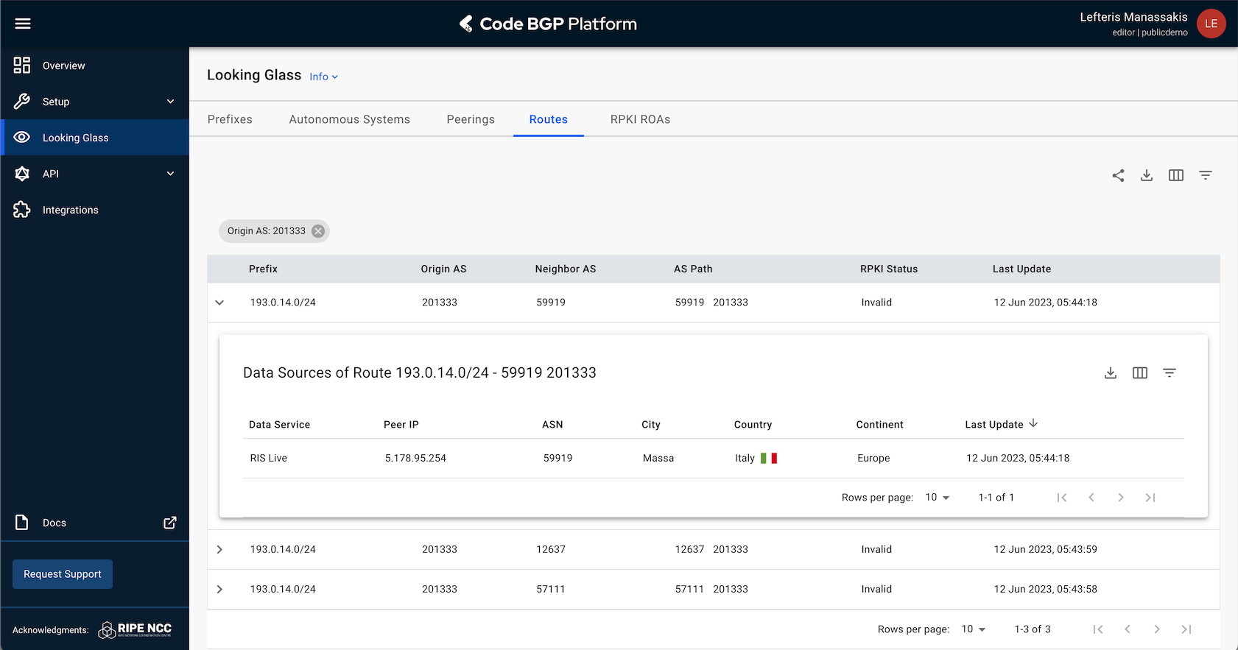
June 12, 2023 – K-Root
Events
AS 201333 appeared as origin of 193.0.14.0/24 – RIPE NCC (AS 25152)

Slide 11
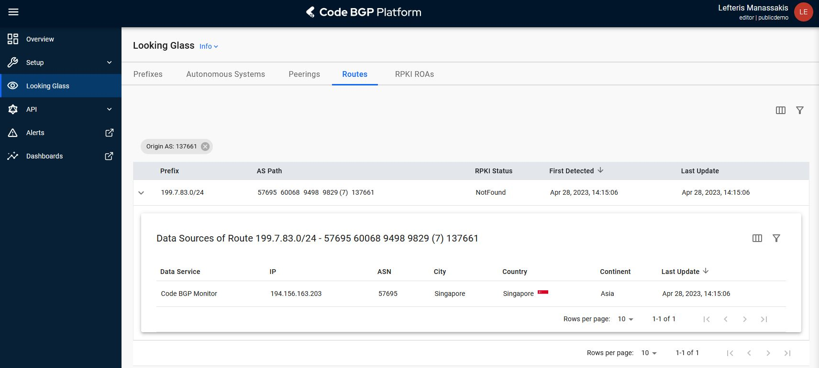
Apr 28, 2023 – L-Root
Events
AS 137661 appeared as origin of 199.7.83.0/24 - ICANN (AS 20144)

Slide 12
Cover dark corners
Visibility
where public sources lack visibility
This event was not detected by RIPE RIS due to it’s very long AS Path (11 hops). However, it was picked up by our monitors [4]
We started monitoring again in the summer of 2024, and the event was still ongoing!
[4] “Suspicious Route against a Root DNS Prefix” – ThousandEyes Blog, 2023

Slide 13
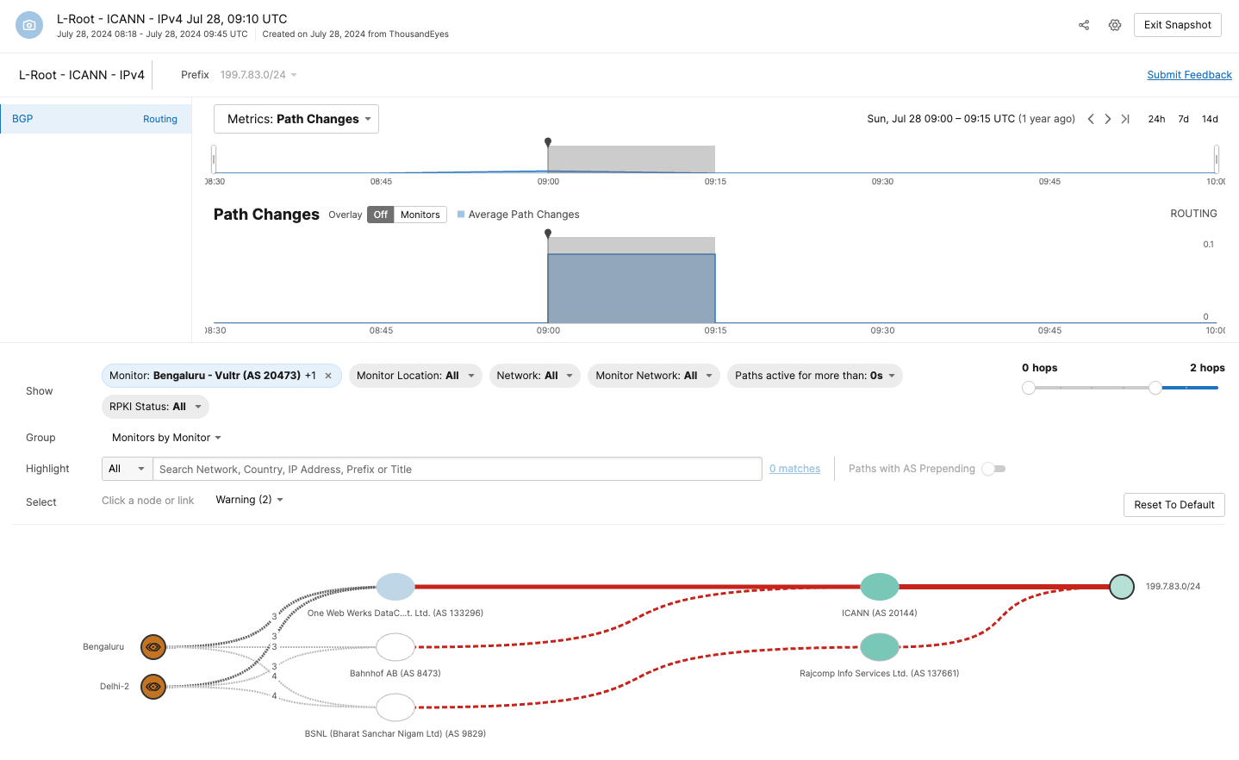
Visualization of AS paths
Visibility
Event was picked up by only two BGP monitors in India

Slide 14
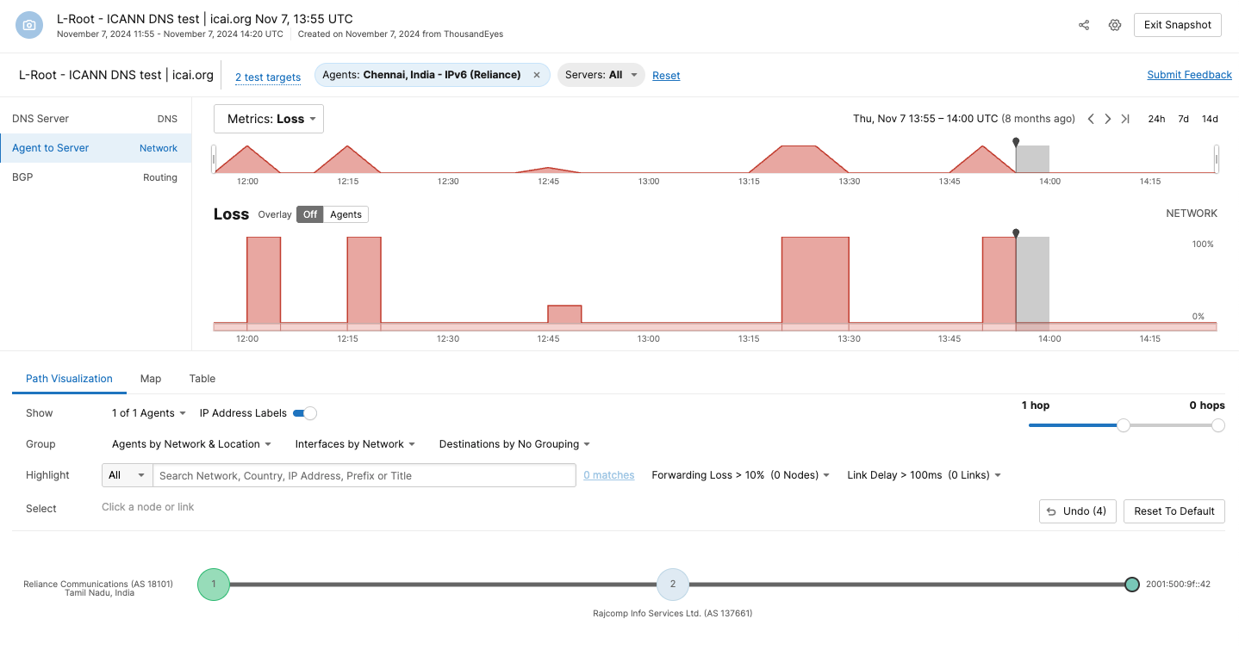
Only 3 probes in India
Data plane impact
were forwarding DNS queries via the offending ASN

Slide 15
Well known research topic
Motivation
Security/Visibility: Research has shown that carefully crafted hijacks to avoid detection by public sources are feasible [2]
    [2] “On the Effectiveness of BGP Hijackers That Evade Public Route Collectors”, 2023

Slide 16
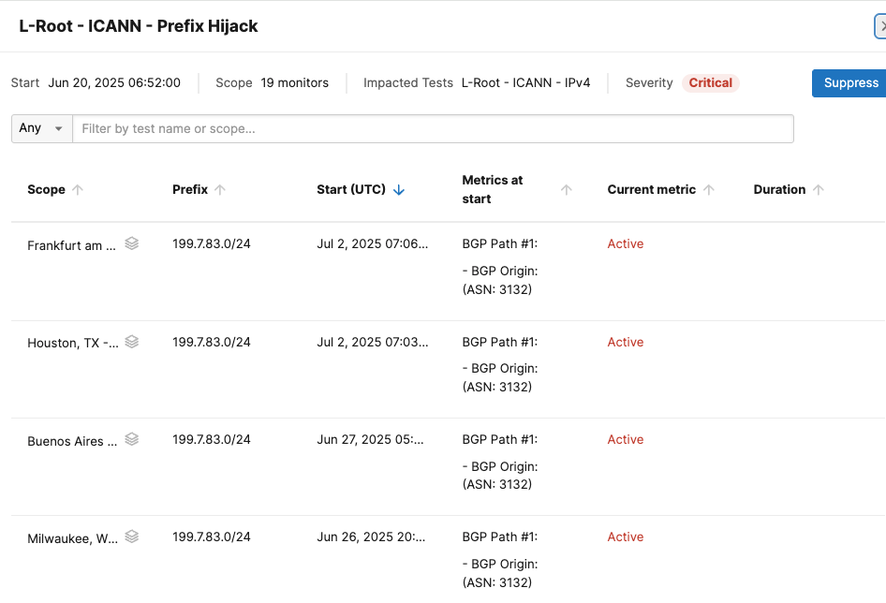
Jun 20, 2025 – L-Root
Events
AS 3132 appeared as origin of 199.7.83.0/24 - ICANN (AS 20144)

Slide 17
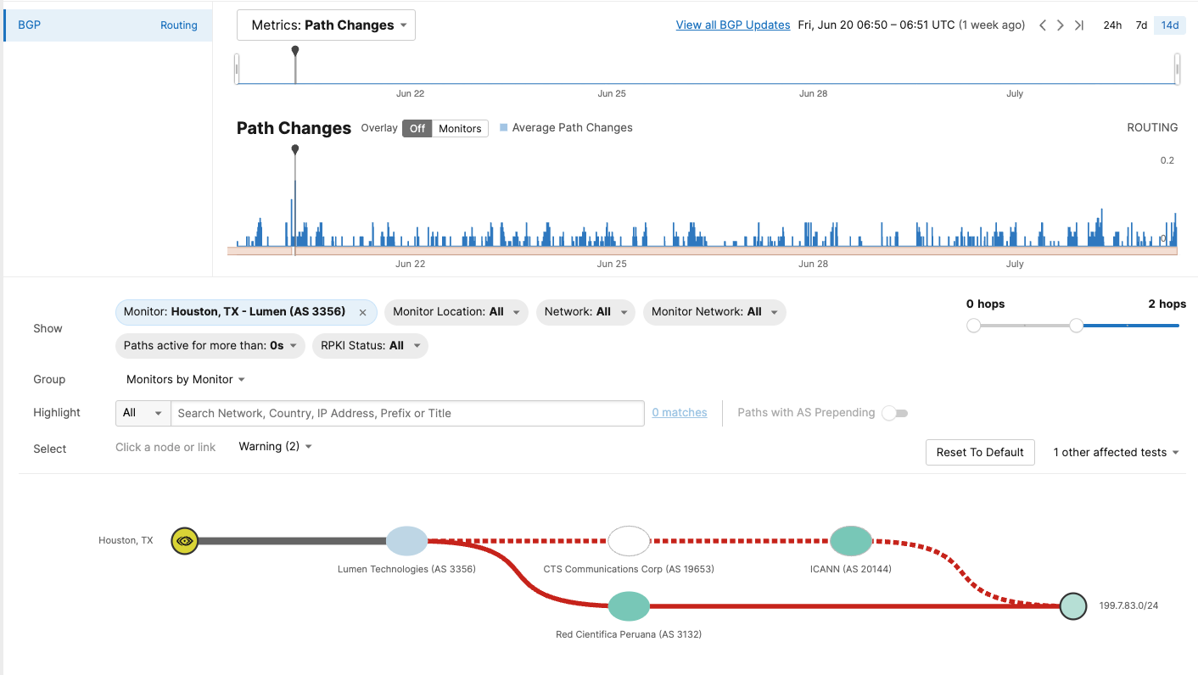
Visualization of AS paths
Visibility
Event was “seen” by only 19 (out of many 100s) BGP monitors

Slide 18
Visualization of AS paths
Visibility
Event was “seen” by only 19 (out of many 100s) BGP monitors

Slide 19
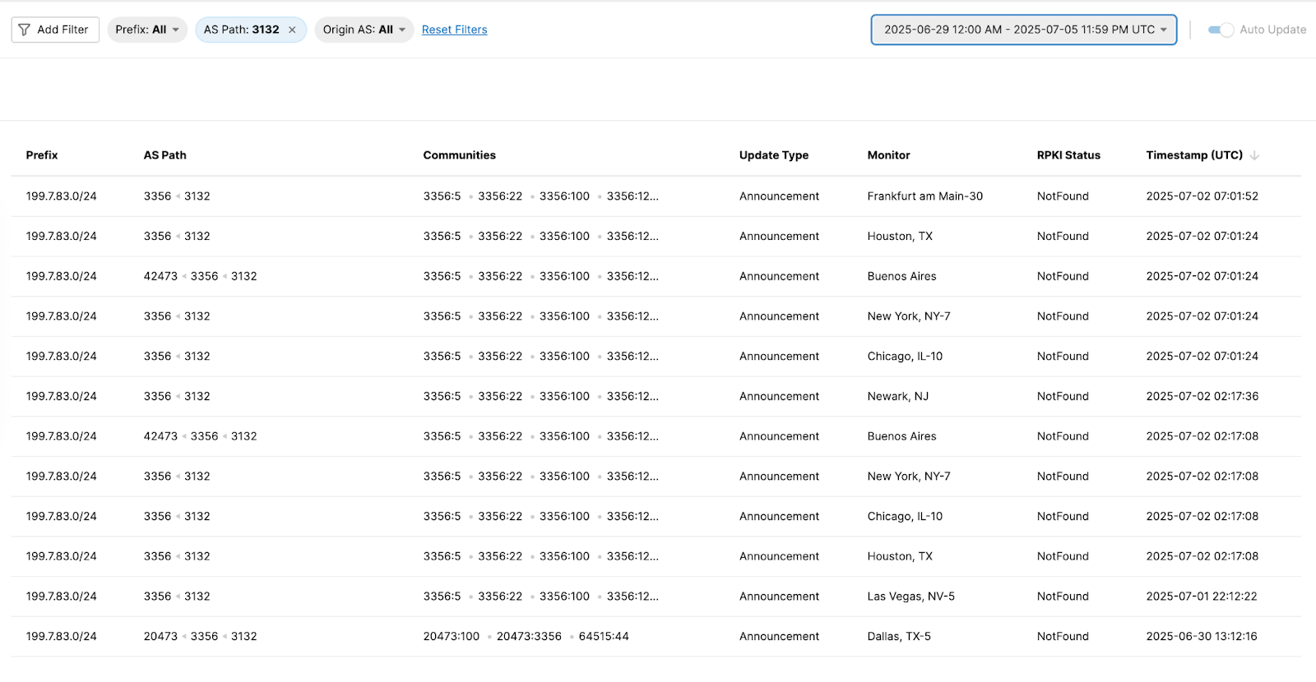
BGP updates table
Raw data
Lumen was picking up and propagating the announcement

Slide 20
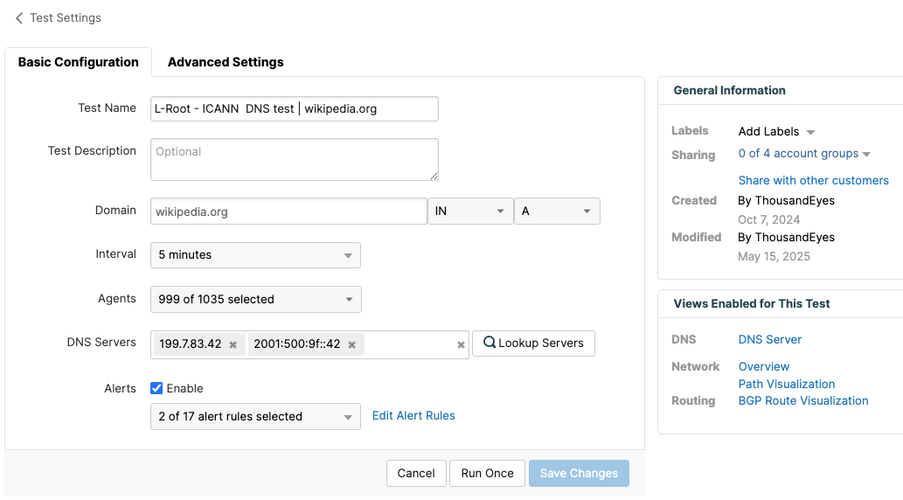
Setting up a suitable DNS test
Data plane impact
Querying a .org domain – L-root IPs as lookup servers

Slide 21
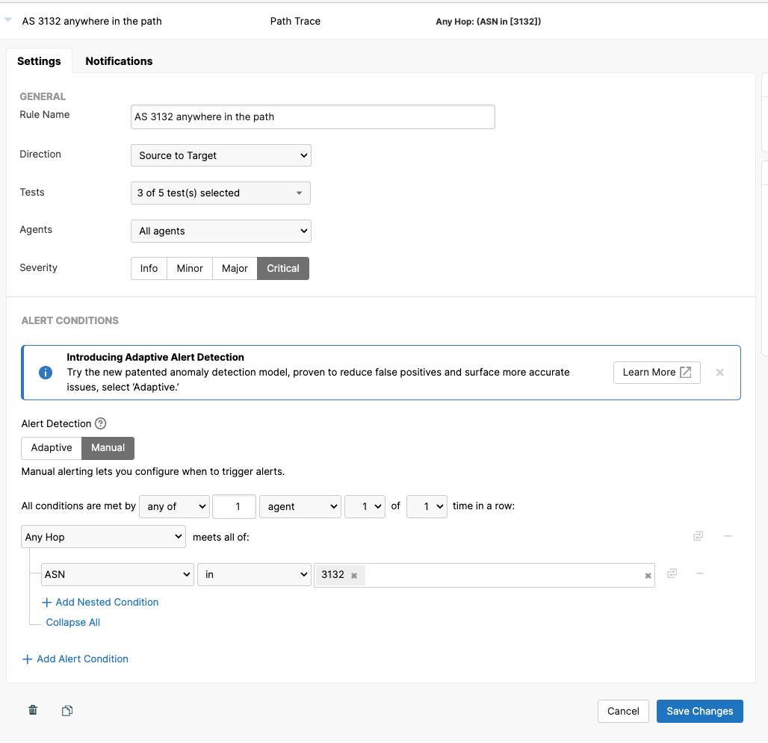
Setting up an alert rule
Data plane impact
Alerting when AS 3132 shows up anywhere in the AS path

Slide 22
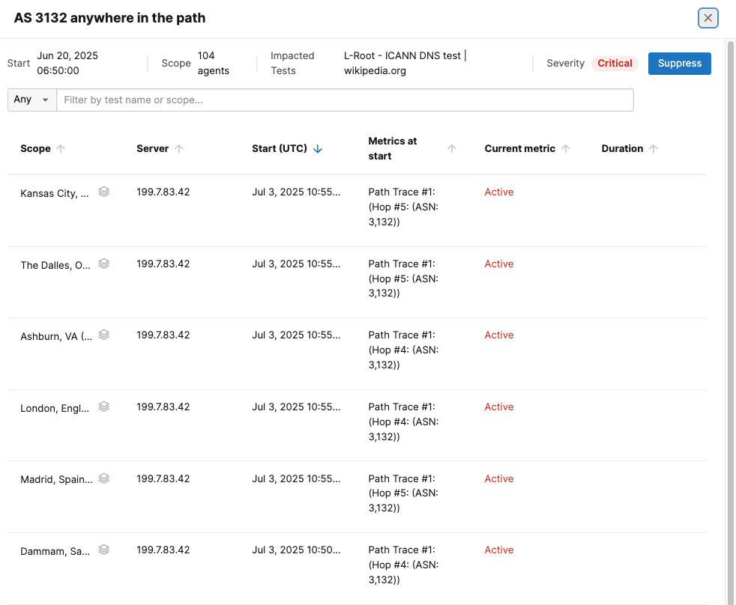
104 (out of 1000+) probes
Data plane impact
were forwarding DNS queries via the offending ASN

Slide 23
Conclusion
Takeaways
For the networks who haven’t yet, please create your ROAS
In BGP, the more you look, the more you find
  Need for quality BGP monitoring

Slide 24
Questions?
leftman@cisco.com

