Slide 1



Automated Network Asset Discovery: Eliminating Human Error Through Intelligent System Integration
Marcin Kaźmierczak
Solution Architect

Slide 2
Why network automation matters today
95%
5600$
1,76mln $
82%
of network outages are caused by human error
average cost of network downtime per minute
cost reduction in organizations with advanced automations
of breaches still involve a human element
Sources: Gartner, Verizon & IBM's reports

Slide 3
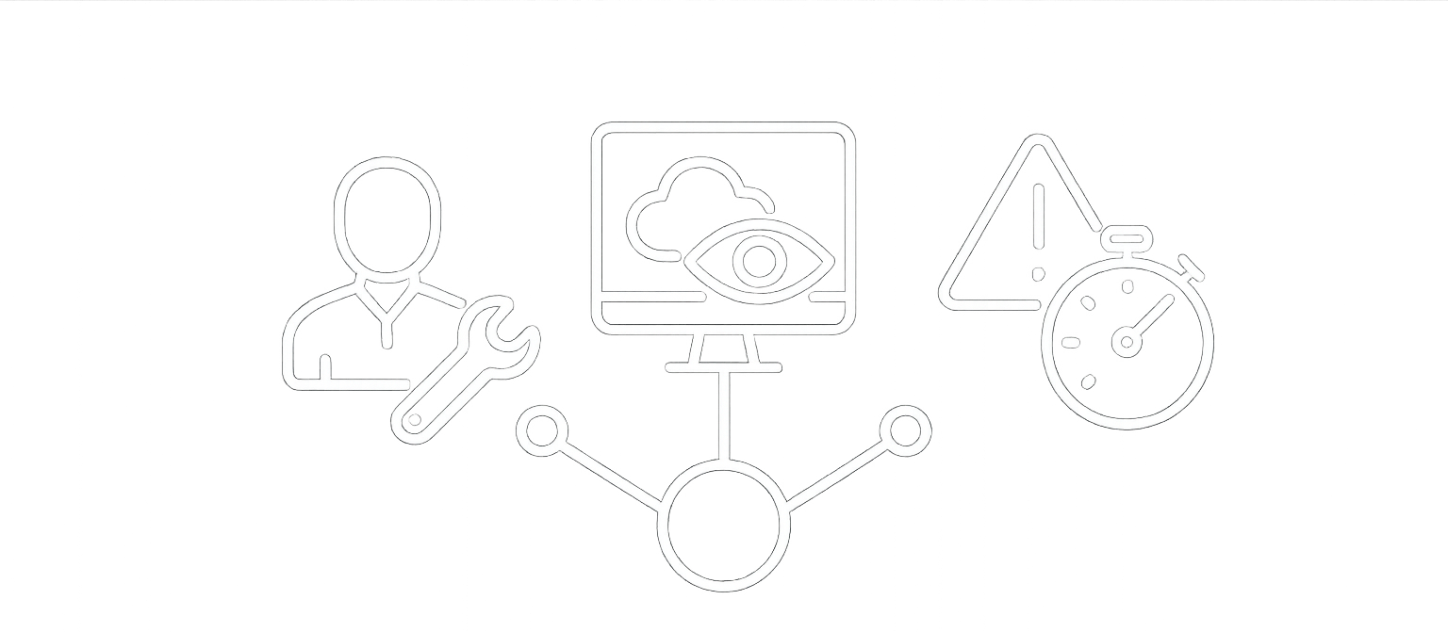
Challenges of traditional network operations
Manual configuration & troubleshooting
Limited visibility across hybrid networks
Slow response to anomalies and threats

Slide 4

Next Generation Approach to Monitoring & Detection (based on NetFlow data)
NOC Teams
NTA
Network Traffic
Analysis
NPM
Network Performance
Monitor
SOC Teams
NDR
Network Detection
and Response
1-minute intervals
Intelligent Trends & Baselines
Passive flow traffic analysis
Automatic Asset Inventory
Application Discovery
No credentials required
Online Repository for Threats and Suspicious activity
Dynamic Alerts and Rules

Slide 5
Network automation
Actions & Integration

Slide 6
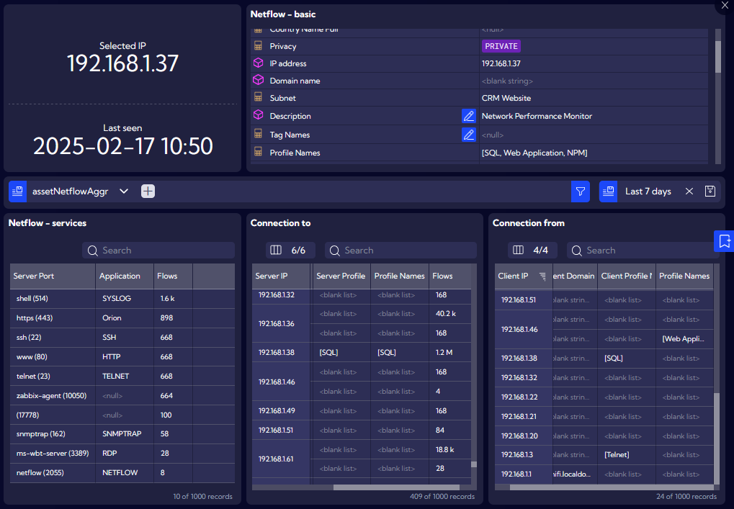
Automatic Device & Application Discovery
Use NetFlow to create Automatic Inventory of your network
Detect Clients and Servers
Inventory of Applications, Ports, Incoming and Outgoing Connections
Detailed Inventory per object
Current Application status and activity

Slide 7
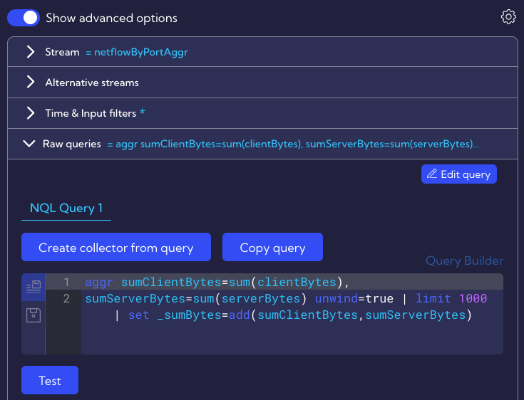
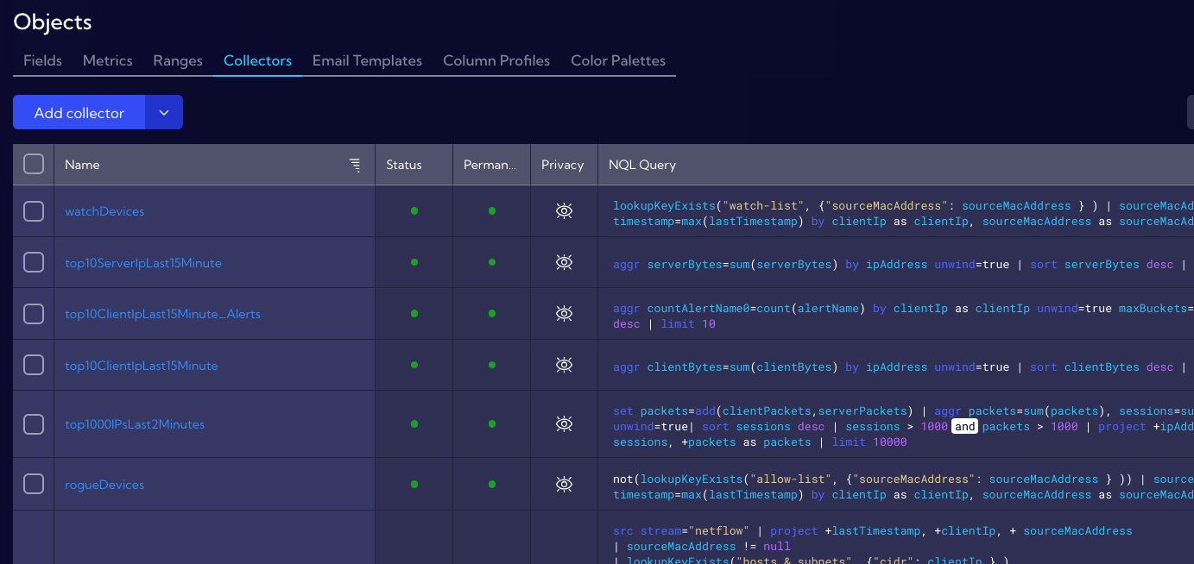
Automation using Mapping & Objects
Support any custom fields
Types:
Lookup
Mapper
Tags
Macros
Fields
Metrics
Ranges
Collector
Bidirectional API synchronization
7
Sekcja

Slide 8
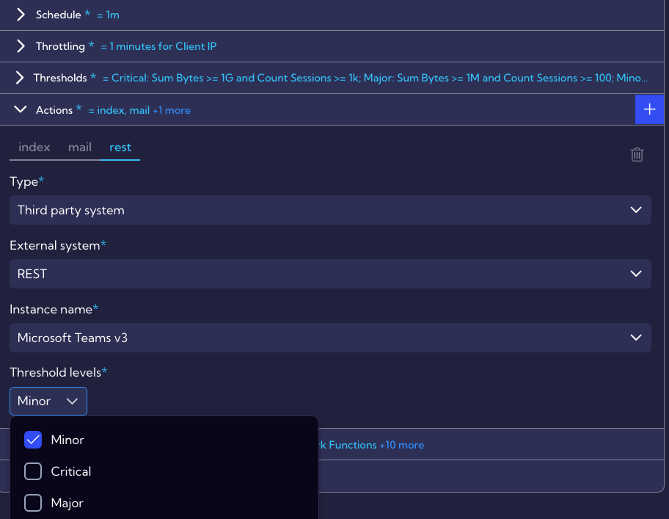
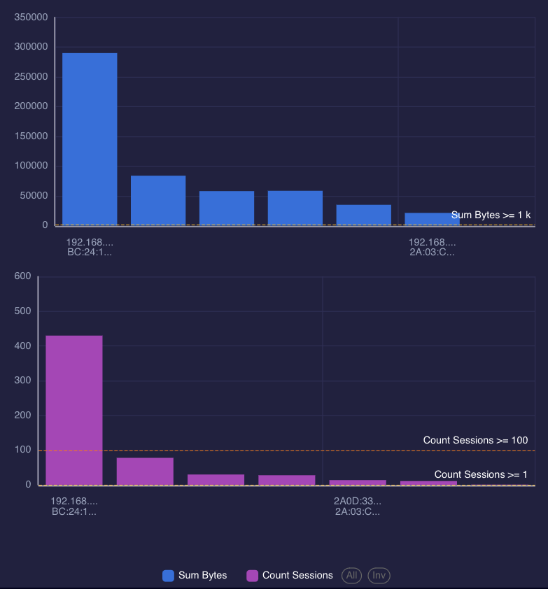
Advanced Alerts & Rules
Simulate trigger conditions
Multiple actions per alert
Choose what to do based on exceeded Threshold: Minor, Major & Critical (multiple options are supported)
Possible actions:
Syslog & Trap Messages
Sending emails
REST API with built-in or Custom Payload with multiple placeholders

Slide 9












Integrations

Slide 10
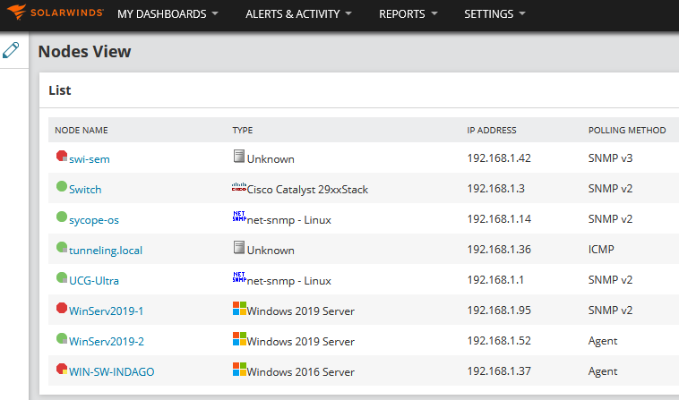
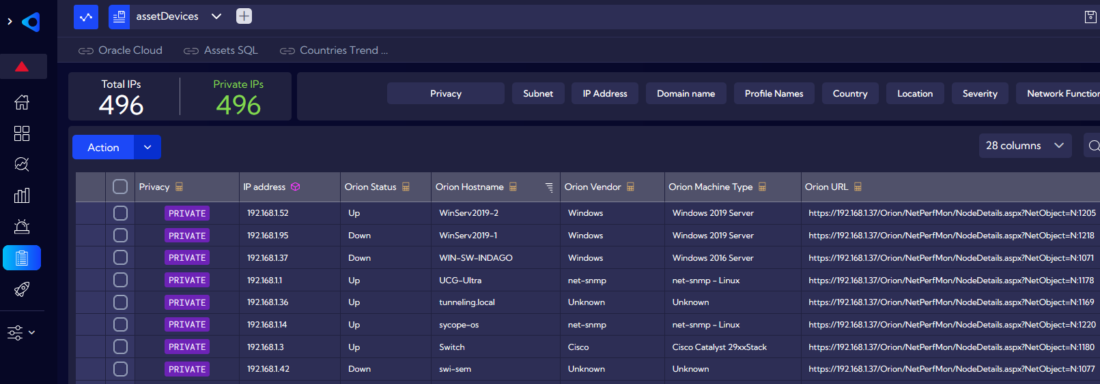
Automatic Inventory Synchronization
Integration via REST API and bidirectional data exchange
URL shortcut to other systems (simple switching between different portals)
Use values from other systems for filters, alerts and more
Example based on integration between Sycope and SolarWinds

Slide 11
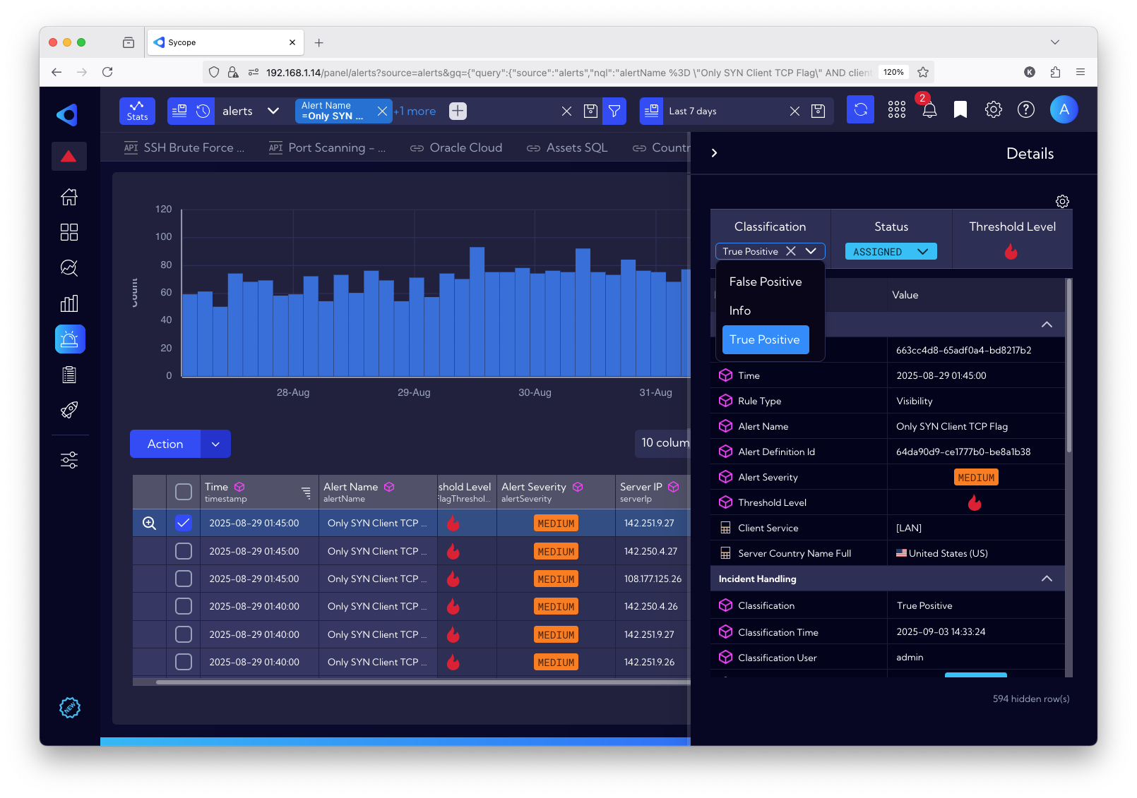
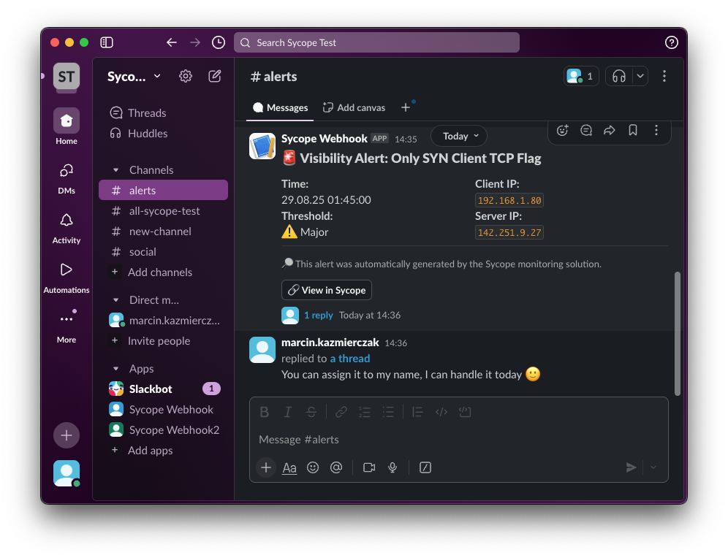
Send Alerts & Threats to Communicators – Slack, Discord Add automatic actions to buttons

Slide 12
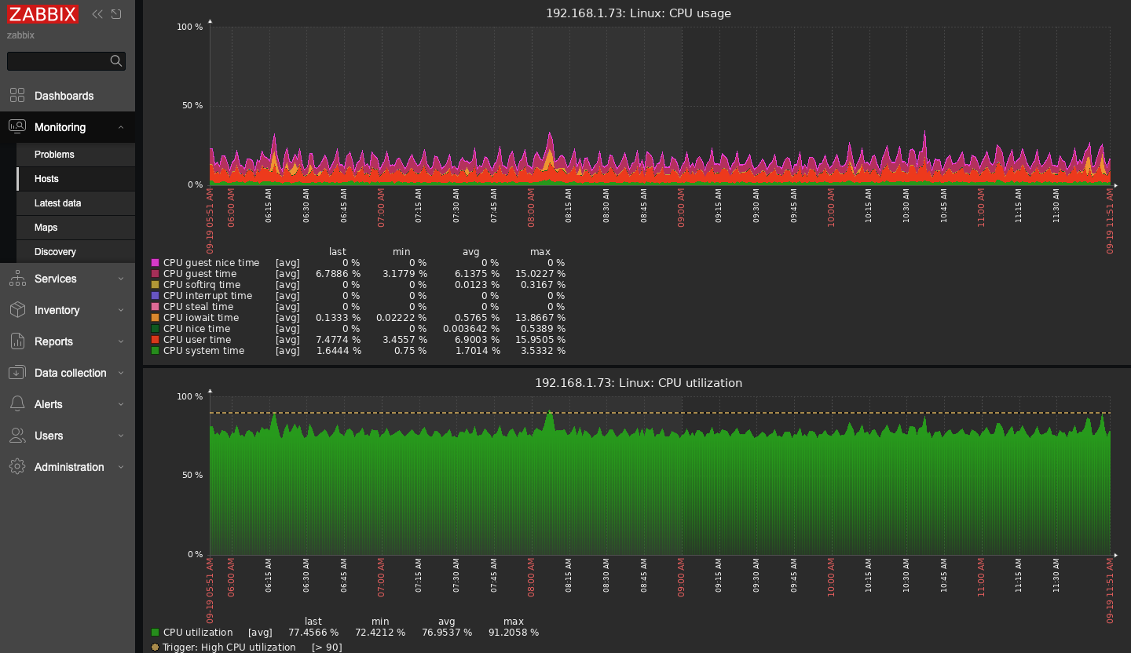
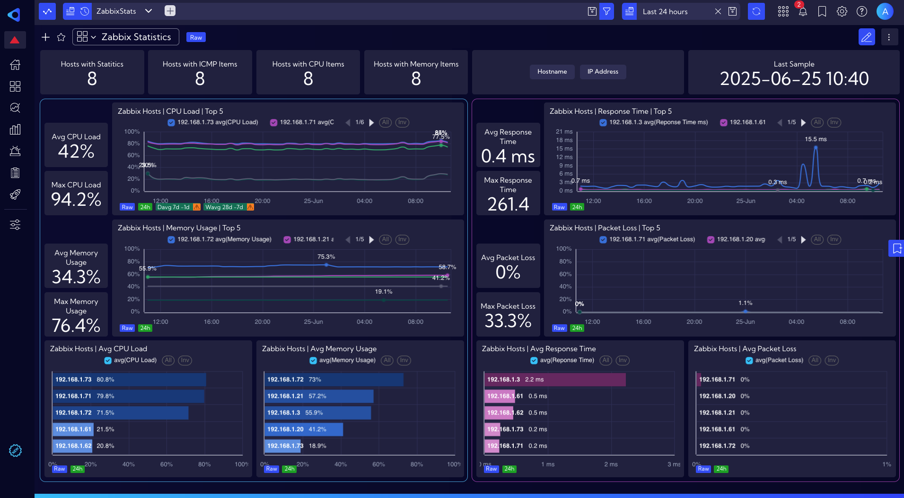
Combining statistics from multiple sources (Zabbix + Sycope example)

Slide 13
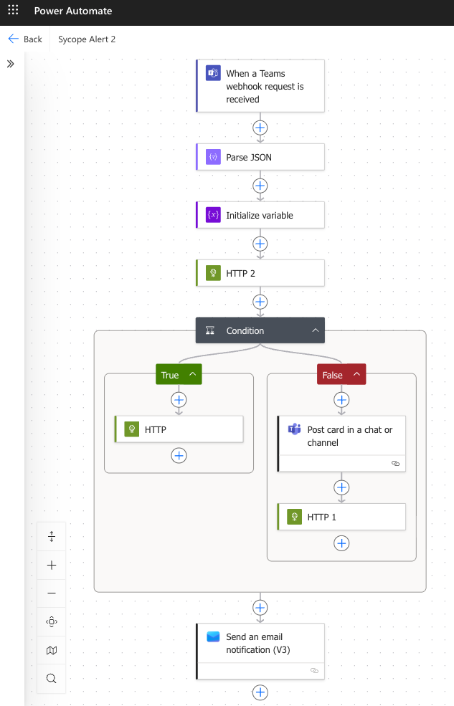
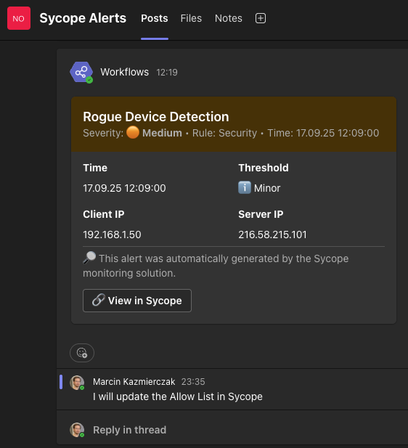

Include additional logic
Use Microsoft Power Automate to achieve logical conditions
Teamwork using Microsoft Teams Channel
Checking existing Jira incidents
Decide What To Do?
Create new Jira incident
Add comment to existing incident
More Automation?
Custom REST API Actions
Notify SIEM or other third party software
Change NACL Rules / Block traffic
Check CMDB and update Allow List automatically

Slide 14
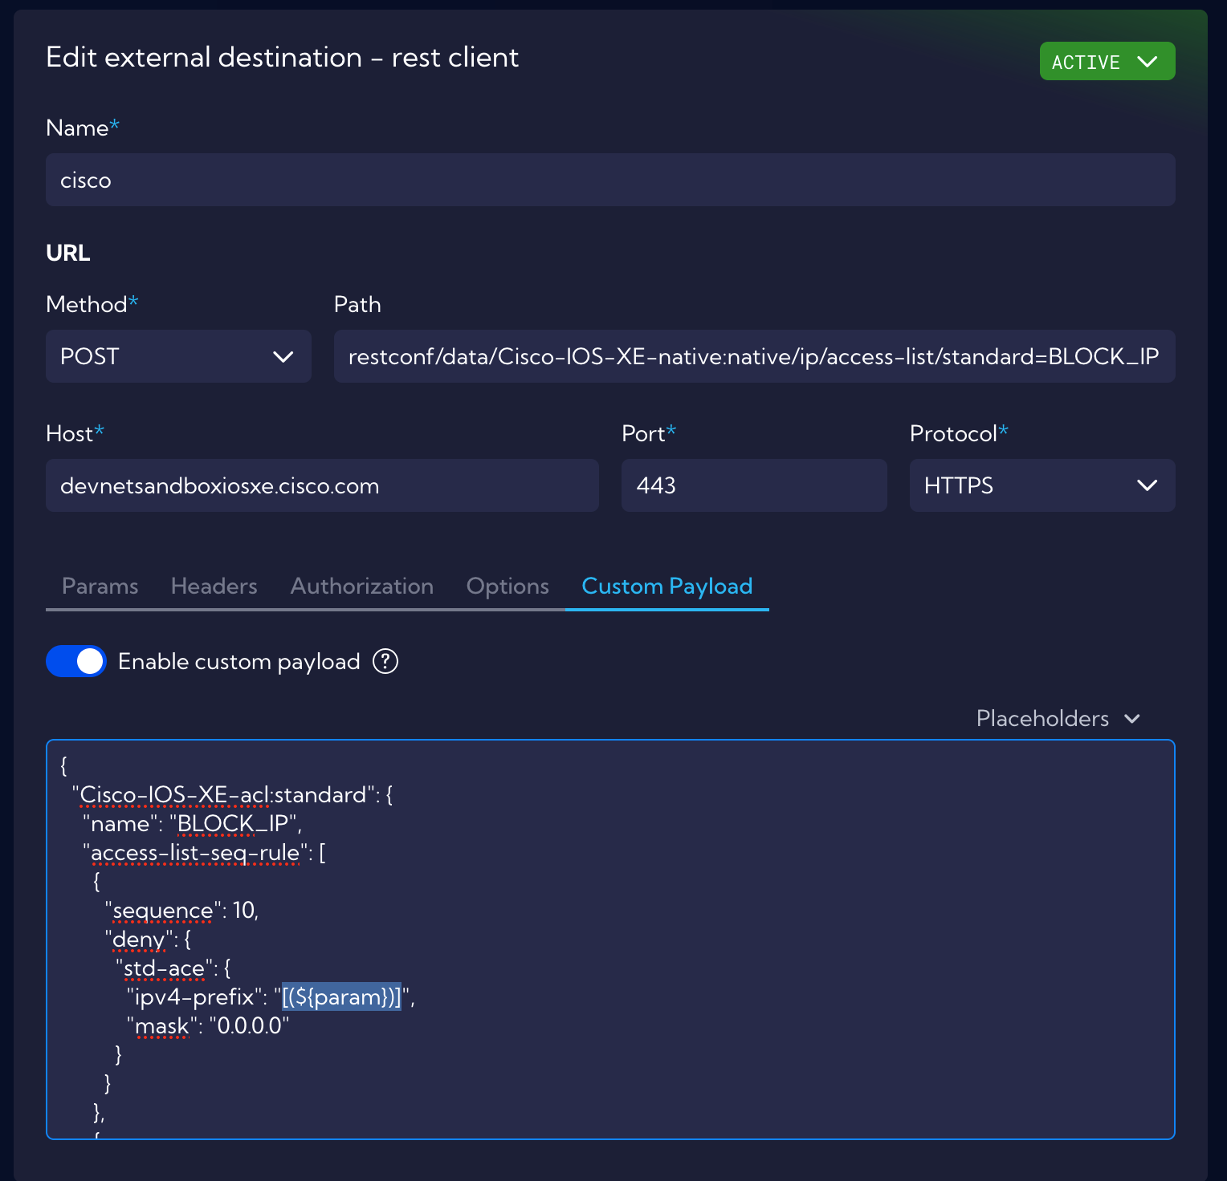
Rest Client – The most powerful tool of Automation
Support for sending IP address to external system e.g. Cisco IOS XE or any network device
Real-time Access List Modification
Blocking IP addresses that do not meet the defined policy
14
Sekcja

Slide 15
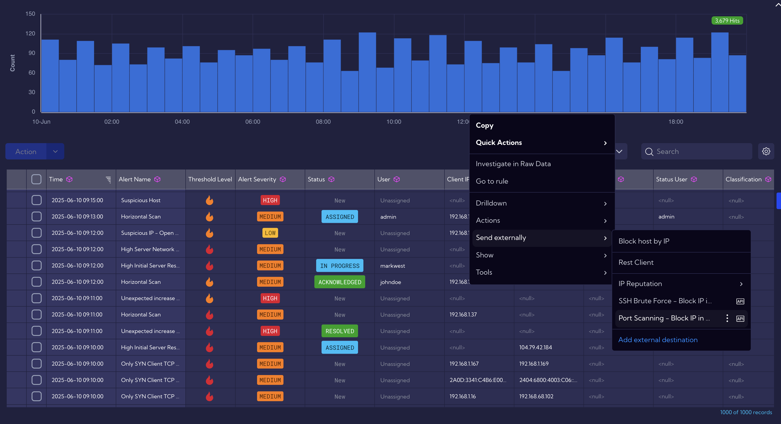
Use Case: Port scanning Mitigation: blocking the attacker's IP address.

Slide 16
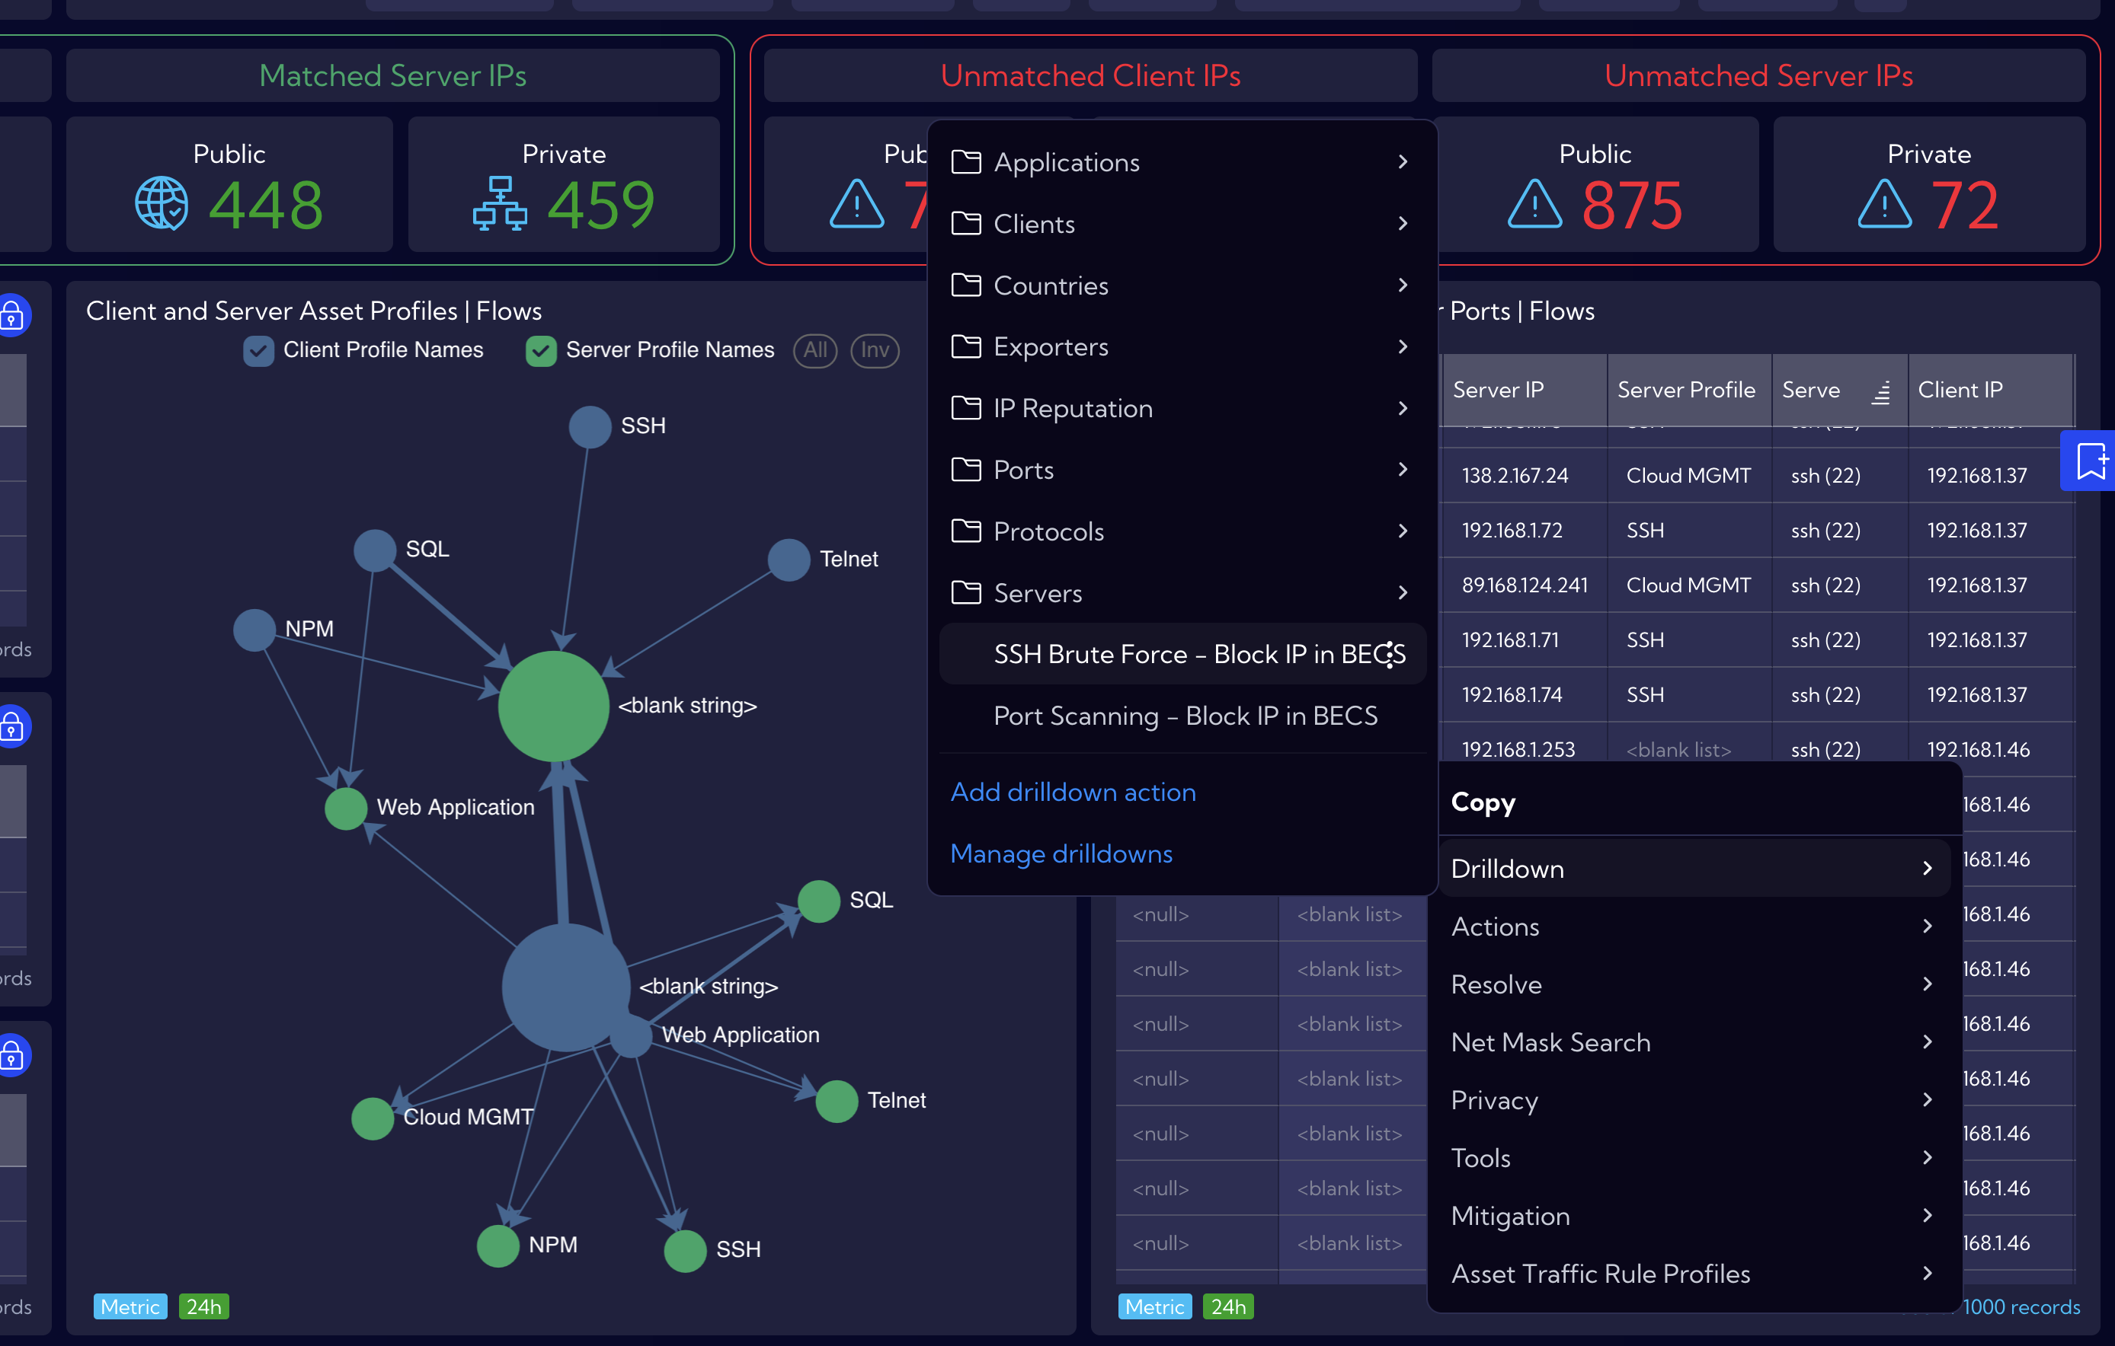
Use Case: Brute-force attack Mitigation: blocking the attacker’s IP address and the targeted port.

Slide 17




Conclusion
Check where your response time is the longest?
How much time do you actually spend on inventory updates?
What tools do you use every day?
Stop by and try out the Sycope solution!

Slide 18
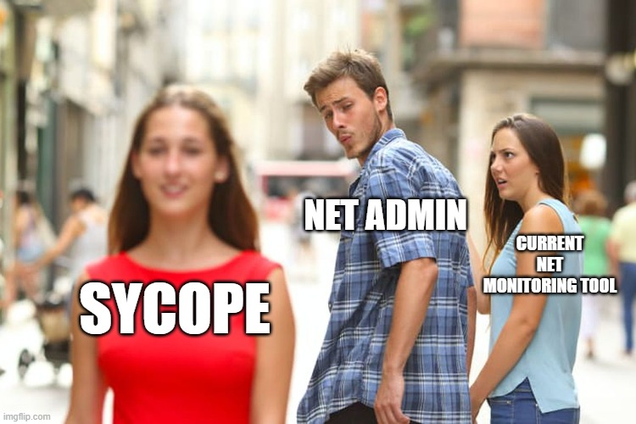

Slide 19

Marcin Kaźmierczak
Solution Architect
www.sycope.com

