Slide 1

Network Architecture Best Practices
for Data Centers
Korhan Kayhan
DC Consulting Engineer

Slide 2
Agenda
Understanding the legacy
Today’s data centers
Choosing the right routing protocols
Connecting to WAN
Telemetry Based Device Management

Slide 3


Understanding the legacy
The burdens of L2 fabrics
Scalability challenges
Broadcast storms → STP and RSTP and MSTP
Temporary L2 loops while converging
Suboptimal bandwidth usage
Inefficient load distribution
Servers
Servers
Servers
Servers

Slide 4


Building the modern data center
CLOS Fabric Design
Spine
Spine
Leaf
B-Leaf
Servers & Workloads
Servers & Workloads
Servers & Workloads
PE router
PE router

Slide 5
Building the modern data center
IP Fabric / Underlay
Spine
Spine
The green arrow indicates a point-to-point routing protocol, which may be ISIS, OSPF, or eBGP. Its purpose is to provide reachability between the nodes’ loopback interfaces.
These loopbacks will serve as endpoints for VxLAN tunnel termination.
Leaf
B-Leaf
Servers & Workloads
Servers & Workloads
Servers & Workloads
PE router
PE router
Notes:
Failure detection is immediate, in DCs all the links have the same BW and cost is not important. So ISIS OSPF doesn’t bring much benefit. BGP converges fast with rapid withdrawal.

Slide 6
Building the modern data center
eBGP for Underlay
Spine
Spine
RFC 7938
eBGP is widely used in the industry for the benefits outlined in RFC 7938.
One of the most important one is the scale.
Leaf
B-Leaf
Another one is 1 hop blast radius for failures.
Servers & Workloads
Servers & Workloads
Servers & Workloads
PE router
PE router
Notes:
eBGP single-hop sessions are established over direct point-to-point links interconnecting the network nodes
IPv6 link-local addresses are used on point-to-point links, along with BGP peer auto-discovery to ease the planning & configuration process.
The point-to-point links are not advertised into BGP. Since the eBGP-based design changes the next-hop address at every device, distant networks will automatically be reachable via the advertising eBGP peer.
Only the system loopback interfaces (VTEP) are advertised across the fabric.

Slide 7
Building the modern data center
eBGP for Underlay
Spine
Spine
RFC 7938
eBGP is widely used in the industry for the benefits outlined in RFC 7938.
One of the most important one is the scale.
Leaf
B-Leaf
Another one is 1 hop blast radius for failures.
Servers & Workloads
Servers & Workloads
Servers & Workloads
PE router
PE router
Notes:
eBGP single-hop sessions are established over direct point-to-point links interconnecting the network nodes
IPv6 link-local addresses are used on point-to-point links, along with BGP peer auto-discovery to ease the planning & configuration process.
The point-to-point links are not advertised into BGP. Since the eBGP-based design changes the next-hop address at every device, distant networks will automatically be reachable via the advertising eBGP peer.
Only the system loopback interfaces (VTEP) are advertised across the fabric.

Slide 8
Building the modern data center
eBGP for Underlay
Spine
Spine
RFC 7938
eBGP is widely used in the industry for the benefits outlined in RFC 7938.
One of the most important one is the scale.
Leaf
B-Leaf
Another one is 1 hop blast radius for failures.
Servers & Workloads
Servers & Workloads
Servers & Workloads
PE router
PE router
Notes:
eBGP single-hop sessions are established over direct point-to-point links interconnecting the network nodes
IPv6 link-local addresses are used on point-to-point links, along with BGP peer auto-discovery to ease the planning & configuration process.
The point-to-point links are not advertised into BGP. Since the eBGP-based design changes the next-hop address at every device, distant networks will automatically be reachable via the advertising eBGP peer.
Only the system loopback interfaces (VTEP) are advertised across the fabric.

Slide 9
Building the modern data center
eBGP for Underlay
eBGP is great but configuring it on every link is a tedious task. Neighbor IPs and ASNs must be coordinated.
Spine
Spine
RFC 8950
IPv6 Unnumbered Peering ( RFC 8950 )
No IP assignment, using IPv6 link-local
Peers auto-discover neighbor IP via IPv6 route-advertisement capability.
This enables automatic discovery and auto peering.
Leaf
B-Leaf
Servers & Workloads
Servers & Workloads
Servers & Workloads
PE router
PE router
Notes:
eBGP single-hop sessions are established over direct point-to-point links interconnecting the network nodes
IPv6 link-local addresses are used on point-to-point links, along with BGP peer auto-discovery to ease the planning & configuration process.
The point-to-point links are not advertised into BGP. Since the eBGP-based design changes the next-hop address at every device, distant networks will automatically be reachable via the advertising eBGP peer.
Only the system loopback interfaces (VTEP) are advertised across the fabric.

Slide 10
Building the modern data center
BGP EVPN for Overlay
RFC 7432
Spine
Spine
L2 and L3 services, anycast-GW, arp suppression, multicast routing and more.. All done with single protocol.
EVPN is inherently loop free. xSTP not relevant in networks using EVPN. Designated Forwarder Election, split-horizon and MAC duplication mechanisms take care of potential loops.
EVPN provides a standardised solution for multi-homing
Unlike MC-LAG, no inter-link needed between leaf pairs
A/A or A/S
Leaf
B-Leaf
Servers & Workloads
Servers & Workloads
Servers & Workloads
PE router
PE router

Slide 11
Orange Arrow represents VxLAN
Red Arrow represents VLAN
Building the modern data center
Providing Connectivity Between Workloads
Spine
Spine
Leaf
B-Leaf
EVPN
EVPN
EVPN
EVPN
Servers & Workloads
Servers & Workloads
Servers & Workloads
PE router
PE router

Slide 12
Orange Arrow represents VxLAN
Red Arrow represents VLAN
Building the modern data center
Vlan Hand-off
Spine
Spine
Clear demarcation between DC and WAN
No need for high end PE
For L2 networks, Ethernet Segments
For L3 networks Inter-AS Option A
Leaf
B-Leaf
EVPN
EVPN
EVPN
EVPN
VRF
VRF
Servers & Workloads
Servers & Workloads
Servers & Workloads
PE router
PE router

Slide 13
Orange Arrow represents VxLAN
Red Arrow represents VLAN
Building the modern data center
DCI Integrated Model
Spine
Spine
Faster convergence for L2
Need for routing policies to segregate WAN and DC
Need for a high end PE like 7750
No need for Inter AS Option-A
Leaf
B-Leaf
EVPN
EVPN
EVPN
EVPN
VRF
VRF
Servers & Workloads
Servers & Workloads
Servers & Workloads
PE router
PE router

Slide 14
Datacenter Interconnect
Spine
Spine
Leaf
B-Leaf
Servers & Workloads
Servers & Workloads
Servers & Workloads
PE router
PE router

Slide 15
Datacenter Interconnect
MPLS/SRv6
VLAN
VxLAN
GW-based DCI - Decoupled
PE router
PE router
PE router
PE router
VRF
VRF
EVPN
Based on RFC 9014
Two devices involved: Border leaf and WAN PE
DC and WAN managed by different entities
DC and WAN separated control planes
Decoupling of data plane encapsulation
VLAN-handoff to PE
EVPN
B-Leaf
B-Leaf
Spine
Spine
Leaf
Leaf
EVPN
EVPN
Datacenter 1
Datacenter 2

Slide 16
Datacenter Interconnect
MPLS/SRv6
VxLAN
GW-based DCI - Integrated
VRF
VRF
EVPN
DC-GW
Based on RFC 9014
Border leaf and WAN PE combined into DC-GW
DC and WAN managed by the same entity
DC-GW participates in control and data planes of both DC and WAN
VXLAN tunnels limited to within the DC
Service stitching to WAN
Value added features
DC-GW
EVPN
Spine
Spine
Leaf
Leaf
EVPN
EVPN
Datacenter 1
Datacenter 2

Slide 17
Datacenter Interconnect
DC-GW
DC-GW
Spine
Spine
Leaf
Leaf
Datacenter 1
Datacenter 2

Slide 18

Datacenter Interconnect
Inter-domain-option-b
NHopSelf swap (VNI → MPLS)
NHopSelf swap (MPLS ← VNI )
Based on draft-rabadan-bess-evpn-inter-domain-opt-b
No overlay service instantiation at DC-GW
ASBRs rewriting next-hop to themselves, programs label swap operation
Label swapping at ASBRs.
Leaves must handle larger MAC/IP tables
One big multi-location DC
B-Leaf
B-Leaf
Spine
Spine
Leaf
Leaf
EVPN
EVPN
Datacenter 1
Datacenter 2

Slide 19
Datacenter Interconnect
Inter-domain-option-b
NHopSelf swap (VNI → MPLS)
NHopSelf swap (MPLS ← VNI )
B-Leaf
Pros
No service Instantiation on border routers
No VPN next-hop scale pressure
Translation of route-distinguishers/route-targets may be possible (not common)
B-Leaf
Spine
Spine
Leaf
Leaf
EVPN
EVPN
Datacenter 1
Datacenter 2

Slide 20
Datacenter Interconnect
Inter-domain-option-b
NHopSelf swap (VNI → MPLS)
NHopSelf swap (MPLS ← VNI )
B-Leaf
Cons
No translation of VPN route attributes across domains (other than RD/RTs)
Requires MPLS service label swap, hence limited to MPLS, SR-MPLS, MPLS over IP tunneling
BUM ingress replication at the ingress PE for L2 broadcast domains
B-Leaf
Spine
Spine
Leaf
Leaf
EVPN
EVPN
Datacenter 1
Datacenter 2

Slide 21
Datacenter Interconnect
Service Gateway Solution
NHopSelf swap (SRv6 → MPLS)
NHopSelf swap (MPLS ← VNI )
DCGW
DCGW
Import/process route, install Prefix in FIB (IP-prefix, MAC, Tag), allocate demultiplexer for the next domain encapsulation and redistribute route into the next domain
Any encapsulation is possible in each domain
Spine
Spine
Leaf
Leaf
EVPN
EVPN
Datacenter 1
Datacenter 2

Slide 22
Datacenter Interconnect
Service Gateway Solution
NHopSelf swap (SRv6 → MPLS)
NHopSelf swap (MPLS ← VNI )
DCGW
Pros
No encapsulation restrictions
No VPN next-hop scale pressure
Translation of all VPN route attributes across domains
Full per domain EVPN multi-homing with no limitations
Hierarchical BUM replication for L2 broadcast domains
DCGW
Spine
Spine
Leaf
Leaf
EVPN
EVPN
Datacenter 1
Datacenter 2

Slide 23
Datacenter Interconnect
Service Gateway Solution
NHopSelf swap (SRv6 → MPLS)
NHopSelf swap (MPLS ← VNI )
DCGW
DCGW
Cons
Service Instantiation at the border routers, mitigated by auto-configuration
FIB scale for MACs and IP prefixes, mitigated using
Default MAC routes for L2
Aggregate routes for IP prefixes
Spine
Spine
Leaf
Leaf
EVPN
EVPN
Datacenter 1
Datacenter 2

Slide 24

Data Center Interconnect Summary
For VXLAN, MPLS or SRv6 data centers
Gateway-less interdomain/DCI
Service gateway-based interdomain/DCI
Characteristics
No service-instantiation on border router
No overlay MAC/IP lookup on border router
Interconnected domains use labels (MPLS, SR-MPLS, SRoUDP)
Low domain protection/demarcation/isolation
Characteristics (terminology taken from RFC9014)
Service-instantiation on border router
MAC/IP lookup on border router (service gateway)
Heterogeneous domain transport
High domain protection/demarcation/isolation
End-to-end underlay tunnels (no segmentation)
Decoupled model (VLAN or PW hand-off to WAN PE)
Inter-AS/domain model B
Service Label swap at border router
Asymmetric option
Integrated models (for L2 and L3 services)
EVPN-VXLAN to VPLS (L2) or IP-VPN (L3)
Inter-AS/domain model C
BGP LU Label swap at BR
EVPN-VXLAN to EVPN-VXLAN/EVPN-MPLS/EVPN-SRv6
EVPN-MPLS to EVPN-VXLAN/EVPN-MPLS/EVPN-SRv6
Inter-AS/domain model C (with TE)
BSID to SID list swap at BR (SRoUDP to SR-MPLS possible) downloaded by controller
EVPN-SRv6 to EVPN-VXLAN/EVPN-MPLS/EVPN-SRv6

Slide 25

Nokia Validated Designs
No Paywall, No License, No Registration Needed
https://github.com/nokia/nokia-validated-designs
https://documentation.nokia.com/data-center-networks-design-hub

Slide 26

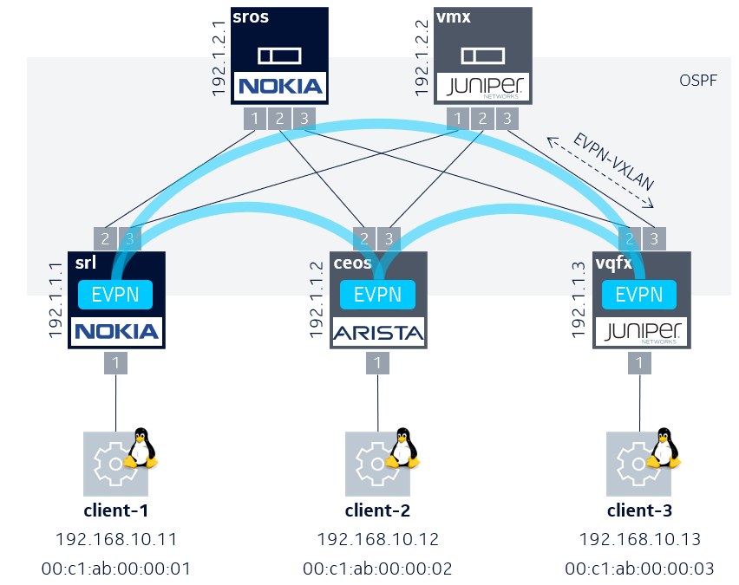
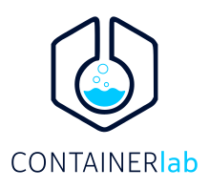
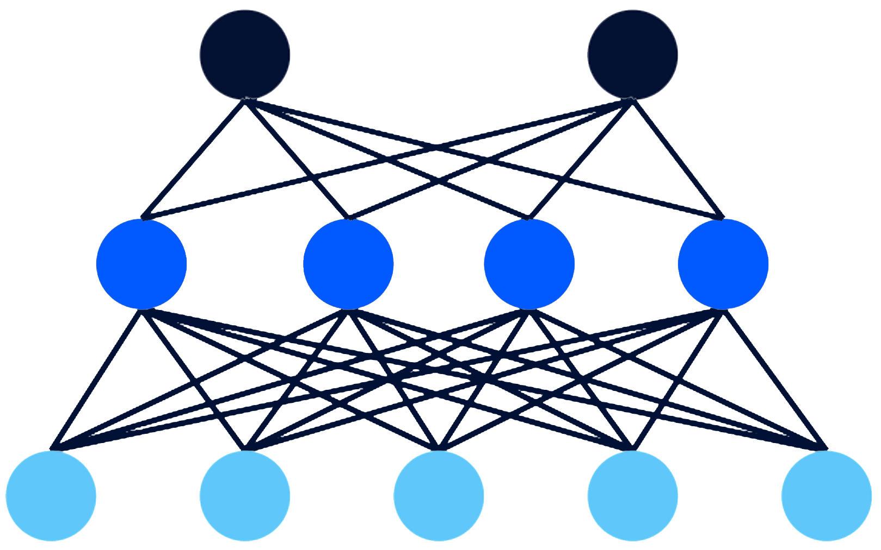
Mutlivendor Labs with Containerlab
Deploy and configure the whole lab with two commands
Multivendor EVPN
containerlab.dev
https://github.com/srl-labs/nokia-evpn-lab

Slide 28
Copyright and confidentiality
The contents of this document are proprietary and confidential property of Nokia. This document is provided subject to confidentiality obligations of the applicable agreement(s).
This document is intended for use by Nokia’s customers and collaborators only for the purpose for which this document is submitted by Nokia. No part of this document may be reproduced or made available to the public or to any third party in any form or means without the prior written permission of Nokia. This document is to be used by properly trained professional personnel. Any use of the contents in this document is limited strictly to the use(s) specifically created in the applicable agreement(s) under which the document is submitted. The user of this document may voluntarily provide suggestions, comments or other feedback to Nokia in respect of the contents of this document ("Feedback"). Such Feedback may be used in Nokia products and related specifications or other documentation. Accordingly, if the user of this document gives Nokia Feedback on the contents of this document, Nokia may freely use, disclose, reproduce, license, distribute and otherwise commercialize the feedback in any Nokia product, technology, service, specification or other documentation.
Nokia operates a policy of ongoing development. Nokia reserves the right to make changes and improvements to any of the products and/or services described in this document or withdraw this document at any time without prior notice.
The contents of this document are provided "as is". Except as required by applicable law, no warranties of any kind, either express or implied, including, but not limited to, the implied warranties of merchantability and fitness for a particular purpose, are made in relation to the accuracy, reliability or contents of this document. NOKIA SHALL NOT BE RESPONSIBLE IN ANY EVENT FOR ERRORS IN THIS DOCUMENT or for any loss of data or income or any special, incidental, consequential, indirect or direct damages howsoever caused, that might arise from the use of this document or any contents of this document.
This document and the product(s) it describes are protected by copyright according to the applicable laws.
Nokia is a registered trademark of Nokia Corporation. Other product and company names mentioned herein may be trademarks or trade names of their respective owners.

