Slide 1
The Curious Case of IPv4
September, 2025

Slide 2
SUSTAINING THE INTERNET
Until IPv6 Arrives
Notes:
“Welcome, everyone. Today I want to explore the curious case of IPv4 — how, even though we declared exhaustion years ago, this protocol is still the backbone of the Internet. More importantly, we’ll look at what this means for IPv6 adoption, the transfer market, and the future of Internet growth.”

Slide 3
Scarcity
RIR | Region Covered | Exhaustion / Run-Out Date | Notes
APNIC | Asia-Pacific | 15 April 2011 | First RIR to reach its final /8 policy (only small blocks thereafter).
RIPE NCC | Europe, Middle East, Central Asia | 14 September 2012 | Reached last /8, can only allocate /22 (1024 addresses) per LIR.
LACNIC | Latin America & Caribbean | 10 June 2014 | Entered Phase 3 of exhaustion; strict allocation policies since.
ARIN | North America | 24 September 2015 | Fully depleted IPv4 free pool;
AFRINIC | Africa | 25 April 2017 (entered “soft landing”) | As of 2020, entered Phase 2 exhaustion (very limited remaining). Official depletion was declared June 2023.
APNIC
2011-04
RIPE NCC
2012-09
LACNIC
2014-06
ARIN
2015-09
AFRINIC
2023-06
2010
2012
2014
2016
2018
2020
2022
2024
Notes:
IPv4 exhaustion was a decade-long process across regions (2011–2023).
Some RIRs (like RIPE, APNIC) only allow very small final allocations to new members — not enough for real growth.
AFRINIC was the last RIR to run out, in mid-2023 → marking the true “end” of IPv4 free pools worldwide.
Since then, the only way to get IPv4 is: transfer, buy, or lease.

Slide 4
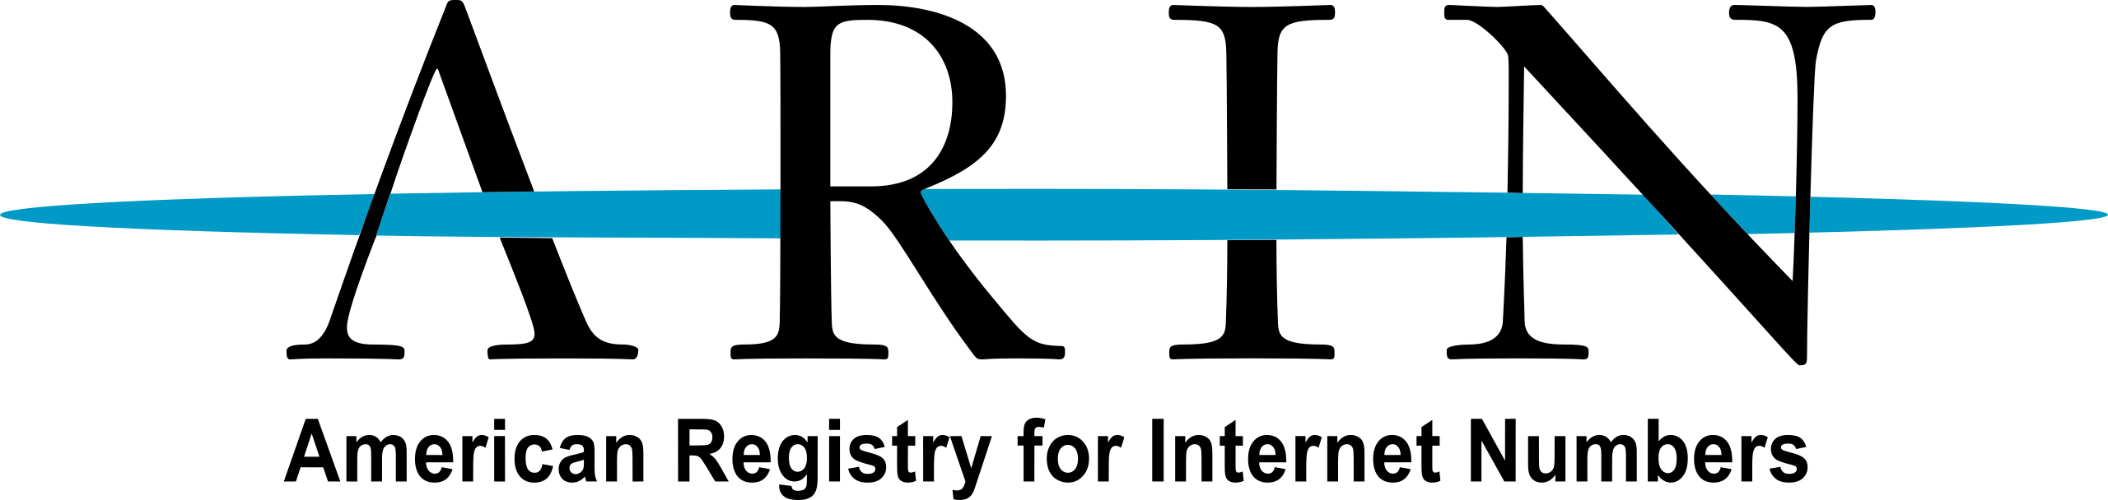
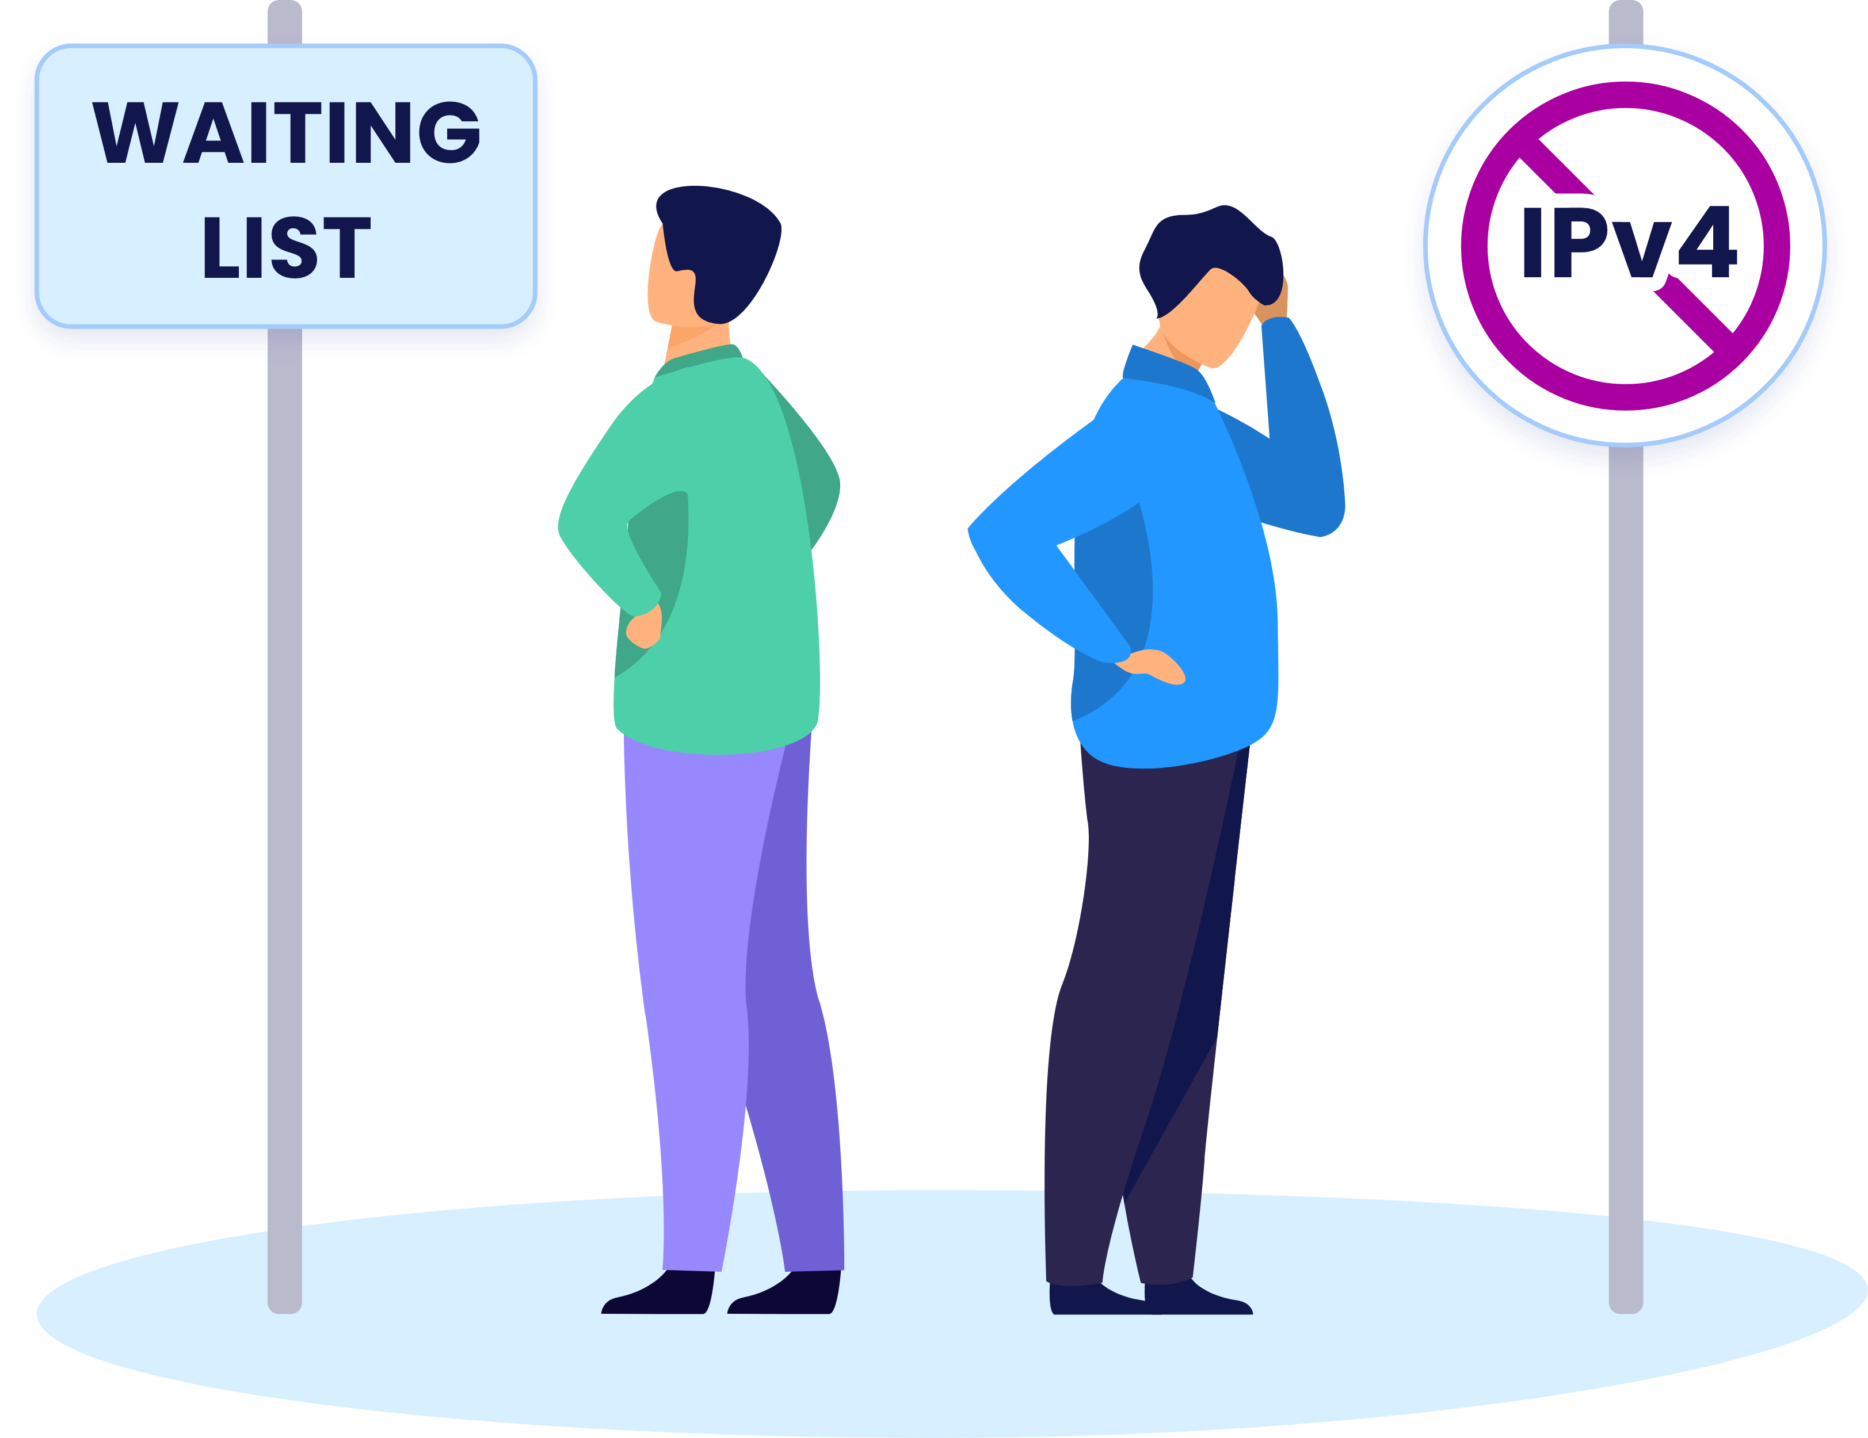
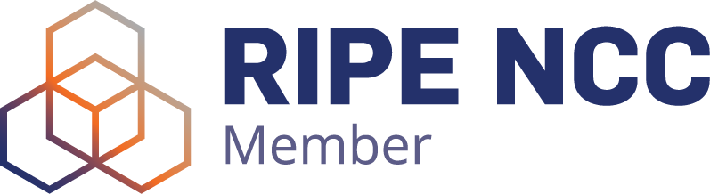

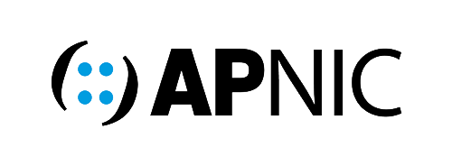
27 Months
(+2 months)
18 Months
(unchanged)
54 Months
Abolished waiting list in 2019
Notes:
Waiting list for the first waiting person to receive their IPv4 allocations

Slide 5
Transfer Market
M&A and Transfer Volume Comparison 2022- 2025
Inter vs Intra RIR transfers
2025
Total 37.4M
Notes:
When scarcity hit, the market responded. This year alone, we saw more than 37 million addresses transferred. Transfers between RIRs are now standard, and mergers and acquisitions are often driven by IP assets. It’s a global, liquid market, with supply and demand determining where growth can happen.”

Slide 6
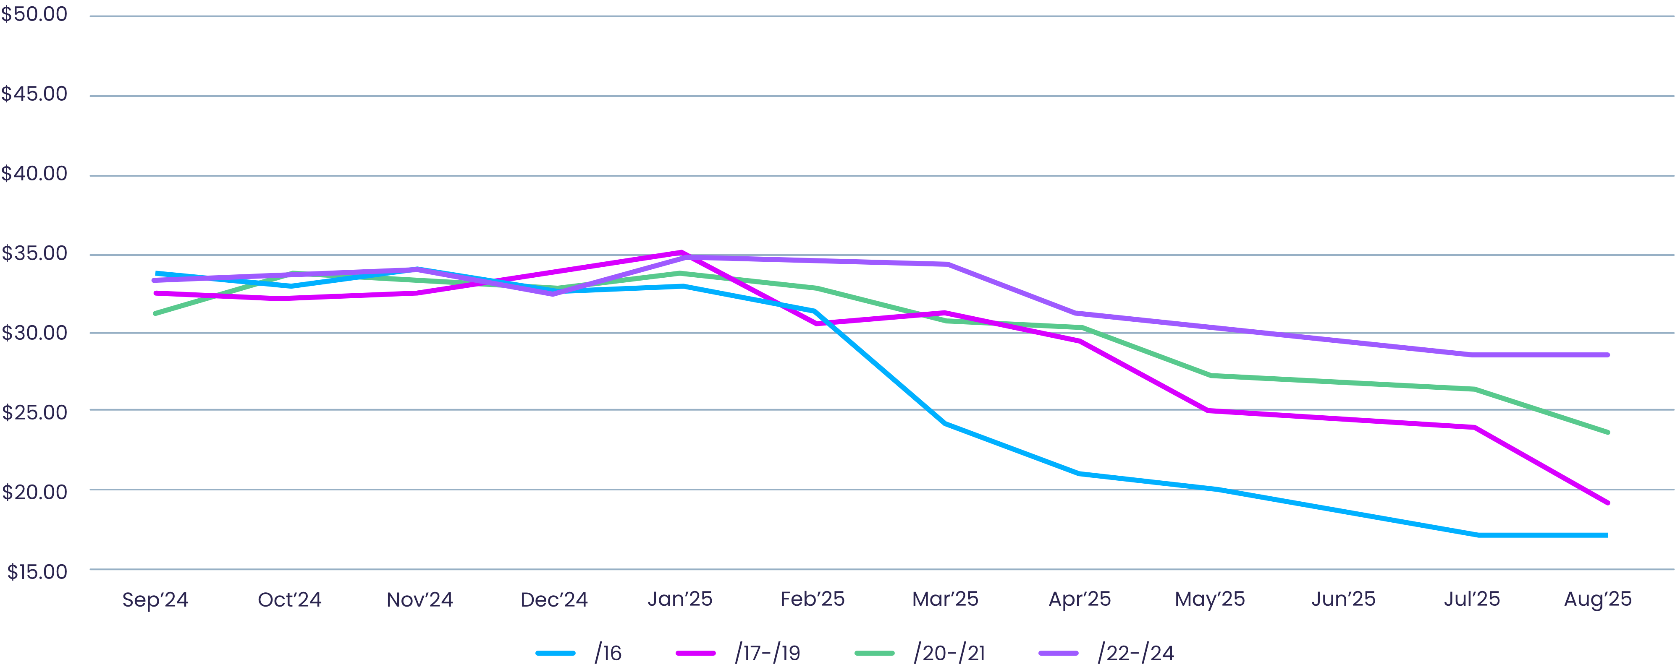
Transfer price change
Monthly Average $ per Address
Notes:
“Prices have stabilized. In mid-2025, /16 blocks even dropped below 20 dollars per IP, largely due to increased supply and block subdivision. Medium-sized blocks are narrowing in price as sellers carve up larger ranges. The important takeaway: demand is steady, but the urgency signal is gone. Operators see no crisis, so momentum for IPv6 adoption slows further.”

Slide 7
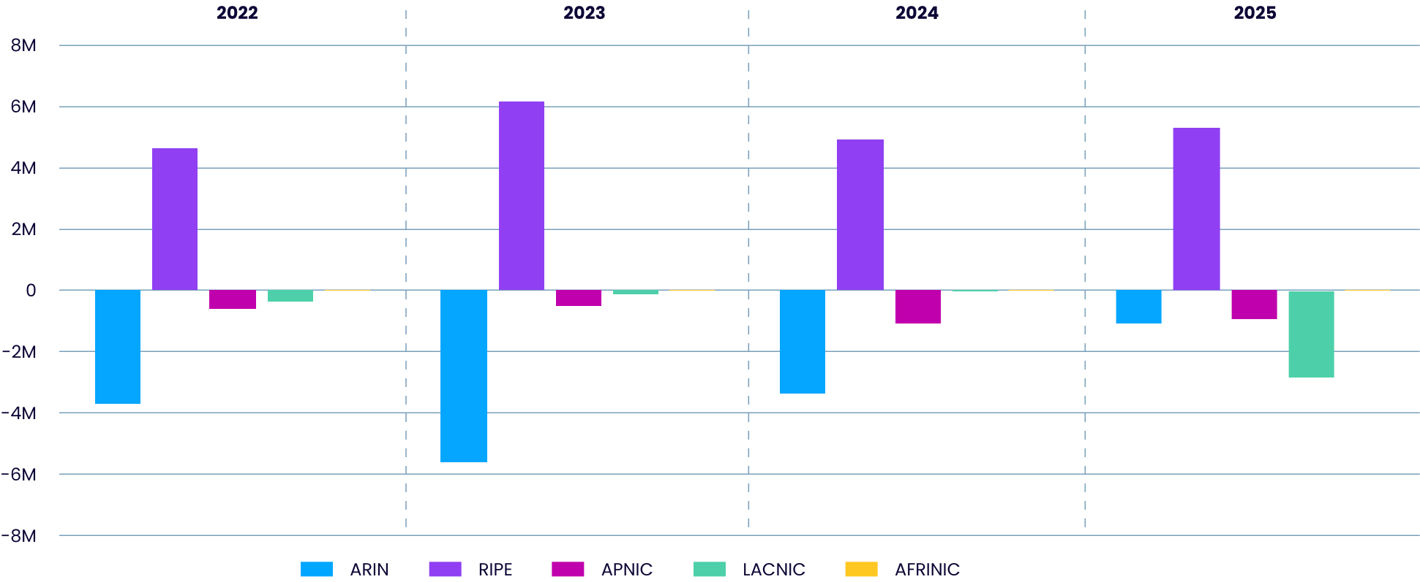
RIR IP amount change 2022-2024
Total IP amount change per RIR
Notes:
The data on IPv4 transfers between RIRs reveals another fascinating dimension of the
market. All regions show net outflows of IPv4 addresses, with one exception: RIPE NCC
(serving Europe, the Middle East, and parts of Central Asia) emerges as the biggest net
recipient.
This is likely due to several factors:
Policy differences: RIPE’s comparatively more flexible inter-RIR transfer policies make itmore attractive than regions with stricter or more bureaucratic transfer processes.
- Charging scheme: RIPE’s fee model is considerably more favorable to IP holders, with a
simple annual fee rather than a per-address amount fee. This is particularly attractive to
companies managing large blocks.
- Legacy status: RIPE also allows legacy IP holders to maintain legacy status for their IP
addresses, reducing complexity and making it easier for organizations to manage their
resources in RIPE’s region.
One standout transfer involved LACNIC, where virtually the entire figure comprises a single
large movement from V.TAL — a major telecom player in Brazil — to ARIN. This
underscores the impact that individual corporate strategies can have on regional IPv4
availability.

Slide 8
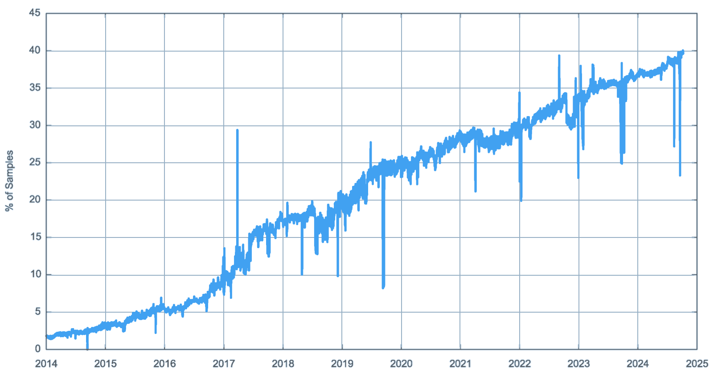
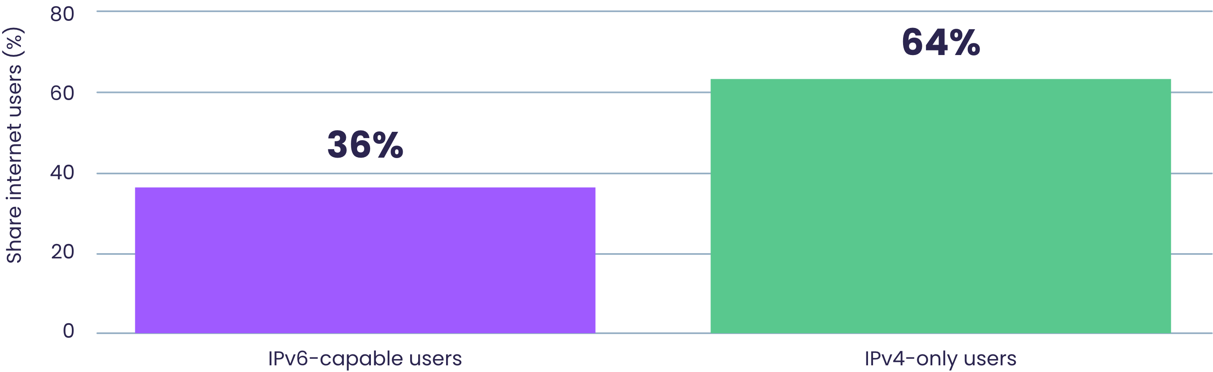
IPv6 vs IPv4: Still a Dual-Stack Internet
IPv6 Adoption – APNIC Labs data
Despite exhaustion, only a bit over one-third of users can reach IPv6-only services (2024 observation; trend continues into 2025).
~20B devices vs ~3.1B unique IPv4s → roughly 7 devices per IPv4 via NAT sharing.
“End-to-end” addressing is no longer the default for most users—yet the Internet keeps working.
IPv6 vs IPv4 Users
Notes:
Let’s start with where we are today. We officially ran out of IPv4 addresses years ago, but the Internet is still mostly IPv4. In 2025, only a little over a third of users can actually reach an IPv6-only service. That means the majority of the Internet is still IPv4-only. Meanwhile, we have around 20 billion devices online, but only about 3 billion unique IPv4 addresses. On average, one IPv4 address is being shared by seven devices. NATs and CDNs have made this possible. So even though we’ve exhausted IPv4, the Internet hasn’t collapsed — it just adapted

Slide 9
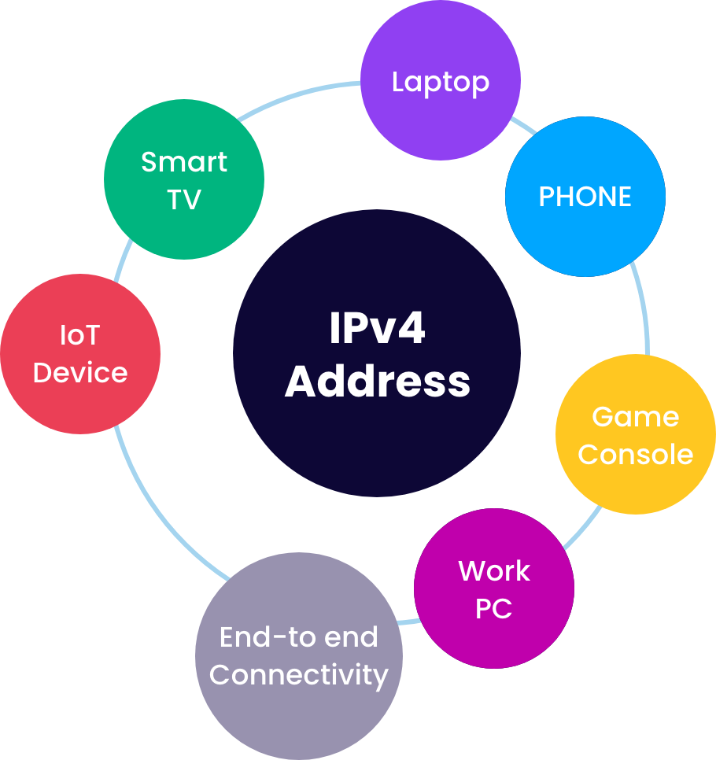
The End of End-to-End
NAT (Network Address Translation) now standard, not an exception
Shared addressing lets billions more devices connect despite exhaustion
“End-to-end” principle — every device with its own IP — is effectively gone
Notes:
Here’s one of the most striking facts about where we are today: on average, a single IPv4 address is now shared by seven devices.
That’s only possible because of NAT — Network Address Translation — which was originally designed as a short-term workaround. Today, it has become the default. Every home router, every mobile carrier network, every enterprise firewall is essentially stretching IPv4 like an elastic band.
This is also the point where we can say: the original Internet principle of end-to-end connectivity, where each device had its own unique address, is over. And yet… it still works. The Internet didn’t collapse. Applications adapted, content distribution networks stepped up, and NAT became invisible to most users.
But this raises a bigger question: if the Internet has survived more than a decade in this post end-to-end era, do we still feel the same urgency for IPv6? Or has IPv4, combined with NAT, carved itself a much longer future than anyone expected?”

Slide 10
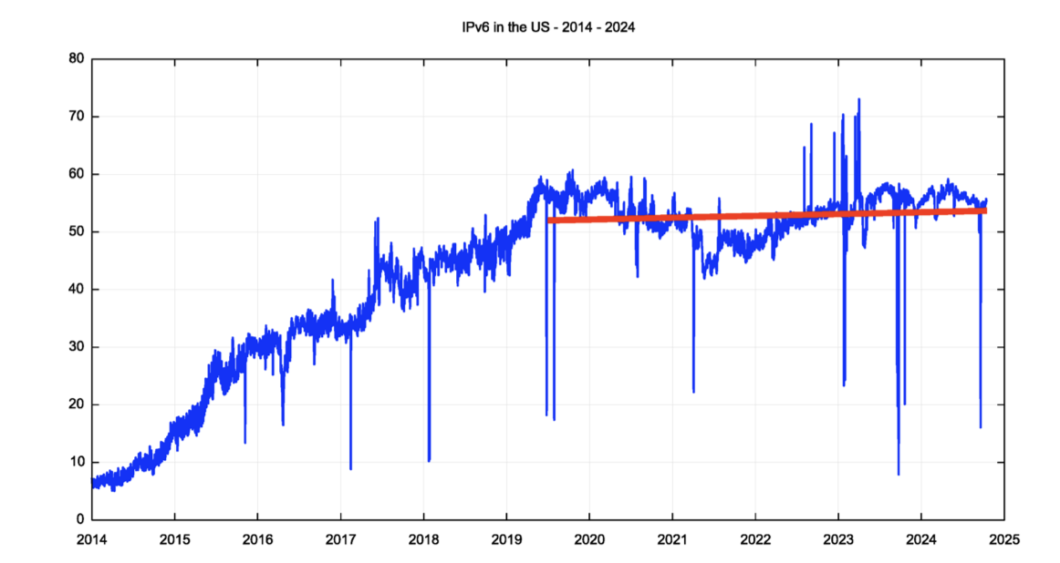
Curious case of USA IPv6 adoption
Notes:
The data shows that the level of IPv6 use in the US has remained constant since mid-2019. Why is there
no further momentum to continue with the transition to IPv6 in this part of the Internet you might ask?
I would offer
the explanation that the root cause is a fundamental change in the architecture of the Internet.
The significant change to the Internet’s architecture is a shift away from a strict address-based architecture.
Clients no longer need the use of a persistent unique public IP address in order to communicate with
servers and services. And servers no longer need to use a persistent unique public IP address to provide
clients with access to the service or content. Address scarcity takes on an entirely different dimension
when unique public addresses are not required to number every client and every distinct service.

Slide 11
Why IPv6 Hasn’t “Tipped” Yet
No immediate upside: IPv6 is “IPv4 with bigger addresses” → little marginal benefit to operators.
Coordination problem: apps ↔ hosts ↔ ISPs ↔ content all waited for each other.
Early pain: auto-tunnels (6to4, Teredo) were unreliable → reputational drag.
NATs worked too well: port multiplexing massively stretched IPv4.
Architecture shift: DNS + TLS/SNI + CDNs push content to the edge—service identity is in names, not addresses.
Notes:
, why is IPv6 adoption so slow? The main reason is that IPv6 doesn’t give operators an immediate benefit. It’s not faster, cheaper, or more secure — it’s basically IPv4 with a bigger address field. That makes the business case hard. On top of that, there’s a coordination problem: apps wait for ISPs, ISPs wait for content providers, content providers wait for users. Early IPv6 transition tools like 6to4 and Teredo didn’t help either — they were unreliable and gave IPv6 a bad reputation. And the biggest factor? NATs worked too well. They extended IPv4 far longer than anyone expected. Add CDNs and TLS/SNI on top, and suddenly unique IP addresses aren’t critical for delivering services anymore. All of this took the urgency out of IPv6

Slide 12

Prices Stabilized, Demand Steady
“/16 blocks dropped below ~$20/IP in mid-2025 due to increased supply.”
“Medium blocks pricing narrowing as sellers subdivide large blocks.”
No Urgency Signal
“Transfer request rates remain strong—demand steady vs previous years.”
Notes:
: if ownership is affordable enough and NATs/dual stack work, boards don’t see a burning platform.
We can also look at the market for IPv4. If exhaustion were really hurting us, we’d see panic pricing. But the opposite happened. Yes, there was a big spike around 2021, but prices have since stabilized between about 26 and 42 dollars per address. That stability tells us that supply and demand found a balance. Transfers keep flowing, and networks keep getting by with NAT and dual stack. So, from a business perspective, IPv4 still feels ‘good enough’ to keep going. And that’s another reason the IPv6 transition drags out.

Slide 13
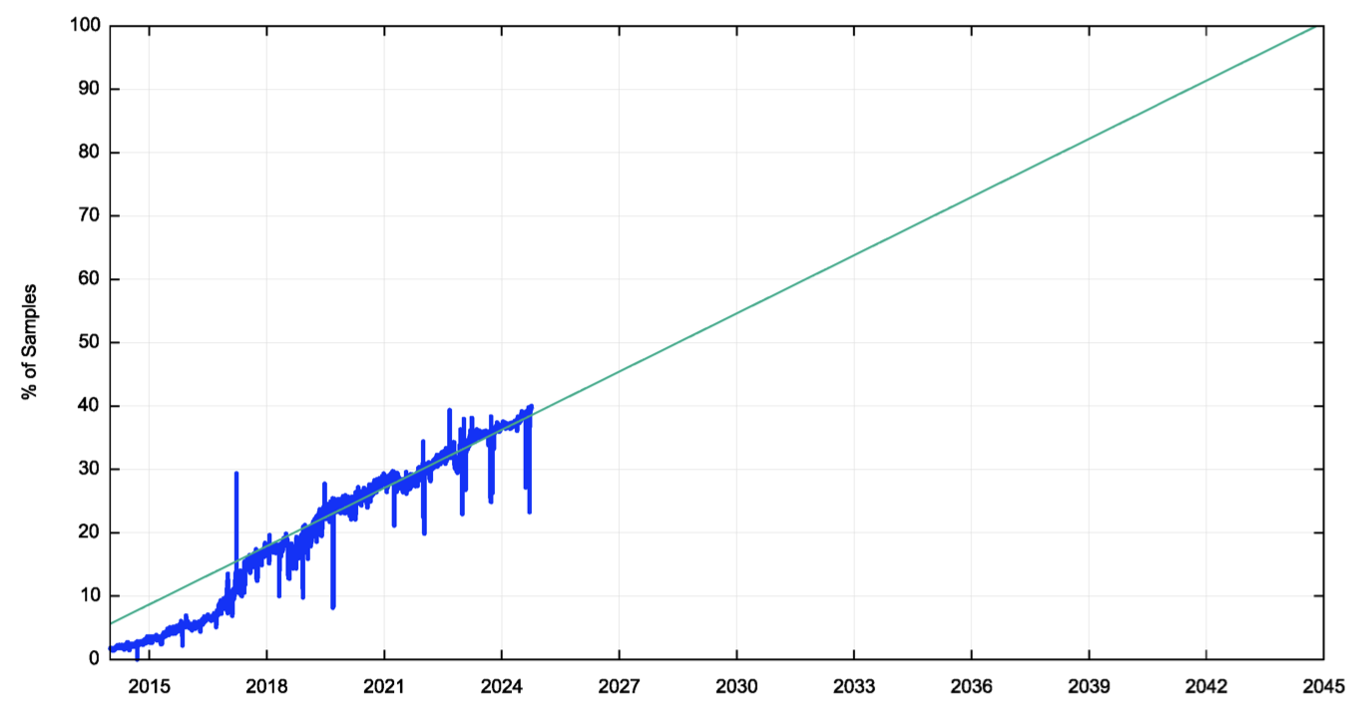
The Long Road to IPv6
IPv6 adoption keeps climbing but slowly — ~⅓ of users by 2025.
At the current trend, completion ≈ late 2045.
Dual-stack isn’t temporary — it may last another 20 years.
Market and architecture shifts (NAT, CDNs, DNS/TLS) reduce urgency for IPv6.
Leasing keeps IPv4 sustainable during this extended transition.
IPv6 Adoption (and Linear Projection) – APNIC Labs Data
Notes:
So when will this IPv6 transition finally finish? If you project the current growth trend, it doesn’t reach 100% until around 2045. That means we’re likely to be in this dual-stack world for another 20 years. That’s a long time to wait. And that’s why leasing matters: it gives us a practical, sustainable way to manage IPv4 during this extended transition. It keeps the Internet growing while we slowly, steadily move toward IPv6.

Slide 14
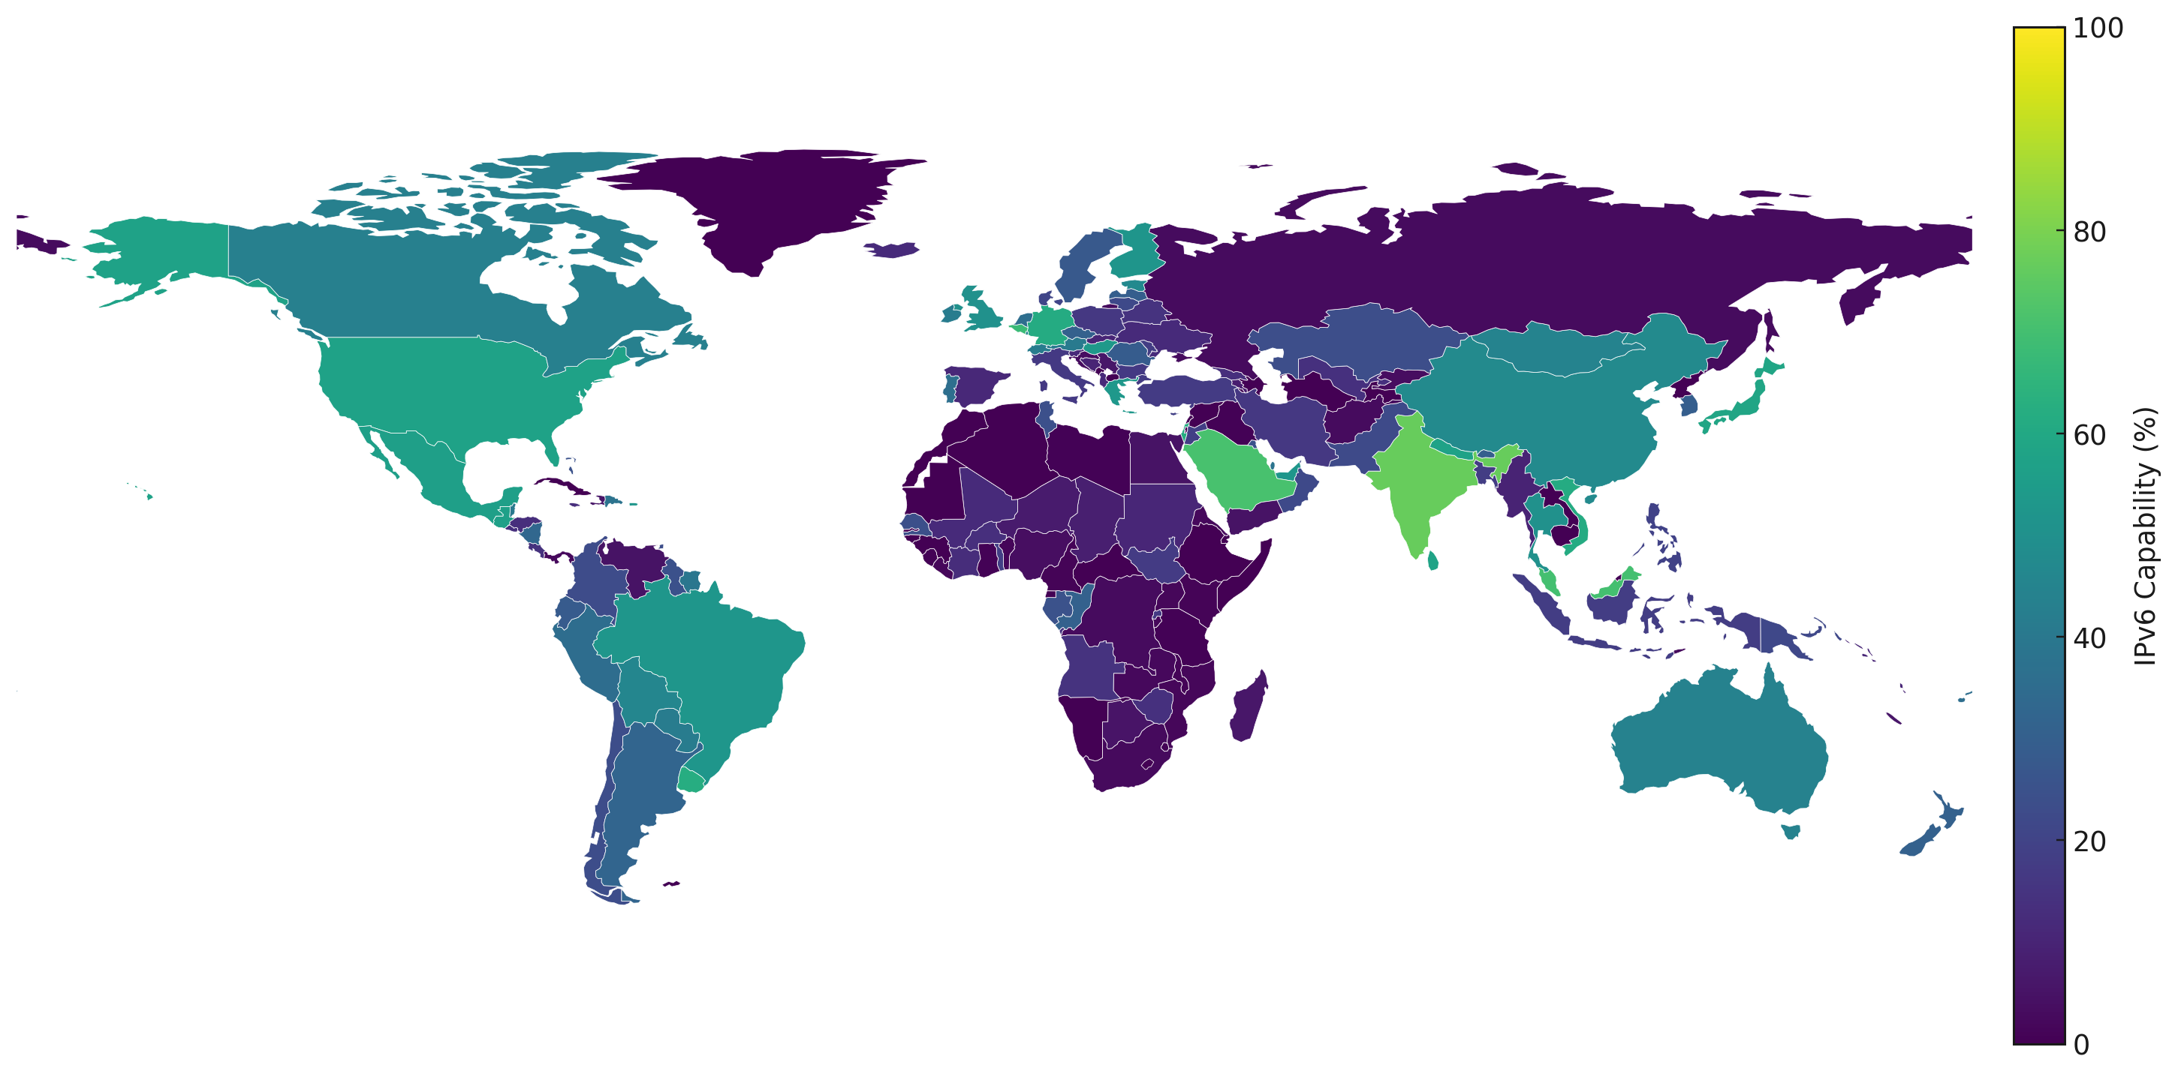

Why IPv6 Hasn’t “Tipped” Yet
🇮🇳 India — 76.72%
🇫🇷 France — 76.43%
🇸🇦 Saudi Arabia — 70.89%
🇲🇾 Malaysia — 70.05%
🇧🇪 Belgium — 67.93%
. . .
Lithuania — 21.85%
. . .
🇱🇧 Lebanon — 0.28%
🇰🇭 Cambodia — 0.28%
🇸🇴 Somalia — 0.25%
🇸🇾 Syria — 0.22%
🇪🇹 Ethiopia — 0.09%
Notes:
Now that we’ve seen how IPv4 scarcity is creating pressure — waiting lists, transfers, rising prices, the complexity of justification — it’s useful to step back and look at how much IPv6 adoption has actually progressed. This helps us frame how long the transition might take, and where IPv4 leasing still plays a role.
On the top side of the list, we see countries like India and France, each with adoption rates above 75%. Also strong are Saudi Arabia, Malaysia, and Belgium, all above 65%. These are examples where IPv6 is clearly mainstream and widely deployed.
At the other end of the spectrum, countries like Lebanon, Cambodia, Somalia, Syria, and Ethiopia are all effectively below 1% — meaning IPv6 is essentially nonexistent.
And then, right in the middle of the pack, we have Lithuania — around 22%. Respectable progress, but far from the leaders, and a clear reminder that Europe in general is lagging behind Asia and parts of the Americas.
This shows three things:
First, progress is uneven. Some countries are racing ahead, others are barely moving.
Second, IPv4 remains essential. Even in countries with 60–70% adoption, there are still millions of users on IPv4 — which is why leasing markets are still needed to bridge the gap.
Third, the transition will take years. Even under optimistic trends, it’s unlikely we’ll see universal IPv6 adoption before the 2030s or 2040s.
So as we look at the regional IPv4 leasing policies in the next slides, keep in mind: this isn’t just about today — it’s about sustaining the Internet during what may be a decades-long dual-stack coexistence.”

Slide 15
Reduce, Reuse, Re-lease: Bridging to IPv6 Responsibly
From Scarcity to Sustainability:
Leasing as the Bridge
REVENUE
EALASTIC SUPPLY
Leasing recirculates idle IPv4—a pragmatic “renewable” mechanism while IPv6 adoption grows.
Holders: keep the asset + recurring revenue, hedge long-term value.
Operators: faster access, lower CAPEX, elastic scaling while deploying IPv6 where it’s easy.
Hygiene matters: pair leasing with RPKI, IRR, abuse controls, geo-DB management.
Idle IPv4
(holders)
Lease Contact & Controls
Operational Ude (lessees)
RE-CIRCULATION
POLICIES & SECURITY
Hygiene Layer:
RPKI
IRR
Abuse Management
Geo DBs
Notes:
exhaustion didn’t trigger a rapid switch; the ecosystem adapted around scarcity (NATs, shared hosting, CDNs).
But we still need solutions. And that’s where leasing comes in. Leasing puts unused IPv4 space back into circulation. For holders, it’s recurring revenue without losing the asset. For operators, it’s a way to scale quickly without huge capital expense. Leasing effectively turns IPv4 into a renewable resource — reducing hoarding and keeping the market liquid. Of course, this has to be done responsibly, with proper RPKI, IRR, geolocation management, and abuse controls. But if we do it right, leasing bridges the gap — it keeps IPv4 sustainable while we keep building IPv6
“This is where leasing becomes critical. Leasing recirculates idle IPv4, turning it into a renewable resource while IPv6 adoption grows. Holders keep their asset and earn recurring revenue. Operators get faster access with lower CAPEX. But hygiene matters — leasing must come with RPKI, IRR, abuse controls, and geolocation management.”

Slide 16
RIR Policies on IPv4 Leasing (2025)
RIR | Policy Position | Can Monetize? | Notes
RIPE NCC | Permissive; temporary transfers allowed | ✅ Yes | Must register transfers; only intra-RIR for temporary.
ARIN | Neutral; allowed but not counted for justification | ✅ Yes | Leases don’t qualify as “efficient use” for new requests.
APNIC | Prohibited; must be tied to connectivity | ❌ No | Leasing = invalid; can revoke allocations.
LACNIC | Prohibited; must be tied to infrastructure | ❌ No (except legacy) | Legacy resources (pre-LACNIC) can be leased.
AFRINIC | Prohibited; assignment only to end-users of LIRs | ❌ No | Very strict; no leasing allowed.
Notes:
“This table gives a clear snapshot of how each RIR treats IPv4 leasing.
RIPE NCC is the most permissive — leasing is explicitly supported through temporary transfers, as long as everything is recorded in the RIPE Database.
ARIN also allows leasing, but with a caveat: leases don’t count as efficient use when requesting more addresses. So you can lease, but you can’t use it as justification to get more space.
On the restrictive side, APNIC, LACNIC, and AFRINIC all tie IP address use to connectivity or infrastructure. That means no pure leasing allowed — except in LACNIC, where legacy addresses, allocated before LACNIC was created, can still be leased.
So depending on where the addresses are registered, leasing can be either straightforward, limited, or prohibited altogether.

Slide 17
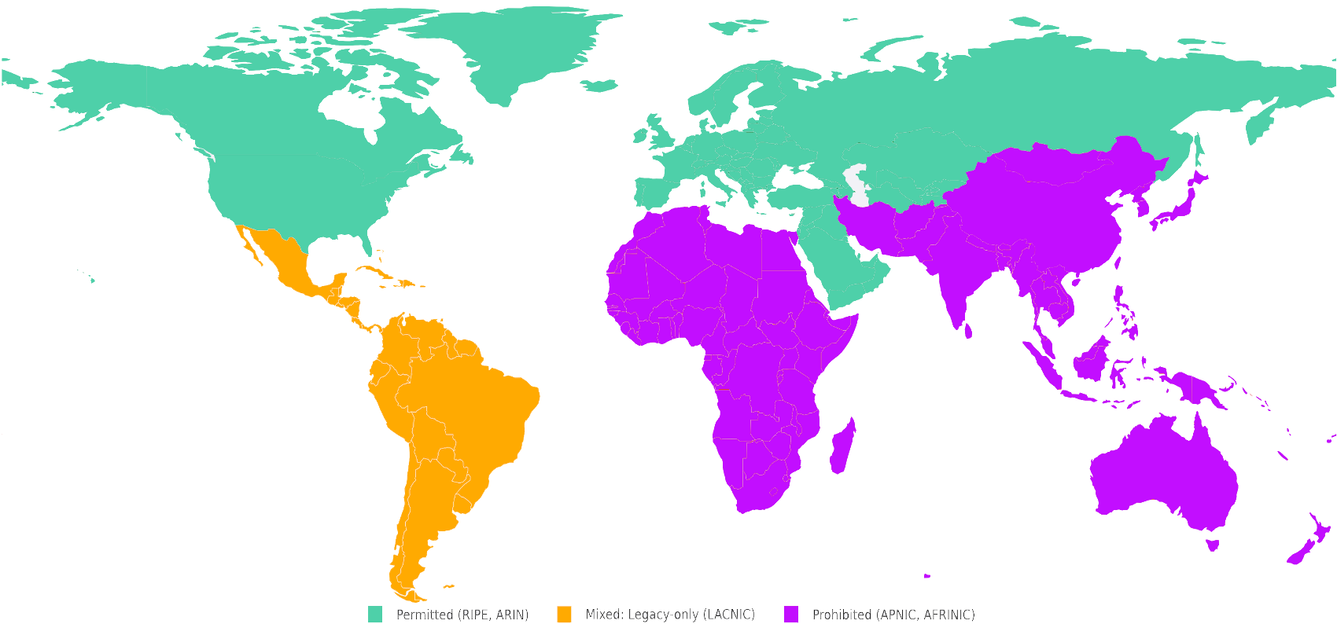
RIR Policies on IPv4 Leasing (2025)
Notes:
This world map helps visualize it.
Green regions — RIPE and ARIN — are where leasing is clearly allowed.
Orange regions — LACNIC — are where leasing is generally prohibited, but legacy blocks remain an exception.
Red regions — APNIC and AFRINIC — are where leasing is outright prohibited by policy.
The map makes it obvious: leasing as a practice is not globally harmonized. Some regions treat it as legitimate, others ban it outright. This creates both opportunities and constraints, depending on where resources are registered and where demand comes from.
“This table gives a clear snapshot of how each RIR treats IPv4 leasing.
RIPE NCC is the most permissive — leasing is explicitly supported through temporary transfers, as long as everything is recorded in the RIPE Database.
ARIN also allows leasing, but with a caveat: leases don’t count as efficient use when requesting more addresses. So you can lease, but you can’t use it as justification to get more space.
On the restrictive side, APNIC, LACNIC, and AFRINIC all tie IP address use to connectivity or infrastructure. That means no pure leasing allowed — except in LACNIC, where legacy addresses, allocated before LACNIC was created, can still be leased.
So depending on where the addresses are registered, leasing can be either straightforward, limited, or prohibited altogether.
“RIRs still diverge in their policies. RIPE and ARIN allow monetization, while APNIC and AFRINIC prohibit it. Yet, once addresses are leased, they can be used globally. Ironically, the regions most in need of growth are the same ones that prohibit leasing. Policy is out of sync with operational reality.”

Slide 18
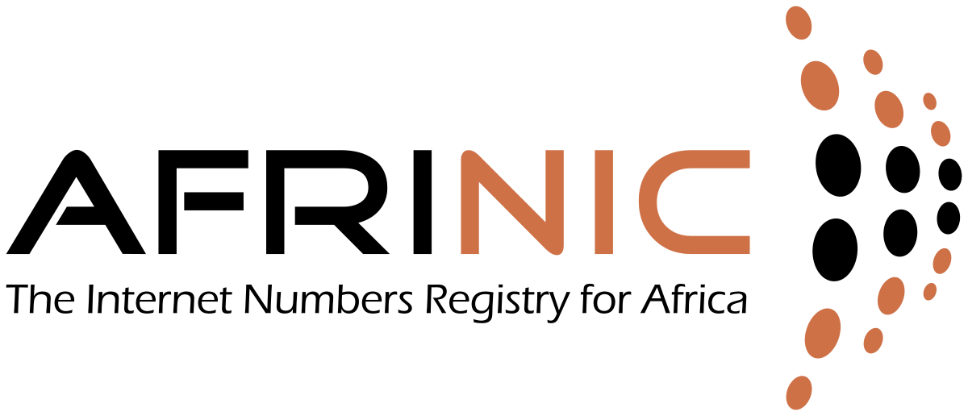
Where Leasing Works Today
CAN MONETIZE
CAN LEASE (as recipients)
Any region
legacy
CANNOT MONETIZE
addresses can be used globally
non-legacy
IPv4 is a universal resource, yet the regions most in need of growth are the same ones that prohibit leasing.
Notes:
To sum it up:
Leasing is fully legitimate in RIPE and ARIN.
In LACNIC, it’s prohibited — with the exception of legacy space.
In APNIC and AFRINIC, policies tie addresses strictly to connectivity, so leasing without services is not allowed.
But here’s the paradox: while leasing is regulated by the RIR where the block is registered, the actual use of addresses is borderless. You can lease space from RIPE or ARIN and announce it anywhere in the world, regardless of the local RIR policy.
That raises a thought-provoking point: IPv4 is a global, universal resource, but policies in the very regions struggling most with connectivity growth — like Africa or parts of Asia — prohibit leasing. In practice, this prevents spare addresses from being monetized and re-used where they could actually accelerate Internet development.
So the question for the community is: are we limiting ourselves with regional policy silos, while the Internet itself doesn’t recognize those borders?”

Slide 19
Leasing – Viable Alternative
Risks
Benefits
Abuse observability rDNS records validation KYC process ASN blocklists Risky industries
IP Hijacking
Instant provisioning
No CAPEX required
WHOIS accuracy
Addressing legacy space
RPKI adoption
More IPv4 in the market
Extra revenue
IPv4 Leasing
Notes:
“Leasing is not risk-free, but it is viable. The benefits: instant provisioning, no CAPEX, more IPs in the market, recurring revenue. T
he risks: abuse, IP hijacking, risky industries. That’s why robust KYC, rDNS validation, and observability are essential. Leasing works, but only with strong governance.”

Slide 20


Launched in 2021 as a US-patented network automation solution to temporarily redeploy idle enterprise network assets to the fast-growing network operators at a fraction of a cost
Notes:
“This is where IPXO comes in. We launched in 2021 with a patented U.S. technology to redeploy idle enterprise assets.

Slide 21
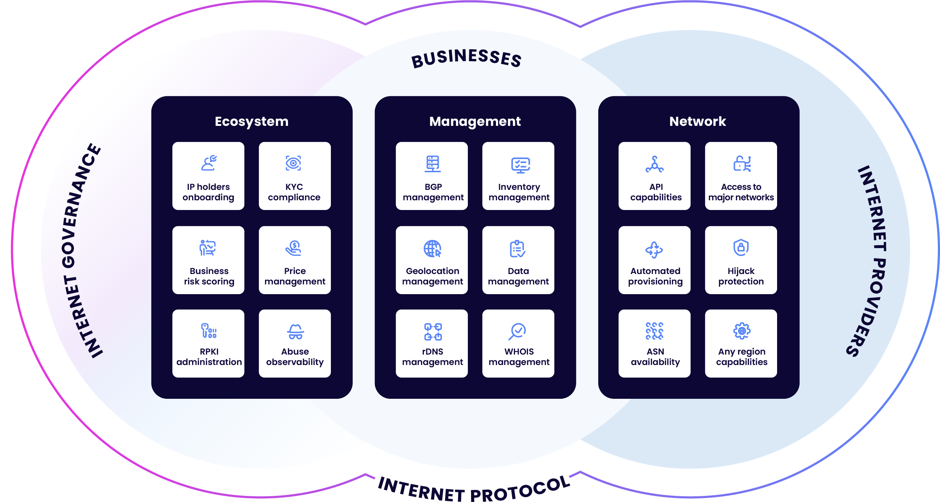
Solution
Develop a unified platform connecting governance and
Internet providers.
Notes:
“Our solution is to unify the ecosystem — connecting IP holders, operators, and governance on a single platform. Automation ensures speed, while compliance ensures trust. This is what keeps the market sustainable.”

Slide 22

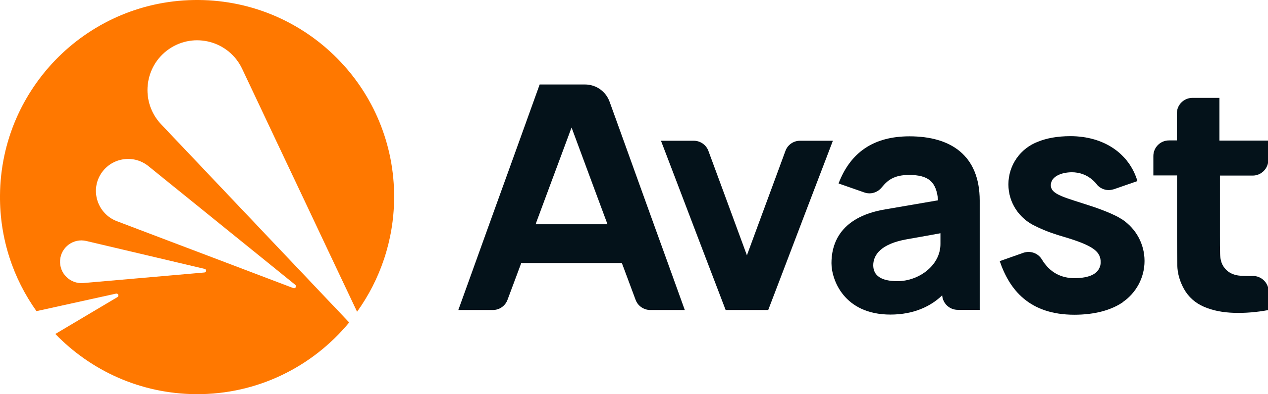


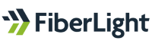
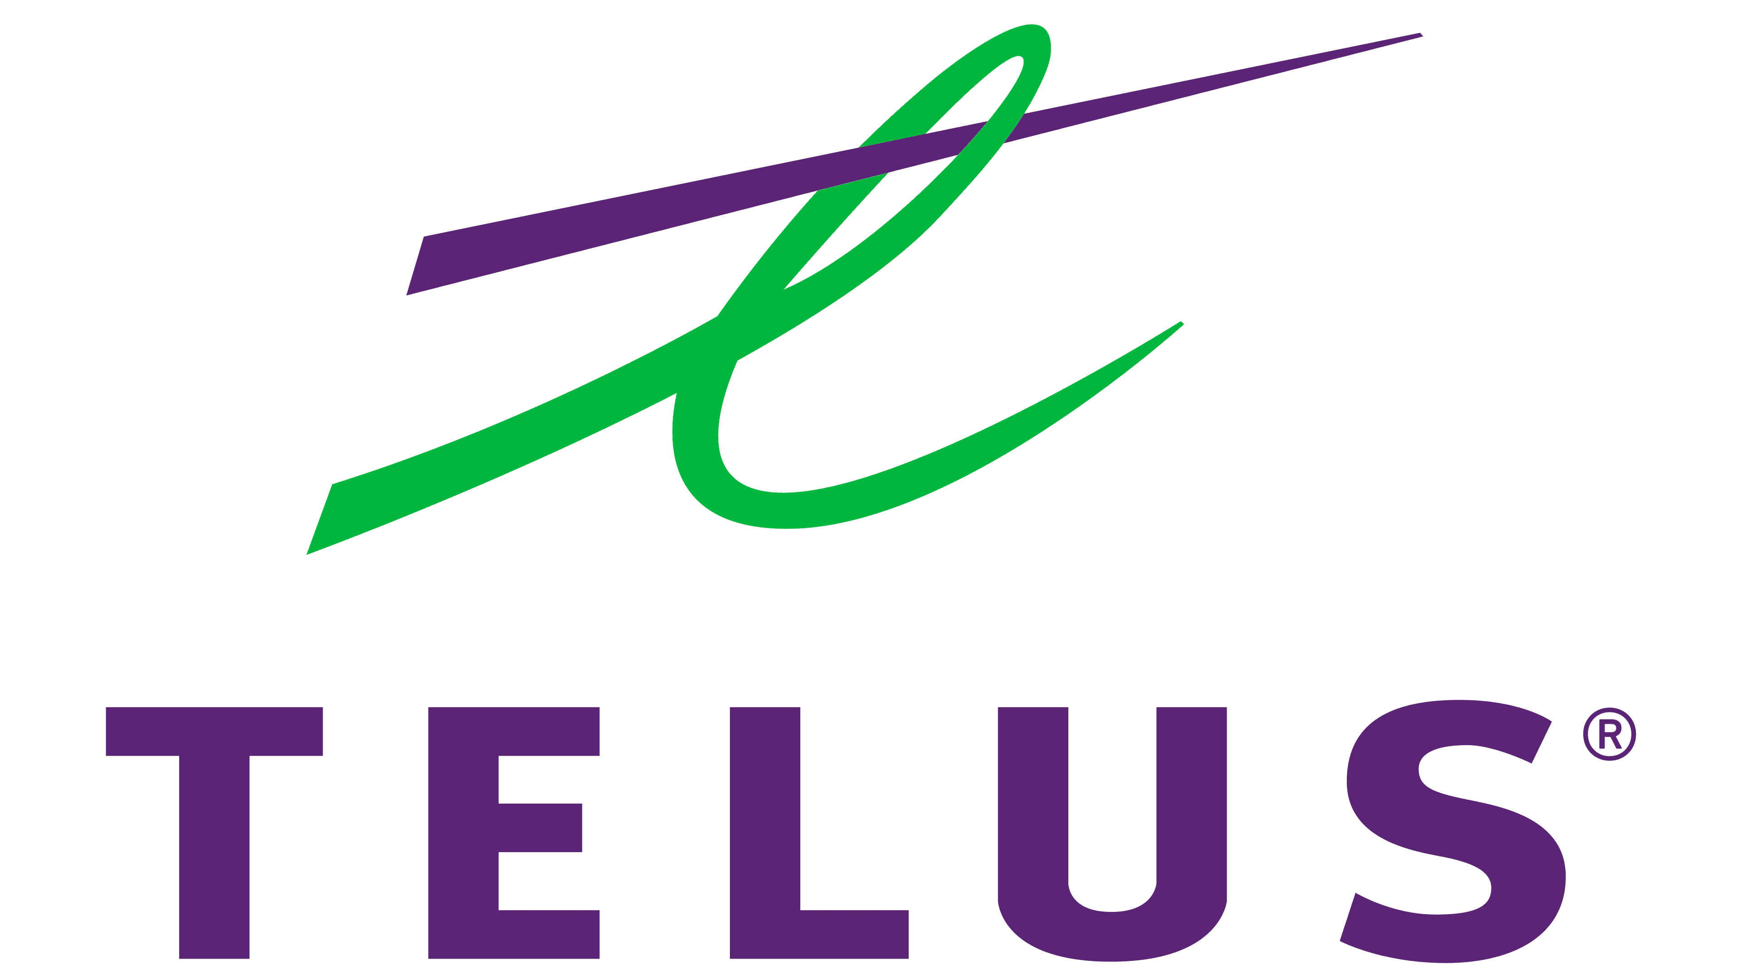
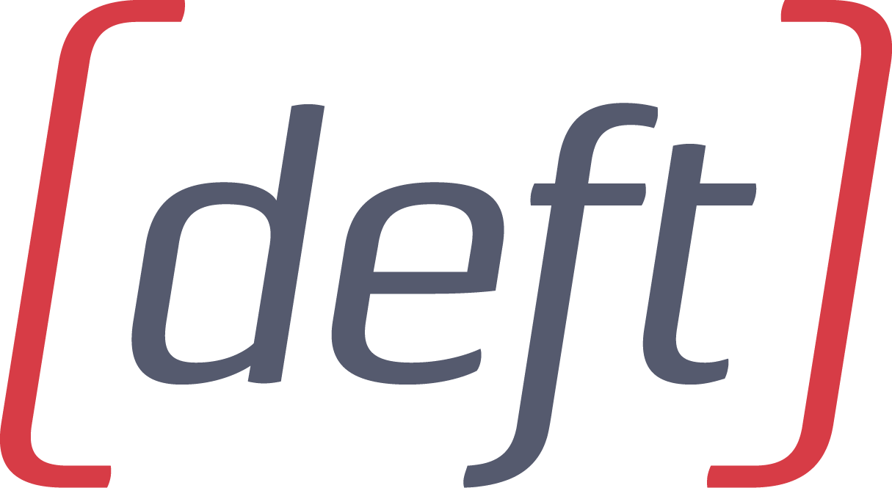
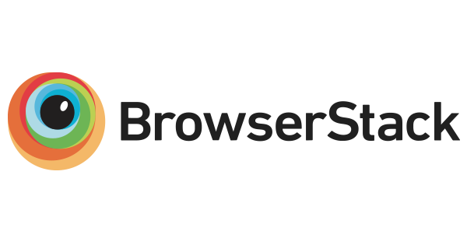
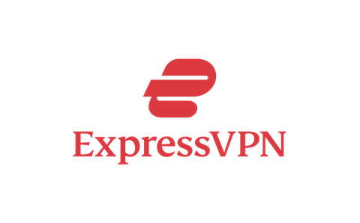


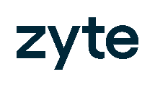
Our know-how
leads the industry
We are trusted by the world's
leading brands
8M+ IP addresses
80% IP utilization rate
400+ IP holders
1600+ IP lessees
B2B customers only
First in the market
Certified and accredited
Notes:
Today, IPXO is trusted worldwide. We manage over 8 million IPs, maintain 80% utilization, support 400 holders and 1,200 lessees, and remain first in the market. Our know-how and certification set us apart. The numbers speak for themselves.”

Slide 23
IP Monetization vs selling comparison
SALE
MONETIZATION
Pros
Pros
One-time significant capital gains
Retaining the ownership
Benefiting from yield gains*
Stable recurring revenue
Cons
Losing the ownership
Not benefiting from yield gains*
Not a recurring revenue
IPv4 monetization provides a stable revenue source, while IP holders benefit from yield gains on the global IPv4 price increase.
Based on global IPv4 pricing statistics, it takes 3 to 4 years of monetization before selling IPv4 assets to receive double the amount compared to selling IPv4 addresses from the start.
* On average, IPv4 addresses display 25% annual yield gains on IP price growth
Notes:
“For holders, the choice is clear: sell once, or monetize continuously. Selling gives a one-time gain, but you lose ownership and miss future appreciation. Leasing means recurring revenue and price growth. On average, monetizing for just 3–4 years can double the returns compared to selling upfront.”

Slide 24
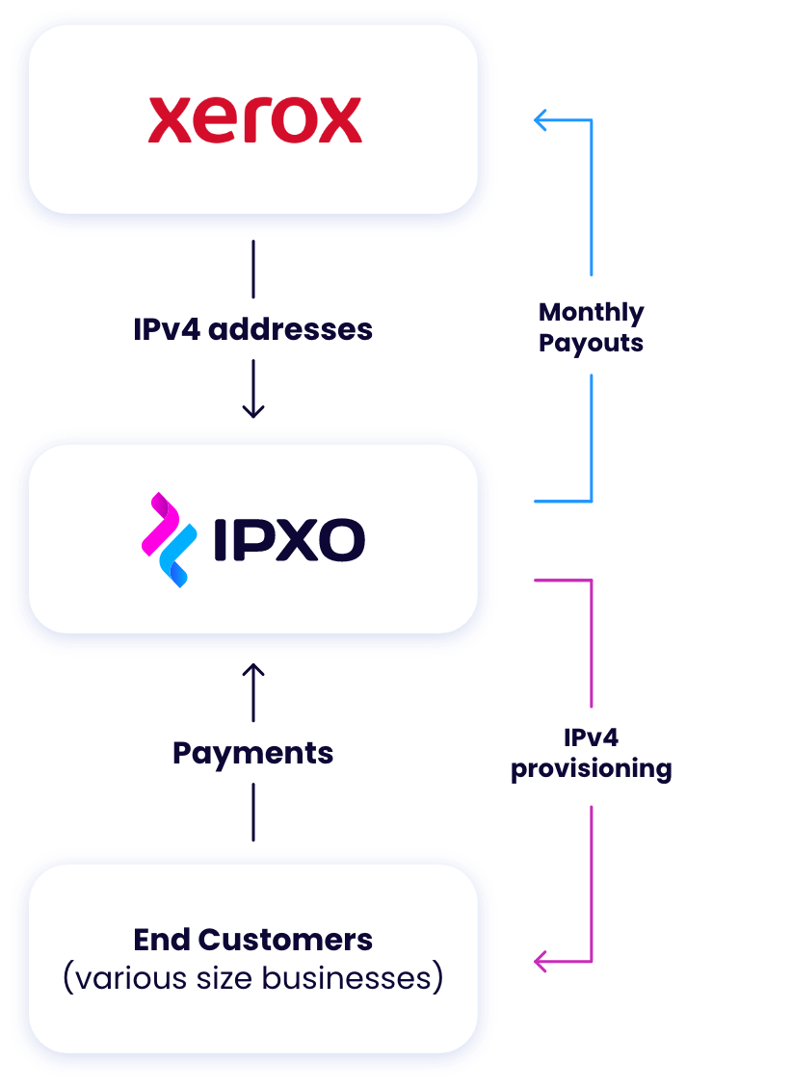

IP Holder
The Process
The IPXO Platform is the first fully automated IP lease platform ensuring quick, easy and secure IPv4 Monetization.
Notes:
“The IPXO platform is the first fully automated lease system. It makes monetization quick, easy, and secure. Automation removes friction, ensuring IPv4 is reused efficiently and responsibly.”

Slide 25
Why choose IP Leasing?
KYC Processes
Full Automation
IP Reputation Management
Robust customer vetting procedures
Automated IP provisioning for end customers
Full abuse observability and management
Geolocation Management
IP Hijack Protection
Inventory Management
Automated Geolocation update mechanism for multiple databases
Preventing unauthorized IP access
Maximizing IP holder's revenue
Notes:
“KYC is central to our platform. Robust vetting prevents abuse. Full automation means faster provisioning. We manage IP reputation, enable geolocation accuracy, and protect against hijacking. We maximize revenue for holders while safeguarding the Internet.”

Slide 26
Lessee perspective key points
Flexibility to make changes
ROI when comparing Buy vs Lease
Fast access to IPs
Notes:
“For lessees, the benefits are just as clear: flexibility to scale, strong ROI compared to buying, and fast access to IPs. Leasing gives them the agility to adjust as networks grow and as IPv6 slowly rolls out.”

Slide 27
Outlook for the future

Slide 28
Outlook for the future
Continuous shortage of IPv4 addresses
Limited supply
Increased demand
Slow transition to IPv6
Economic factors
Notes:
1.
The future is clear: IPv4 shortages will persist. Supply is limited, demand is strong, and the transition to IPv6 is slow. Economic factors and market incentives will keep the IPv4 transfer and leasing markets alive for decades to come. IPv4 will continue to sustain the Internet until IPv6 is finally ready to take over.”
Exhaustion of the IPv4 Address Space:
Global Internet Growth: The rapid expansion of the internet, fueled by the proliferation of connected devices and services, has put a strain on the existing IPv4 address space.
Depletion of Allocations: Regional Internet Registries (RIRs) have exhausted their supply of IPv4 addresses, forcing organizations to rely on the secondary market.
2. Increased Demand:
IoT and Smart Devices: The proliferation of Internet of Things (IoT) devices and smart home technologies is driving demand for IPv4 addresses.
Data Centers and Cloud Services: The growth of data centers and cloud computing services has increased the need for IPv4 addresses to support network infrastructure.
3. Limited Supply:
Secondary Market: The secondary market for IPv4 addresses is fragmented, with limited supply and increased competition among buyers.
Hoarding: Some organizations are hoarding IPv4 addresses, further limiting their availability and driving up prices.
4. Transition to IPv6:
Slow Adoption: The transition to IPv6, which offers a much larger address space, has been slow due to technical challenges, costs, and lack of awareness.
Dual Stack: Many organizations are maintaining dual-stack networks, which require both IPv4 and IPv6 addresses, increasing demand for IPv4.
5. Economic Factors:
Inflation: Inflationary pressures can contribute to rising prices for goods and services, including IPv4 leases.
Market Speculation: Speculation and investment in IPv4 addresses can drive up prices, particularly in times of economic uncertainty.
As the demand for IPv4 addresses continues to outpace the supply, it is likely that lease prices will remain high or continue to increase in the coming years.

Slide 29
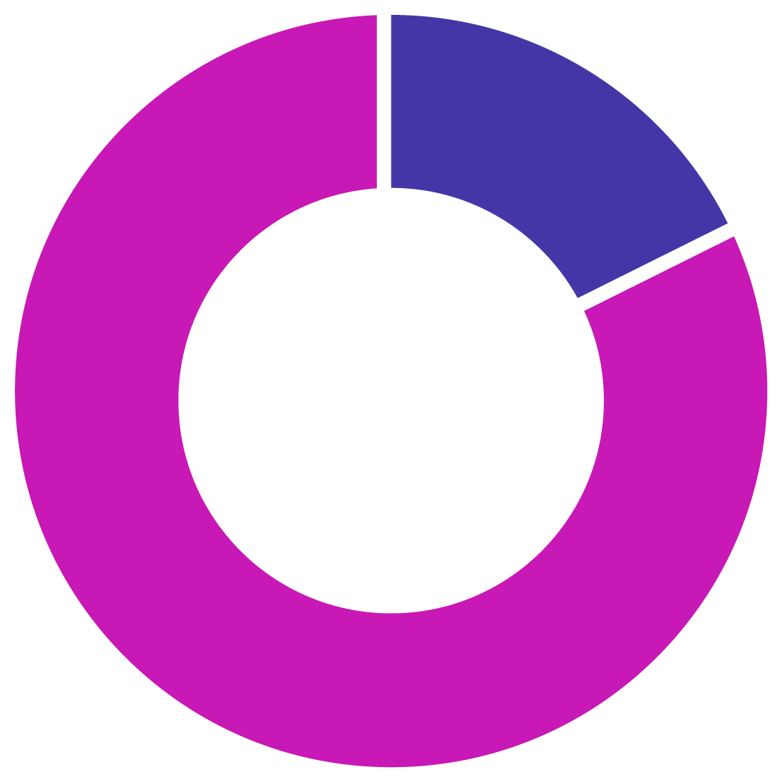
15.68%
(-1.97)
Not announced
(577,988,184 IPv4)
(- 72,717,328)
Total allocated IPv4 pool
84.32%
(+1.97%)
3,687,172,600 (+337,184)
Total IPv4 address space announced
(3,108,847,232 IPv4) (+72,380,144)
Notes:
As we close, let me leave you with this. IPv4 is far from obsolete. In fact, since the beginning of this year alone, over 70 million IPv4 addresses have been added to the global routing table.
That’s not a sign of a dying protocol — that’s proof that IPv4 is still absolutely critical for the Internet.
More than 84% of the global IPv4 pool is announced and active. Operators keep bringing more space online, and the need is not slowing down.
So the story is clear: IPv6 is the future, yes — but IPv4 is still the present. And without bridging solutions like transfers and leasing, the Internet would not be able to sustain its growth today.”

Slide 30

Q&A

Slide 31

Paulius Judickas
VP of Strategic Alliances
paulius@ipxo.com

