Slide 1

Securing the Backbone: Defending Peering Networks Against DDoS, Blackholing Risks, and VPN Threats
Yolandi Cloete
Interconnection Community & Academy Manager

Slide 2
Security in Peering Environments
Importance
What is it? Security in peering refers to the measures and controls implemented to protect the interconnected networks that exchange traffic directly. It involves safeguarding routing protocols, access controls, and data integrity between peers.
Peering enables efficient, low-latency data exchange and greater control over traffic routing, improving network performance and reducing costs.
Security is vital to maintain service availability, data confidentiality, and trust between peering partners.
What if the attacker is already inside your peering relationship?
Notes:
Talking Point: Imagine you’re the network engineer for a global streaming platform. On the day of a major live event, suddenly millions of users experience buffering and outages. The culprit? A targeted DDoS attack on your peering point. Cisco. (2024). Cisco Cyber Threat Trends Report. [online] Available at: https://www.cisco.com/c/en/us/products/security/cyber-threat-trends-report.html.
‌

Slide 3
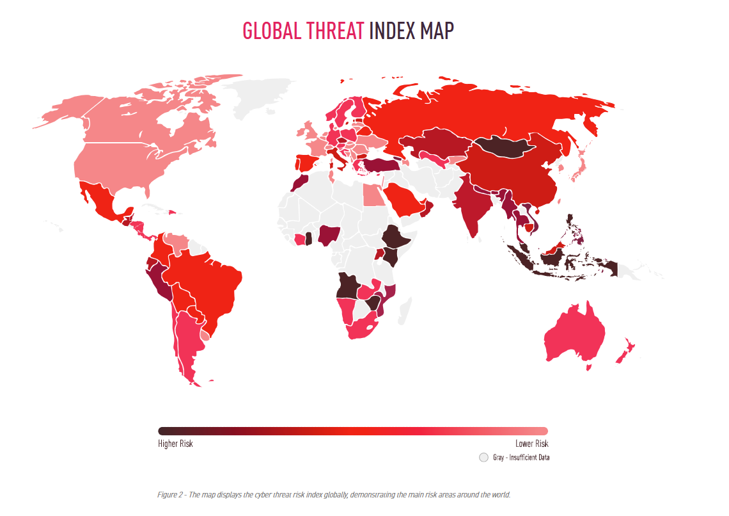
2024 Cyber Security Events
Notes:
Check Point: https://engage.checkpoint.com/security-report-2025/?utm_campaign=dg-cm_ps_25q1_ww_all_mix-gen-inf-cyber-security-report-2025-or_en-gsem&utm_source=google-dg&utm_medium=cpc&utm_term=annual%2Bcyber%2Bthreat%2Breport&utm_content=cyber_threat_report&gad_source=1&gad_campaignid=22120823898&gbraid=0AAAAADIBfpeunKBWPtARmsZG13MZKkU9G&gclid=Cj0KCQjw18bEBhCBARIsAKuAFEb-doVlPLwTwYpW75_GrOT6bsFRuLa_H_LnzUFMRWDeZCPYs5Ihw5IaAhZWEALw_wcB

Slide 4
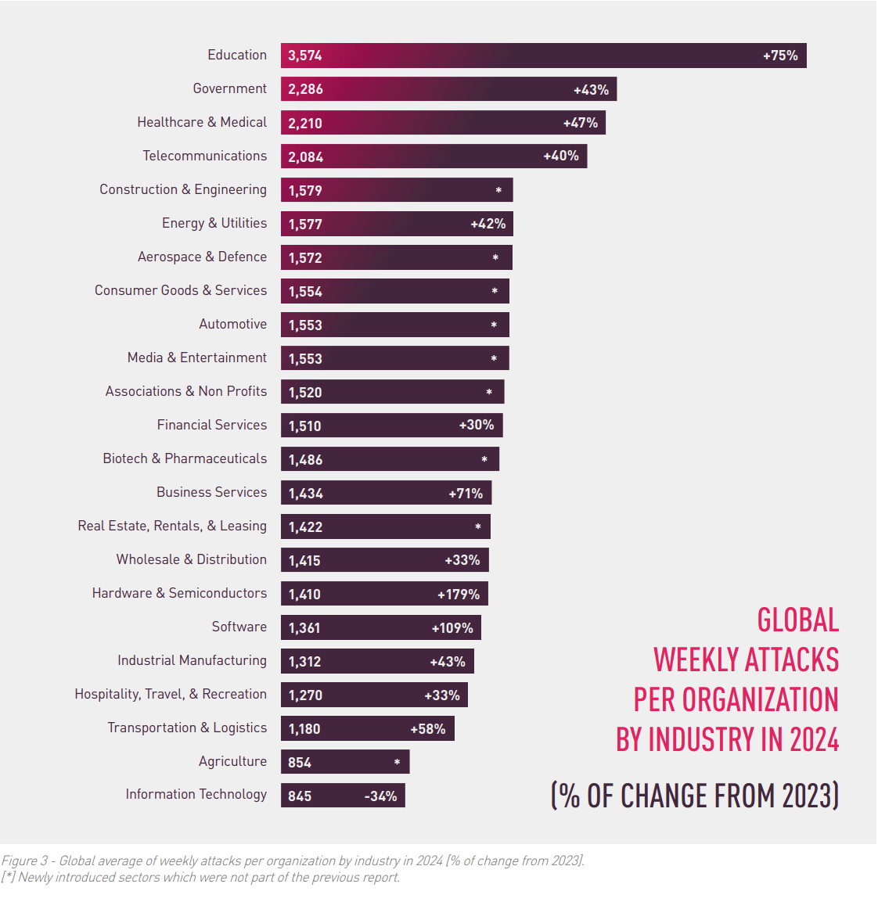
2024 Cyber Security Events
Notes:
Check Point: https://engage.checkpoint.com/security-report-2025/?utm_campaign=dg-cm_ps_25q1_ww_all_mix-gen-inf-cyber-security-report-2025-or_en-gsem&utm_source=google-dg&utm_medium=cpc&utm_term=annual%2Bcyber%2Bthreat%2Breport&utm_content=cyber_threat_report&gad_source=1&gad_campaignid=22120823898&gbraid=0AAAAADIBfpeunKBWPtARmsZG13MZKkU9G&gclid=Cj0KCQjw18bEBhCBARIsAKuAFEb-doVlPLwTwYpW75_GrOT6bsFRuLa_H_LnzUFMRWDeZCPYs5Ihw5IaAhZWEALw_wcB

Slide 5
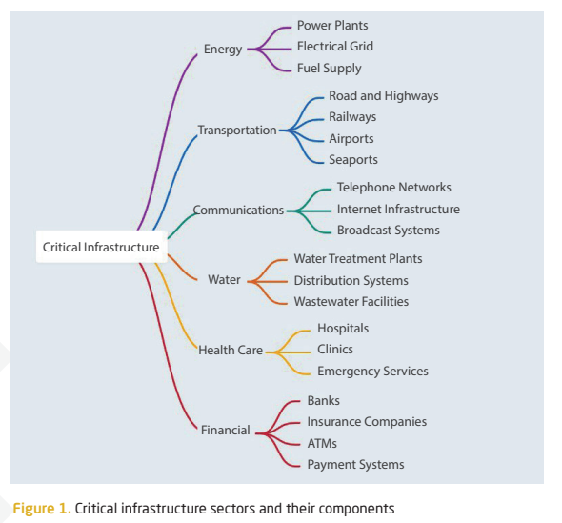
Cyberattacks in the Baltics
According to the National Cyber Security Centre:
‘There had been an increase in targeting of the region ranging from ransomware to sophisticated state sponsored attacks.’
‘The most targeted sectors are energy, especially oil and gas, transportation sector, including maritime and aviation, and communication networks.’
Notes:
GlobalSecurityMag.fr – Cybersecurity in Former Soviet Countries
Key Points
Baltic States and Ukraine lead in cybersecurity among former Soviet countries due to strong digital infrastructure and proactive defense strategies.
The region faces persistent threats from Russian-linked actors, especially targeting critical infrastructure and government systems.
Cyber maturity in the Baltics is significantly higher than in other post-Soviet states, thanks to EU integration and NATO collaboration.
IRJournal.pl – Baltic States Cybersecurity Policy
Key Points
The Baltic States (Estonia, Latvia, Lithuania) are rapidly developing cyber capabilities in response to geopolitical threats, especially from Russia .
Digital Economy and Society Index (DESI) data shows strong progress in digitalization and cyber resilience.
Challenges include:
Resource limitations for small states
Fragmented regional coordination
Dependence on external cybersecurity expertise
Cybersecurity is now a pillar of national defense, closely tied to NATO’s collective security strategy.
Freiheit.org – Baltic Digital Transformation & Security
Key Points
Estonia is a global leader in digital governance, with 99% of public services online and pioneering e-residency and e-voting.
Lithuania and Latvia are catching up, focusing on cyber education, digital literacy, and secure digital infrastructure.
The Baltics are seen as models for digital resilience, especially in the face of hybrid threats from Russia.
Education and innovation are central to long-term cybersecurity strategy.
Themes to Highlight
Regional Leadership: Estonia’s digital success and Lithuania’s rapid progress.
Cyber Defense as National Strategy: Cybersecurity is not just IT — it’s defense.
Hybrid Threats: Cyber attacks are part of broader geopolitical strategies.
Education & Innovation: Investing in digital literacy and secure infrastructure.
National cyber security centre: https://www.nksc.lt/doc/rkgc/2024_Cyber_Threats_to_Critical_Infrastructure_in_the_Baltic_Sea_region.pdf Surfshark (2025). Cybersecurity in former Soviet countries: Ukraine and the Baltic states are in the lead – Global Security Mag Online. [online] Global Security Mag Online. Available at: https://www.globalsecuritymag.fr/Cybersecurity-in-former-Soviet-countries-Ukraine-and-the-Baltic-states-are-in.html [Accessed 5 Aug. 2025].
‌
Górka, M. (2023). Baltic States Cyber Security Policy: Development of digital capabilities in 2017-2022. Stosunki Międzynarodowe – International Relations, 3, p.15. doi:https://doi.org/10.12688/stomiedintrelat.17684.1.
‌
Friedrich Naumann Foundation. (2024). Baltic Security in a Global Context: Challenges, and Collaborations : baltics. [online] Available at: https://www.freiheit.org/central-europe-and-baltic-states/episode-2-baltics-estonia-lithuania-latvia-overview.
‌

Slide 6
DDoS Attacks in Peering
What is it? A Distributed Denial of Service (DDoS) attack is a malicious attempt to overwhelm a network or service by flooding it with excessive traffic from multiple sources, causing disruption or downtime.
Risks
Overwhelmed peering links lead to network downtime and service degradation.
Collateral damage to other networks sharing peering infrastructure.
Increased operational costs due to mitigation efforts and potential SLA penalties.
Notes:
Talking Point: “Imagine a flood of traffic so large it overwhelms your network’s front door.” Attacker’s View: “Attackers seek the busiest peering points to maximize disruption.”

Slide 7
DDoS Attacks in Peering
Real-World Example: Crypto Sector Under Siege
In Q2 2025, Cloudflare mitigated over 6,500 hyper-volumetric DDoS attacks, averaging 71 per day.
One notable incident involved a crypto exchange targeted during a major token launch, causing multi-hour outages and $12M in trading losses.
Attackers exploited Layer 7 (HTTP) vectors to mimic legitimate traffic, bypassing basic defenses.
Notes:
Khalil, M. (2025). DDoS Attack Statistics: How Attacks Are Escalating Worldwide. [online] DeepStrike. Available at: https://deepstrike.io/blog/ddos-attack-statistics.
‌
Watson, M. (2025). Cloudflare records largest DDoS attack at 7.3 Tbps in Q2 2025. [online] SecurityBrief Australia. Available at: https://securitybrief.com.au/story/cloudflare-records-largest-ddos-attack-at-7-3-tbps-in-q2-2025 [Accessed 1 Aug. 2025].
‌
The Cloudflare Blog. (2025). Hyper-volumetric DDoS attacks skyrocket: Cloudflare’s 2025 Q2 DDoS threat report. [online] Available at: https://blog.cloudflare.com/ddos-threat-report-for-2025-q2/.
‌
https://www.cloudflare.com/learning/ddos/famous-ddos-attacks/

Slide 8
DDoS Attacks in Peering
Real-Life Examples & Impact
Dyn DNS Attack (2016): Disrupted major websites globally.
GitHub DDoS Attack (2018): Massive attack mitigated quickly but demonstrated threat scale.
Business Impact: Loss of revenue (network downtime costs businesses $5,600+ per minute on average), customer churn, and reputational damage.
Network Impact: Congestion, increased latency, and potential overload of mitigation resources.
Layered defenses and collaboration are your best shields.
Notes:
Blain Communications and CASA Software (2024). CASA Software highlights impact, cost of network and app downtime. [online] ITWeb. Available at: https://www.itweb.co.za/article/casa-software-highlights-impact-cost-of-network-and-app-downtime/kYbe97XbrV3qAWpG [Accessed 6 Jul. 2025].
‌

Slide 9

DDoS Attacks in Peering
What is the motivation?
Revenge
Competition
Politics
Cloaking Criminal Activity
War
Employees
Customers
Litigations
Disgruntled Hackers
Reputational Damage
Operations are halted
Decrease in sales
Political Organizations
Terrorists
Cloaking other hacking efforts (Distraction)
Used to prevent companies from warning customers of fraud, etc.
There are three common types of DDoS attacks:
Volumetric (Gbps)
Protocol (pps)
Application layer (rps) attacks.
Notes:
Indusface (n.d.). What is a DDoS Attack? Why are DDoS Attacks Dangerous. [online] Indusface. Available at: https://www.indusface.com/learning/what-is-a-ddos-attack/.
‌
Cloudflare (2025). What is a DDoS attack? [online] Cloudflare. Available at: https://www.cloudflare.com/learning/ddos/what-is-a-ddos-attack/.
‌
Imperva (2021). DDoS Attack Types & Mitigation Methods | Imperva. [online] Learning Center. Available at: https://www.imperva.com/learn/ddos/ddos-attacks/.
‌

Slide 10
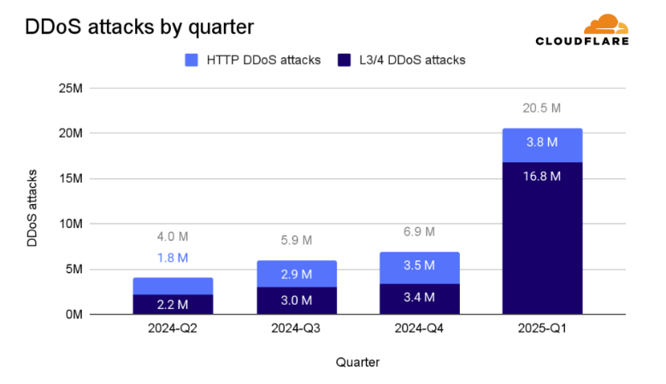
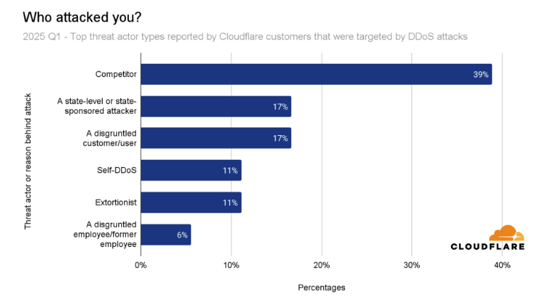
DDoS Attacks in Peering
Stats & Trends
27.8 million DDoS attacks blocked in the first half of 2025 — already 130% of all attacks in 2024.
358% year-over-year increase in attack volume in Q1 2025.
DNS-layer attacks surged by 876%, and HTTPS floods now account for 21% of all DDoS traffic.
Notes:
Talking Point: "DDoS is no longer just noise — it's a precision weapon aimed at high-value targets like crypto exchanges, news outlets, and critical infrastructure." Yoachimik, O. and Pacheco, J. (2025). Record-breaking 5.6 Tbps DDoS attack and global DDoS trends for 2024 Q4. [online] The Cloudflare Blog. Available at: https://blog.cloudflare.com/ddos-threat-report-for-2024-q4/.
‌
Khalil, M. (2025). DDoS Attack Statistics: How Attacks Are Escalating Worldwide. [online] DeepStrike. Available at: https://deepstrike.io/blog/ddos-attack-statistics.
‌
Cloudflare.com. (2025). DDoS threat report for 2025 Q2 | Cloudflare Radar. [online] Available at: https://radar.cloudflare.com/reports/ddos-2025-q2.
‌

Slide 11
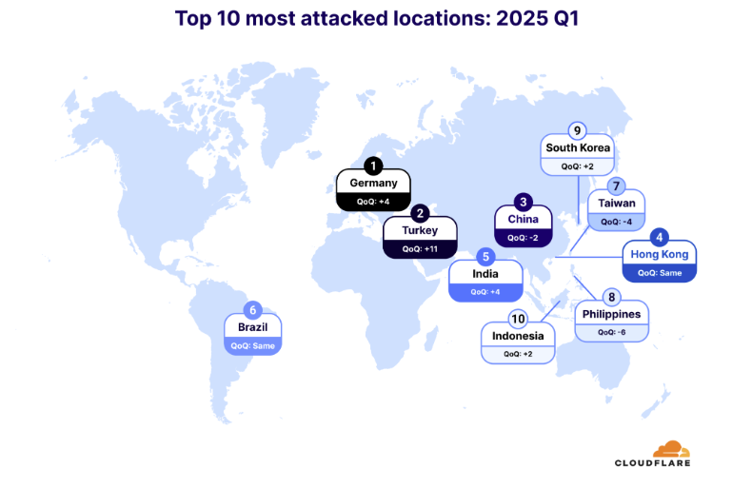
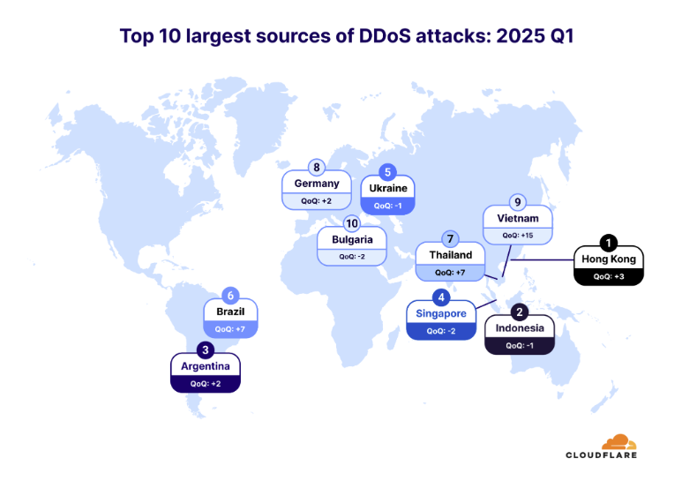
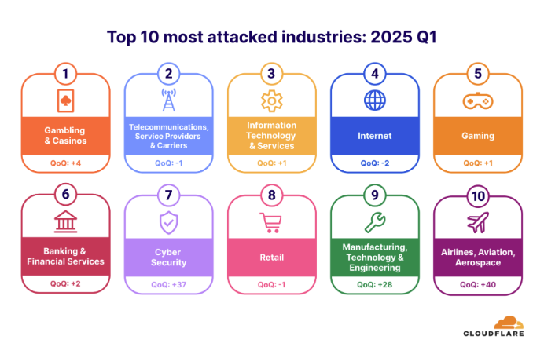
DDoS Attacks in Peering
Emerging Trends to Watch
AI-generated DDoS traffic (mimicking human behaviour)
Attacks on BGP sessions themselves
DDoS-for-hire services becoming more sophisticated
IPv6-based DDoS vectors
Tomorrow’s attacks won’t look like yesterday’s.
Notes:
Talking Point: "DDoS is no longer just noise — it's a precision weapon aimed at high-value targets like crypto exchanges, news outlets, and critical infrastructure." Yoachimik, O. and Pacheco, J. (2025). Record-breaking 5.6 Tbps DDoS attack and global DDoS trends for 2024 Q4. [online] The Cloudflare Blog. Available at: https://blog.cloudflare.com/ddos-threat-report-for-2024-q4/.
‌
Khalil, M. (2025). DDoS Attack Statistics: How Attacks Are Escalating Worldwide. [online] DeepStrike. Available at: https://deepstrike.io/blog/ddos-attack-statistics.
‌
Cloudflare.com. (2025). DDoS threat report for 2025 Q2 | Cloudflare Radar. [online] Available at: https://radar.cloudflare.com/reports/ddos-2025-q2.
‌

Slide 12
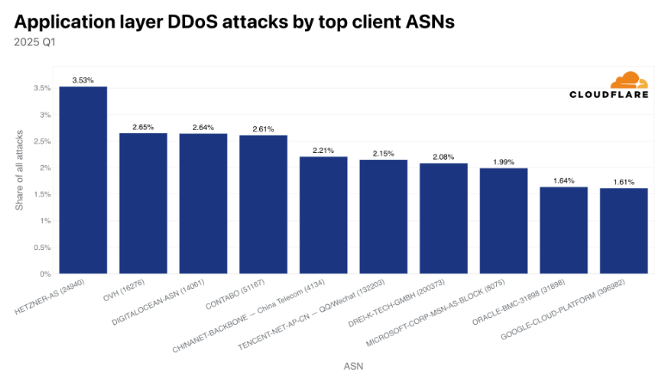
DDoS Attacks in Peering
When looking at where the DDoS attacks originate from, specifically HTTP DDoS attacks, there are a few autonomous systems that stand out.
Notes:
Talking Point: "DDoS is no longer just noise — it's a precision weapon aimed at high-value targets like crypto exchanges, news outlets, and critical infrastructure." Yoachimik, O. and Pacheco, J. (2025). Record-breaking 5.6 Tbps DDoS attack and global DDoS trends for 2024 Q4. [online] The Cloudflare Blog. Available at: https://blog.cloudflare.com/ddos-threat-report-for-2024-q4/.
‌
Khalil, M. (2025). DDoS Attack Statistics: How Attacks Are Escalating Worldwide. [online] DeepStrike. Available at: https://deepstrike.io/blog/ddos-attack-statistics.
‌
Cloudflare.com. (2025). DDoS threat report for 2025 Q2 | Cloudflare Radar. [online] Available at: https://radar.cloudflare.com/reports/ddos-2025-q2.
‌

Slide 13
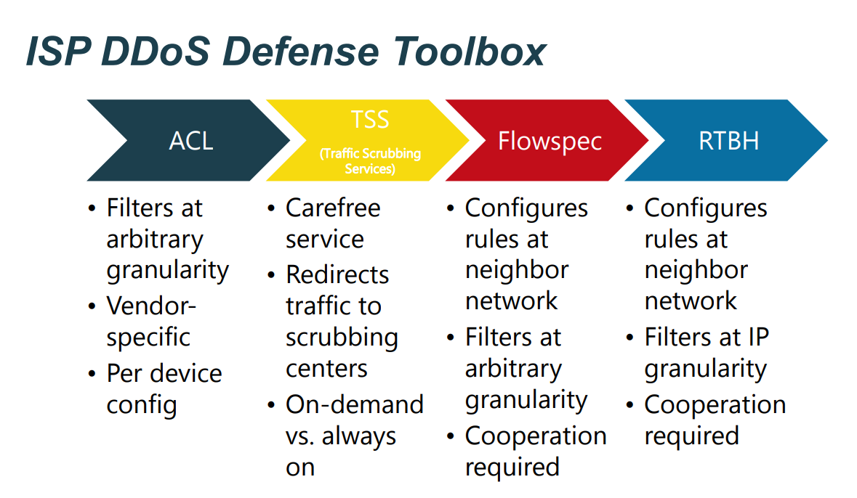
DDoS Attacks in Peering
Key Considerations
Multi-layered DDoS defenses and early detection.
Collaboration with upstream providers and peers.
Investment in scalable mitigation infrastructure.
Notes:
https://ripe78.ripe.net/presentations/9-RIPE_Presentation_MW.pdf

Slide 14
Advanced Blackholing
What is it? Blackholing is a network defense technique where traffic destined for a targeted IP address or prefix is dropped (sent to a “black hole”) to mitigate DDoS attacks.
Advanced blackholing allows for more granular and selective filtering - this advanced method allows selective filtering of malicious traffic based on protocols, ports, and packet headers — preserving legitimate traffic and improving mitigation accuracy.
How It Works
Detection: Anomaly detection systems identify malicious traffic patterns.
Trigger: A blackholing request is sent via API or portal.
Filtering: DE-CIX hardware filters traffic based on Layer 2–4 attributes (e.g., MAC, IP, TCP/UDP ports).
Telemetry: Real-time visibility into dropped traffic and attack behavior.
Recovery: Once the attack subsides, filtering is lifted automatically or manually.
Notes:
Define as being a ‘roadblock’
“It’s Like blocking a road to stop a threat, but risking blocking ambulances too.” DE-CIX – we make interconnection easy. Anywhere. (2025). Blackholing Advanced: optimize your response to DDoS attacks. [online] Available at: https://www.de-cix.net/en/services/blackholing-advanced [Accessed 6 Jul. 2025].
‌
https://www.de-cix.net/_Resources/Persistent/2/7/3/1/2731074c857497be3827ac9537b6e486f27aa57c/Research%20paper-Stellar-Network%20Attack%20Mitigation%20using%20Advanced%20Blackholing.pdf
Matthias Wichtlhuber (2019). Advanced Blackholing at Internet Exchange Points | APNIC Blog. [online] APNIC Blog. Available at: https://blog.apnic.net/2019/07/26/advanced-blackholing-at-internet-exchange-points/ [Accessed 6 Jul. 2025].
‌
DE-CIX India. (2024). DDoS mitigation with Blackholing Advanced - DE-CIX India. [online] Available at: https://www.de-cix.in/white-papers/ddos-mitigation-with-blackholing-advanced/ [Accessed 6 Jul. 2025].
‌
https://ripe78.ripe.net/presentations/9-RIPE_Presentation_MW.pdf

Slide 15
Advanced Blackholing
Why it’s different
Traditional Blackholing | DE-CIX Advanced Blackholing
Drops all traffic to prefix | Filters by protocol, port, and prefix
Manual Activation | Automated triggers via telemetry
High collateral damage | Minimal impact on legitimate traffic
No visibility | Real-time monitoring and analytics
Peer-dependent | Hardware-based, peer-independent
Precision and automation in blackholing can save your network and your customers.
Notes:
Talking Point
“Traditional blackholing is like tossing everything into a black hole — no questions asked. DE-CIX Advanced Blackholing? It’s like using a smart filter at the event horizon — only the bad traffic gets pulled in, the good keeps flowing.” Why We Have It
Traditional blackholing is blunt — it drops all traffic, including legitimate users.
Advanced blackholing is precise — it targets only malicious traffic.
It enables faster response, less collateral damage, and greater control — especially critical in high-volume peering environments like DE-CIX Frankfurt or DE-CIX Mumbai.

Slide 16
VPN Encryption in Peering
What is it? VPN (Virtual Private Network) encryption secures data traffic between peered networks by creating an encrypted tunnel, ensuring confidentiality and integrity of exchanged data.
Importance
VPNs protect data confidentiality and integrity between peered networks.
Critical for compliance and securing sensitive inter-network traffic.
Risks
Weak or outdated encryption exposes data to interception.
VPN endpoints can be targeted for attacks, including DDoS.
Misconfigurations may allow unauthorized access.
Notes:
Talking Point: Imagine your VPN as a secret tunnel—if the lock is weak, intruders can sneak in.
Attacker’s View: “Weak passwords and outdated encryption are invitations to attackers.”

Slide 17
VPN Encryption in Peering
Real-Life Examples & Impact
Colonial Pipeline Attack (2021): Compromised VPN credentials led to ransomware, causing fuel shortages and economic disruption.
Brute-Forced VPN Access: Resulted in lateral movement and data breaches.
Business Impact: Direct financial losses, regulatory penalties, reputational damage.
Network Impact: Service outages, compromised network integrity, increased remediation costs.

Slide 18
VPN Encryption in Peering
Key Considerations
Use strong encryption standards (AES-256, IKEv2).
Enforce multi-factor authentication and strict access controls.
Regular patching and monitoring of VPN endpoints.
Network segmentation to limit exposure.
Strong encryption, MFA, and vigilant monitoring are non-negotiable.

Slide 19
Securing the Backbone in the Baltic Region
Why It Matters
The Baltic states are strategic digital gateways between Western Europe and Eastern networks.
Peering infrastructure here is critical for resilience, especially amid rising hybrid threats and geopolitical tensions.
Regional Trends
Estonia leads in digital governance, but all Baltic states face Russian-linked cyber threats.
Increasing use of hybrid warfare tactics, blending cyber attacks with disinformation and kinetic threats.
Fragmented incident response coordination across borders.

Slide 20

Securing the Backbone: Strategic Actions
Layered DDoS defences at peering points and IXPs.
Advanced blackholing with automation and telemetry.
BGP monitoring tools like BGPStream and Cloudflare Radar.
Regional CTI sharing platforms and joint cyber exercises.
Zero-trust architectures and endpoint hardening for VPNs.
In the Baltic region, securing the backbone isn’t just about uptime — it’s about sovereignty, stability, and trust in the digital age.

Slide 21
Engineer’s Toolkit for Peering Security
Category | Tools & Platforms
DDoS Mitigation | Cloudflare Magic Transit – Combines DDoS protection with BGP hijack detection . Arbor Networks APS – Widely used in IXPs for high-volume attack mitigation. Radware DefensePro – Behavioral-based DDoS detection and mitigation. NetIX Smart Blackholing – Automated blackholing based on traffic thresholds DE-CIX Advanced Blackholing – Fine-grained filtering by protocol, port, and prefix Nokia Deepfield Defender - uses AI and big-data analytics to detect and stop DDoS attacks instantly
Notes:
Talking Point: “Security isn’t a product — it’s a toolkit. Are you stocked up?” Cooper, S. (2025). The Best BGP Monitoring and Anomaly Detection Tools. [online] Comparitech.com. Available at: https://www.comparitech.com/net-admin/bgp-monitoring-tools/ [Accessed 5 Aug. 2025].
‌

Slide 22
Engineer’s Toolkit for Peering Security
Category | Tools & Platforms
BGP Monitoring | BGPStream – Open-source tool for real-time BGP anomaly detection. Cisco Crosswork Cloud Network Insights – Formerly BGPmon; monitors route anomalies and hijacks. Kentik – Offers traffic analytics and BGP anomaly detection with compliance insights. Site24x7 – Cloud-based hybrid monitoring with BGP, NetFlow, and SNMP support. ManageEngine OpManager – Tracks BGP sessions and alerts on route instability
Notes:
Talking Point: “Security isn’t a product — it’s a toolkit. Are you stocked up?” Cooper, S. (2025). The Best BGP Monitoring and Anomaly Detection Tools. [online] Comparitech.com. Available at: https://www.comparitech.com/net-admin/bgp-monitoring-tools/ [Accessed 5 Aug. 2025].
‌

Slide 23
Engineer’s Toolkit for Peering Security
Category | Tools & Platforms
VPN Hardening & Endpoint Security | Cisco AnyConnect – Enterprise-grade VPN with endpoint posture checks. OpenVPN + MFA – Lightweight and secure with multi-factor authentication. Microsoft Defender for Endpoint – Integrates VPN security with threat detection. CISA/NIST Guidelines – Use as a checklist for VPN configuration best practices.
Notes:
Talking Point: “Security isn’t a product — it’s a toolkit. Are you stocked up?” Cooper, S. (2025). The Best BGP Monitoring and Anomaly Detection Tools. [online] Comparitech.com. Available at: https://www.comparitech.com/net-admin/bgp-monitoring-tools/ [Accessed 5 Aug. 2025].
‌

Slide 24
Engineer’s Toolkit for Peering Security
Category | Tools & Platforms
Threat Intelligence Sharing & Collaboration | MISP (Malware Information Sharing Platform) – Open-source CTI sharing platform. Cybercation – Baltic-Nordic initiative for cross-border cybersecurity collaboration. CyberBazaar – Baltic-focused platform showcasing cybersecurity innovations and partnerships . NKSC Lithuania CTI Framework – National-level CTI sharing and incident coordination
Notes:
Talking Point: “Security isn’t a product — it’s a toolkit. Are you stocked up?” Cyberbazaar.eu. (2024). Cyberbazaar. [online] Available at: https://www.cyberbazaar.eu/.
‌
Hural, A. (2025). 12 Best Threat Detection Tools for Cybersecurity. [online] UnderDefense. Available at: https://underdefense.com/blog/best-threat-detection-tools/.
‌
Cyberbridgeforum.com. (2017). Cybercation: Cybersecurity Awareness and Collaboration in the Nordic and Baltic Regions | Cyber Bridge Forum. [online] Available at: https://cyberbridgeforum.com/cybercation/.
‌

Slide 25
Engineer’s Toolkit for Peering Security
Category | Tools & Platforms
Threat Detection | FastNetMon – Real-time DDoS and anomaly detection using NetFlow/sFlow. ARTEMIS – BGP hijack detection and mitigation automation. MANRS (Mutually Agreed Norms for Routing Security) – Best practices and monitoring for routing security. UnderDefense MAXI – AI-native XDR platform with rapid containment and integration. Cynet 360 AutoXDR – Unified detection across endpoints, networks, and users. LogRhythm NextGen SIEM – Advanced analytics and automated threat response. Rapid7 InsightIDR – Detects lateral movement and insider threats.
Notes:
Talking Point: “Security isn’t a product — it’s a toolkit. Are you stocked up?” Hural, A. (2025). 12 Best Threat Detection Tools for Cybersecurity. [online] UnderDefense. Available at: https://underdefense.com/blog/best-threat-detection-tools/ [Accessed 5 Aug. 2025].
‌

Slide 26
Engineer’s Toolkit for Peering Security
Category | Tools & Platforms
DDoS Mitigation | Cloudflare Magic Transit, Kentik RTBH, DE-CIX Advanced Blackholing, Arbor Networks APS, Radware DefensePro, Nokia Deepfield Defender
BGP Monitoring | BGPStream, Cisco Crosswork, Cloudflare Radar, Kentik, Site24/7, ManageEngine OpManager
VPN Hardening | Cisco AnyConnect, CISA/NIST Guidelines, OpenVPN & MFA, Microsoft Defender for Endpoint
Threat Detection | FastNetMon, ARTEMIS, MANRS, UnderDefense MAXI, Cynet 360 AutoXDR, LogRhythm NextGen SIEM, Rapid7 InsightIDR
Community & Learning | RIPE, NANOG, DE-CIX Academy, MISP, Cyberaction CyberBazaar, NKSC Lituania CTI Framework
Notes:
Talking Point: “Security isn’t a product — it’s a toolkit. Are you stocked up?” Cooper, S. (2025). The Best BGP Monitoring and Anomaly Detection Tools. [online] Comparitech.com. Available at: https://www.comparitech.com/net-admin/bgp-monitoring-tools/ [Accessed 5 Aug. 2025].
‌

Slide 27
Summary & Recommendations
Peering enhances performance and reduces costs but introduces security and operational risks that can severely impact business and network health.
Proactive security measures and collaborative mitigation strategies are essential to protect peering infrastructure.
Real-world incidents illustrate the high stakes: downtime costs, reputational damage, and regulatory consequences.
Investing in strong authentication, precise blackholing, layered DDoS defenses, and robust VPN encryption safeguards both network integrity and business continuity.

Slide 28
Thank You!
Email: yolandi.cloete@de-cix.net
Yolandi Cloete
Interconnection Community & Academy Manager

Slide 29
Difference Between Traditional Blackholing and DE-CIX Advanced Blackholing
Aspect | Traditional Blackholing (RTBH) | DE-CIX Advanced Blackholing
Basic Concept | Drops all traffic to a targeted IP prefix by routing it to a null interface, effectively blocking everything (both malicious and legitimate traffic). | Provides fine-grained filtering by selectively dropping or rate-limiting traffic based on Layer 2-4 header information (e.g., MAC, IP, transport protocol, ports).
Granularity | Binary, prefix-level (all-or-nothing) filtering. | Granular filtering by protocol, port, and other header fields, allowing partial blocking and shaping of attack traffic.
Effectiveness | Depends on cooperation of peering ASes to honor blackhole routes; studies show often only ~50% of targeted traffic is dropped, especially for host routes (/32). | Drops attack traffic with 100% reliability by directly using DE-CIX’s own hardware, independent of peer cooperation.
Collateral Damage | High collateral damage since all traffic to the prefix is dropped, including legitimate users. | Minimizes collateral damage by filtering only attack-related traffic, preserving legitimate traffic.
Signaling & Deployment | Requires customers to announce blackhole prefixes via BGP communities; depends on peers to accept and enforce routes. | Uses a simplified signaling interface directly with DE-CIX’s infrastructure; no need for broad peer cooperation.
Scalability & Performance | Limited scalability for Tbps-level attacks; slower reaction due to manual or semi-automated processes. | Scales efficiently to Tbps-level attacks; fast reaction times with hardware-accelerated filtering and rate limiting.
Telemetry & Feedback | No detailed telemetry; traffic is simply dropped without insight. | Provides telemetry on dropped and shaped traffic, enabling better attack analysis and forensics.
Use Cases | Suitable for emergency, blunt mitigation of large attacks when no finer controls are available. | Enables precise, automated, and scalable mitigation tailored to the attack characteristics, reducing impact on services.
Notes:
Talking Point: Traditional blackholing (Remote Triggered Blackholing - RTBH) is a blunt, all-or-nothing approach that drops all traffic to a targeted prefix, often causing significant collateral damage and relying on peer cooperation, which may be incomplete. In contrast, DE-CIX Advanced Blackholing leverages hardware-based, fine-grained filtering and rate limiting directly at the Internet Exchange Point. It offers 100% reliable traffic dropping, reduces collateral damage by filtering specific protocols and ports, scales to massive attack volumes, and provides valuable telemetry—all without requiring cooperation from other peers.

