Slide 1
3 tips for securing your AS-SET
BalticNOG1
Lasse Jarlskov
Lasse.Jarlskov@teliacompany.com
2025-09-25

Slide 2
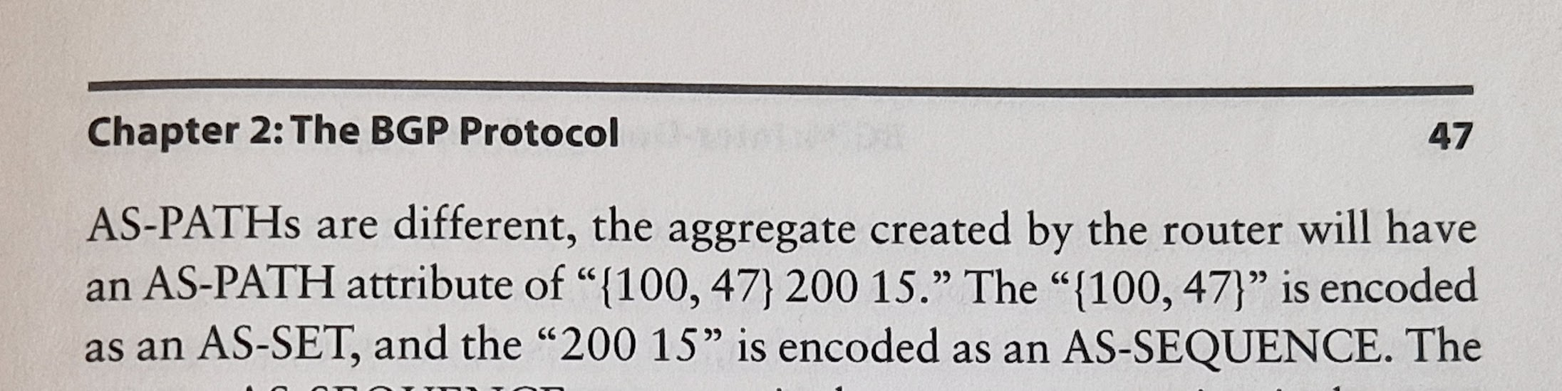
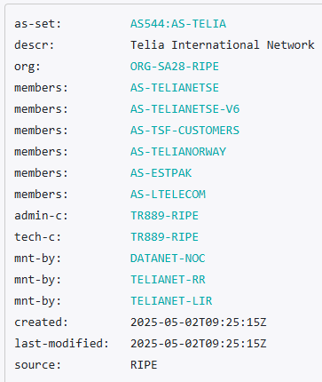
What is an AS-SET?
BGP: AS_SET
  Will show up in { } in your router
  Never used - deprecated
IRR DB: AS-SET
  e.g. RIPE DB
  Used to create route-filters

Slide 3
AS-SET use-cases
1. Customers
Announcements towards IP transit
Most common use-case by far.
2. Peers / Peering-routes
Useful for whom?
Neat RPSL definitions, and so what?
3. IXP members
Used to filter your BGP session to the route-server

Slide 4
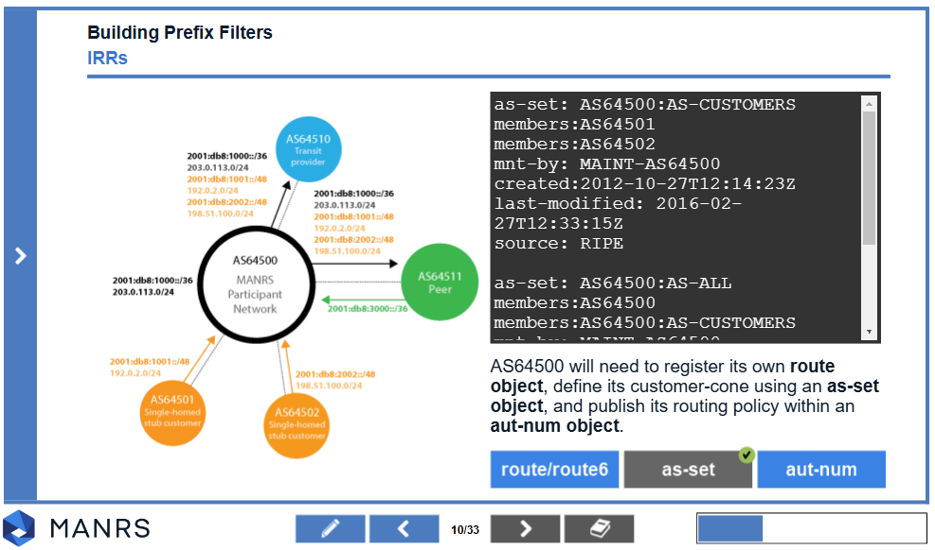
AS-SET use-cases
1. Customers
2. Peers
3. IXP members
Documents your upstream announcements
Upstream providers will use this to create filters
Most AS-SETs are this type!
Documenting peerings
Used in RPSL documentation
Does anyone actually use this for filtering??
Cause for confusion
IXP
Used to filter your BGP session to the route-server
Harmful?
Harmful?

Slide 5
3 tips for securing your AS-Set
Your AS-set purpose
What are you including?
  Beware of the size!
  Bigger is not better!
Who are including you?

Slide 6
3 tips for managing your AS-Set
Understand your AS-set purpose
What are you including?
Who are including you?
What are you documenting here?
Will this AS-set actually be used by anyone to generate filters?
  If not, maybe you are just creating more confusion?

Slide 7
Understand your AS-set purpose
AS-SOX
->
AS-DATAIX (RIPE)
->
as-cais (RADB)
->
as3491:as-customers-eu (RADB)
->
AS-BROADNETIL (RIPE)
->
AS-DIGICOMMPS (RIPE)
->
as200455:as-peers (RIPE)
->
AS-LOCIX (RIPE)
->
AS-BALKAN-IX (RIPE)
->
AS-NL-IX-RS (RIPE)
->
as-1-ix-waw (RIPE)
->
AS-DECIX
->
AS6695:AS-DECIX-FRA
->
AS-LTELECOM
Example: AS-SOX
3 different types of AS-SETs:
  Customers
  Peers
  IXP Members
If you are listing customers.
  Don’t include an IXP.
If you are listing peers
  Why are you even doing it?
If you are listing IXP members.
  Don’t list your members’ peers.
Rule of thumb:
  Would you readvertise this in BGP?

Slide 8
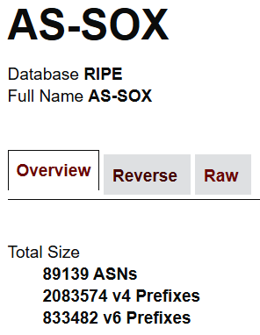
Understand your AS-set purpose
AS-SOX
->
AS-DATAIX (RIPE)
->
as-cais (RADB)
->
as3491:as-customers-eu (RADB)
->
AS-BROADNETIL (RIPE)
->
AS-DIGICOMMPS (RIPE)
->
as200455:as-peers (RIPE)
->
AS-LOCIX (RIPE)
->
AS-BALKAN-IX (RIPE)
->
AS-NETIX-INT
->
AS-SET-UTG
->
AS-ARMENTEL
->
AS-TELARM
->
AS-SOVAM
->
AS-MMTS
->
AS-MELBICOM
Example: AS-SOX (Serbian Open Exchange)
  Includes far more ASNs and prefixes than the global routing table.
  Example: Includes local company Melbicom
3 different types of AS-SETs:
  Customers
  Peers
  IXP Members
If you are listing customers.
  Don’t include an IXP.
If you are listing peers
  Why are you even doing it?
If you are listing IXP members.
  Don’t list your members’ peers.
Rule of thumb:
  Would you readvertise this in BGP?

Slide 9
3 tips for managing your AS-Set
Understand your AS-set purpose
What are you including?
Who are including you?
Beware of the size!
Bigger is not better.
Recursive references are powerful and dangerous.
The bigger your AS-set, the more threat to routing security.
Clean up regularly.
A lean as-set improves routing security!
This is your contribution to the routing security for everyone else.

Slide 10
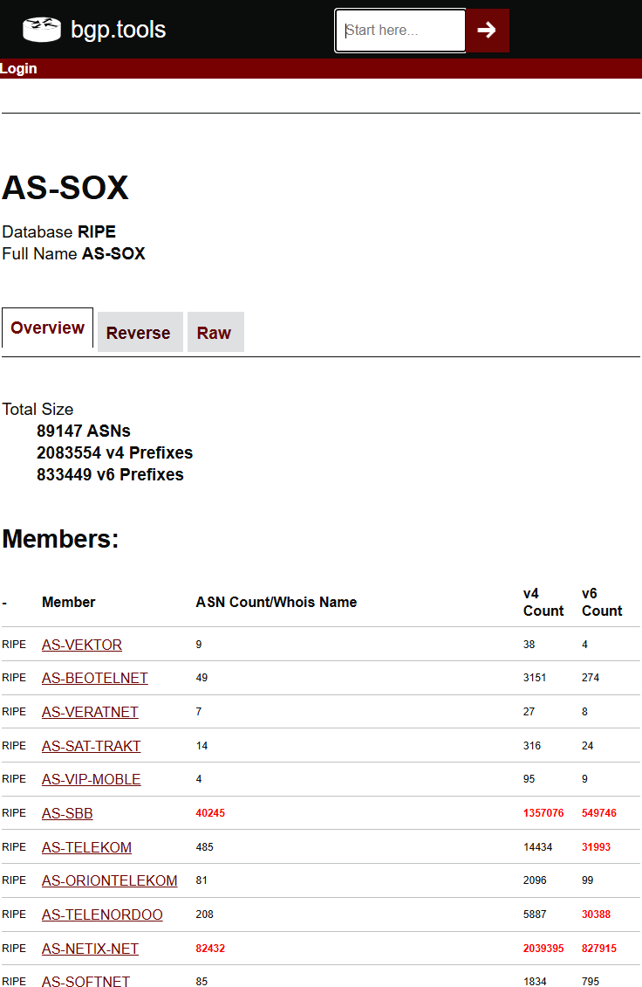
What are you including?
Include only what you would advertise
Check and double-check the size of your customers’ AS-sets.
BGP.tools has an excellent tool to view the size of your AS-set member AS-sets.
IP Transit
RPSL-based filtering
Accidental route leak?
Your AS
Accidental route leak?
Customer
Rule of thumb:
  Would you readvertise this in BGP?

Slide 11
3 tips for managing your AS-Set
Understand your AS-set purpose
What are you including?
Who are including you?
This is where you get to police everyone else.
Unfortunately no automatic approval available.
If your ASN/AS-set is included in someone elses policy, then your routes will be accepted by their upstream.
Every inclusion, is a potential BGP hijack/leak affecting your customers.

Slide 12
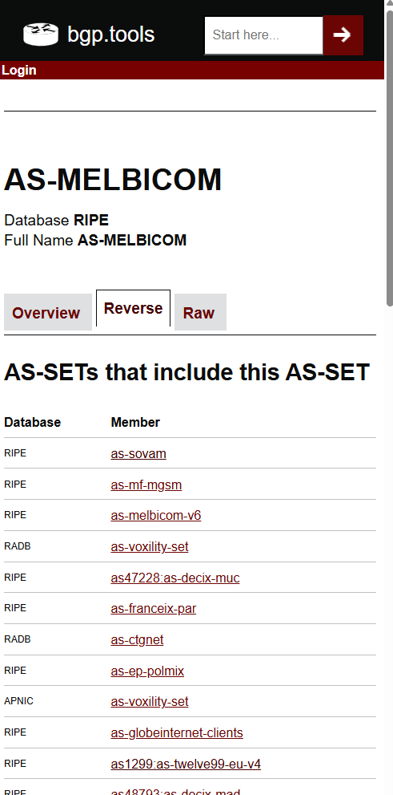
Who are including you?
Use BGP.tools ”reverse” features to easily discover who are including your AS-set.
All inclusions are a potential BGP hijack
Rule of thumb:
  Would you readvertise this in BGP?

Slide 13

Further reading
Summary
Rule of thumb:
  Would you readvertise this in BGP?
DKNOG15: Prelude to a BGP hijack?
https://events.dknog.dk/event/32/contributions/297/
The Scourge of Excessive AS-SETs | Kentik Blog
https://www.kentik.com/blog/the-scourge-of-excessive-as-sets/
Module 2: IRRs, RPKI, and PeeringDB – MANRS
https://manrs.org/resources/training/tutorials/irrs-rpki-peeringdb/
Questions?

