Slide 1
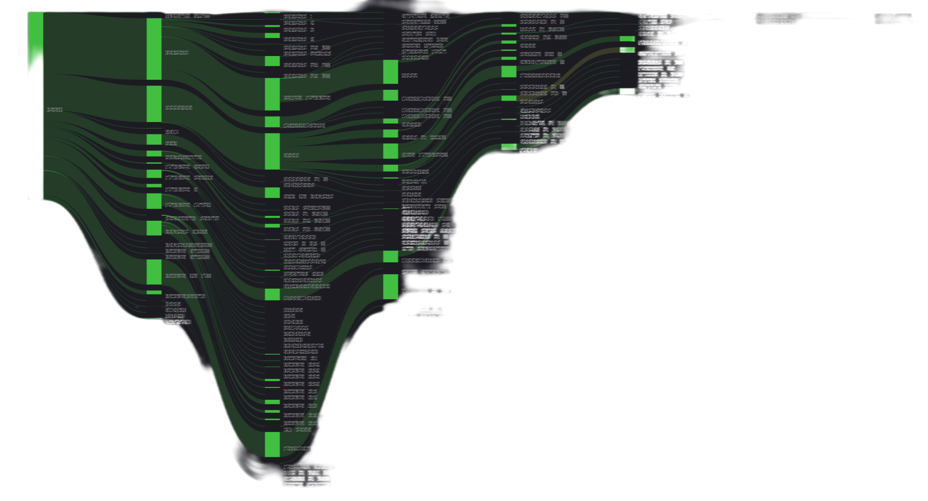
Every ISP Needs To Use A QoE Middle-Box On Their Network
BalticNOG
Robert Chacón
CEO, LibreQoS
robert@libreqos.io
Herbert Wolverson
CPO, LibreQoS
hwolverson@libreqos.io
Frantisek (Frank) Borsik
Gofer, LibreQoS
frantisek.borsik@gmail.com

Slide 2




LibreQoS - On A Mission to Save The Net
Robert Chacón (CEO): “I must fix this!” Built LibreQoS to apply FQ-CoDel and Cake to customer connections. Founded the LibreQoS project, created a really solid starting point.
Herbert Wolverson (Chief Product Officer): “My ISP Needs This - I’ll Rewrite it in Rust” - Herbert’s ISP in Central Missouri was suffering, LibreQoS made it work again. Along the way, Herbert rewrote a chunk in Rust, and started adding features…
Frantisek Borsik (Gofer): “The Internet Needs This” Frank runs an awesome community, keeps us on track, and has a knack for connecting with ISPs.
Made In Loving Memory of Dave Täht
Dave Täht (Chief Science Officer): “14 years of 100x better internet latency feasible… why hasn’t it deployed fully?” - Created the bufferbloat project.

Slide 3
The Bufferbloat Problem

Slide 4
Bufferbloat? Sounds Uncomfortable!
Have your customers ever…
Called you, complaining of slow speeds? Their net connection is fine - but someone decided to update Call of Duty during a Zoom meeting?
Experienced jittery VOIP phone calls or video-conferencing while everything looks to be fine?
Rage quit a video game and threatened to quit their ISP because of lag?
Most routers enqueue packets linearly.
When the queue is full, packets “bounce off the tail” - they are dropped indiscriminately.
No effort is made to balance “flows”.
Many routers have huge buffers to compensate - and “time in buffer” can become a latency problem by itself.

Slide 5
CoDel, FQ_CoDel and CAKE
CoDel started out adding “time in transit” to packets in a router, dropping old packets.
FQ_CoDel adds a better timing algorithm, and tracks packets per flow - fair queueing. Now your VOIP and Video traffic flows even though the pipe is full.
CAKE adds an even better algorithm, divides traffic into “tins” (by traffic type).
100% Open Source, included in the Linux kernel.
Bufferbloat is most evident when a connection is heavily loaded with downloads or uploads. It causes increased latency (ping), resulting in poor performance for real-time tasks like VoIP, video chat, and lag in online gaming, and generally makes the internet less responsive.

Slide 6

NOTE: Flow Queueing is almost enough today!!
98% of flows don´t need AQM, but the 2% need it desperately and the 98% need the 2% well taken care of.
Otherwise the principal driver of subscriber bandwidth need is video streaming.
To get 4K video, provision about 35 Mbits to the user (DASH 4/10 rule)
Per customer average usage at peak time is no more than 6-10 Mbits.
Gaming, DNS, keystrokes, VOIP and videoconferencing always just work
Once uploads are CAKEd…
nobody cares about lag anymore.
(except on Wi-Fi)

Slide 7
About Bufferbloat & LibreQoS
To date, the advice you will get on the Net is “Install OpenWrt”, and “configure CAKE SQM”. 99% of users don't know they have bufferbloat and even fewer know how to fix it.
The goal of the bufferbloat project has always been to get the ISPs to “do it right” in the first place. Much progress has been made in the cable industry where DOCSIS-PIE and L4S are emerging… but little elsewhere.
Everybody should have CAKE.

Slide 8
SQM´s Problems for ISPs
Shaping inbound on the home router is the wrong place.
It is also CPU intensive there - you need a bigger router.
Requiring router upgrades is expensive.
Doing it right for thousands of customers has multiple bottlenecks.
LibreQoS adds one or more “middlebox(es)” to your network that provides shaping for all of your customers at once.

Slide 9
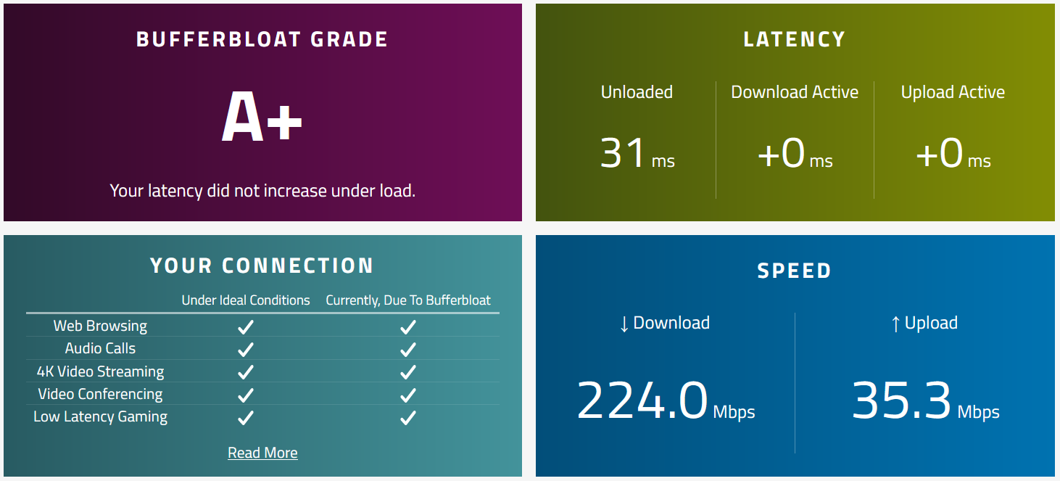
Typical Customer Response w/LibreQoS
Running CAKE to shape inbound on the CPE has more jitter than this.

Slide 10
Challenges

Slide 11
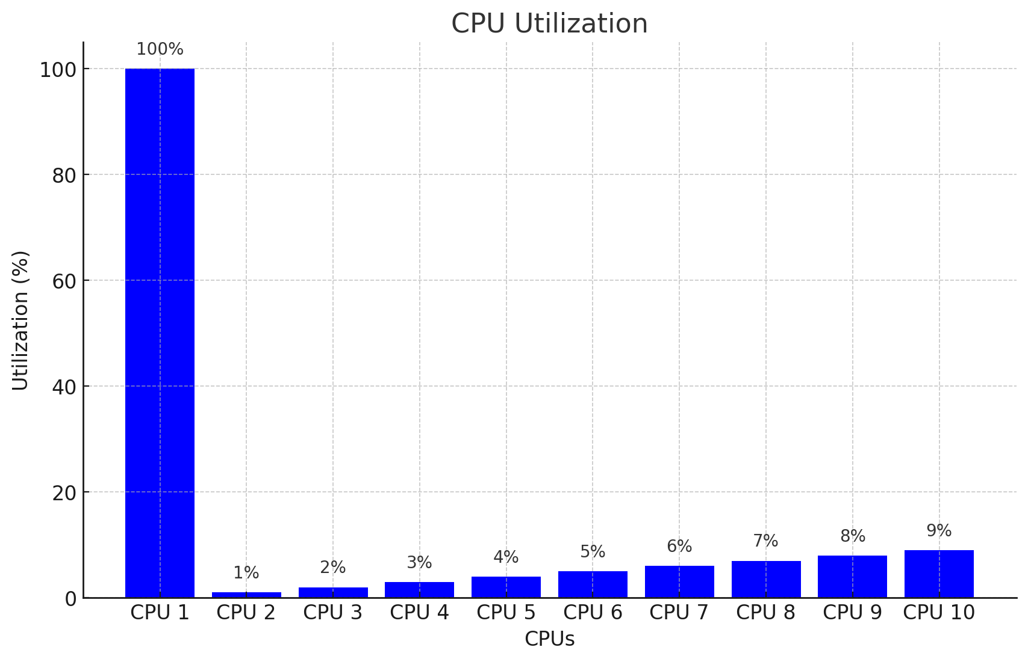
Linux Traffic Control is Single Threaded
TC is great, but it was designed with a single CPU core in mind.
CAKE+HTB is heavy - throughput is limited by CPU, even if you have lots of them!

Slide 12
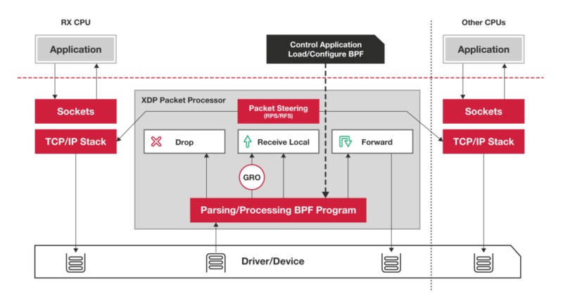
XDP cpumap
XDP cpumap is part of the XDP project, running eBPF programs per-packet as they pass through the kernel.
XDP cpumap provided us a way to scale traffic across CPU cores.

Slide 13


Slide 14
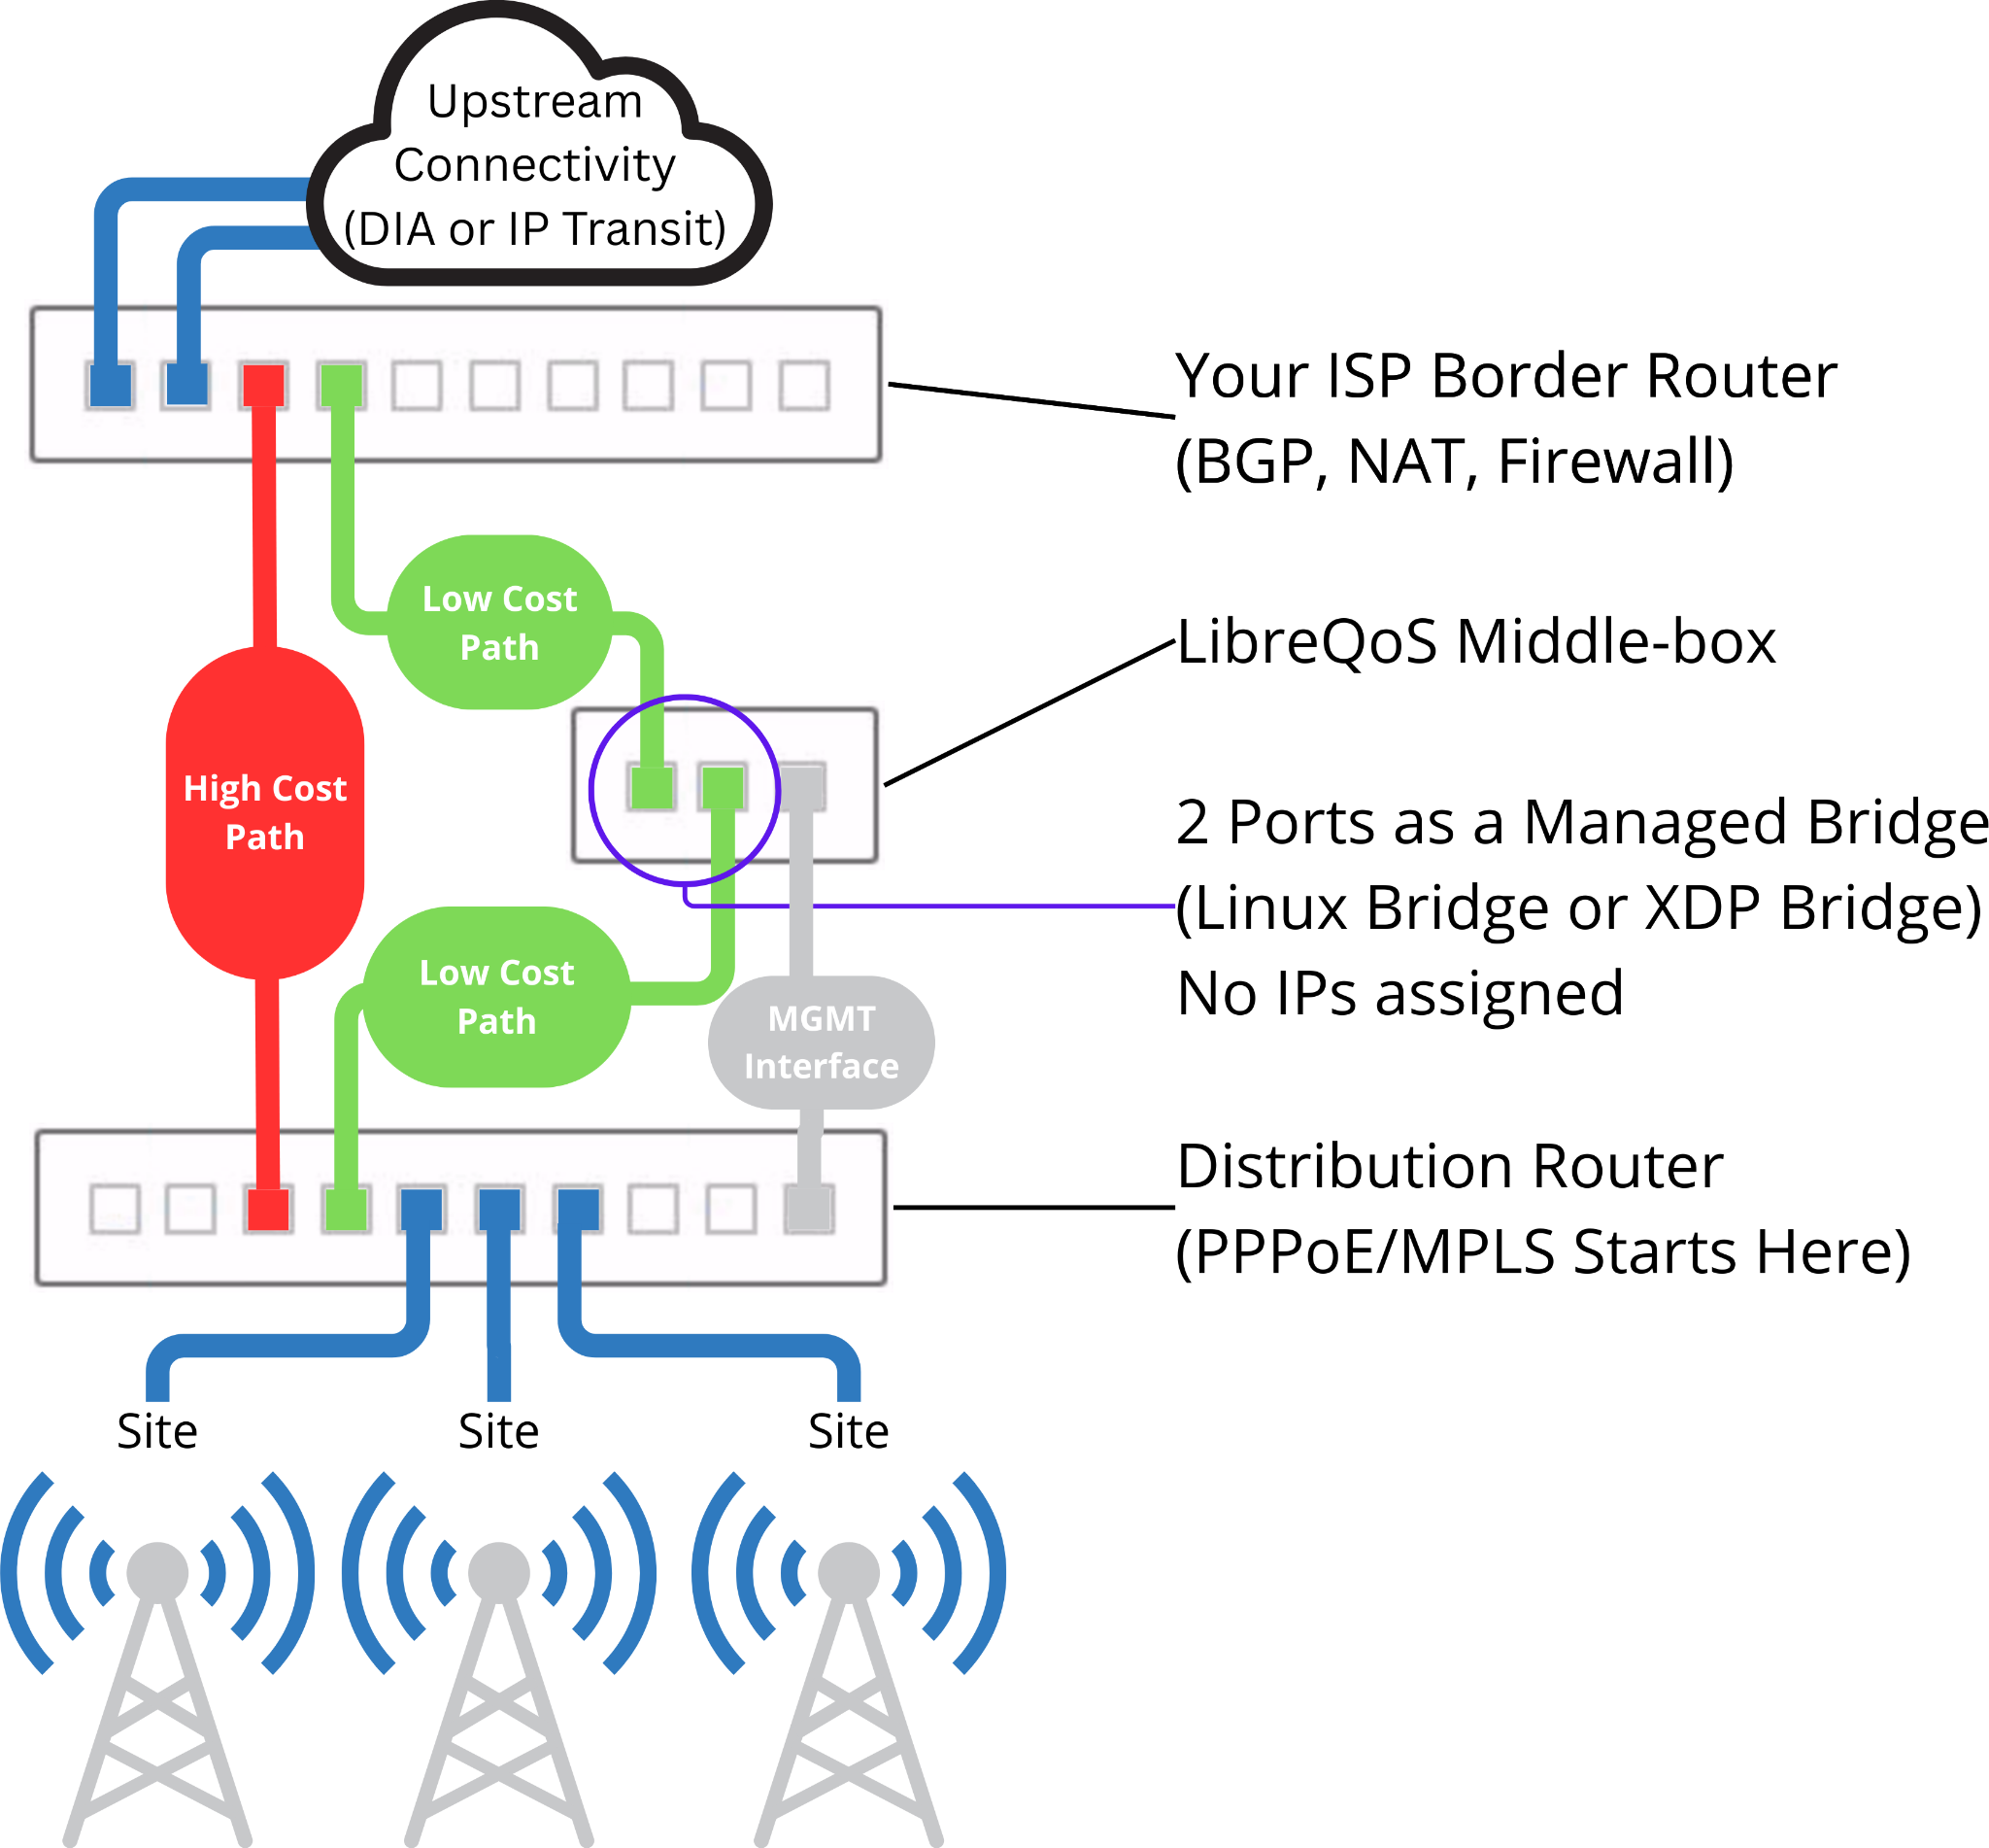
LibreQoS is a “MiddleBox”
LibreQoS is routing agnostic - it’s a transparent bridge.
Either 2 interface (“Internet facing” and “Customer facing”) or “On a Stick” with VLANs.
Reads inside VLAN tags, PPPoE headers and MPLS headers.
Pass your traffic through - LibreQoS does the rest

Slide 15
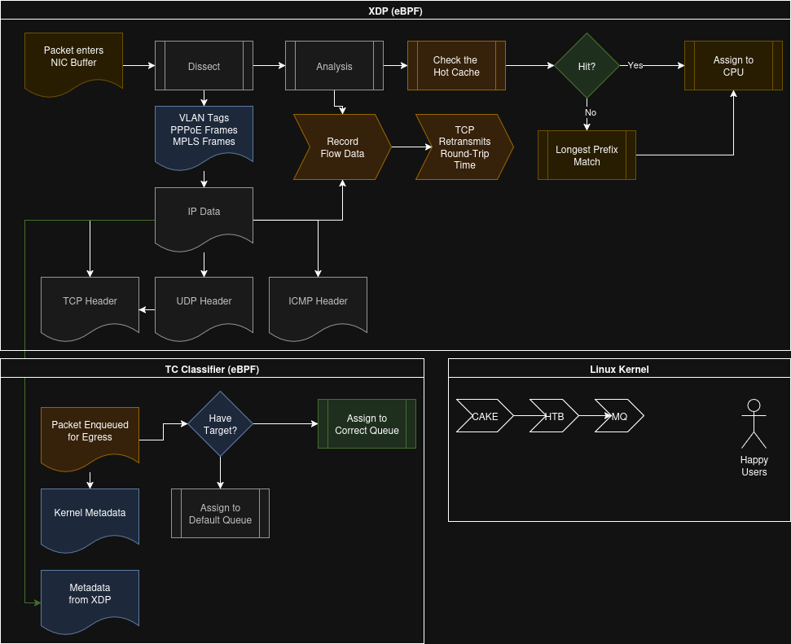
EVERY packet:
Dissected
Analyzed
Routed
Multi-Queued
At millions of packets per second.

Slide 16
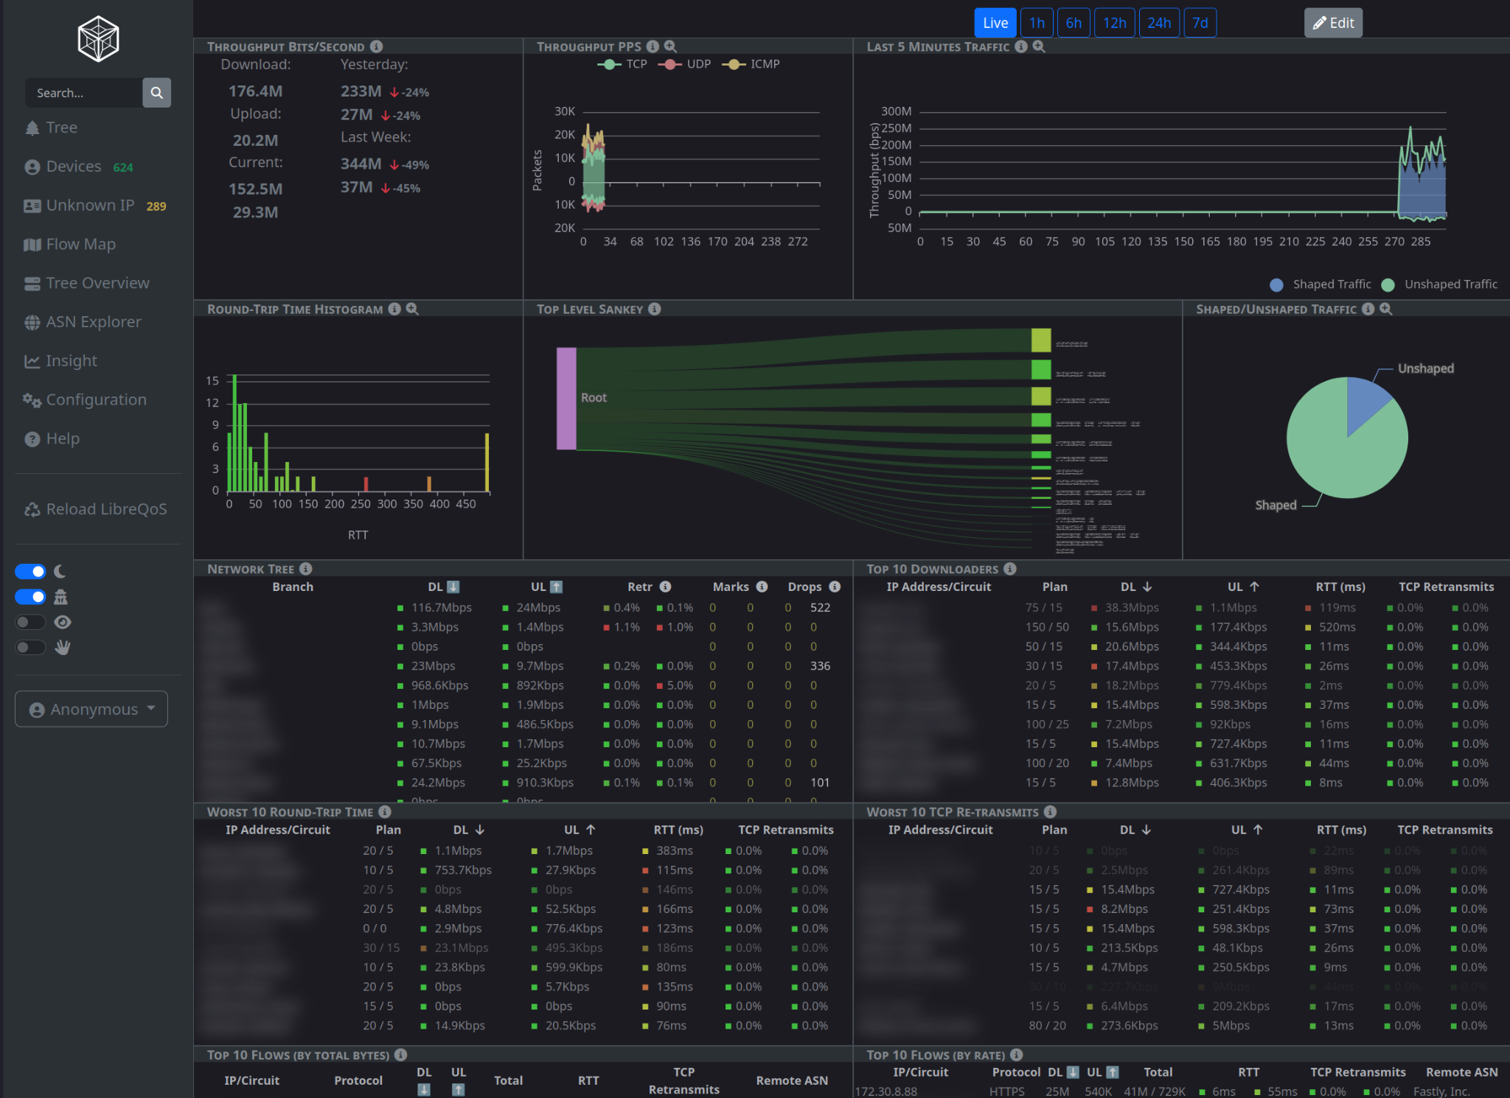
Understand Your Network: In Real Time
Current Traffic Round-Trip Time
TCP Retransmits
“Flows”
ASN Quality
How much are you shaping?
The LibreQoS dashboard gives you real-time analytics.

Slide 17
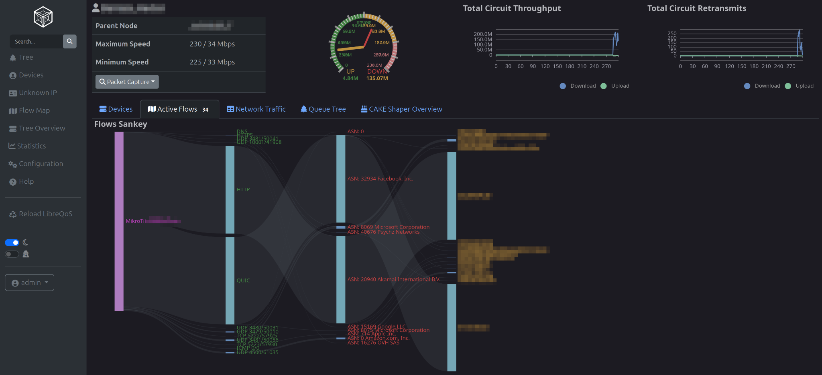
Analyze Customer Traffic - When They Call
“It’s Slow!”
Watch them run a speed test.
Watch them also update Call of Duty and watch a video…

Slide 18
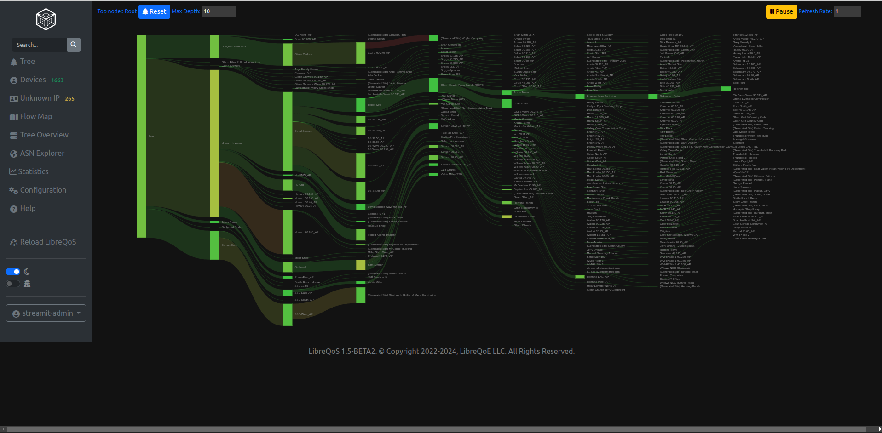
LibreQoS Sankey Total Network Overview
LibreQoS can model and manage a network 8 hops deep. It has all kinds of cool stats like this Sankey, which in this case shows latency issues across dozens of towers.
We have NOCs dedicating whole displays to this!

Slide 19
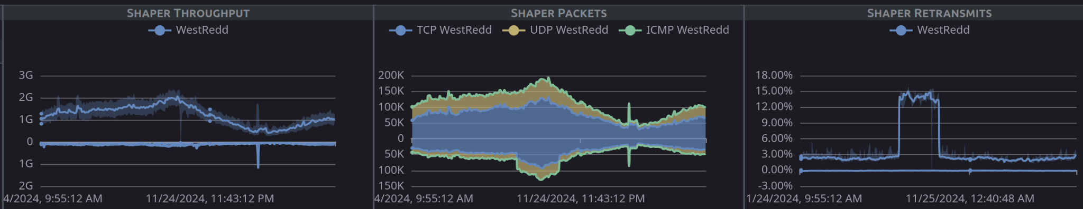
Tracking TCP retransmits
(this was a case where a packet sniffer on a given network segment caused excess packet loss)

Slide 20
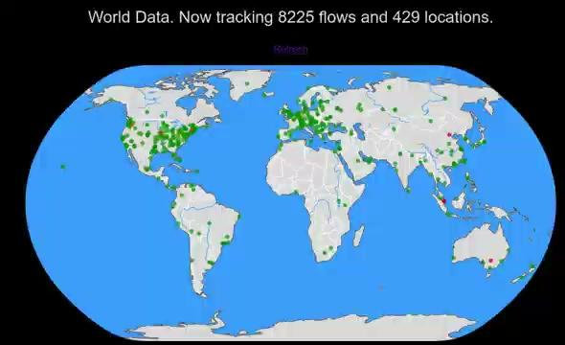
Measuring live latency worldwide

Slide 21
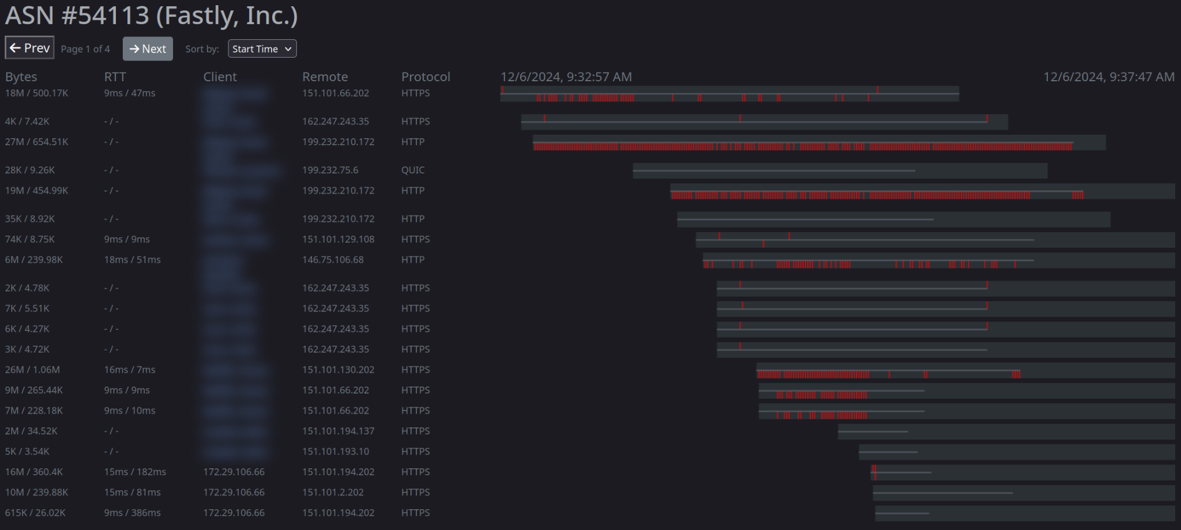
Per-ASN Performance

Slide 22
Operational Success: Understand Your Customers
Before version 1.4, we could:
Use CAKE to fight bufferbloat and improve latency.
Use HTB to model the networks.
Use XDP cpumap to scale to large networks.
Drop in a “bump in the wire” transparent bridge to do this without visiting customers.
Integrate with various Customer Relationship Management solutions to gather traffic plans and apply them in real-time.
Receive 80% fewer support calls
Now we can - with a tactical view:
See “hotspots” and pain points in real time.
Drill down and identify trouble occurring right now.
Receive a call, jump to a customer’s circuit and watch their experience right now - and provide personalized troubleshooting.
Capture data for further analysis.
Expand the science - collect useful, actionable data for the Bufferbloat team to make this even better.

Slide 23

An answer
LibreQoS´s FQ, packet shaping and AQM algorithms completely remove excess latency from an ISP network.
Really. If you don´t believe us, schedule or download a demo.
That said, once your network is LibreQoS optimized, our extensive passive statistics can track new problems and old in and outside your network.

Slide 24
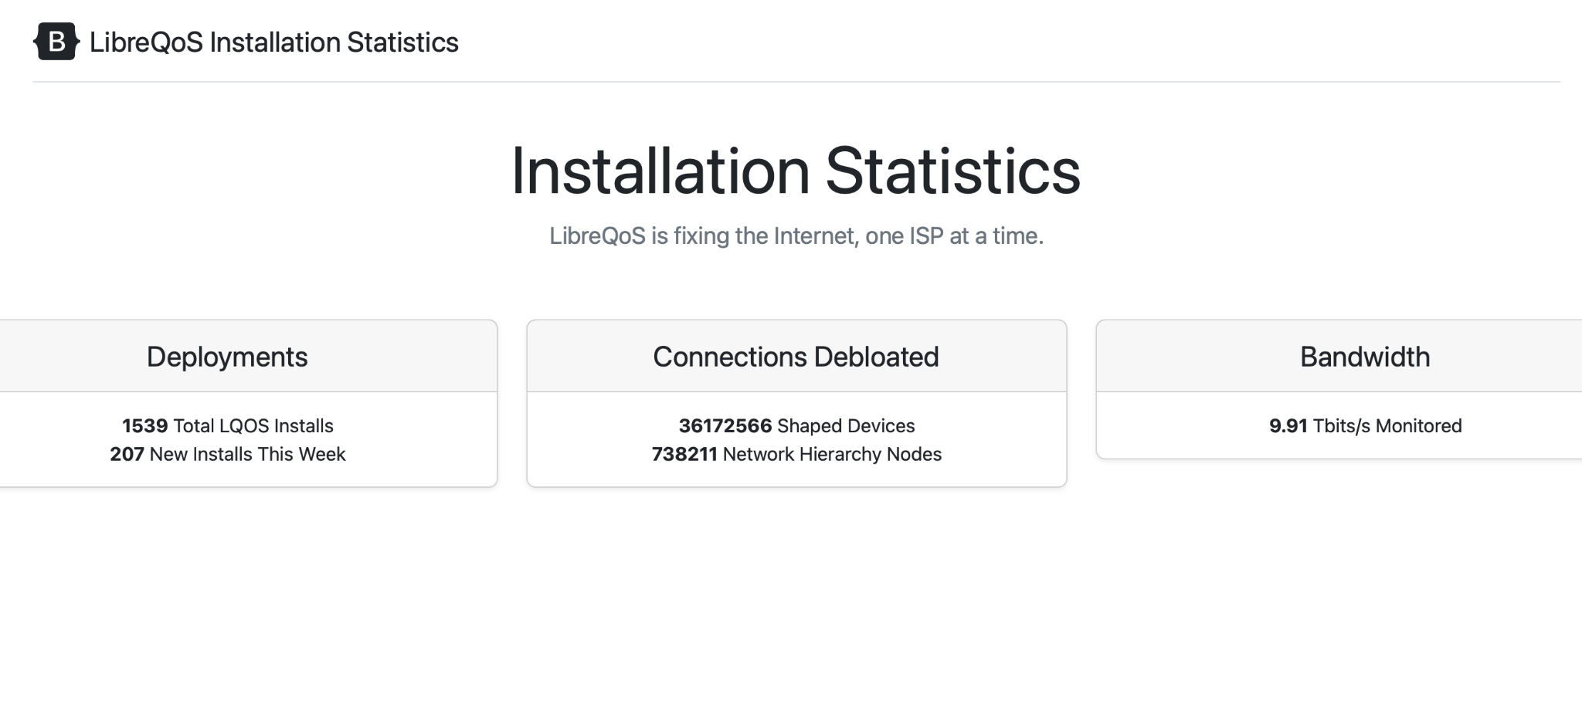
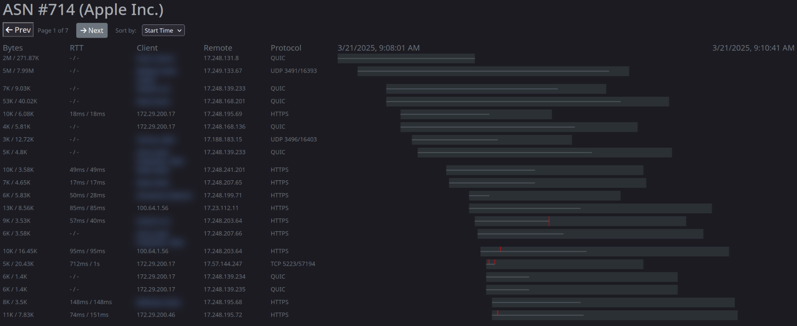
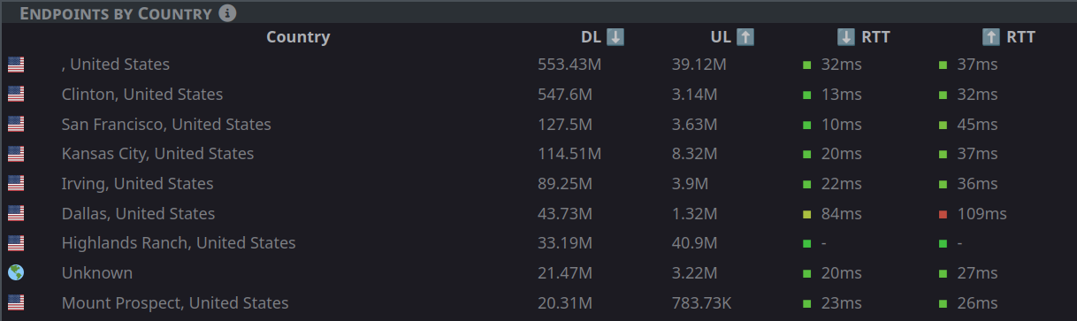
LibreQoS 1.5-RC-2 New Features
Integrations: Splynx (Enhanced), Sonar, UISP, Powercode. In Progress: Gaiia, VISP, WISP Gate, Netzur
Features: Netflow, IS-IS Pass-through, New Web UI, Massively improved memory usage and performance.
Per-Flow Tracking: Round-Trip Time, TCP Retransmits, per-ASN statistics, per-protocol statistics.
BETA API: Pull data into your monitoring system. Ask Libby for multilingual network help.
Hardware Support: Works well from 100 Gbps systems all the way down to 1 Gbps systems.

Slide 25
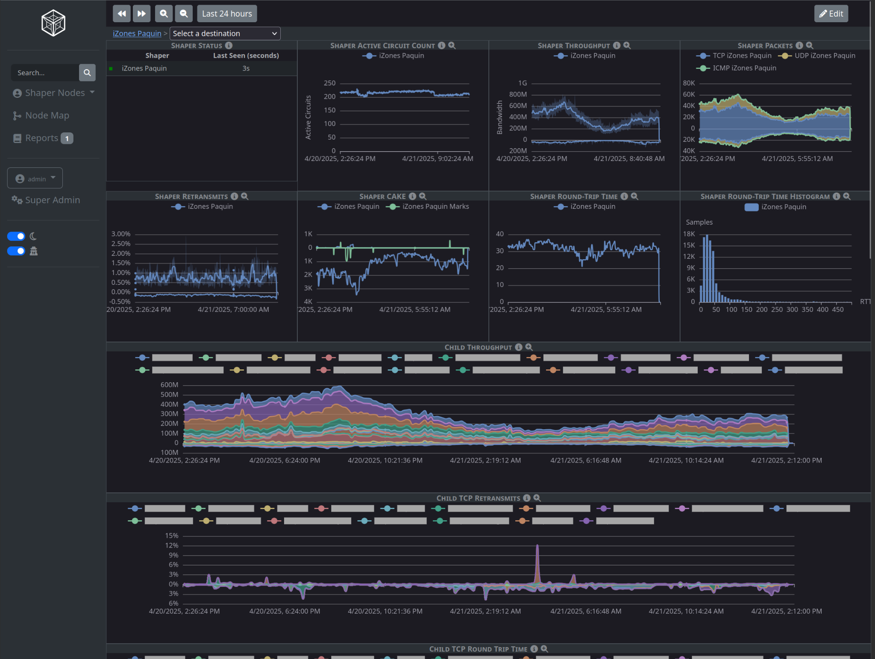
LibreQoS Insight
LibreQoS gives you a real-time view of the last few minutes. That’s great, but you probably want deeper analysis.
LibreQoS Insight gives you long-term visibility into your network.
LibreQoS is still free and Open Source - this is entirely optional, but we do have to pay our hosting fees.
Insight is in development (alpha) and expected to launch this autumn.

Slide 26
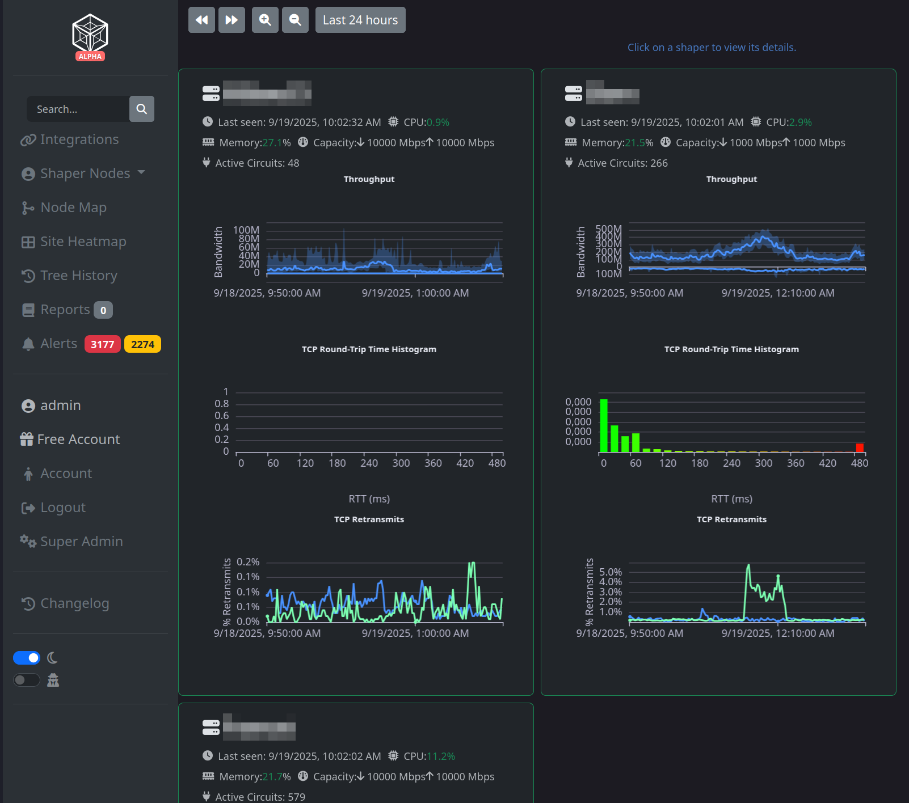
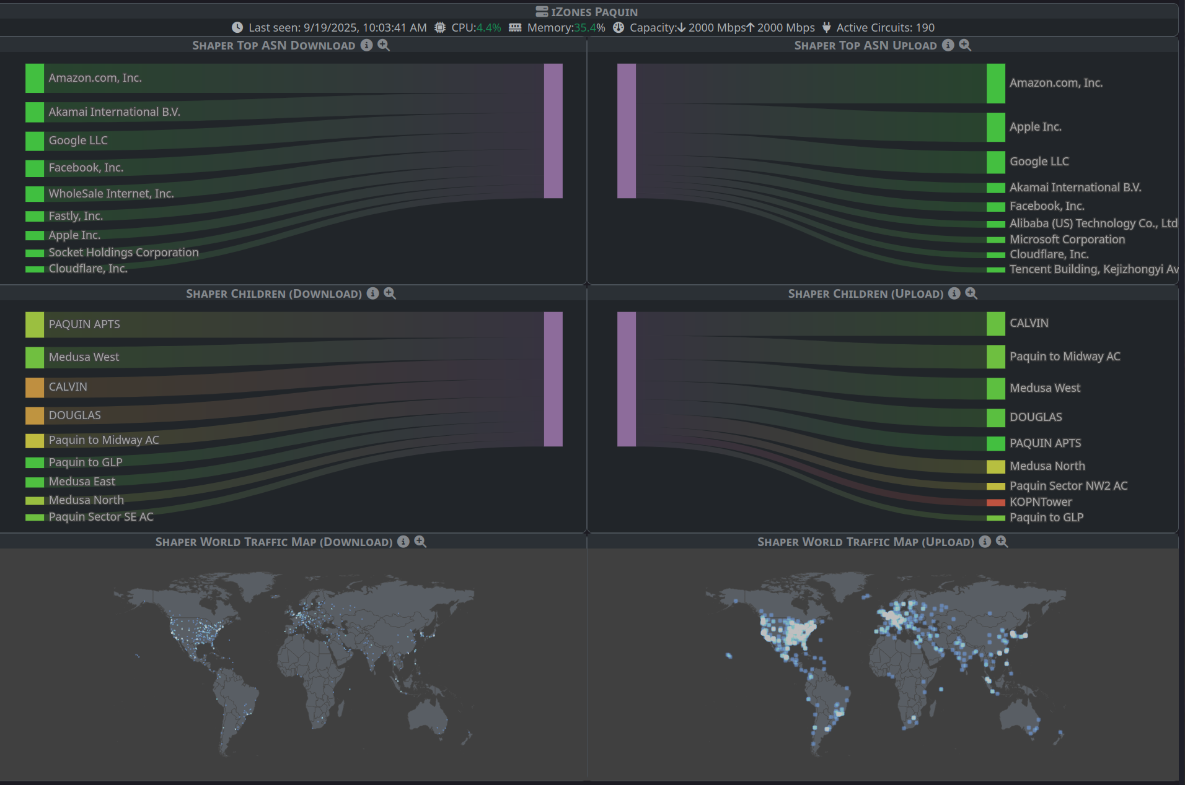
LibreQoS Insight: When Real-Time Isn’t Enough
Track all your egress points
How was your network (custom timeframes)?

Slide 27
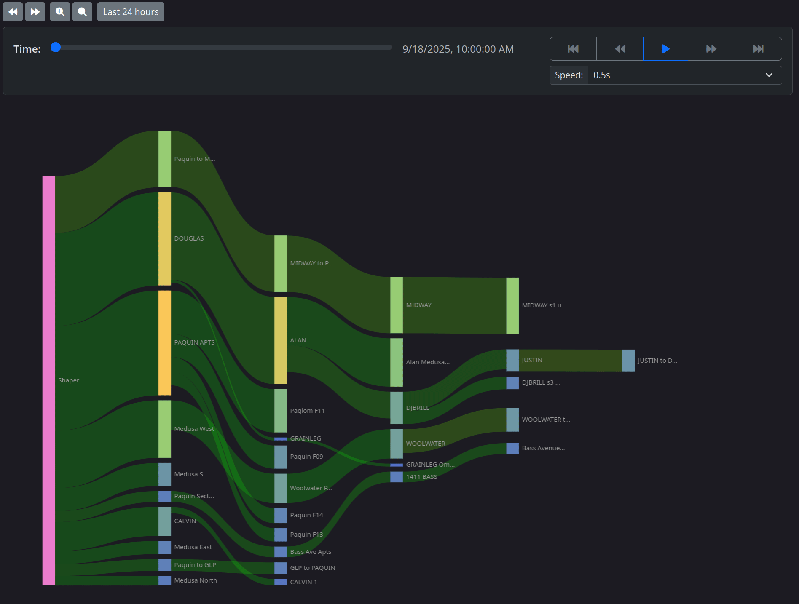
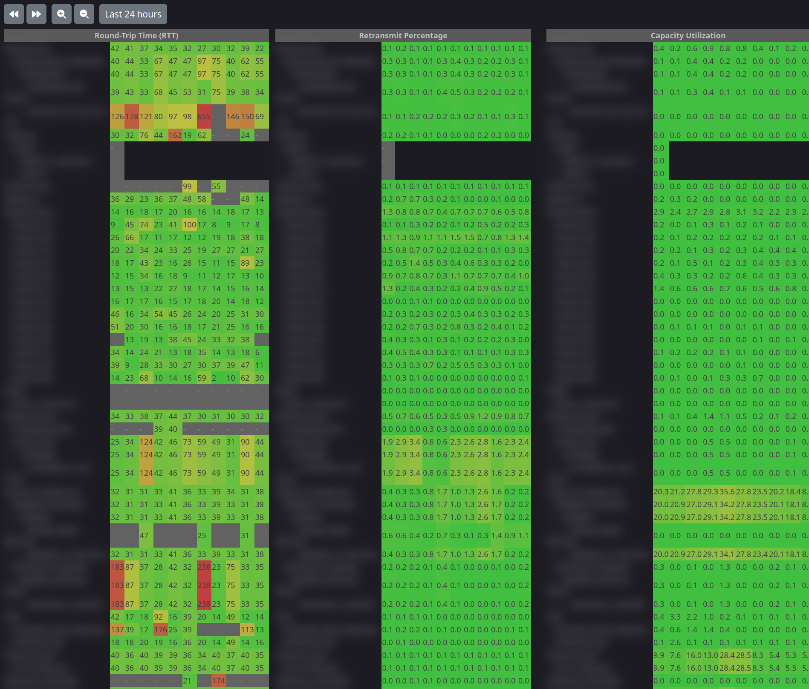
Find Network Problems
Network Overview Time Machine
Network-Wide Heatmaps

Slide 28
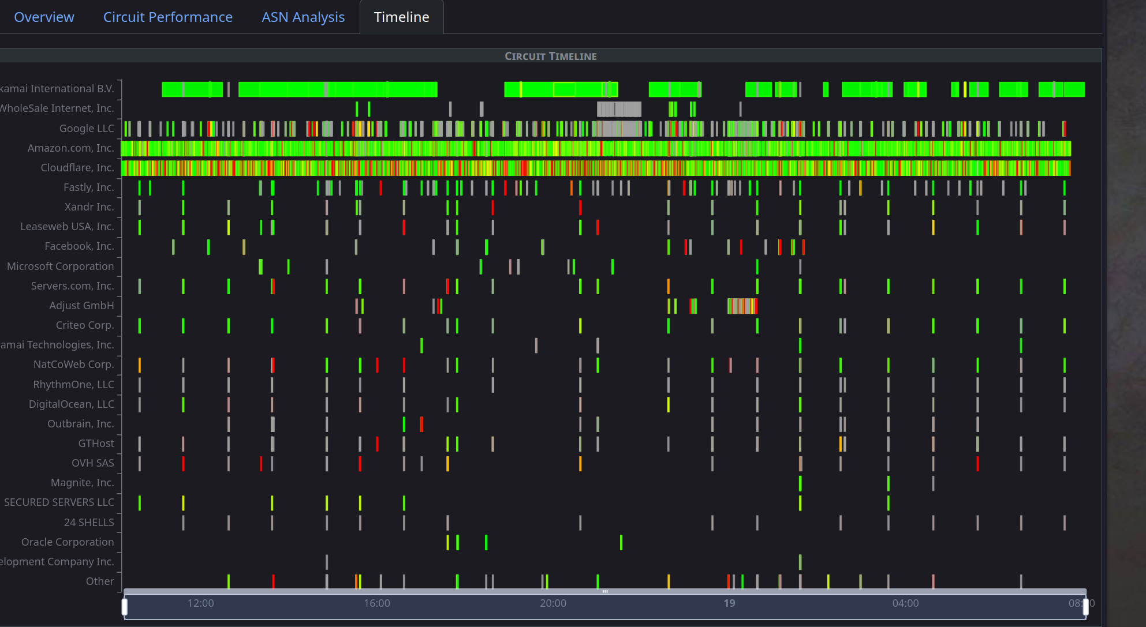
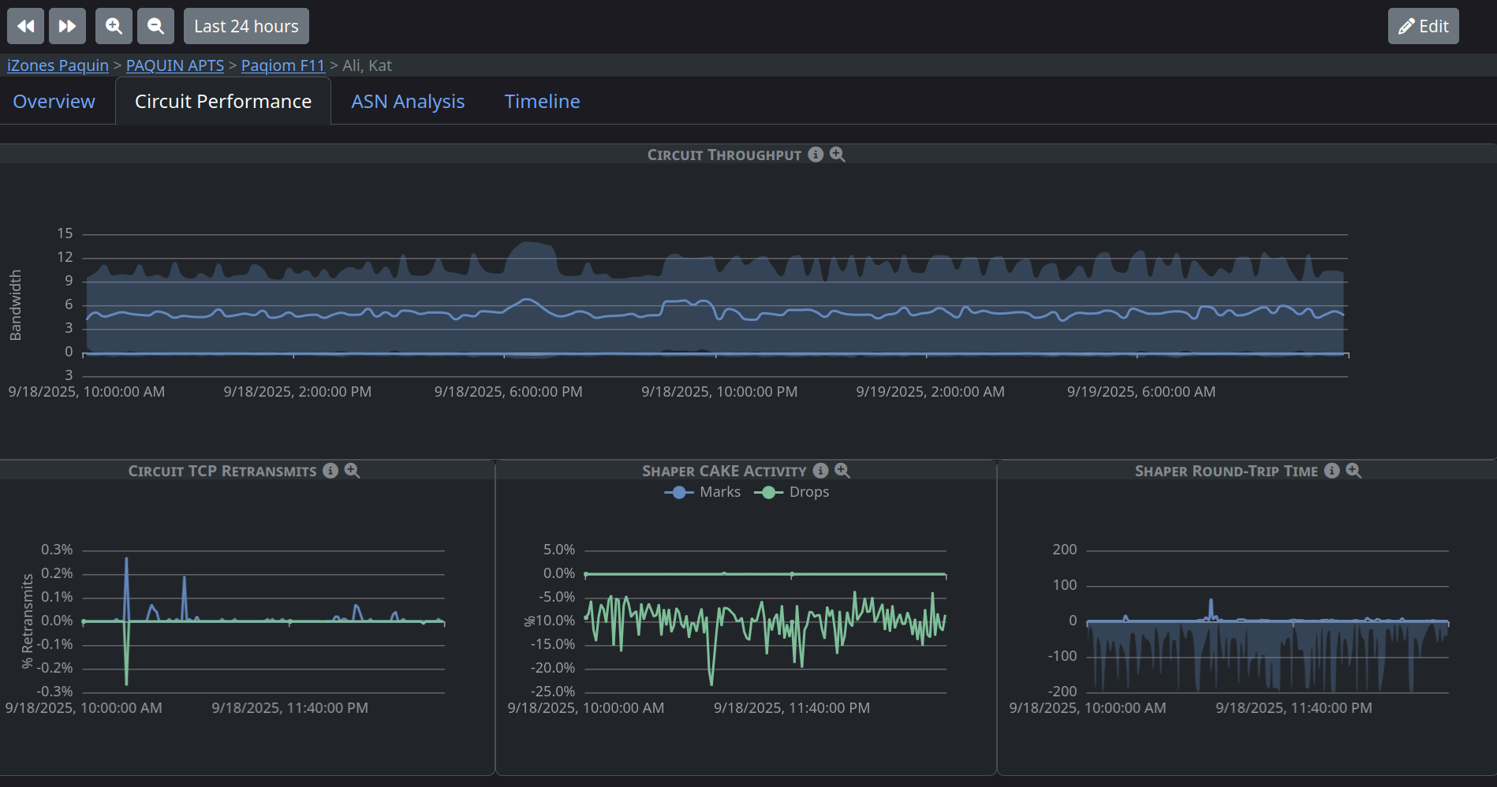
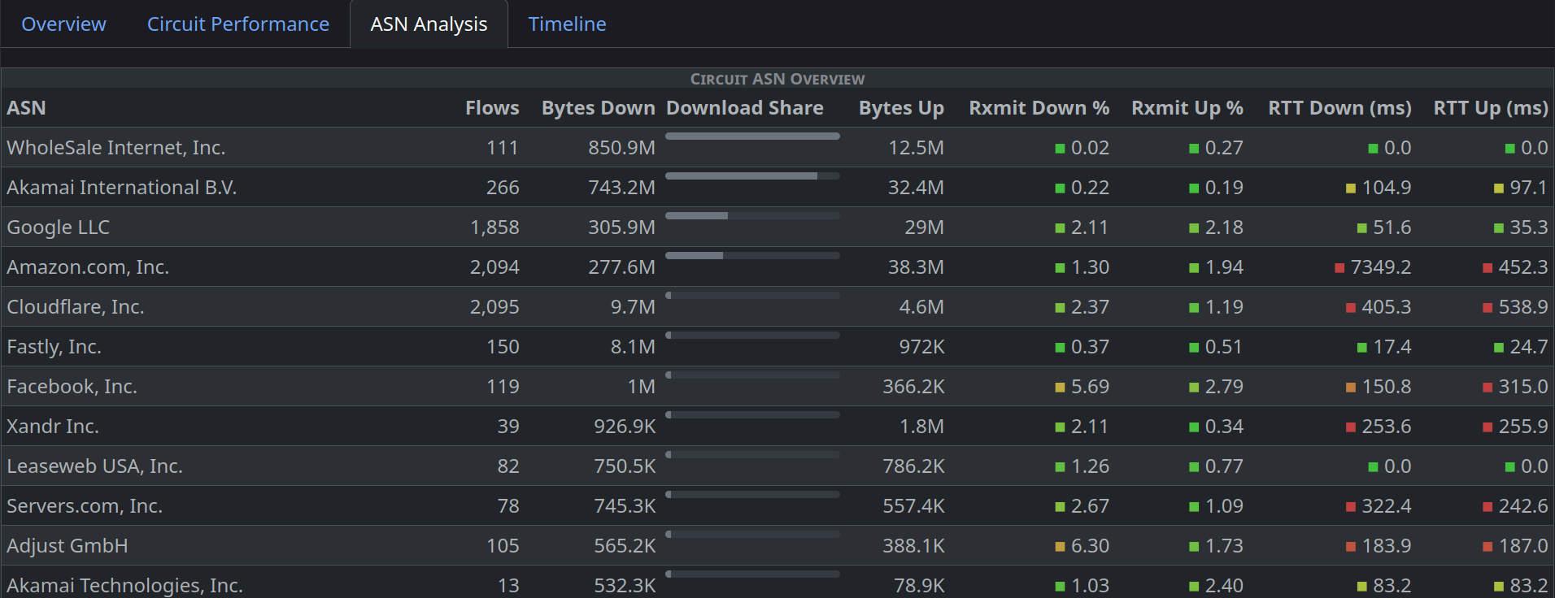
What Happened at 2AM?
Graphs, ASN Summaries - and a zoomable timeline showing exactly what the customer was doing at 2AM!

Slide 29
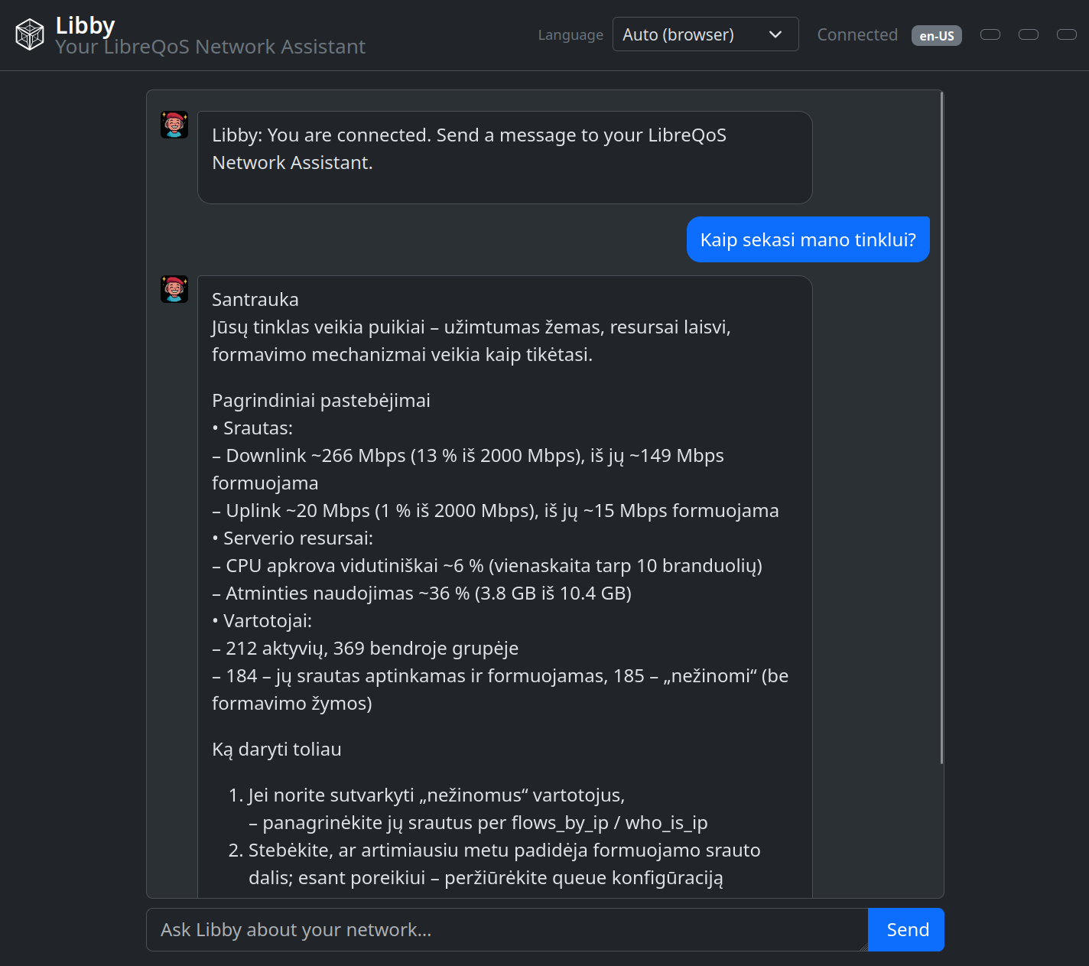
Using AI/LLM to Bridge Language Barriers
Introducing Libby - part of the LibreQoS Insight API.
Chat with an LLM - in your own language - about your network.

Slide 30
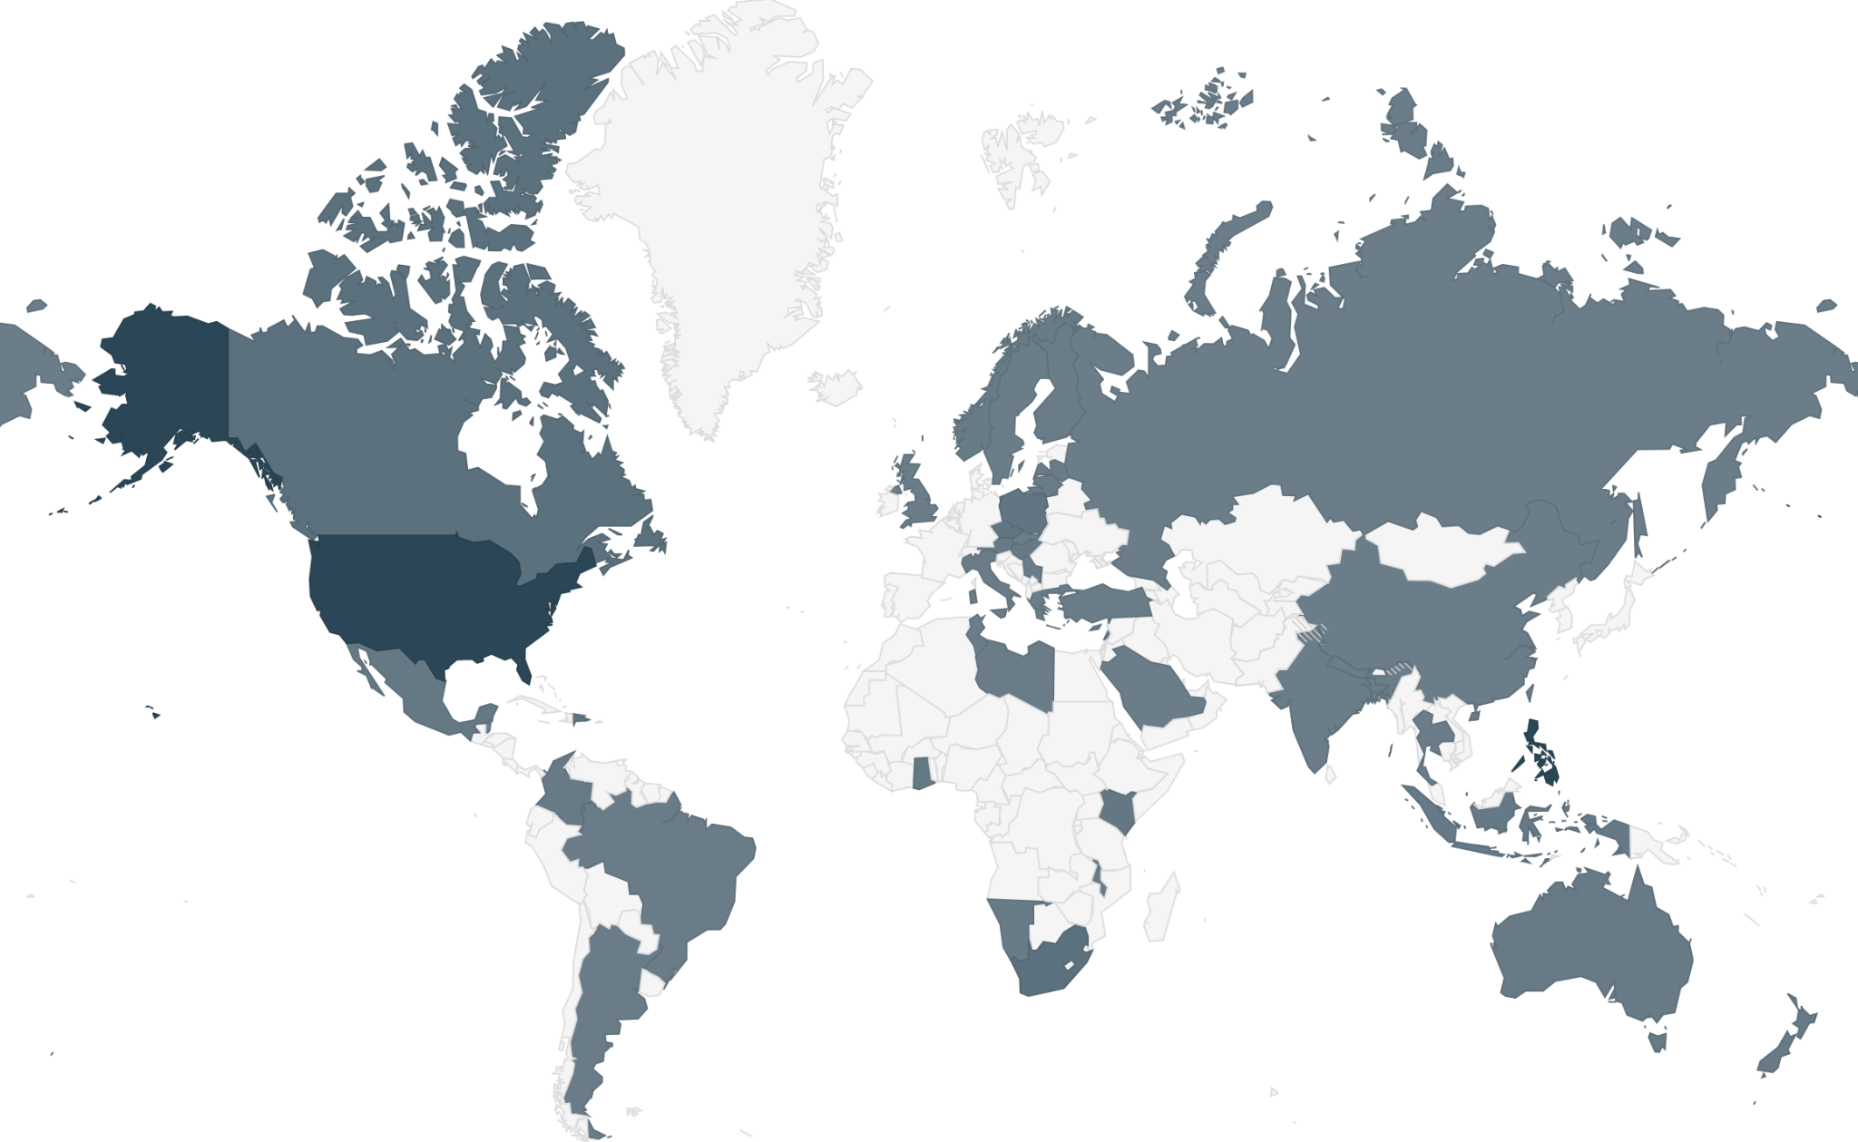
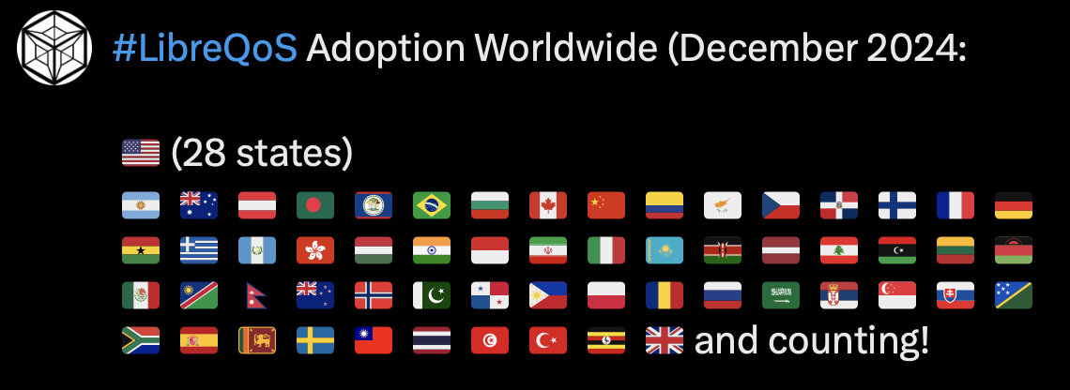
About LibreQoS
World beating ISP bufferbloat solution - leveraging Rust, C, Python, eBPF, CAKE
Core product is Open Source. Over 900 ISPs using it today! 30k subscribers/box.
Core Supported by NLnet’s NGI0 Fund

Slide 31
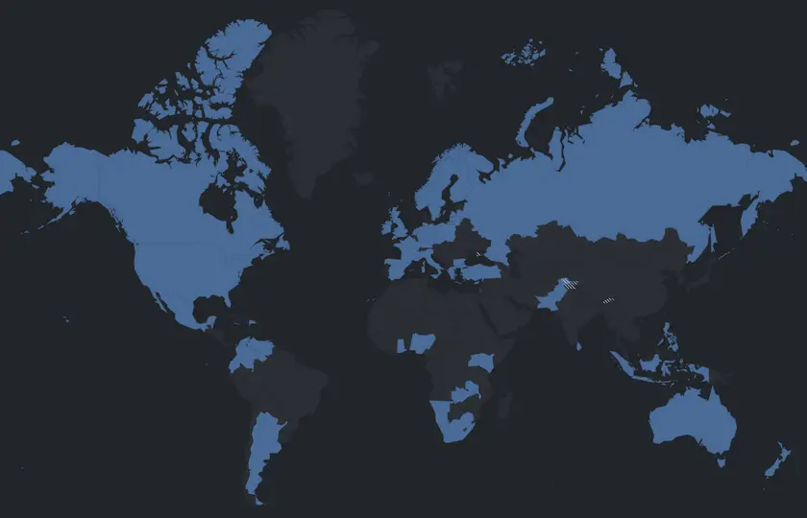
LibreQoS is Free, Open Source Software
We love giving it away.
We’ve helped so many small ISPs in the regions that need the most help.
Making the Internet better for everyone just feels right.
We’ve helped many of the parts of the world that need it the most.
Unfortunately, we still have to eat.

Slide 32
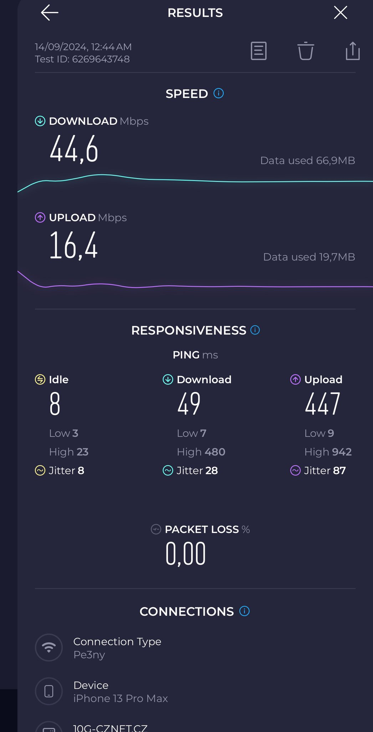
Test Tools of the trade
“It is wrong to suppose that if you can’t measure it, you can’t manage it – a costly myth.” - E.W. Deming
Flent v2.2 - the rrul and rtt_fair tests
Iperf2 - many new features!
Crusader - Rust rrul on everything
Xtcp2 - Monitor TCP_DIAG in docker
networkQuality - from Apple
Orb.net - continuous monitoring of the quality of your internet connections; any platform or device.
All the speedtests have Bufferbloat Metrics now!
https://sou rceforge.net/projects/iperf2/
https://github.com/Zoxc/crusader
https://flent.org
https://github.com/randomizedcoder/xtcp2
https://github.com/network-quality
https://www.waveform.com/tools/bufferbloat
https://test.libreqos.com

Slide 33
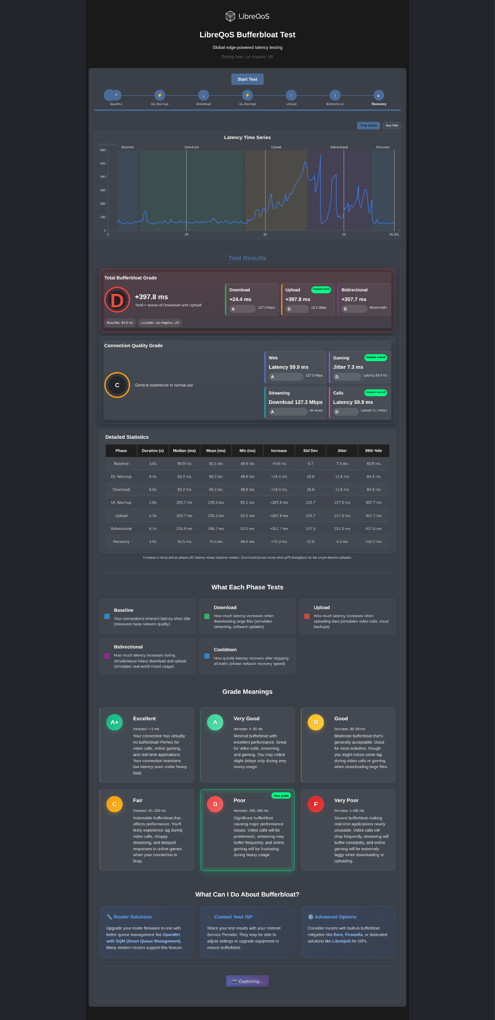
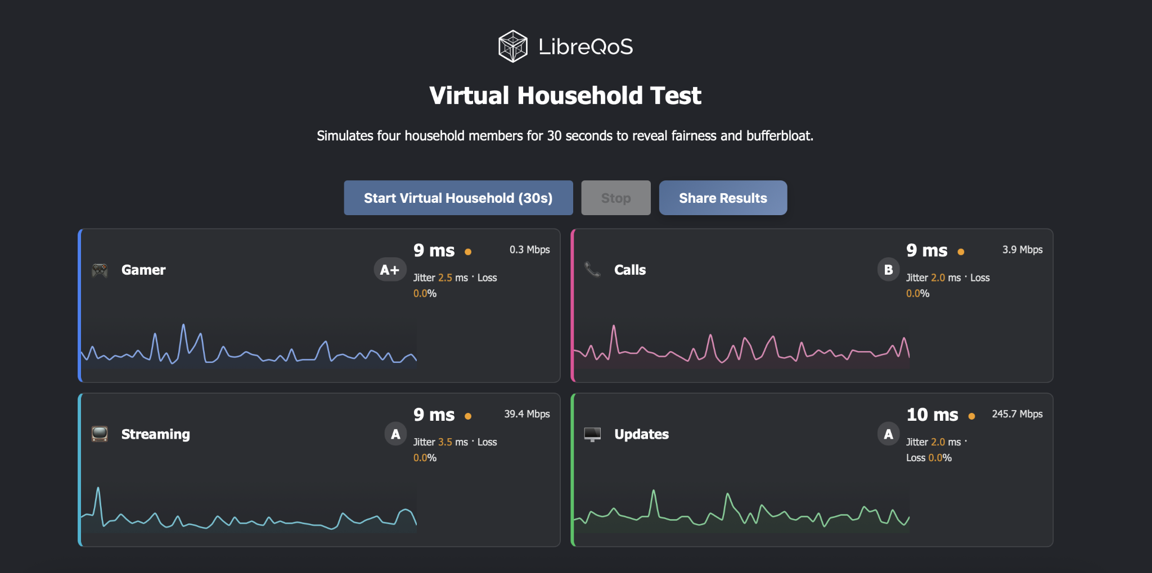
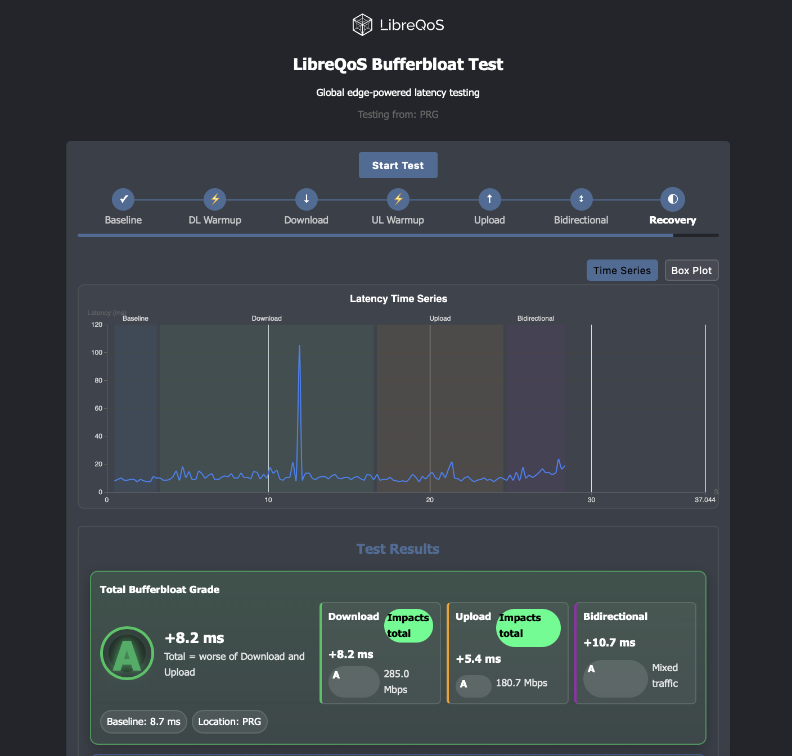
LibreQoS Bufferbloat Test
https://test.libreqos.com/
Finally, a bufferbloat test that matches Dave Täht’s vision!
Long Ramp-Up
Tests Under Load
Simulates a Virtual Household
Explains the Results

Slide 34


Thank you!
NLnet have funded development of many features - THANK YOU.
Equinix provided us with servers and network infrastructure for testing - THANK YOU.
Some of our enthusiastic users make donations - THANK YOU.
It’s amazing and awesome…

Slide 35



BUT
We still have to eat!
Like so many other OSS projects, we’ve made the decision to monetize some of the non-essential features.
We’ve made 100% sure that you can use LibreQoS and reap the benefits for free - but some of the deeper analytics are now monetized (a self-host version is coming).
We’ll let you know how it goes!

Slide 36
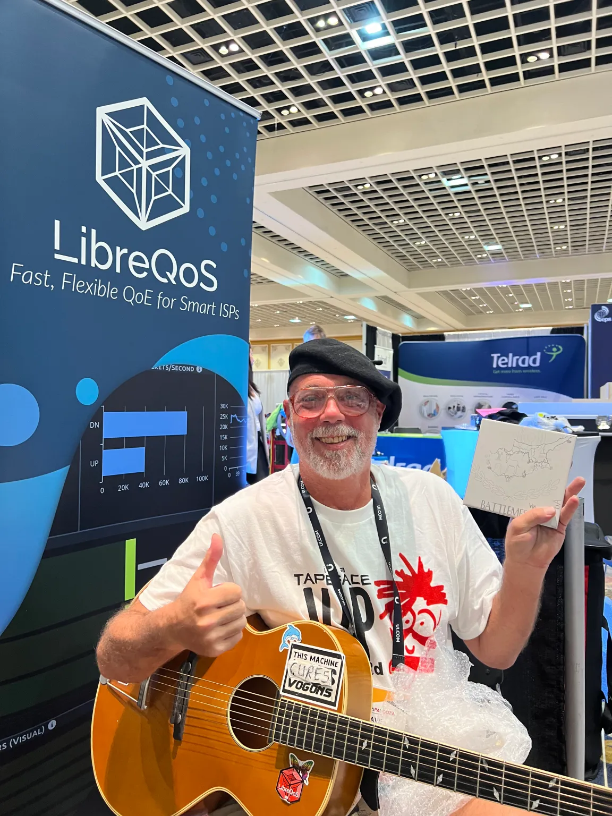


In loving memory of Dave Täht
Dave Täht sadly passed away in April. Dave was:
Co-creator of CoDel, FQ-CoDel, CAKE and a leading voice in the fight against Bufferbloat.
A contributor to Linux, OpenWrt and more.
LibreQoS Chief Science Officer.
You’ve probably used his code, without ever realizing it: millions of routers around the world contained Dave’s contributions.
Above all, Dave was a great man - and a great friend.
Read more: https://libreqos.io/2025/04/01/in-loving-memory-of-dave/

Slide 37

Thanks!
Contact us:
sales@libreqos.io
www.libreqos.io
https://github.com/LibreQoE/LibreQoS
Please join the chat!

Slide 38

See you in Las Vegas!
Broadband event of the year, not only for Internet Service Providers - Booth 630.

Slide 39

Postscript
What Can I Do About Bufferbloat?
https://www.bufferbloat.net/projects/bloat/wiki/What_can_I_do_about_Bufferbloat/
https://bufferbloat-and-beyond.net

Slide 40
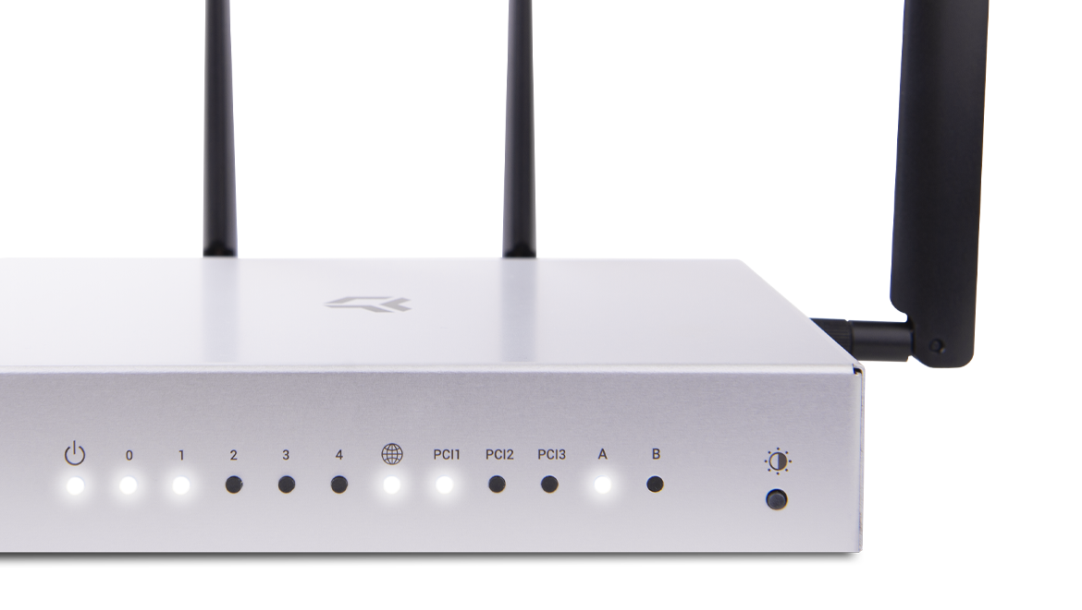
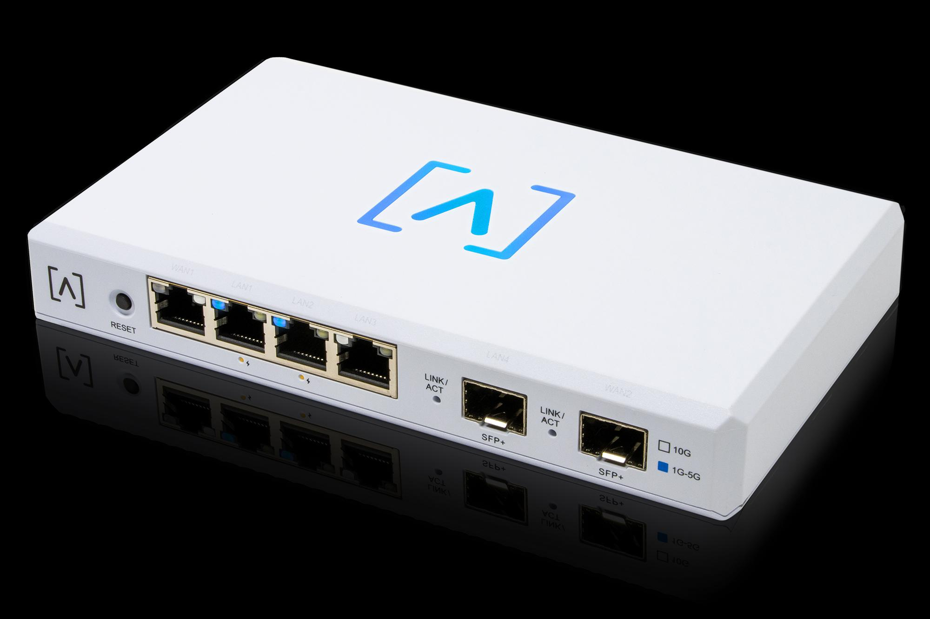
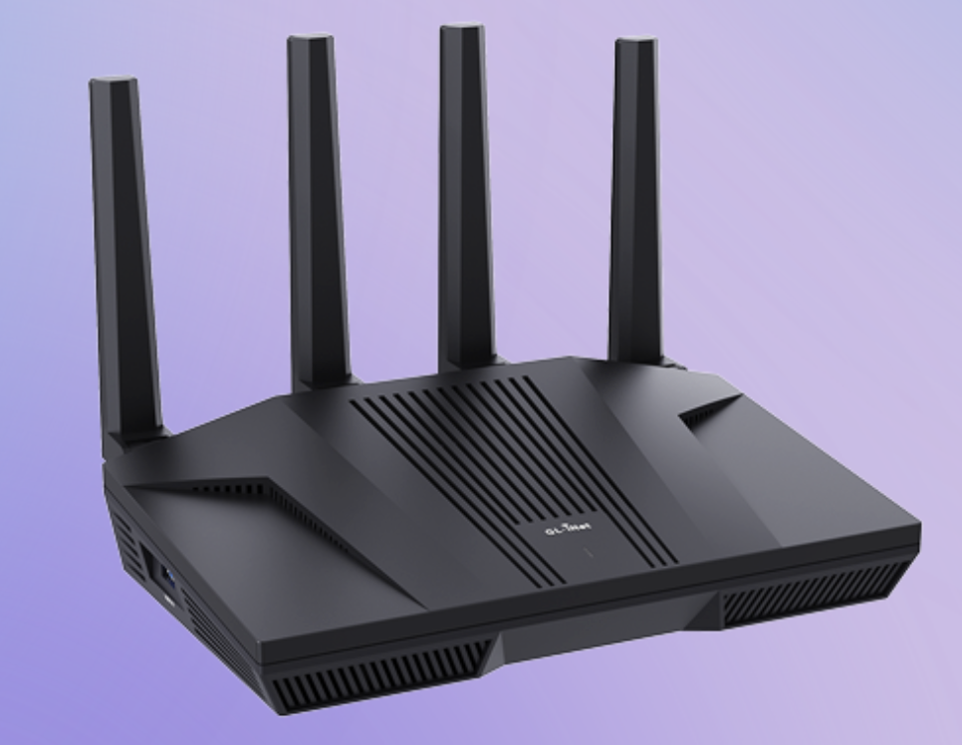
Postscript 2
GL-iNet
Alta Labs Route10
Turris Omnia
…also just flash your router with OpenWrt or get a MikroTik.

Slide 41

Postscript 3
RFC 8290
Read it. Use it. Spread the word.
PS: Bandwidth is a lie!

Slide 42

Postscript 4
LibreQoS is built in Rust 🦀
https://pragprog.com/titles/hwmrust/advanced-hands-on-rust/

