Slide 1
The Myth around AI networks & AI for networks
Mikael Holmberg
Distinguished Engineer – Member of the Office of the CTO

Slide 2
AI Waves 2022 - 2035
Wave 1
Academic Research
Pre 2022
<$108 in equipment spend
Wave 2
Foundational model
and content creation
2022 - 2025
$300B equipment spend
Wave 3
AI Agents
2025 - 2028
~$IT in equipment spend
Wave 4
Autonomus transportation
and robots
2027 - 2035
>~IT in equipment spend
Soure: 650 Group

Slide 3

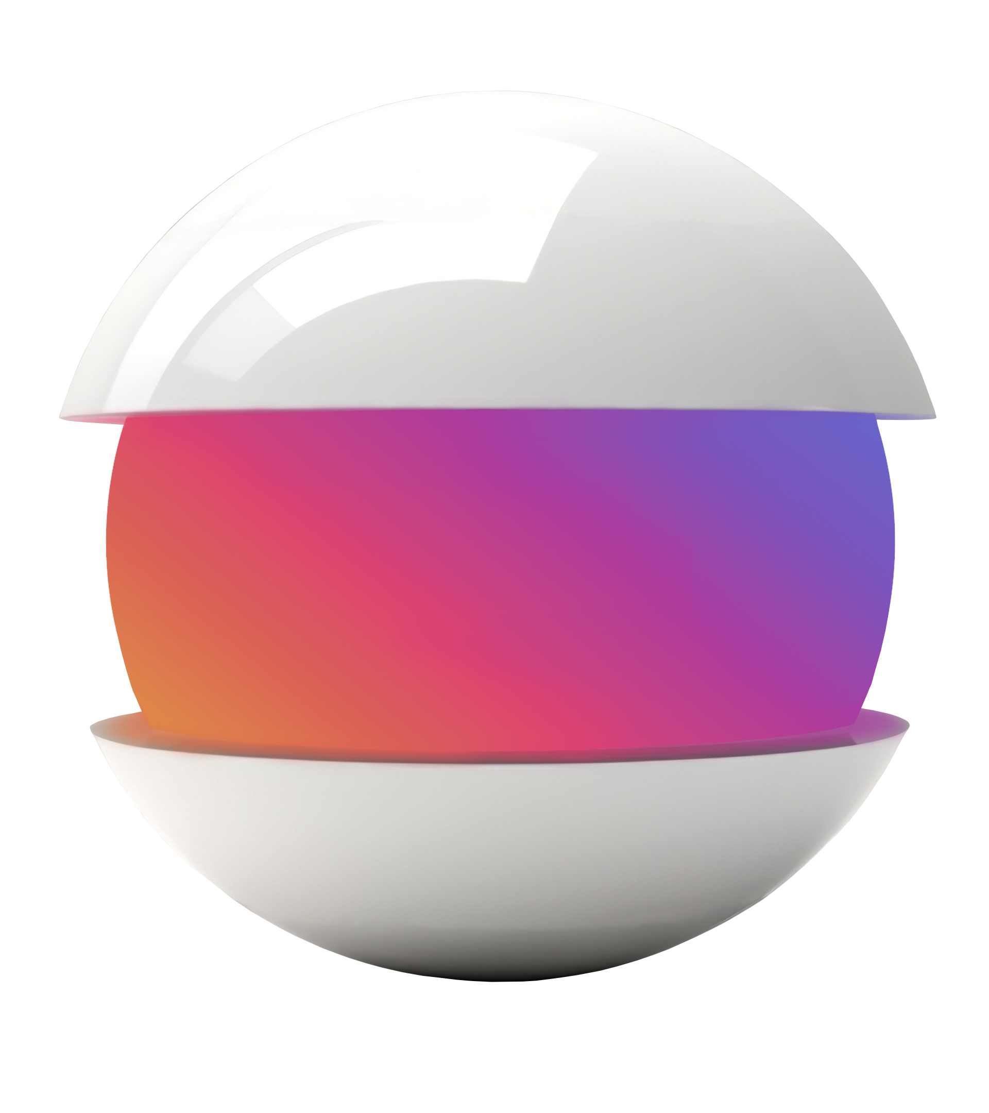

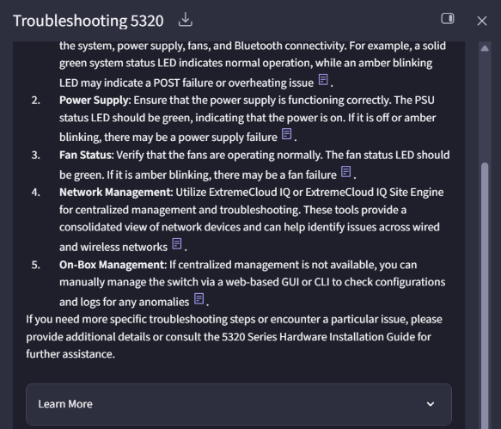
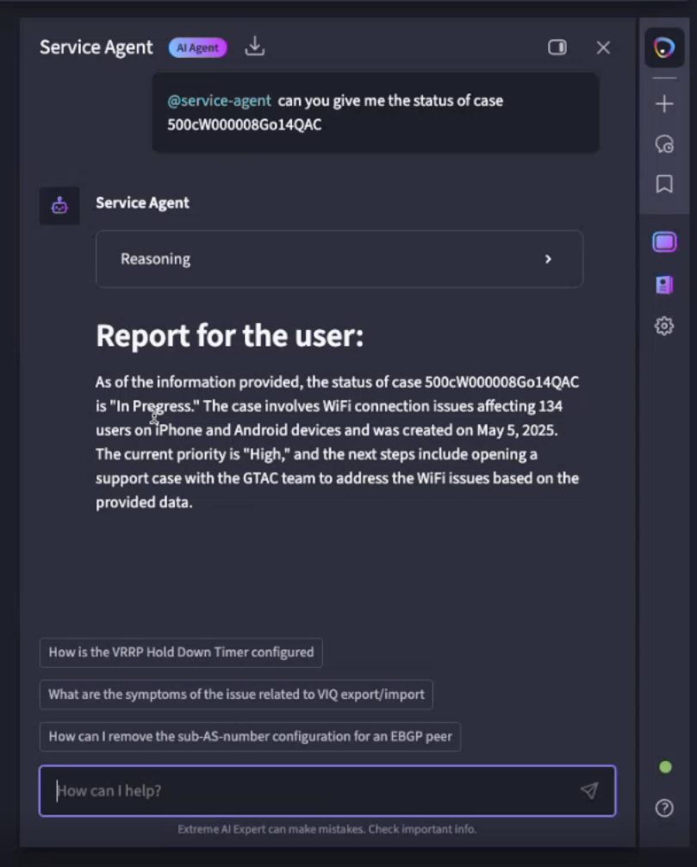
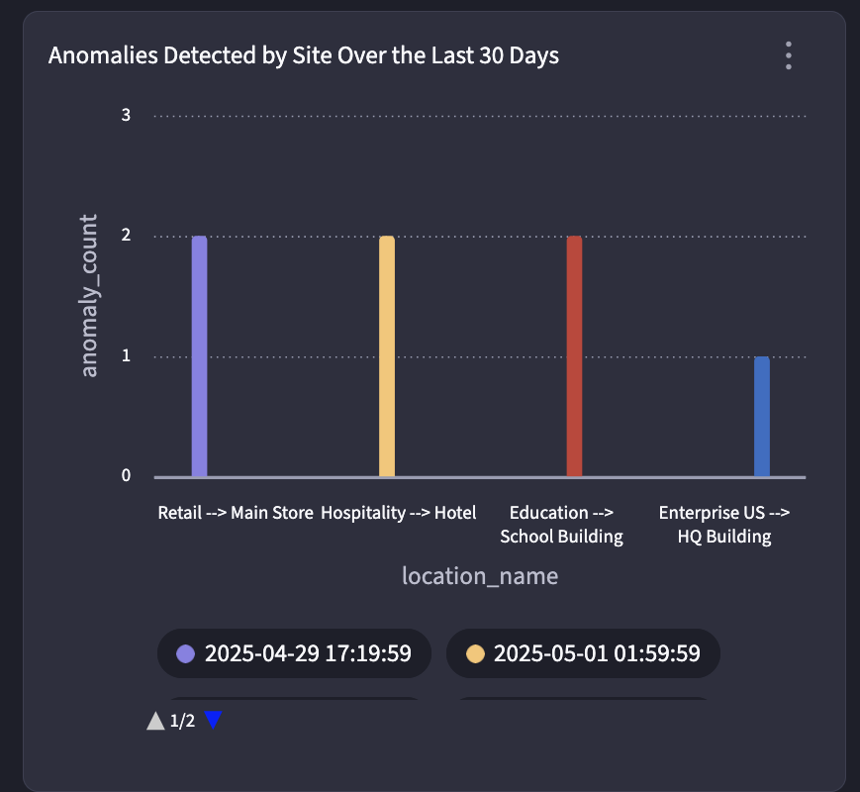
Modern Networks Need More than AIOps
AI Expert
Conversational
AI Canvas
Interactive,
Multi-Modal
AI Agents
Autonomous
with HITL
AI Core
Conceptual

Slide 4
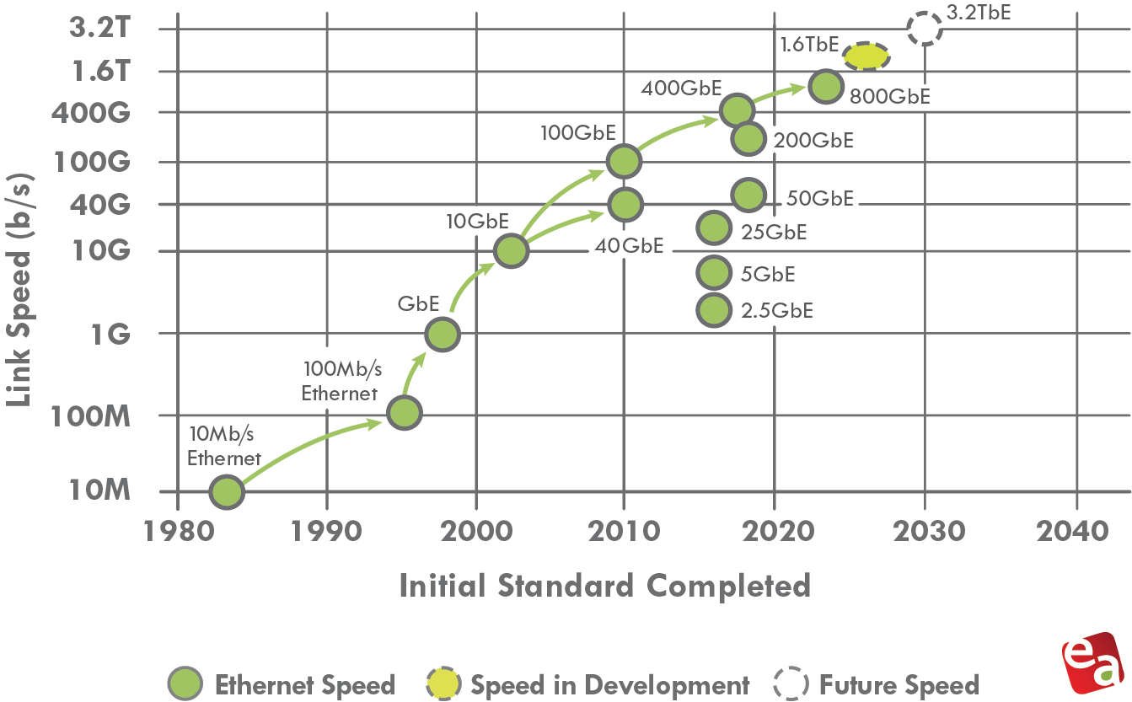

Ethernet Speeds Evolution
Source: Ethernet Alliance

Slide 5
Acceleration of Computes for AI Workloads
CPU
GPU
GPU Clusters
Optimized for serial tasks
Optimized for parallel tasks
Scale-up network for AI workloads

Slide 6
AI Workload - Networking Uniqueness
Fewer flows (low entropy)
High bandwidth flows
Synchronized and bursty traffic
Links are saturated in micro-seconds (<<RTT)
Training jobs run for long periods of time (hours, days)
Tail latency impacts job completion time significantly
Synchronize
Communicate
Compute
JCT (Job Completion Time)

Slide 7


AI Data Center Fabric Networks
Leaf & Spine (CLOS)
Data Center Fabric (front-end)
AI workloads present new challenges to current Ethernet networks
  Need for higher scale,
  Higher bandwidth density
  Multi-pathing
  Fast reaction to congestion, and inter-dependency on the progress of individual flows
  AI workloads within compute clusters (GPU – GPU)
….
CPU
GPU
….
RoCEv2
NIC
RoCEv2
Fabric
Leaf & Spine (CLOS)
AI Data Center Fabric (back-end)

Slide 8
AI Workload Challenges
INCAST (IN)
Incast traffic patterns happens when multiple sources target the same destination.
OBLIVIOUS BULK SYNCHRONIZATION (OBS)
Computation steps are interleaved with global communication steps that often synchronize processes – Three dimensional parallellism in AI deep-learning 1. Number of processes 2. Duration of computation 3. Size of communication (end point).
LATENCY SENSITIVE (LS)
Some workloads are latency sensitive, could fall into the OBS category – complex, data-dependent, message chains forming critical performance paths in application.
DEPLOYMENT CHARASTERISTICS
Confidential compute – all traffic must be encrypted on the wire.
Multitenancy - managing thousends of from single host.
Cost effective low-diameter topologies requires advanced load balancing and routing for high bandwidth requirements.

Slide 9
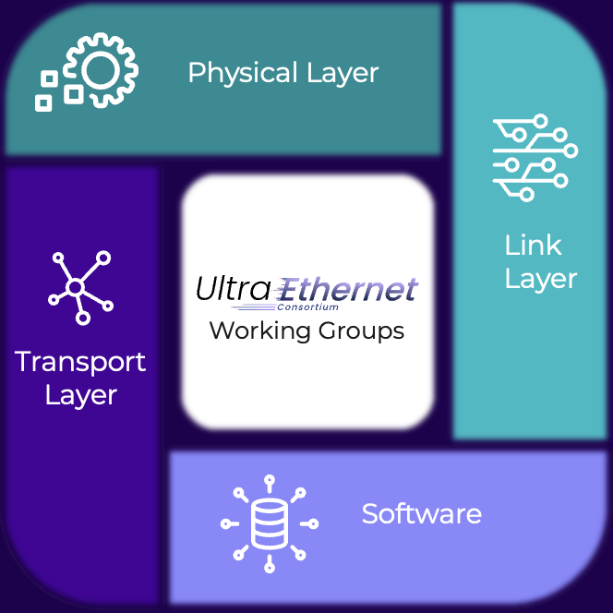
Ultra Ethernet Consortium – Working Groups
A group of vendors and operators have teamed up to form the Ultra Ethernet Consortium (UEC), as there are concerns that today's traditional network interconnects cannot provide the required performance, scale, and bandwidth to keep up with AI demands,
The consortium aims to address these concerns by adding new capabilities to the known and proven Ethernet technology specification, adding number of new features and capabilities.
Goal to develop specifications, APIs and source code to define protocols, interfaces and data structure.

Slide 10

AI Cluster Components
WAN/DCI/Internet
AI Data Center Cluster Networks
Front-end:
Inference clusters use this network
Shared storage pools
Management network for training
Back-end:
GPU Compute Fabric
Dedicated Storage Fabric
  Could be converged with compute
Shared Storage Pool
All Ethernet
Front-end Network
Inference Cluster
Dedicated Storage
Training Cluster
Back-end Network
InfiniBand or Ethernet

Slide 11
RDMA (Remote Direct Memory Access)
Remote Direct Memory Access (RDMA) is an ultra-high-speed network memory access technology
Allows programs to access the memory of remote compute extremely fast.
With RDMA network access does not need to go through the OS kernel (sockets, TCP/IP, etc.),
It would consume CPU time with kernel operations.
RDMA bypasses OS kernel overheads and enables direct memory access to the Network Interface Card (NIC).
Buffers
Buffers
RDMA App
Sockets
TCP
Buffer Headers
Kernel Bypass
Kernel
IPv4/IPv6
Network
Driver
Device Driver
….
NIC
(Host Channel Adapter)
InfiniBand
RoCE
iWARP

Slide 12
AI Data Center Technology Reference
Compared to expensive network deployments like InfiniBand, RoCE is a relatively cheaper option, although it still cannot be considered inexpensive.
Protocol | InfiniBand (IB) | RoCEv2 | Ultra Ethernet (UE)
Hardware Requirements | Both NICs and switches | Both NICs and standard Ethernet switches | Both NICs and standard Ethernet switches with additional optional features
Losless Mechanism | Hop-by-hop credit at L2, rate based | Hop-by-hop PFC at L2. Go Back N recovery, rate based | Adaptive Sender congestion window. Receiver controlled credit
Congestion Management | FECN and BECN | ECN marking and CNP, WRED for buffer control, QoS | PFC and ECN, QoS, optional packet trimming in switches
Load Balancing | Per packet adaptive routing | ECMP | Packet spraying, ECMP
Latency | Very low | Low | Info not available *
Control Plane | Centralized Subnet Manager | Distributed | Distributed

Slide 13


IP Fabric Data Center Scale-Out Design for CSP 5G Workloads
Internet
XCO
XCO
Data Center Fabric
Spine
Data Center
Routing (BL)
Leaf
N x 10/25G Server
N x 100G Server
Compute
Compute

Slide 14
Front-End AI Data Center Reference Design
CPU – Storage Traffic
  Front-end to back-end
  25G/100G
CPU – NS Traffic
  N to S Traffic
  100G/200G
AI Fabric
4 x 400G
(1.6T)
4 x 400G
(1.6T)
4 x 400G
(1.6T)
4 x 400G
(1.6T)
Headend Servers
8 x 200G Server
(1.6T)
16 x 100G Server
(1.6T)
16 x 100G Storage
(1.6T)
Compute
Compute
Compute
Storage

Slide 15
Back-End AI Data Center Reference Design
AI Fabric
CPU – Storage Traffic
  Front-end to back-end
  25G/100G
GPU – GPU Traffic
  Back-end Traffic
  100G/200G/400G
GPU – Storage Traffic
  Back-end Traffic
  100G/200G
CPU – NS Traffic
  N to S Traffic
  100G/200G
4 x 400G x 2
(3.2T)
4 x 400G x 2
(3.2T)
4 x 400G x 2
(3.2T)
4 x 400G x 2
(3.2T)
8 x 200G x 2 Storage
(3.2T)
16 x 200G Server
(3.2T)
8 x 200G x 2 Storage
(3.2T)
16 x 200G Server
(3.2T)
Compute
Compute
Storage

Slide 16
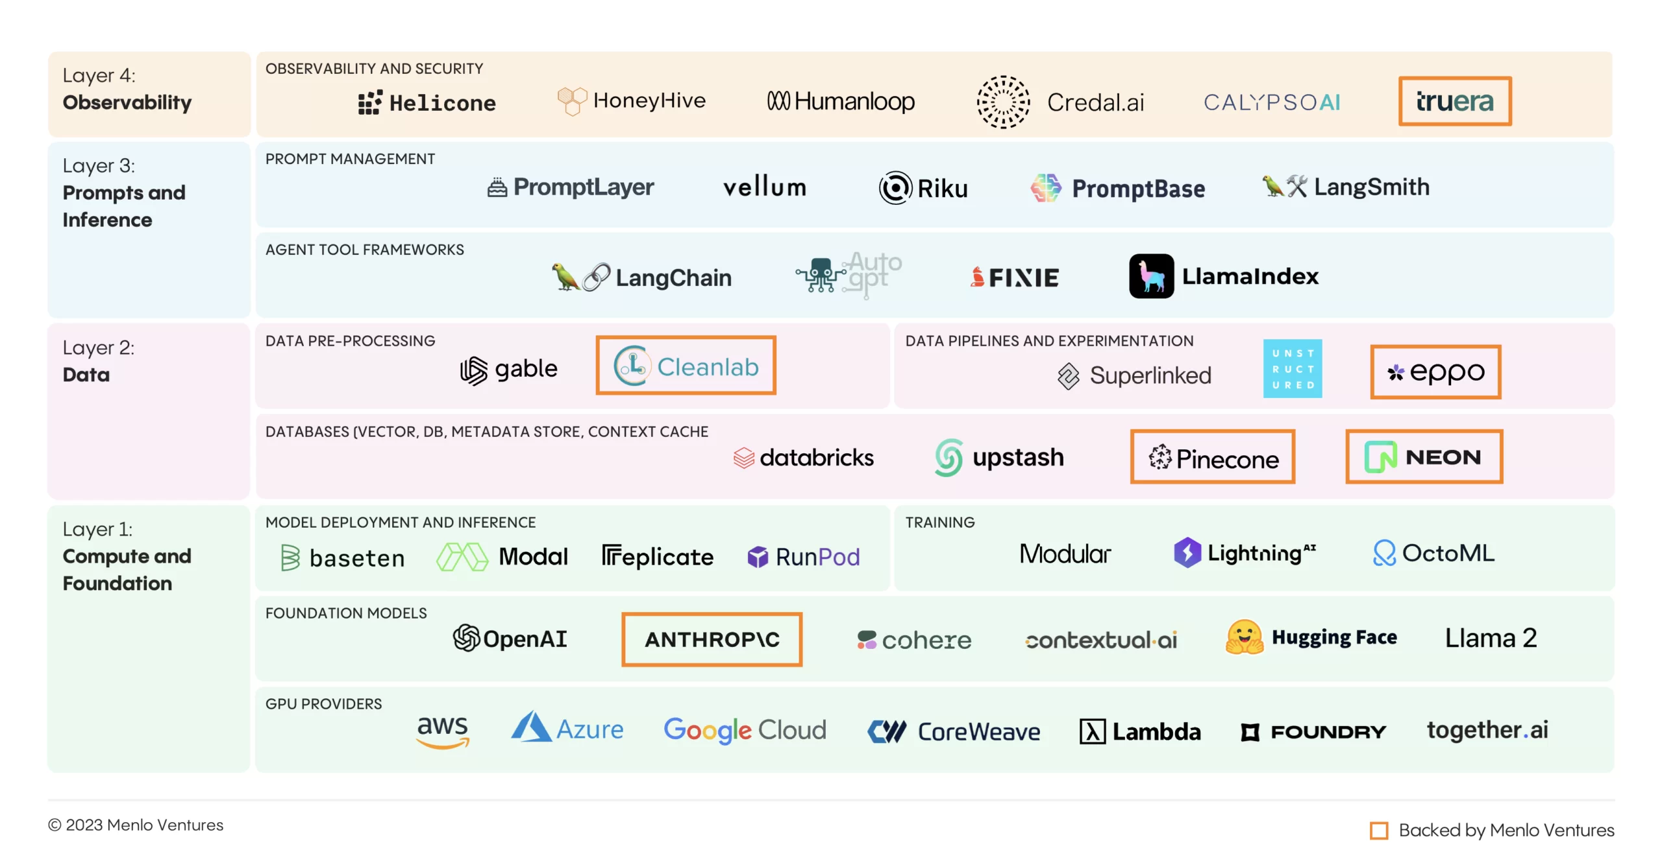
The AI Stack
Network is part of the GPU Cluster
Source:Menlo Ventures

