Slide 1

The Network Automation Blueprint

Slide 2

Introduction
14 years in networking engineering
4 years at AWS
7 years in network automation
Founded Network automate

Slide 3
Agenda
The State of Networking Today
Why Network Automation
Pre-requisites to Automation
The Dilemma
Roadmap to Automation Adoption
Antipatterns & Pitfalls
Use Cases
Orchestrators
Native Network As Code Implementation
Measuring Success

Slide 4
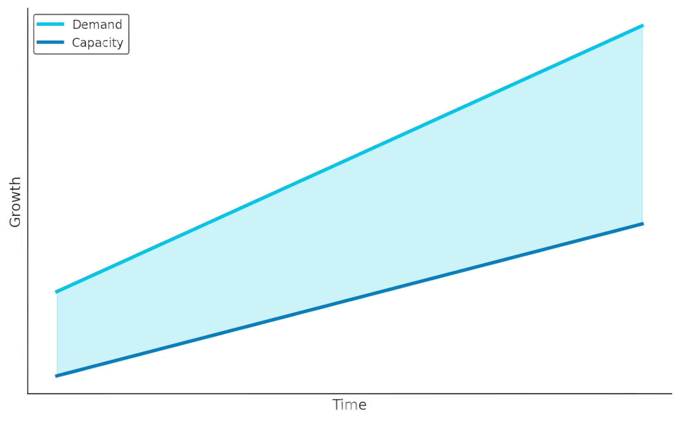
The State of Networking Today
Command Line & Graphical User Interface (GUI)
Siloed tooling
Ever growing demand
Internet of Things
IPV6
DDoS
Telemetry
Traffic Engineering

Slide 5
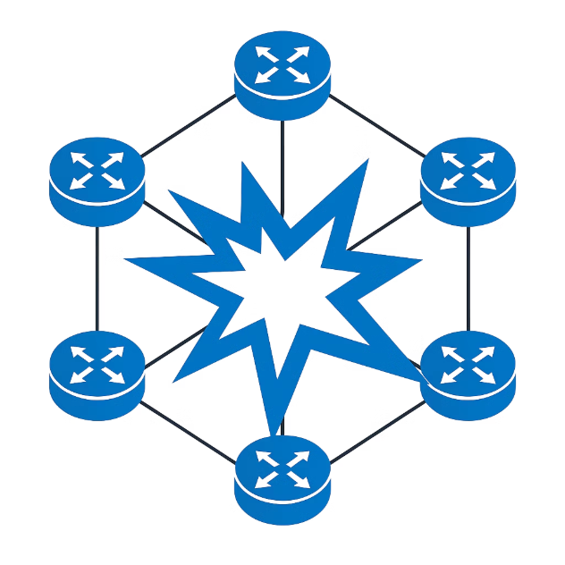
Why Network Automation
Deploy faster
Minimize Risk
85% reduction in time to launch
Pre-checks & post-checks
Progressive rollouts
66 - 80% downtime due to human error
Reduce costs
55% reduction in OPEX
What is the cost of staying manual?

Slide 6




Pre-Requisites to Automation
Organizational
Technical
Skills Development
Training teams on automation and programming
Automation
Defined Processes
Leadership Buy-in
Securing executive support and resources
Patternization
Standards
Adaptable processes
Evolving workflows to accommodate automation

Slide 7
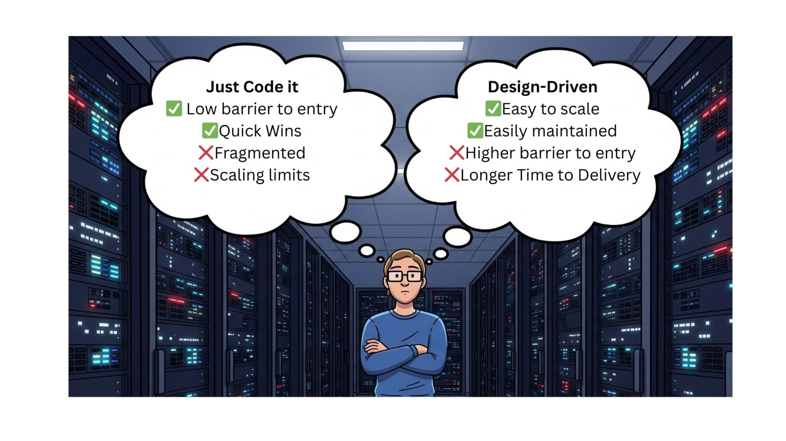
The Dilemma

Slide 8
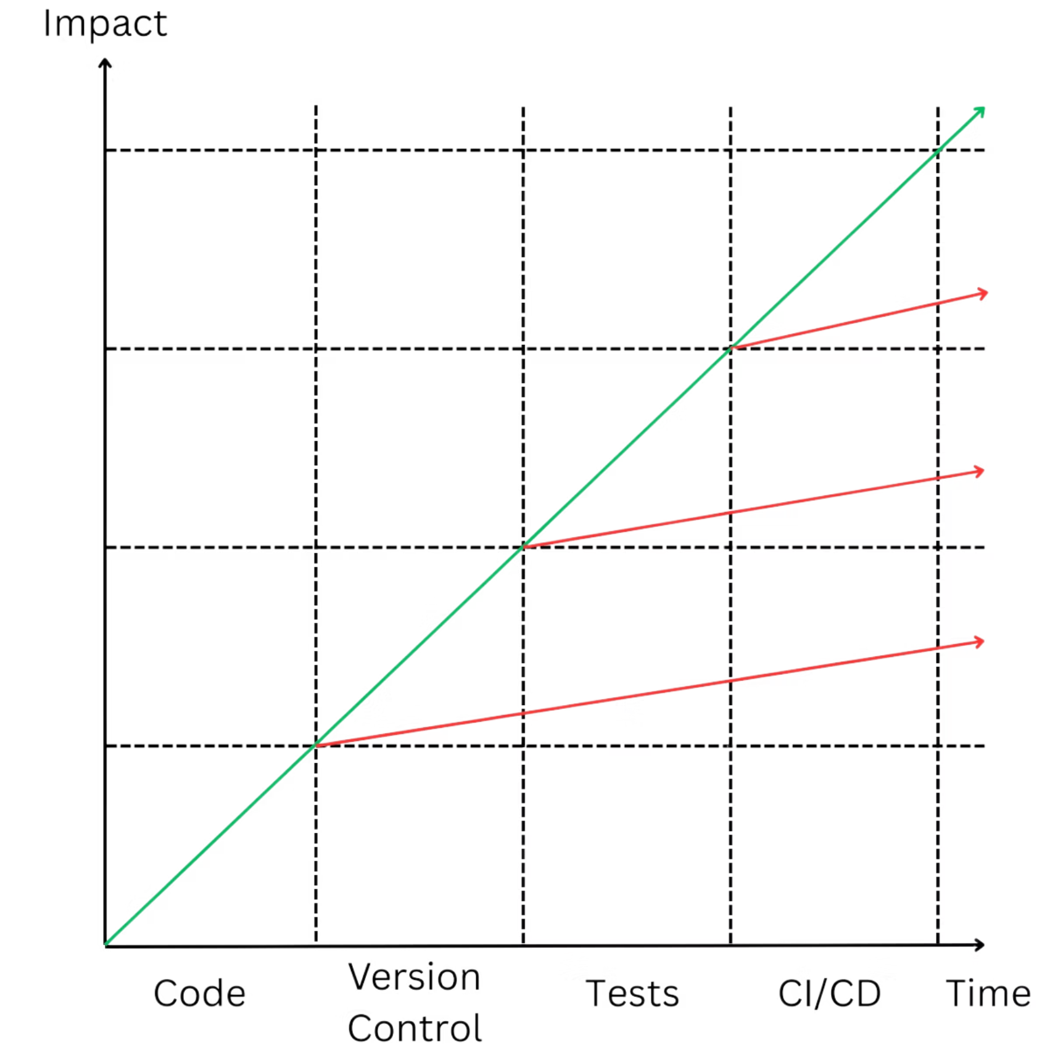
Simplified Adoption Roadmap

Slide 9
Antipatterns & Pitfalls
❌ Trying to automate everything at once
❌ Waiting for the perfect tool or architecture
✅ Start with highest-impact, lowest-risk use cases
✅ Start with good enough, iterate and improve
❌ Building cool tech without operational focus
❌ Aiming for trendy Automation
✅ Solve real problems with measurable business impact
✅ Focus on practical solutions that address real needs

Slide 10


Slide 11
What can we automate?
Allocations & Reservations
Security Policies
Interfaces
Vlans
VXlans
IP addresses
Config Management
BGP ASNs
Generation
Deployment
Tooling Integration
IPAM
Guardrails
TACACs
Networking Monitoring
Pre-checks & post-checks
Telemetry
Advanced
OS Upgrades
Self Healing
Traffic Engineering

Slide 12
Orchestrators
Definition
A platform or a system
coordinates and executes automated workflows
across multiple network domains, devices, and tools
Delivers an intended service or change
Anti-Patterns
20+ clicks to make a change (e.g. adding a Vlan)
5+ API calls to make a change
No one button rollback
Poorly documented and inconsistent APIs

Slide 13
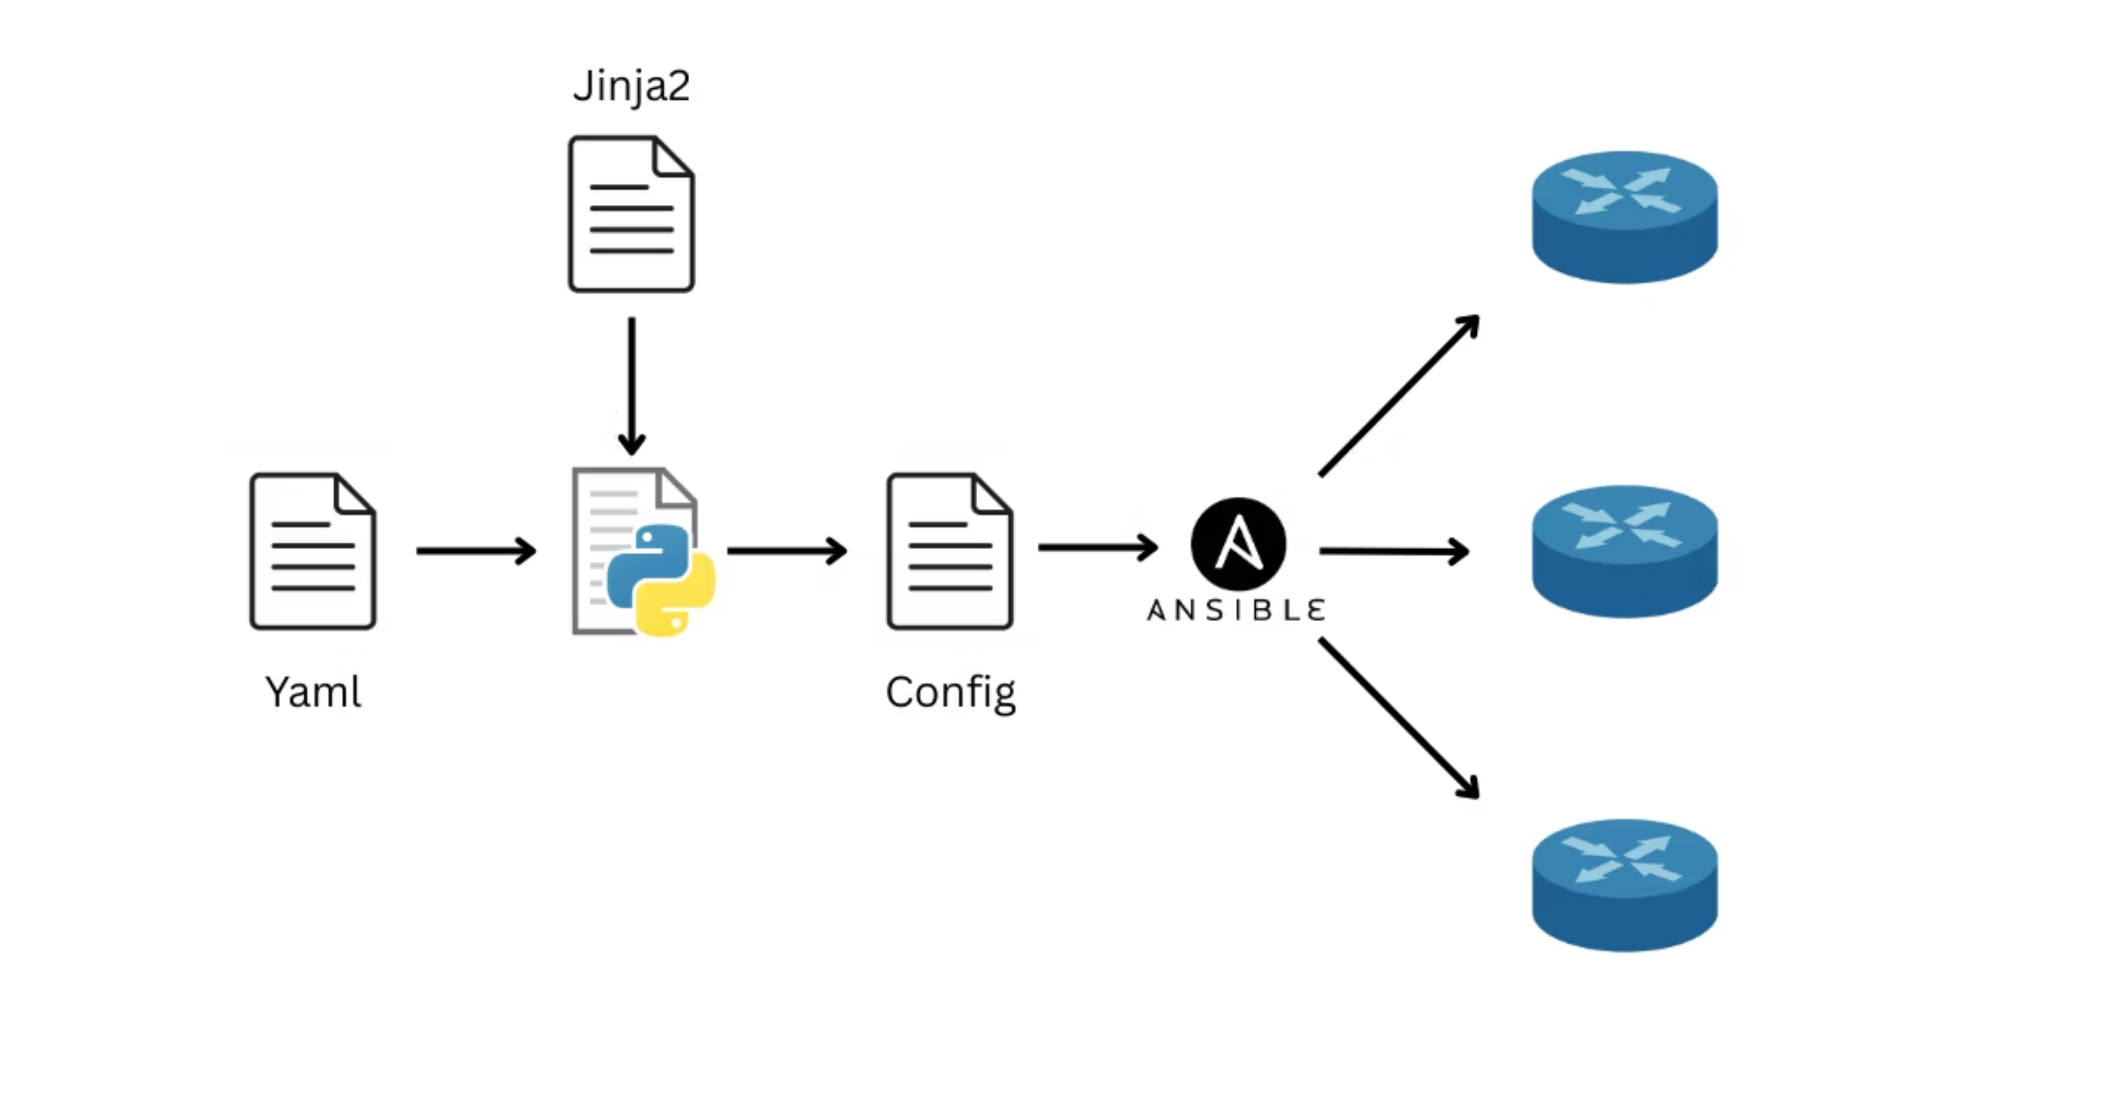
Native Network as Code - NaC

Slide 14
Measuring Success
Always benchmark before you automate!
Time Saved
Cost Reduction
Reduction in deployment time
Decrease in operational expenses
Automated Network Tests
Automation Coverage
Pre-checks & post-checks implemented
Percentage of changes automated

Slide 15
Key Takeaways
Start small, scale smart
Balance quick wins with long term strategy
Automation is a capability, not a one-off project
Choose simple over complex solutions

Slide 16
Thank you

