Slide 1
Powering small communication nodes during long power outages
Development Experience. Implementation and Key Benefits for Critical Infrastructure
Speaker: Yuriy Vykhnevych
Owner & CTO Best-Link LLC. Senior member IEEE

Slide 2
Problems Faced
Unpredictable behaviour during power outages
No real time information
Unknown remaining battery time
Unknown SOC, SOH
No remote power control and monitoring
Variety of battery types
Limited space inside the box
No climate control
No integration into existing CRM

Slide 3
Why А Custom Solution. Pros And Cons.
Pros:
All in one solution
Flexible functionality
Independence from third-party solutions
High security level
Easy integration into existing infrastructure
Cons:
Long-term development process (design, prototype, live tests)
High initial investment

Slide 4
System Design Requirements
Real-time control and telemetry aligned with NOC
Universal, software-defined power controller
Compact size: 136x185x45 mm
Battery types: Lead-Acid/AGM/GEL/Li-ion/LFP
Cell quantity: 3-16 Cell
Stack voltage: 10–80 V
Charging current: 0.1 - 40 A
Low cost: $200–250.
Fast and easy installation
NMS/CRM/Cloud integration
Power sources: Grid, Generator, PV, Battery Pack
ASSC/ATS functionality
Communication Interfaces: Ethernet, Wi-Fi, LoRa, UART, BLE, CAN, RS-485
Scalability

Slide 5
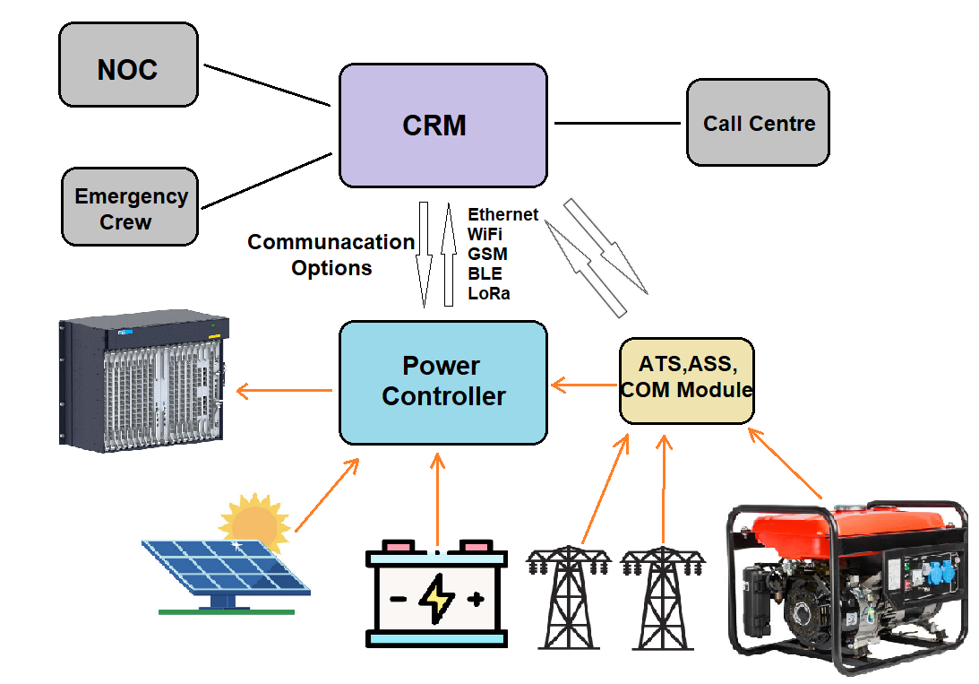
System Diagram

Slide 6
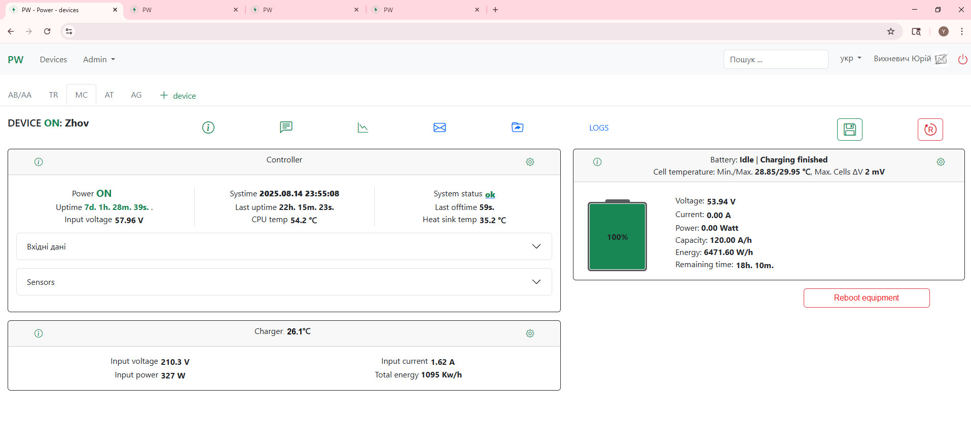
Web Interface

Slide 7
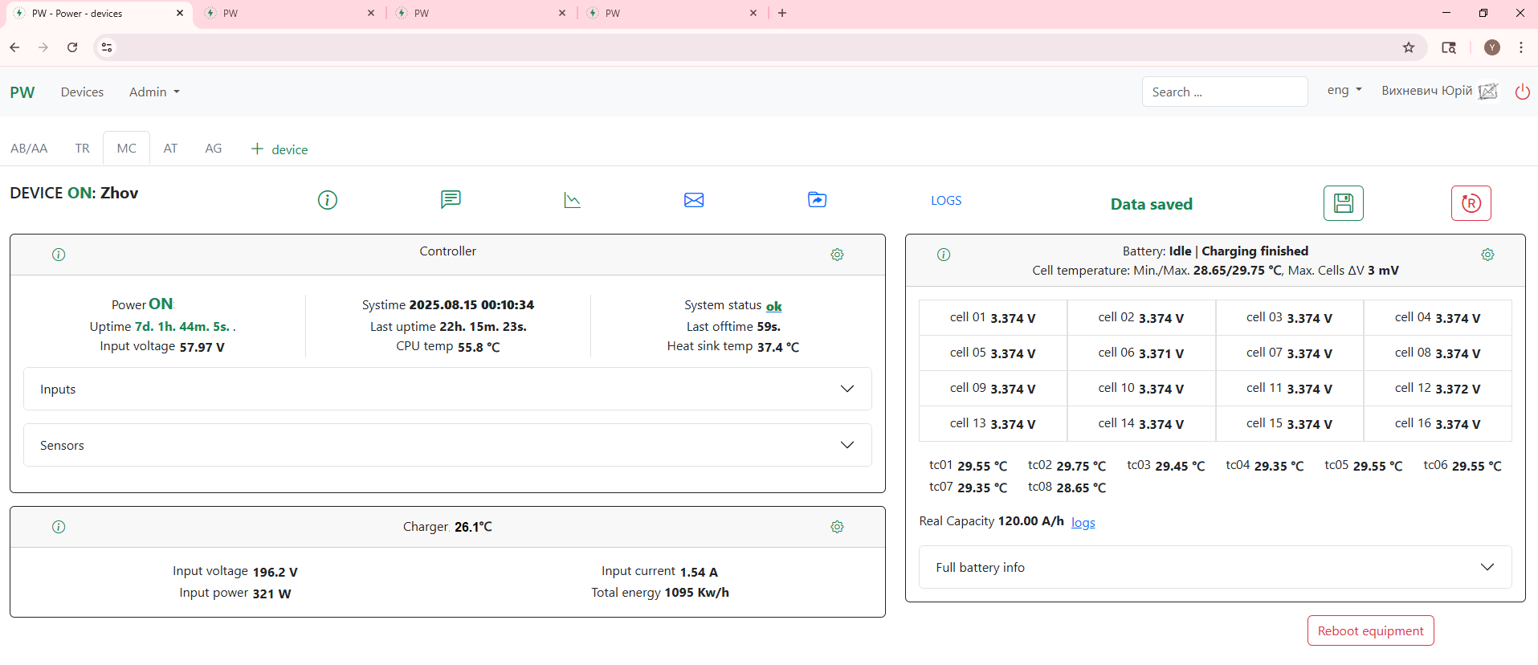
Web Interface

Slide 8
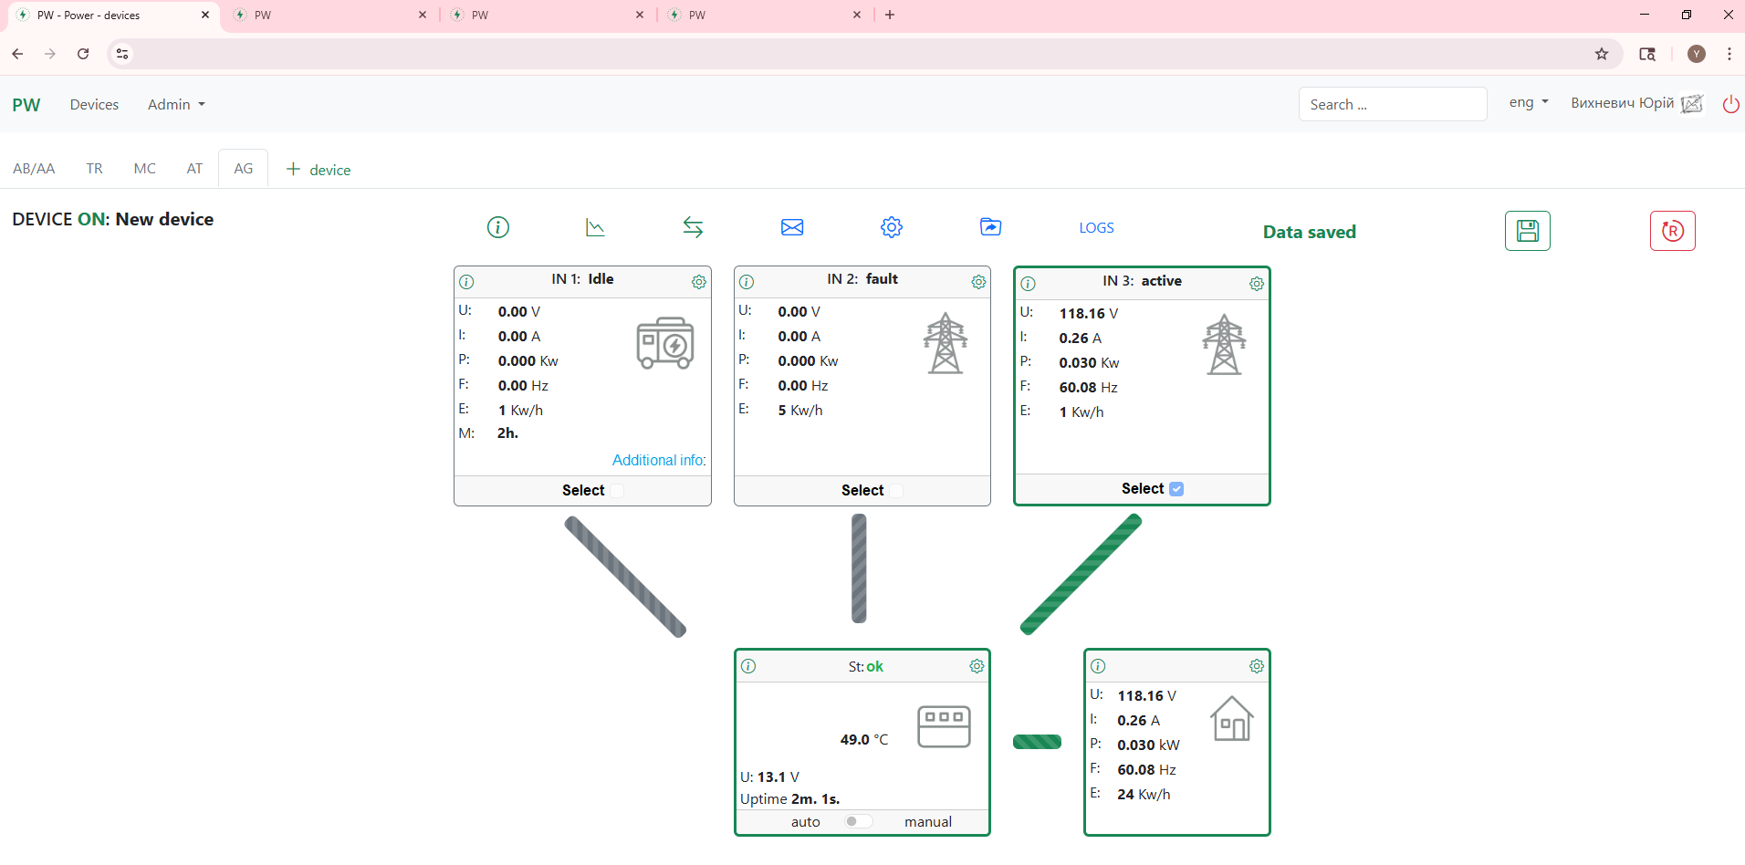
Web Interface

Slide 9
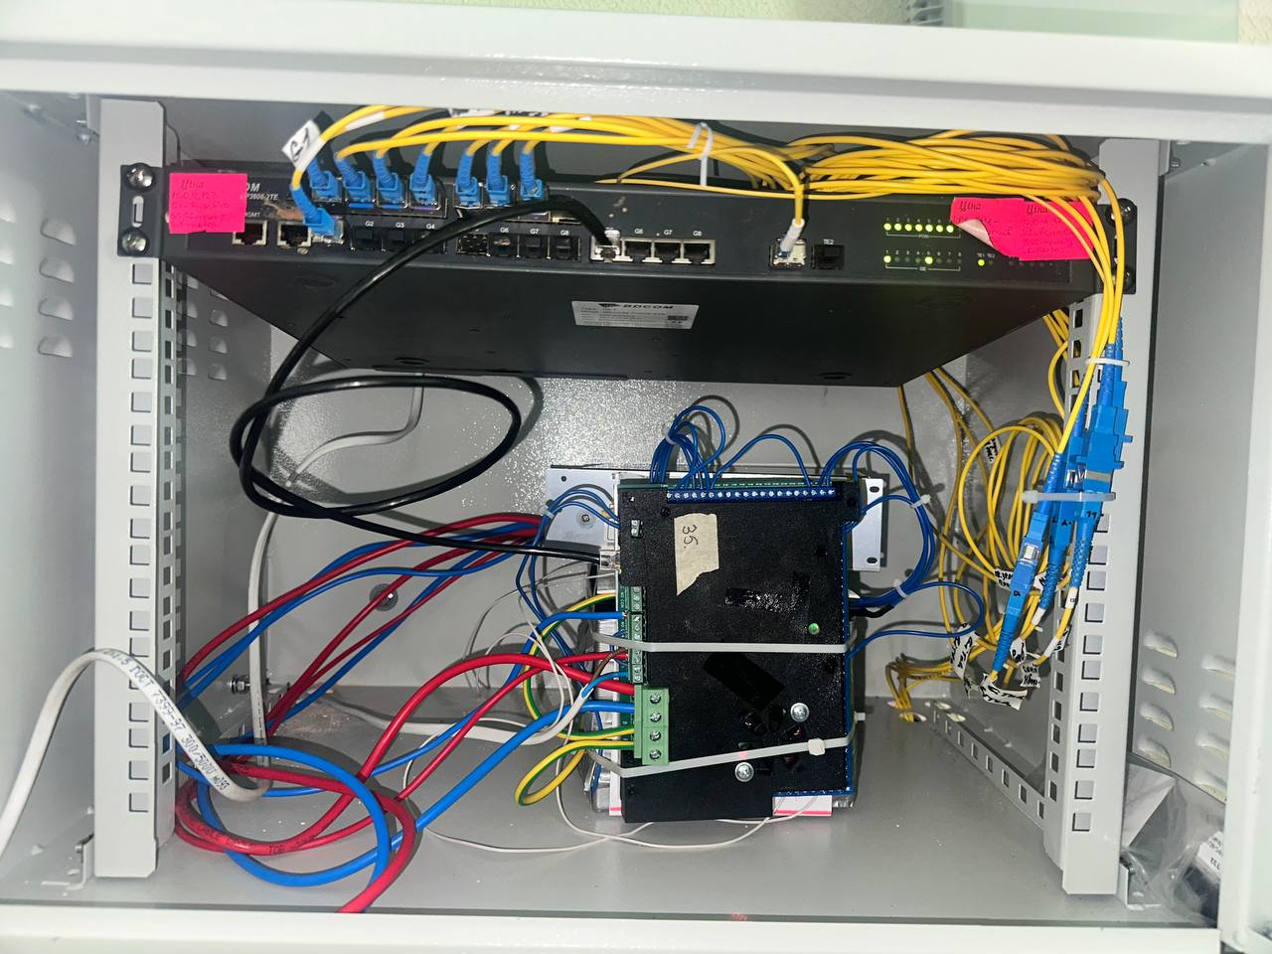
Inside The Box

Slide 10
Results And Benefits Achieved
Full automatization, monitoring, management and control of node power
Quick modernization of existing nodes
Significantly shortened service outages
Reduced expenses for nodes service
Extended equipment and batteriy lifespan
Increased number of new customers

Slide 11
Thank You!
Email: yurkou@gmail.com

