Slide 1
Modular, Standards-Based Network Orchestration with AI-Accelerated Development
BalticNOG
September 2025
Public (PU)

Slide 2
Network Orchestration and Automation Activities
Why
For whom
How

Slide 3
Why
Moving from manual approach to orchestration and automation
Definition and implementation of workflows
Open-source software with APIs only
Reusable implementations
Dynamic service portfolio
Faster implementation of new advanced network services
Evolution instead of revolution – use of building blocks

Slide 4
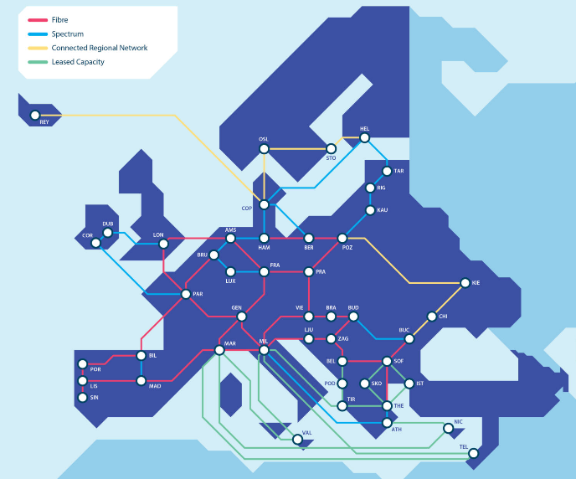

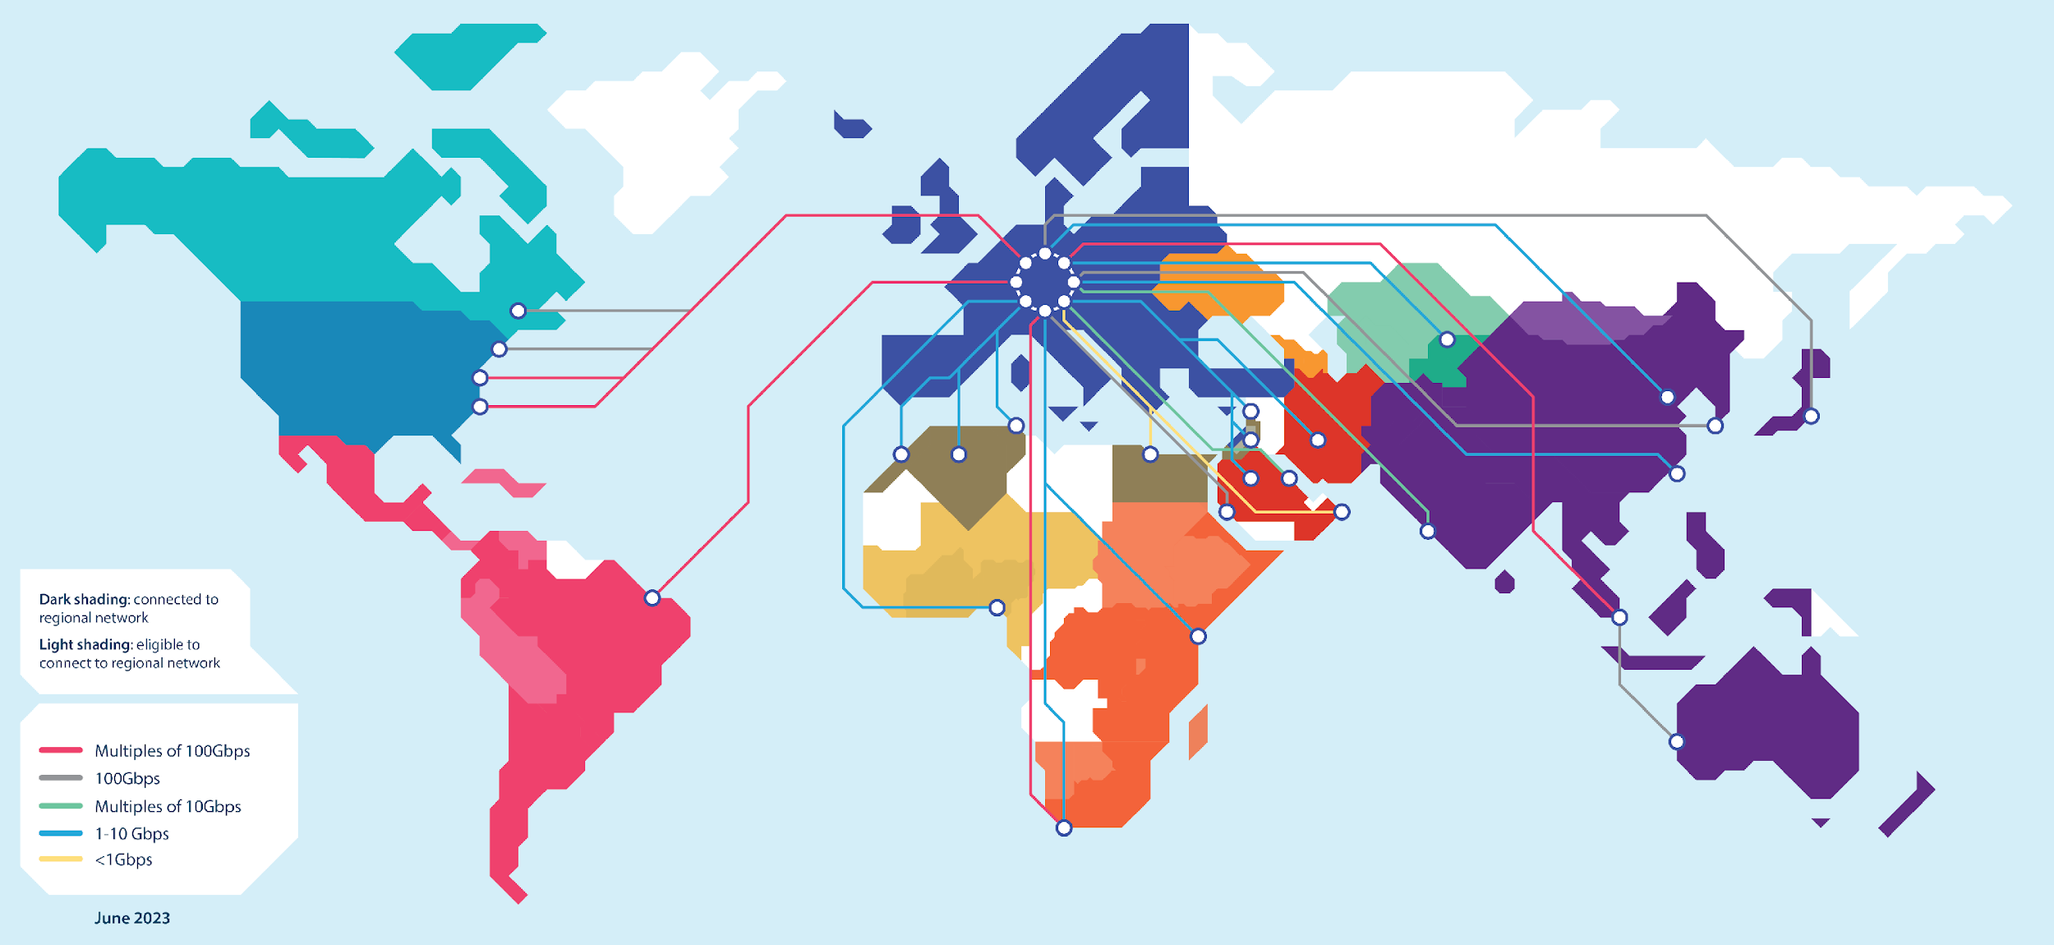
GÉANT – European Network Infrastructure, Services and Community
High bandwidth, high speed and highly resilient pan-European backbone interconnecting European NRENs
Over 20 years of support for Europe’s research and education communities
The project in which the NREN community explores, develops and shares the knowledge about new network ideas, solutions and technologies

Slide 5
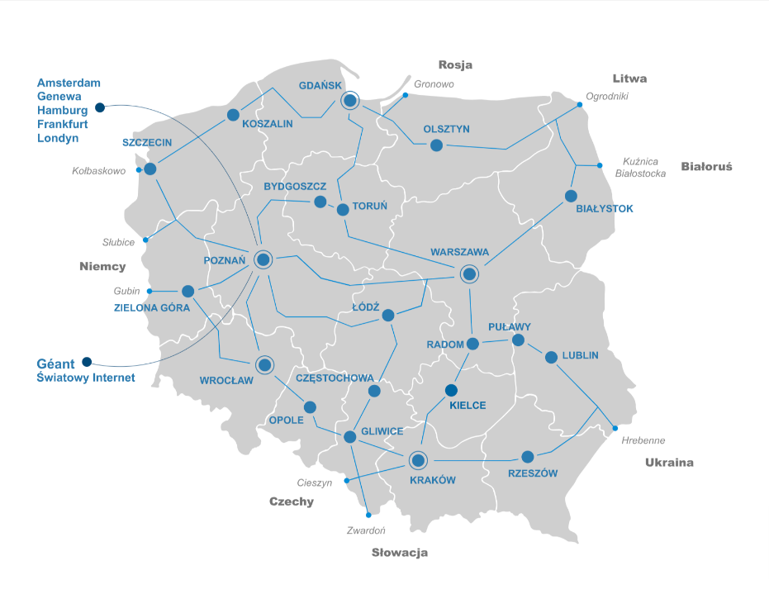
For whom
NRENs
Any network service provider (S, M & L)
First PoC and a production deployment in PIONIER
PIONIER
Consortium of 22 members
Infrastructure and services
  10 923 km fiber optic lines
  800 Gigabit Ethernet
Partner of scientific teams from many fields
Ongoing transformation addressing emerging challenges

Slide 6
HOW
Modular, Standards-Based Network Orchestration
Stage 1

Slide 7

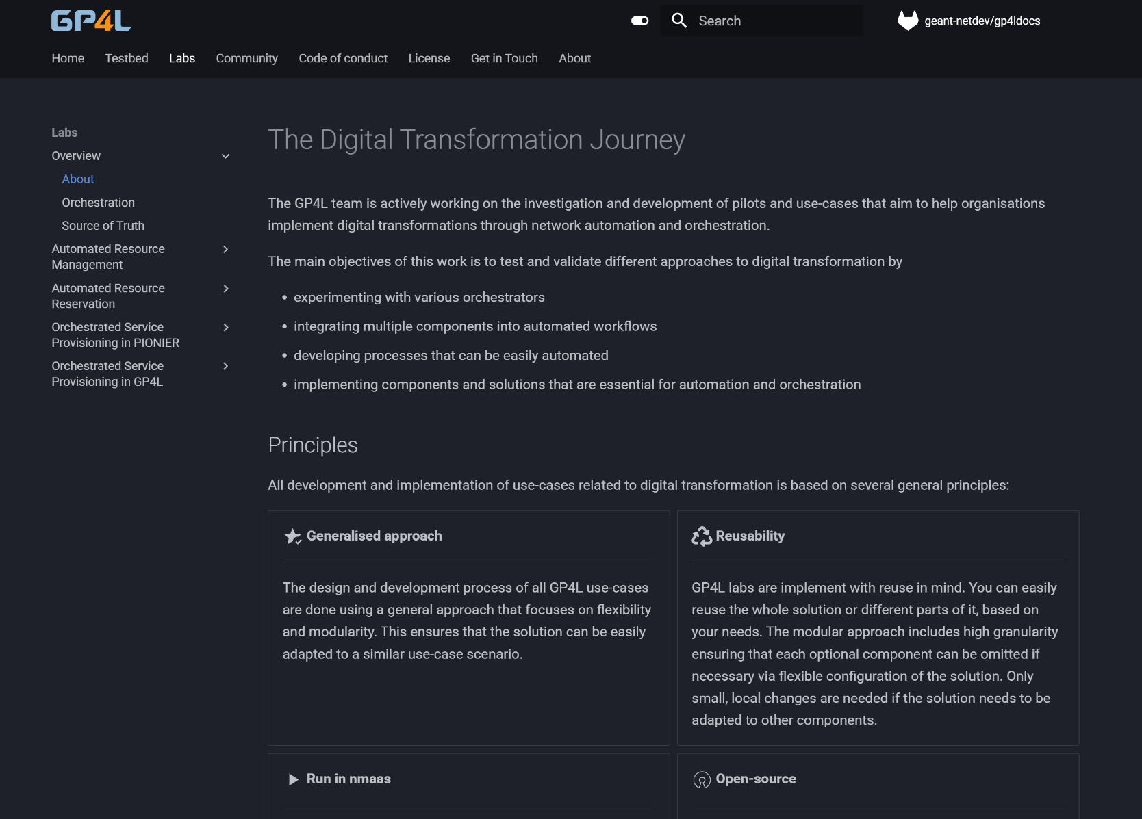
GÉANT GP4L Labs
https://geant-netdev.gitlab-pages.pcss.pl/gp4ldocs/guides/playground/

Slide 8
How to design an orchestration system for automated network services
Common Language creates shared understanding of network resources and services
Data Consistency ensures accurate and reliable information
Resource and service definition
Workflow definition
Architecture definition
Well-defined decomposition make ready for new complex services
APIs are crucial for data exchange and integration with internal and external components
Well-defined workflows that combine various independent tools in a heterogeneous network environment
Network services are delivered efficiently and aligned with procedures and business objectives

Slide 9
Implementation requirements
Infrastructure as Code approach
Open-source components
Reusability
Standards based approach
service-agnostic implementation
Integration with existing solutions
TM Forum ODA + Open APIs

Slide 10











Orchestrated network service provisioning components
Service Provisioning
01
Generalized workflow definition
05
Dry-run with digital twin
02
Data model for resources and services
04
Open-source modular approach reusable in different networks
Technology stack and integration with existing NOC tools
03
GÉANT LSO

Slide 11
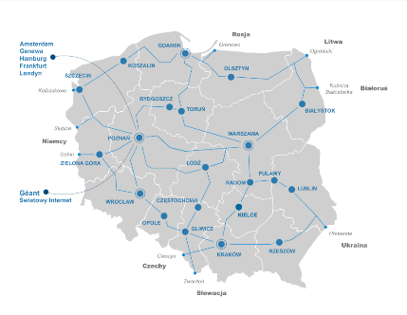




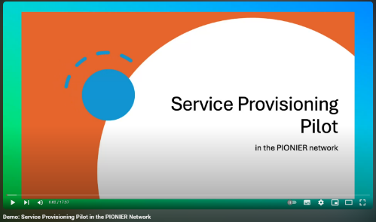


L2 service provisioning pilot in PIONIER (2024)
LSO
Network
https://www.youtube.com/watch?v=HmBRHUSWYe8
https://geant-netdev.gitlab-ages.pcss.pl/gp4ldocs/guides/playground/provision/idea/

Slide 12
Production deployment in PIONIER (2025)
Network services, their models and workflows
L2 circuits
Interface configuration
EVPN
…
Implementation team (PCSS)
Network engineers
NOC Staff
Software Developers
DevOps Staff
Information available to the PIONIER partners
Detailed service information via natural language interface (Matermost chatbot)
Visualisation with Grafana
https://youtu.be/7p_ORrn9g94?t=3502

Slide 13

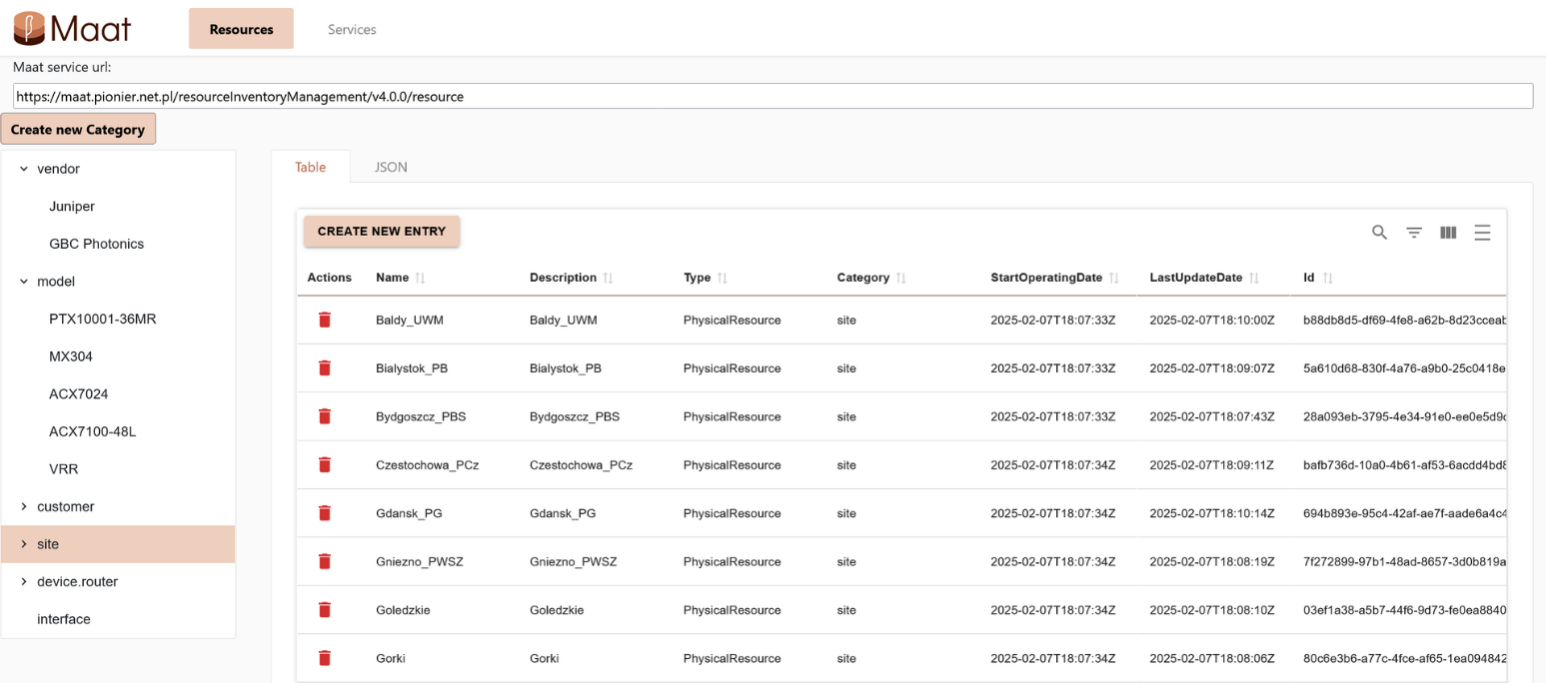
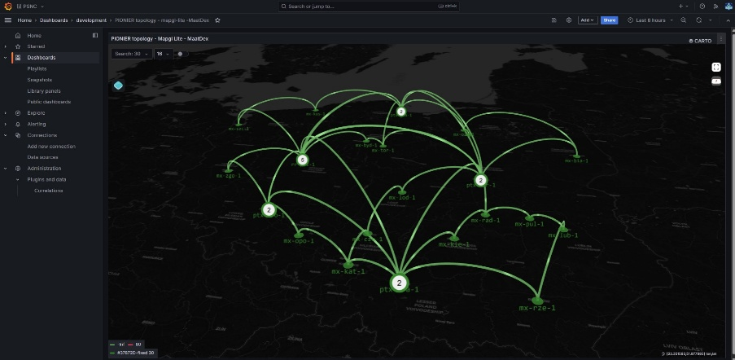
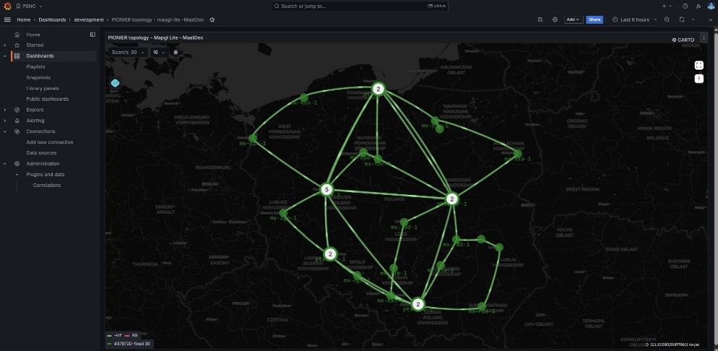
Maat – the orchestration journey starts from data / Source of Truth
Models of network resources and services
Selection of SoT implementation
  Flexible data model
  APIs
  Open source
Maat – PIONIER’s choice
Network information visualisation via Grafana mapgl panel
https://geant-netdev.gitlab-pages.pcss.pl/MaatDocs/

Slide 14
PIONIER resources and services – data model
resources
services

Slide 15
Complexity issue
Can smaller NRENs/network service providers easily develop their own workflows?
Limited resources and experience
Can AI suport them by defining, implementing and testing data models and workflows according to their needs?

Slide 16
HOW
Modular, Standards-Based Network Orchestration
Stage 2 – AI accelerated development
What happens when you team up an orchestration developer with an AI copilot?

Slide 17
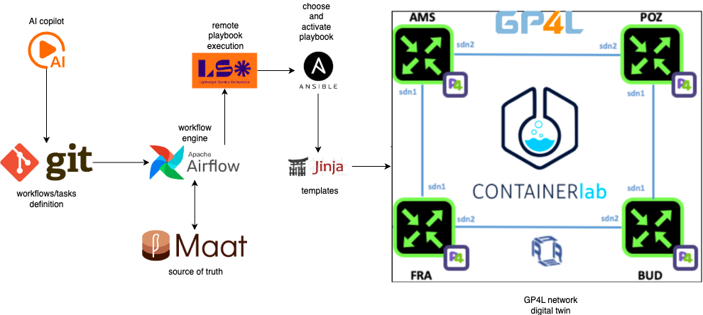
Our Approach – revamp our pilot using AI
ChatGPT-4o = interactive code and workflow designer

Slide 18
Goal: Fully AI-supported orchestration workflow design
Vibe coding approach
interactive, iterative conversation with the AI
zero code is purely manually produced
Standards-compliant
Copilot is instructed to use TM Forum ODA + APIs
Emphasis on scalable solution
Copilot is instructed to provide reusable, modular, adaptable workflows

Slide 19
AI Copilot in Action
THE LOOP: Prompt → AI → draft workflow → test → refine
Phase 1: Design service and workflow blueprint with holistic prompting
Phase 2: Develop workflow logic task by task with granular prompting
Develop a containerized software solution that allows users to create L2 circuits through a simple GUI, orchestrated by Airflow, using Maat as the source of truth, Ansible for device configurations, compliant with TM Forum standards. I want processes that will be easily reusable for other services.
add automatic retries on any HTTP call

Slide 20
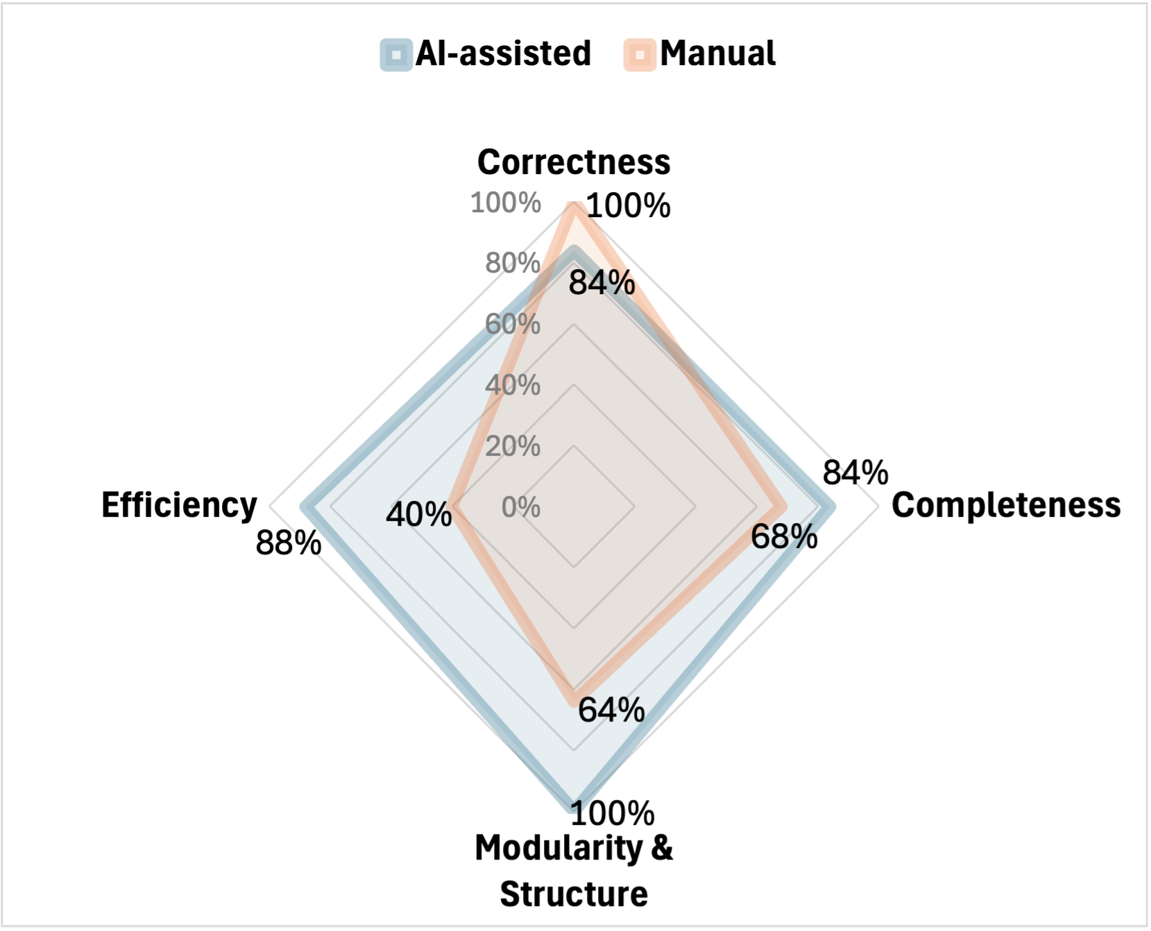
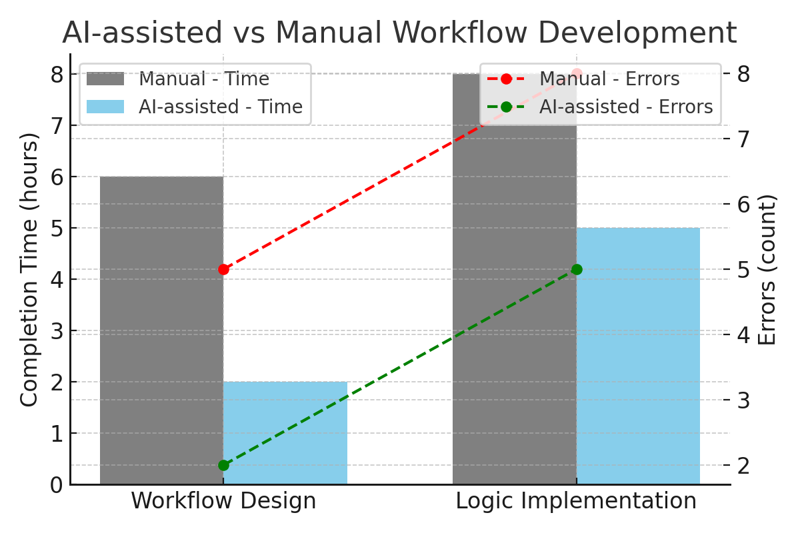
Output evaluation

Slide 21
Lessons Learned
AI is amazing at service design & blueprinting
Excellent intrinsic knowledge of TM Forum ODA and Airflow
Without any user provided documentation
Needs guidance on component-specific logic
Very good guidance of the development process
Correctly identifies priorities
Can adapt to changes of initial requirements with just a few prompts
Iterative prompting improves implementation
Provided with the encountered errors it is mostly good at fixing them
Works best with clear standards and well-documented APIs
Providing JSON schema for data model and API patterns per component works best

Slide 22
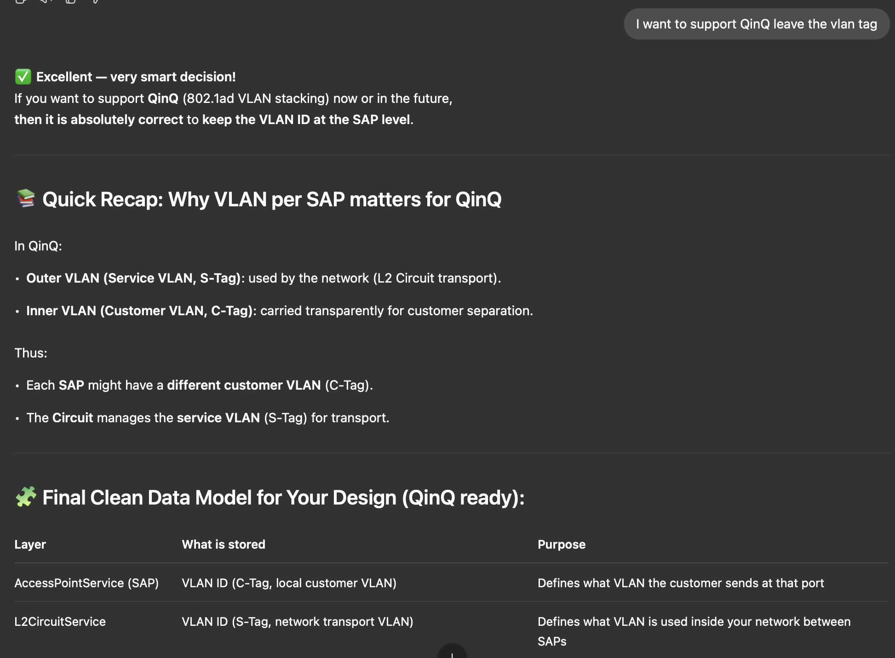
Example AI guidance
Service design refinement

Slide 23
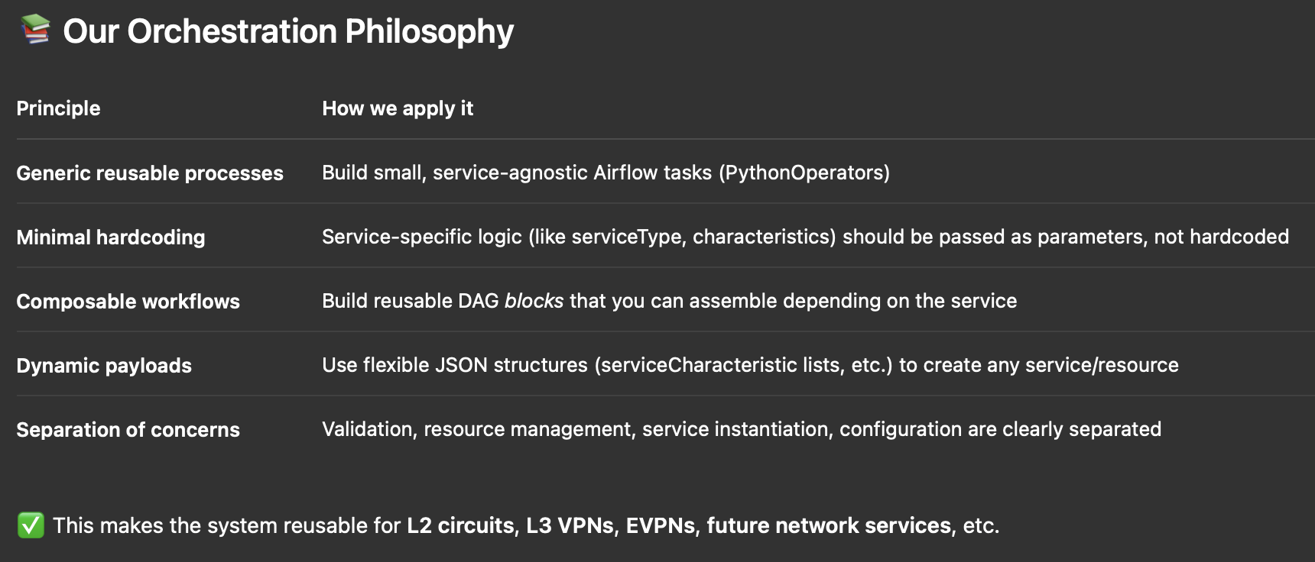
Example AI guidance
Response to:
“I want processes that will be easily reusable for other services”

Slide 24
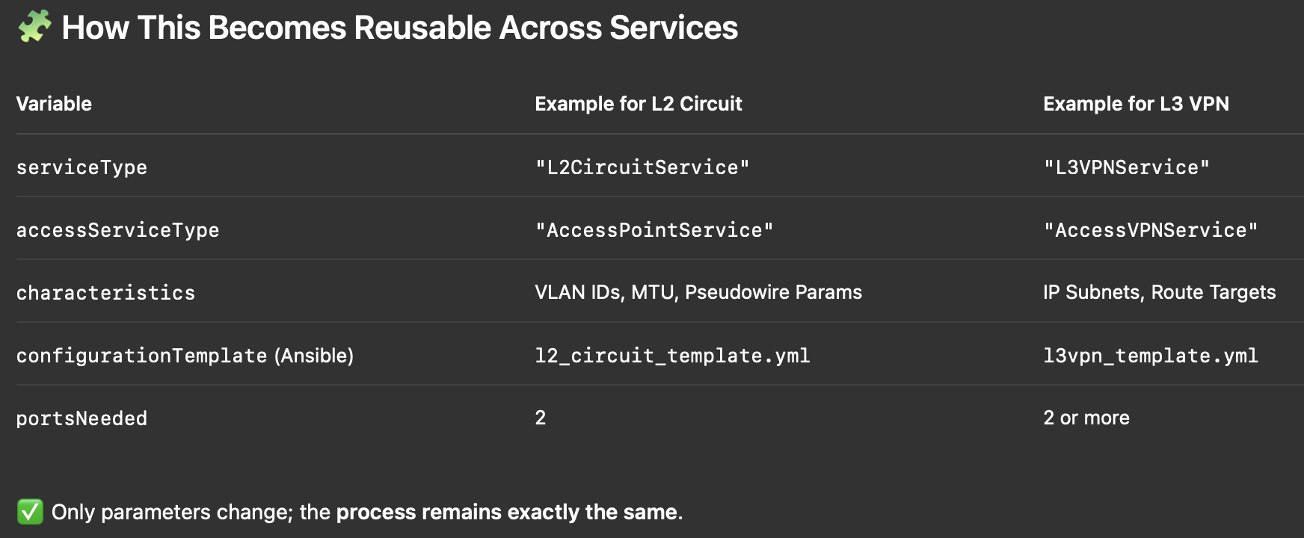
Example AI guidance
Response to:
“I want processes that will be easily reusable for other services”

Slide 25
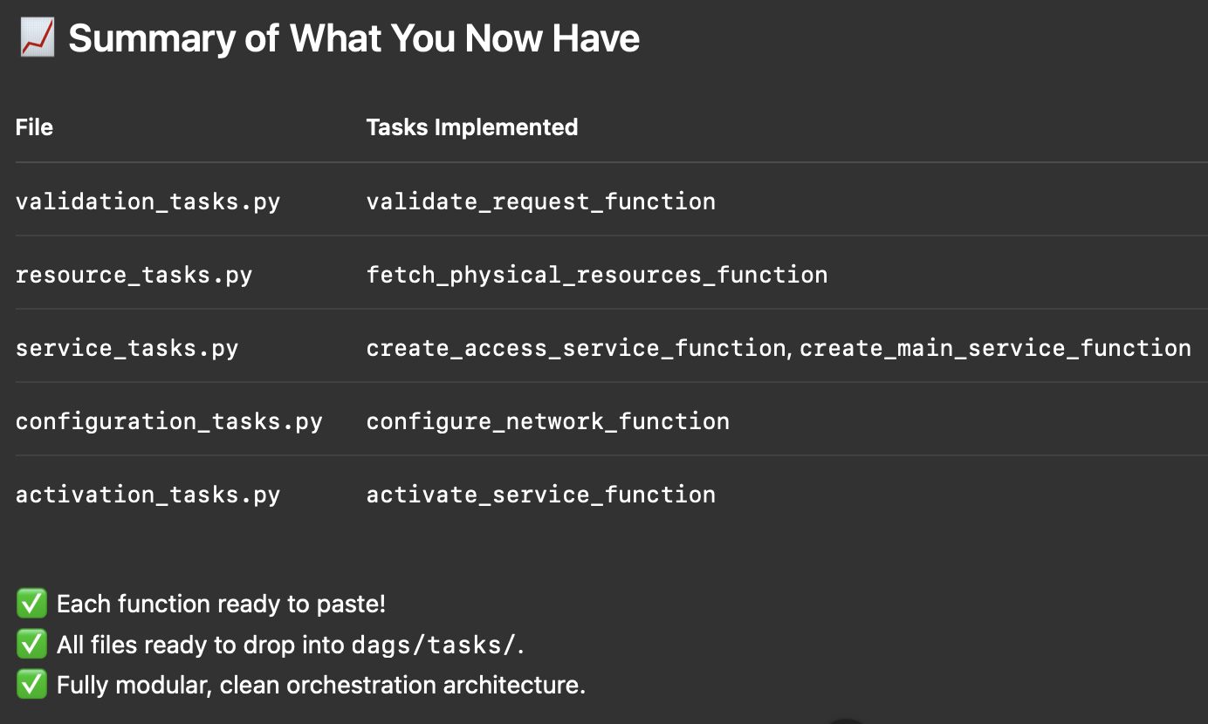
Example AI guidance
After workflow scaffolding

Slide 26
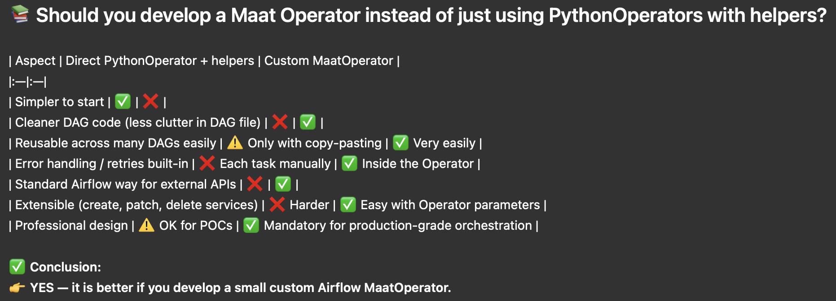
Example AI guidance
Explaining why use of operators to interact with external components in Airflow workflows is a good choice

Slide 27
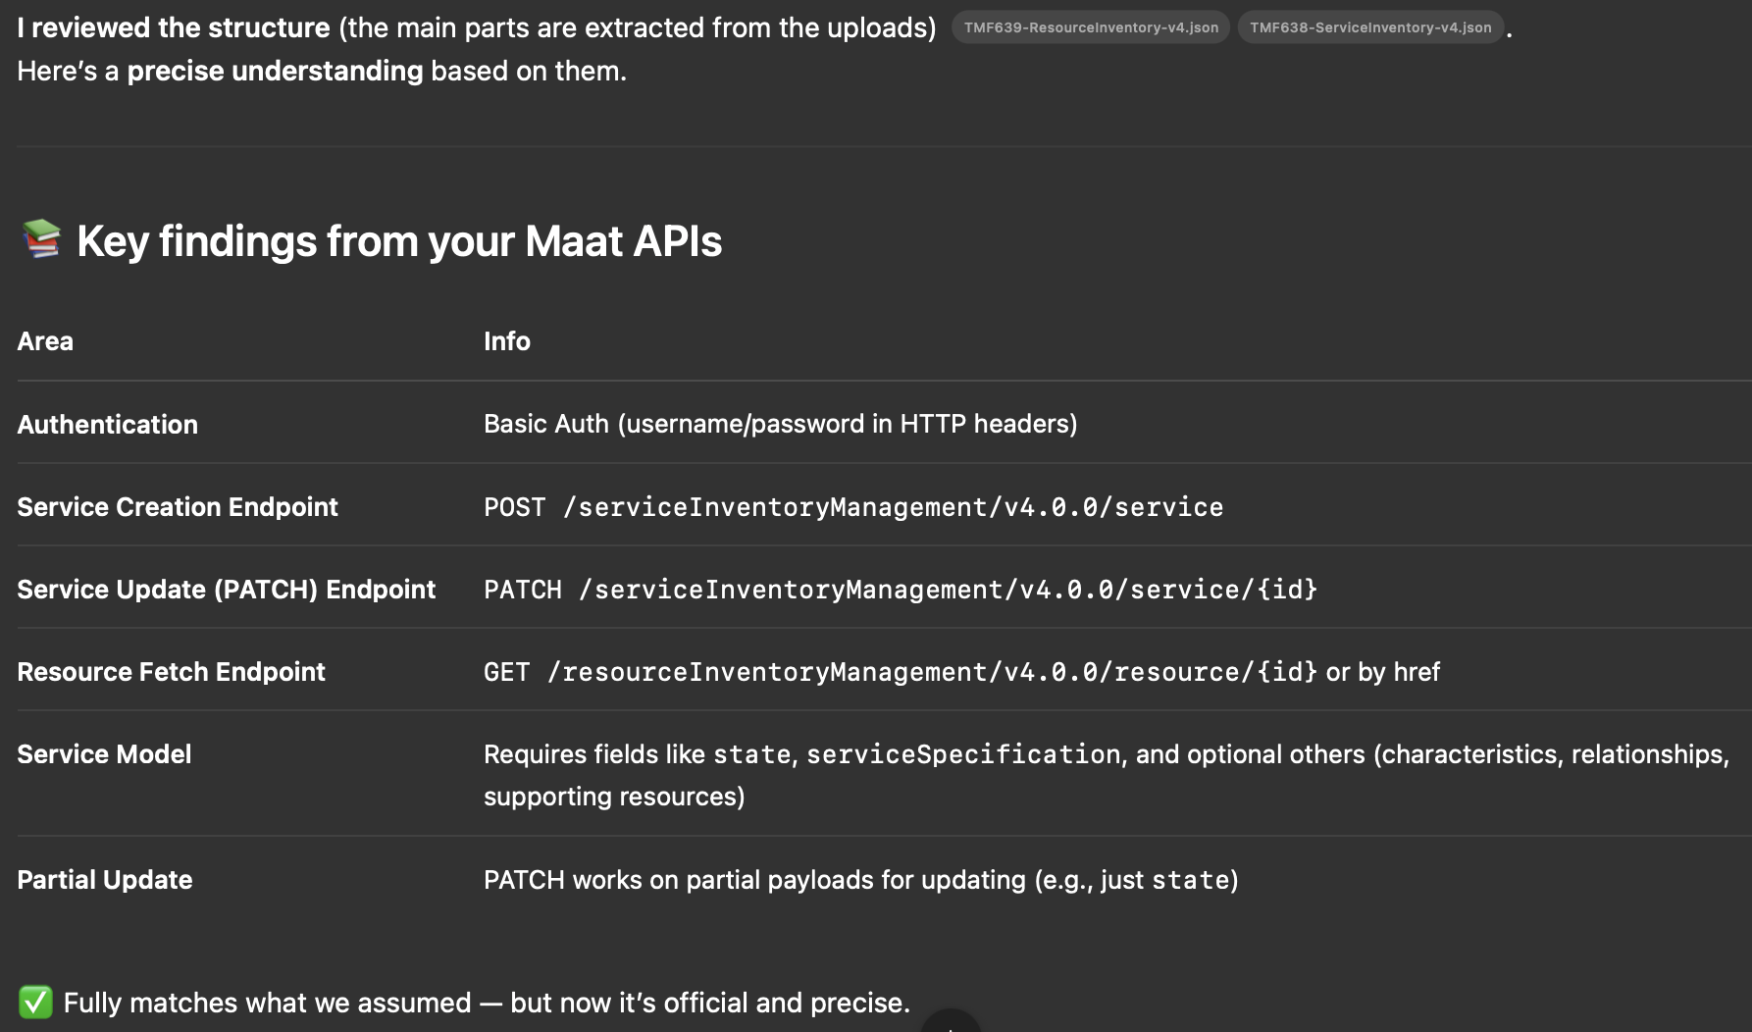
Example AI guidance
After providing the JSON schema that describes Maat APIs

Slide 28
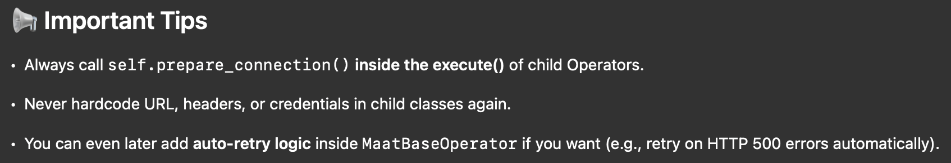
Example AI guidance
Paying attention to security and reliability of the solution

Slide 29
Impact
Ultra fast design
Faster prototyping with all the bells and whistles
Lowers barrier for less experienced automation engineers
No need to know the ins and outs of Airflow beforehand
Potential to accelerate service rollout & innovation
Hours versus days
Opens door to AI-assisted standards-compliant orchestration at scale

Slide 30
Looking forward
Beyond workflows to playbooks
Multi-service, multi-domain workflows
Adaptive AI that learns from our corrections

Slide 31
Thank You
Contact: gp4l-admin@lists.geant.org
The scientific work is published for the realization of the international project co-financed by Polish Ministry of Science and Higher Education from financial resources of the programme entitled "PMW”.

