Slide 1

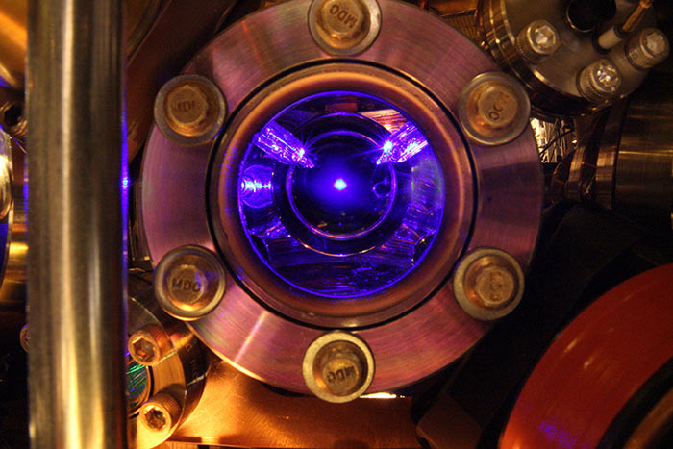
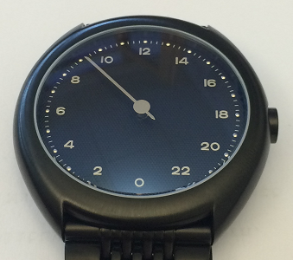
Redundant National Distribution of Time and Frequency
Sven-Christian Ebenhag

Slide 2
Outline
Why?
Clocks
National Distribution
Questions

Slide 3
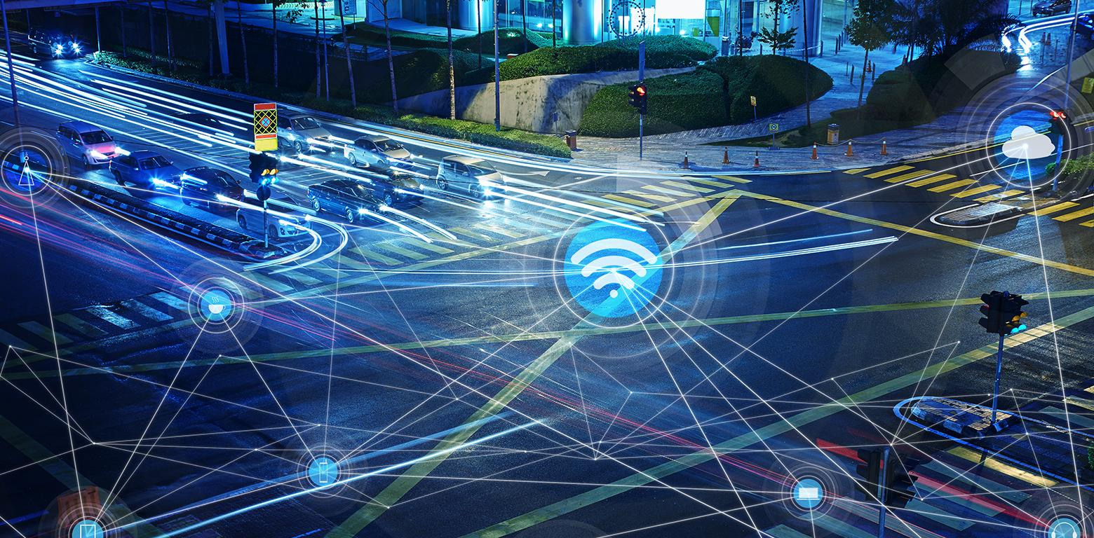
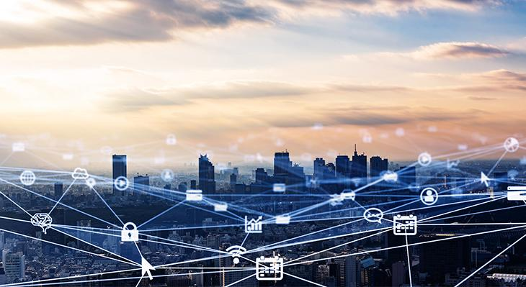


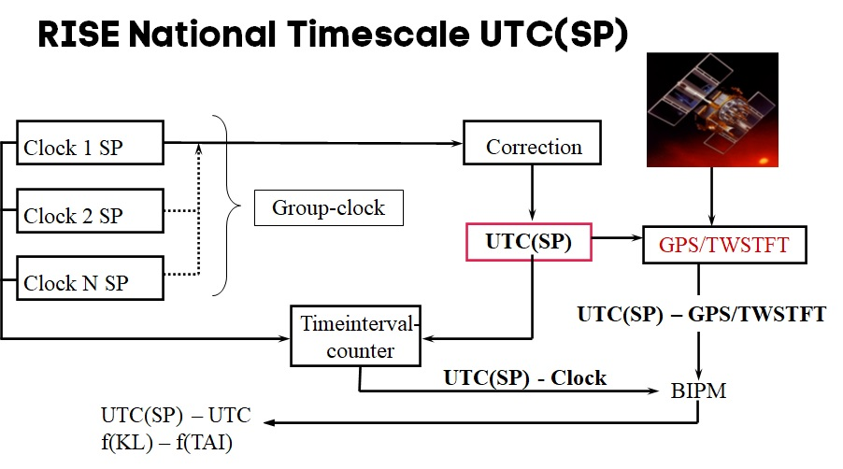
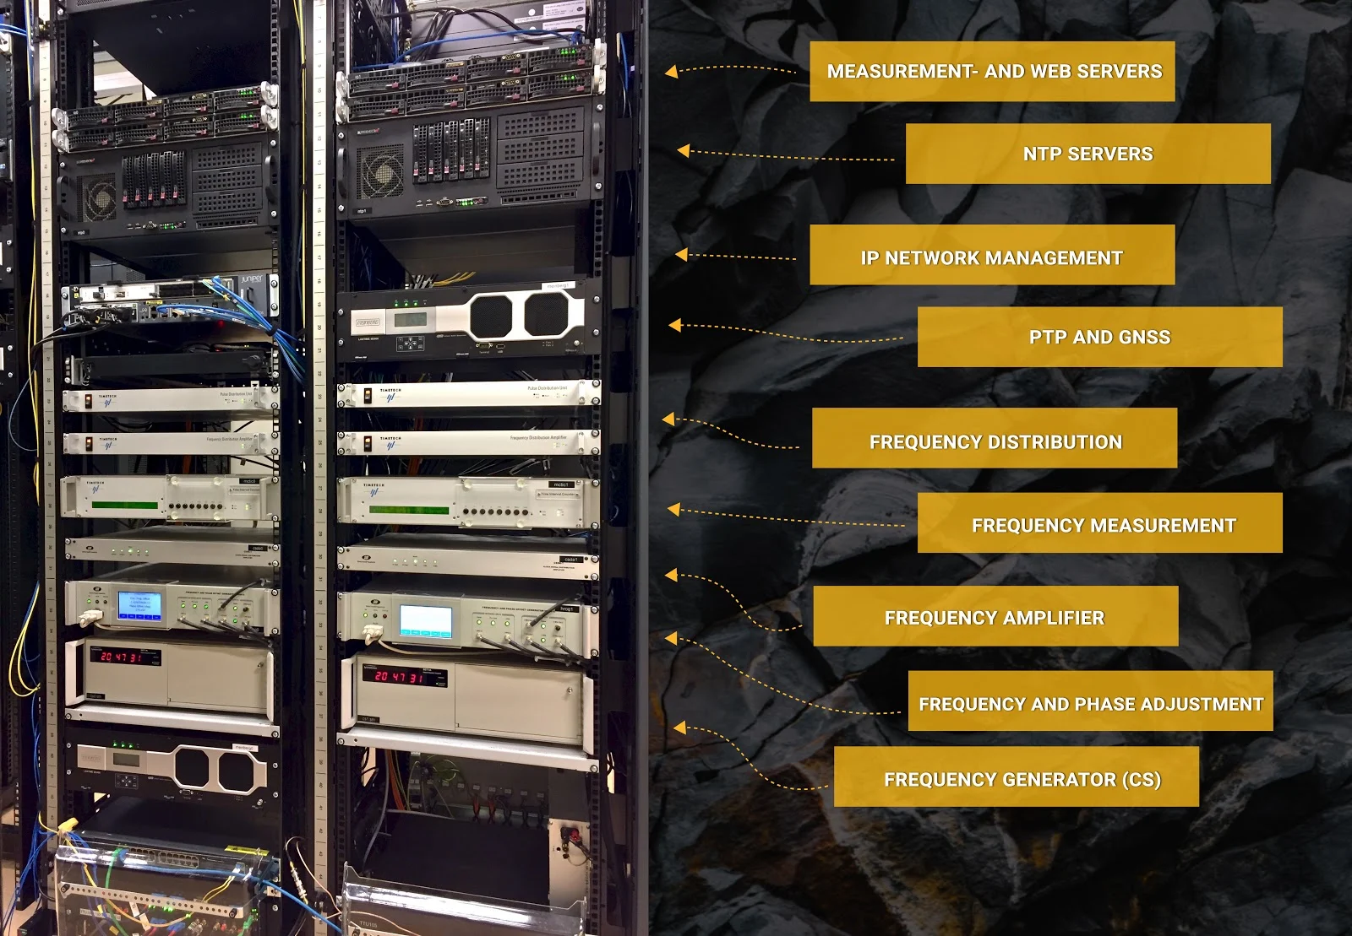

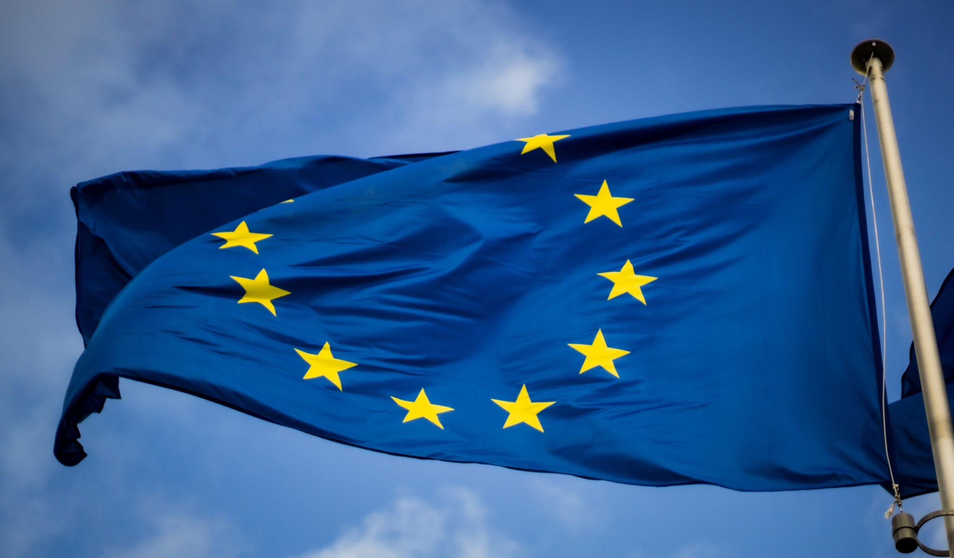
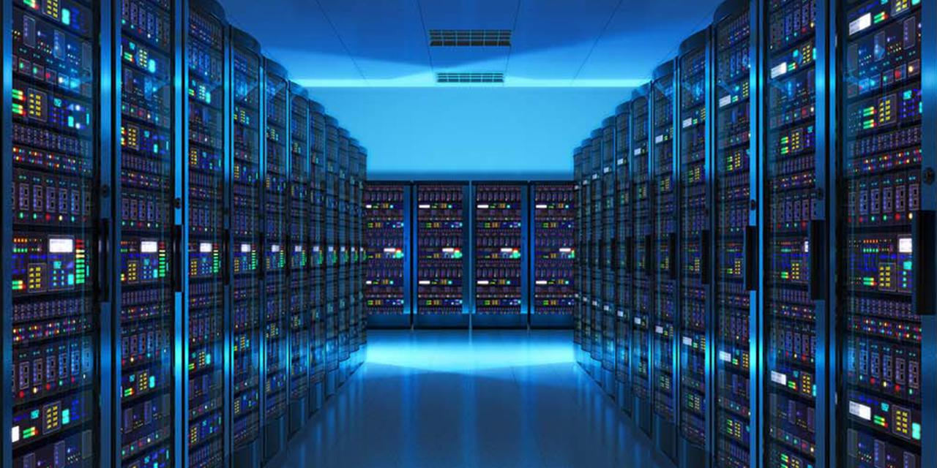
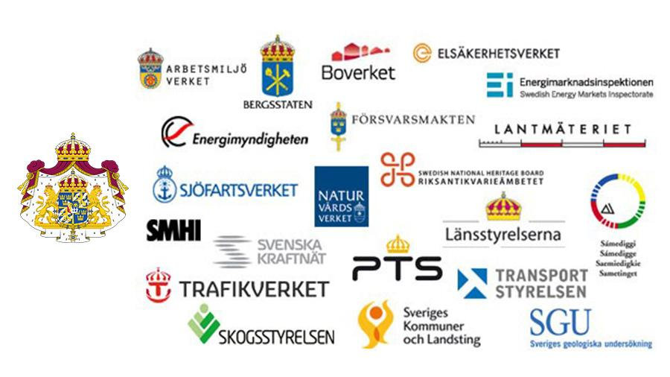
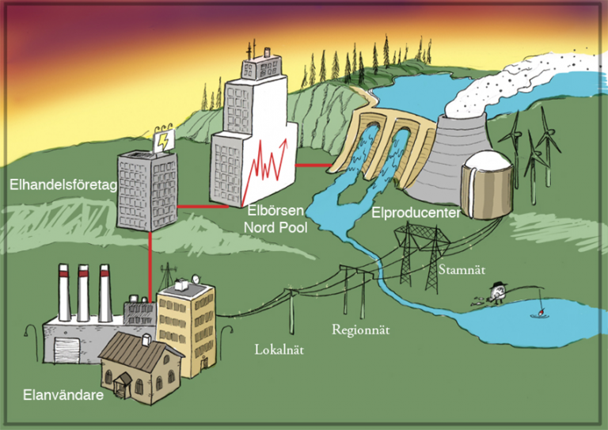

Netnod Time
and Frequency Distribution
Autonomy/
positioning
Aviation
Defense
Economy
EU-projects
Research
HPC/Storage
Research
Authorities
The energy sector

Slide 4
The history of time
Example from Sweden, similar development in all countries.
Local solar time.
12.00 noon when sun is in the south.
24 min difference within Sweden.
Swedish Railroad Time (mid 1800)
Local Solar time of Gothenburg
Swedish National Time (1879)
Local Solar time of Laxå. Equally offset from Gothenburg and Stockholm.
Greenwich Mean Time
12.00 noon when sun is in the south of Greenwich Observatory outside of London
Swedish normal time = GMT + 1 hour (1900)
Danish normal time = GMT + 1 hour (1894) (Bornholmstid)
UTC Universal Coordinated Time
International Time since 1972
Based on TAI – International Atomic Time
Adds leap seconds to adjust for earth rotation

Slide 5
Historical definitions of the second
1⁄86,400 of a mean solar day. Practical solution in mechanical clocks since 1656 (first clock showing seconds) Defined by Gauss 1832 for reference system when measuring gravitation
"the fraction 1⁄31,556,925.9747 of the tropical year for 1900 January 0 at 12 hours ephemeris time”.
  Decision of the CIPM (Comité International des Poids et Mesures) 1956
  Resolution in 11th CGPM (General Conference on Weights and Measures) 1960

Slide 6
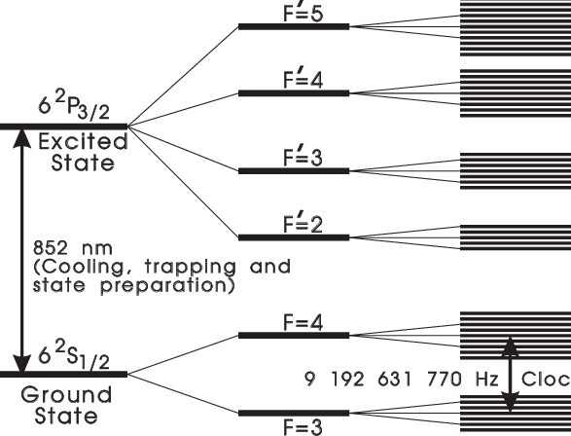
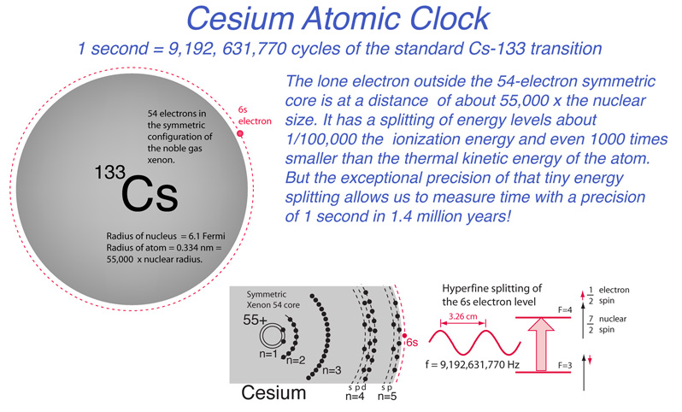
How long is a Second nowdays?
From 1967 to present: Atomic Second
  Based on radiations in the caesium 133 atom
    Counting periods of electromagnetic radiation locked to an atoms resonant frequency
    When an atom changes energy level, it either radiates or absorbs energy with a specific frequency
  1 second = “the duration of 9 192 631 770 periods of the radiation corresponding to the transition between the two hyperfine levels of the ground state of the caesium 133 atom” (at a temperature of 0 K and at mean sea level).
  The number of periods was chosen so as to make the atomic second equal to the ephemeris second
  Decision of the CIPM 1964
  Resolution in 13th CGPM 1967

Slide 7
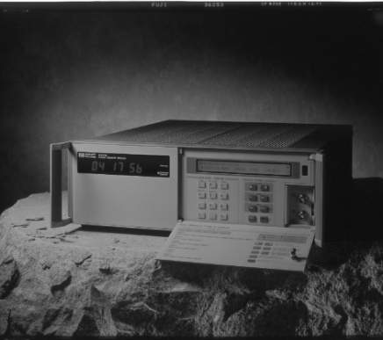
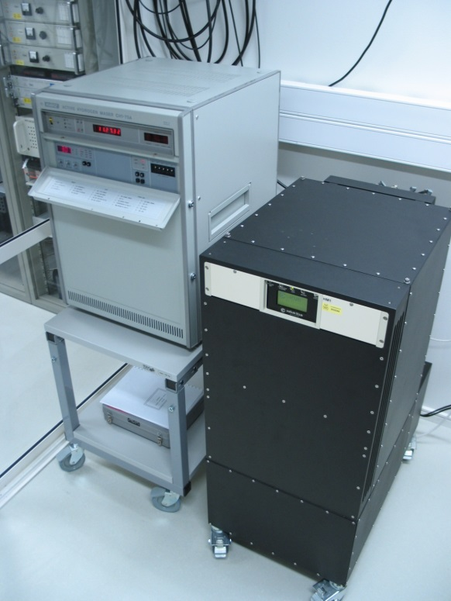
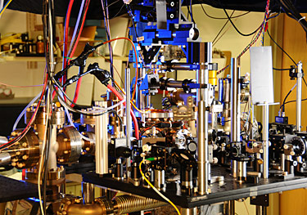
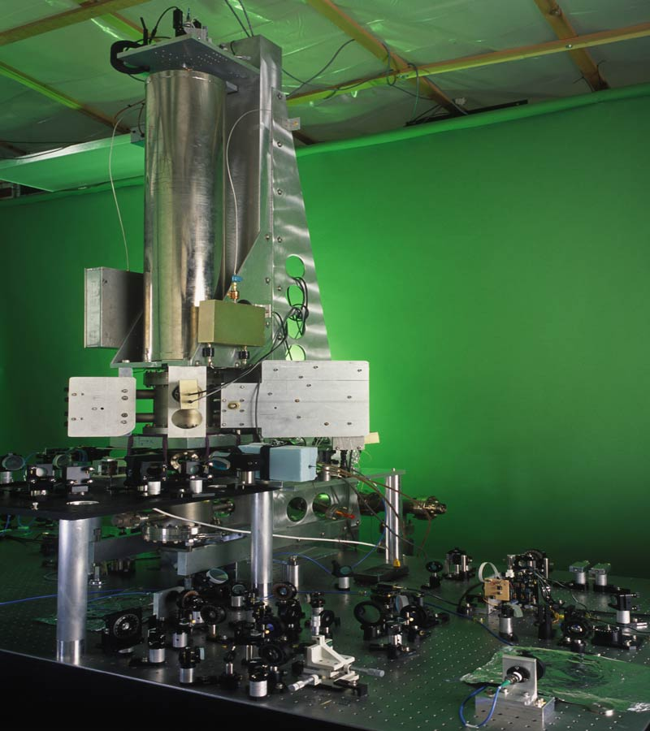
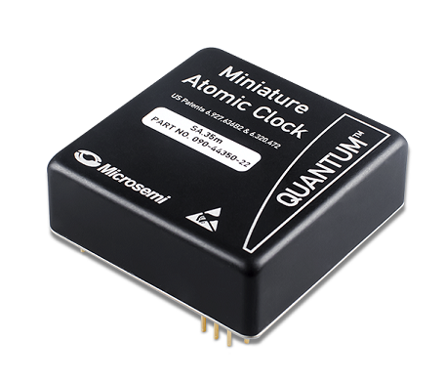
Atomic clocks
Commercial Caesium clock
Commercial Hydrogen maser
Caesium fountain clock
Small Rubidium clock
Ytterbium optical clock

Slide 8
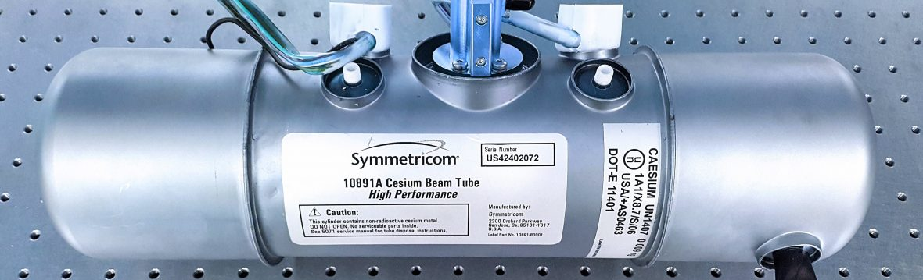
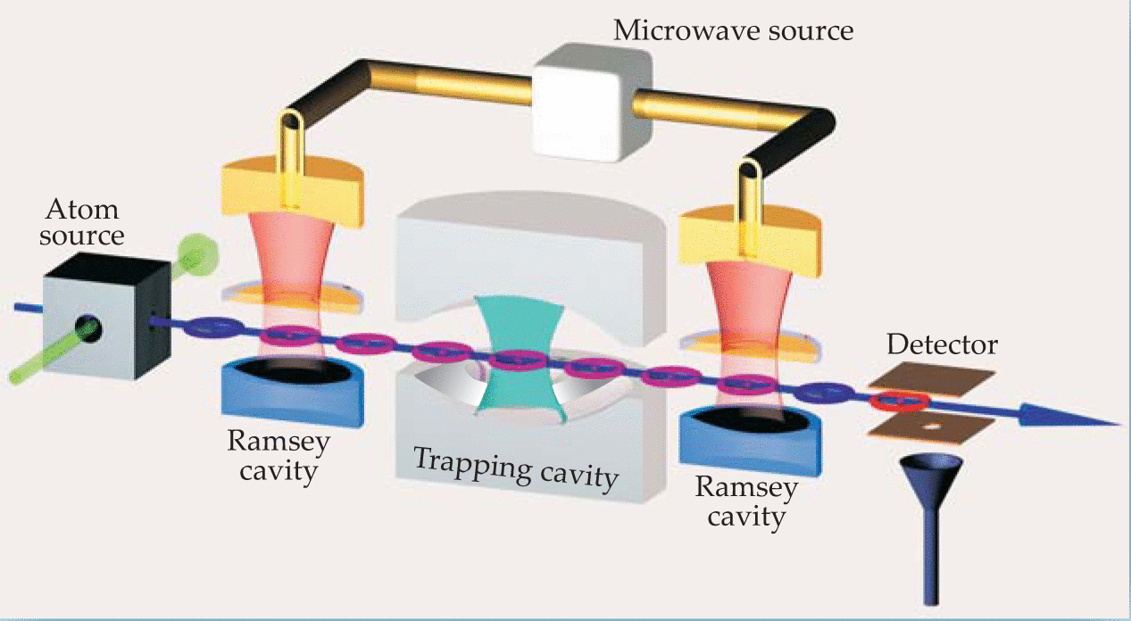
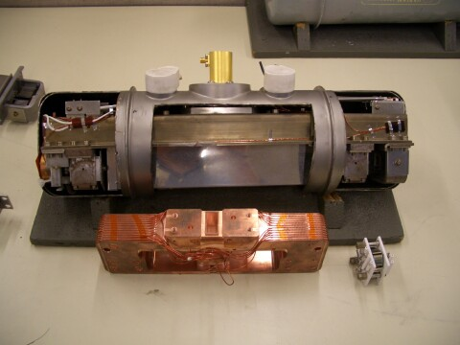
Cesium beam tube
Commercial Caesium clock
CREDIT
Microchip

Slide 9
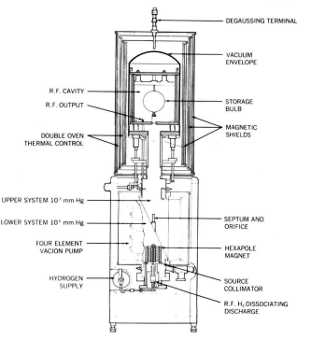
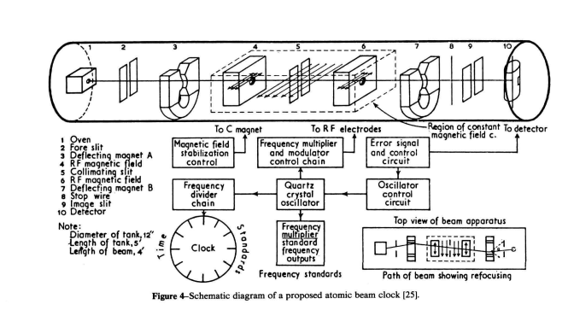
Atomic clocks (Microwave clocks)
Hydrogen Maser
  Very stable frequency
    Must compensate for drift when used for time scale
  Microwave oscillation based on energy spin levels of H
  1,4 GHz
  Based on work of Norman Ramsey
Cesium beam tubes
Long term stability
9,7 GHz
Based on work of Isidor Rabi and Norman Ramsey

Slide 10
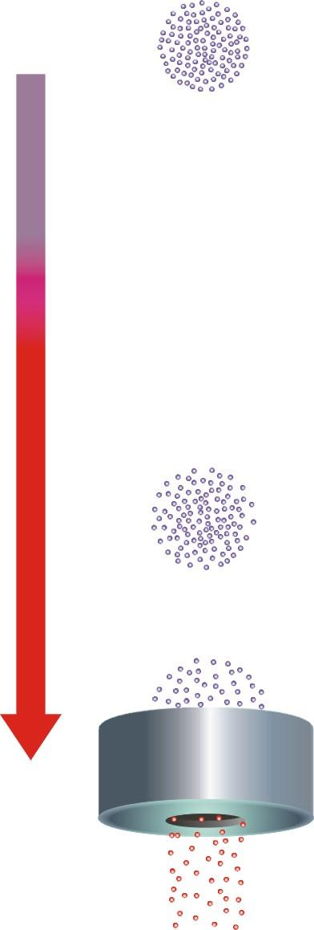
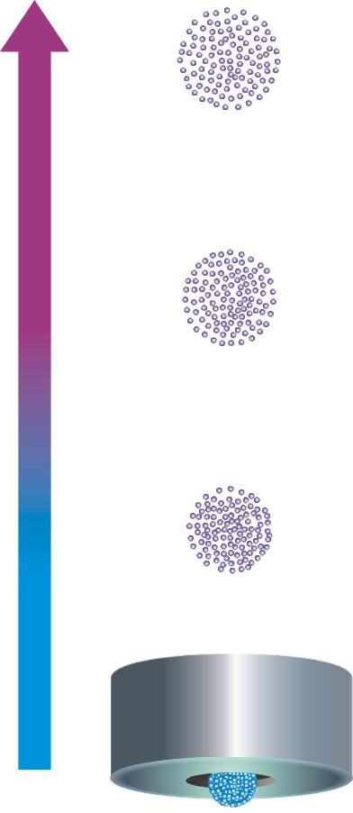
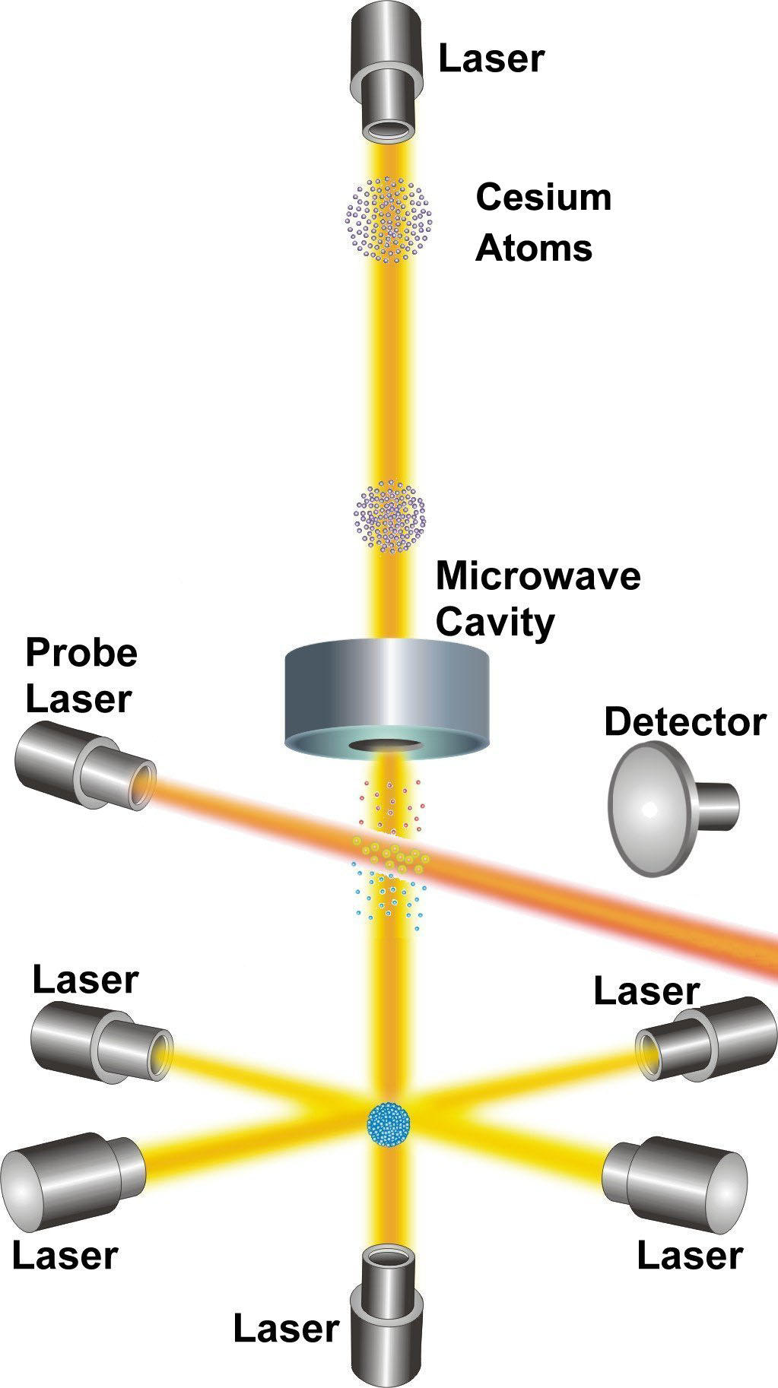
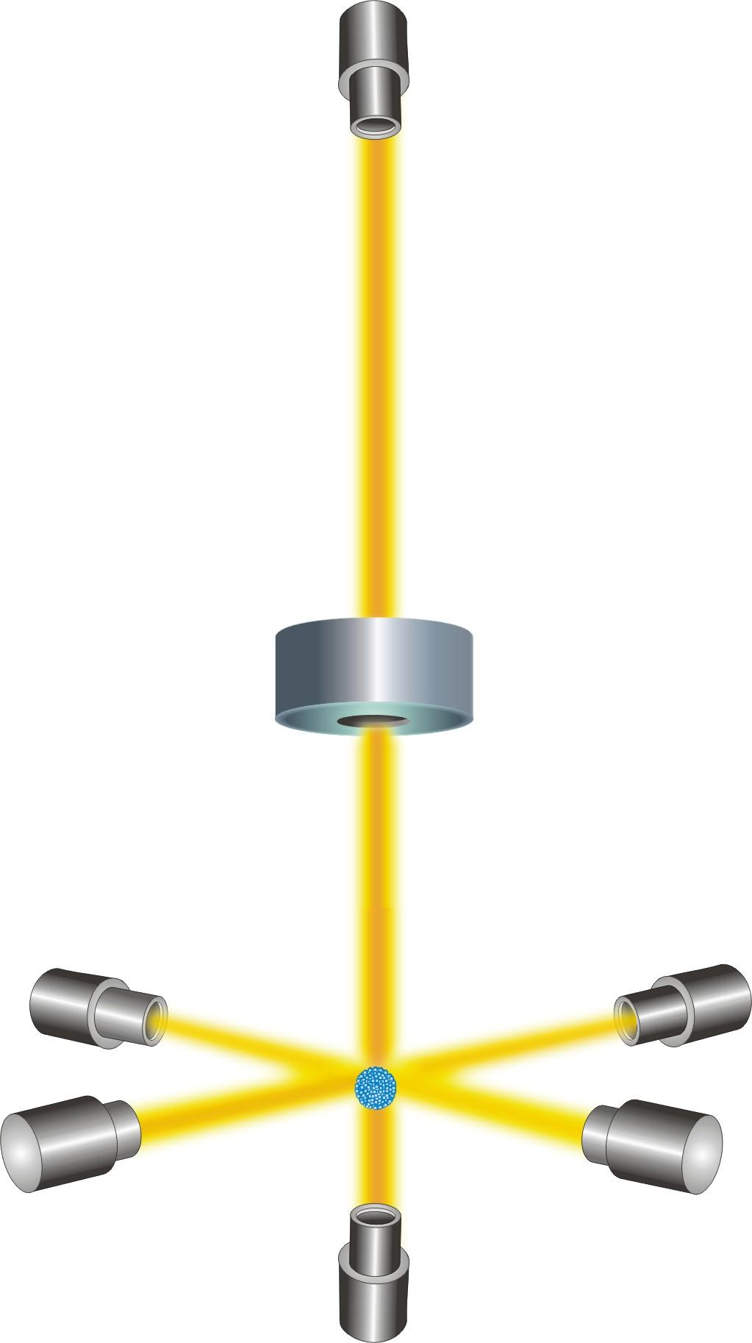
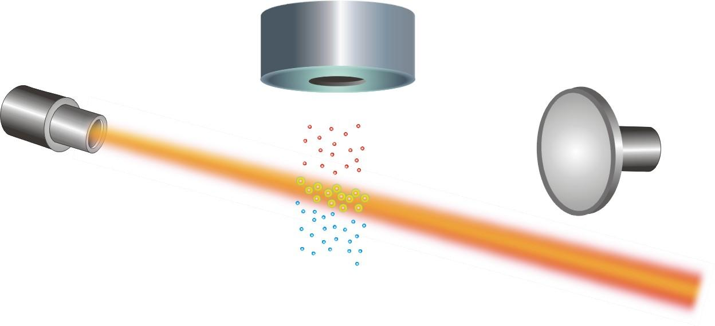
Cesium fountain (Primary clock)
Figures from NIST

Slide 11
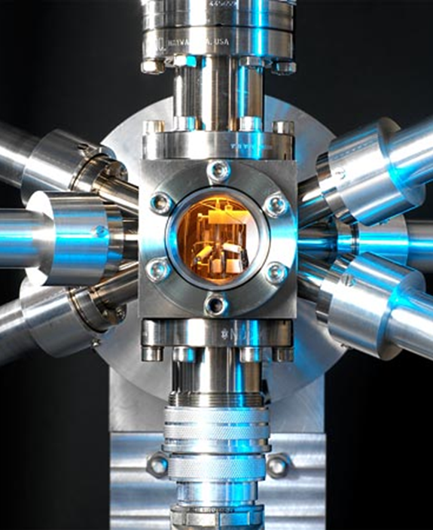
Atomic clocks (Optical clocks)
Optical lattice clocks
  Ensemble of atoms trapped and used for frequency measurements
Optical Ion clocks
  Single ions are trapped and used for frequency measurement
Optical lattice clocks
  Ensemble of atoms trapped and used for frequency measurements
Optical clocks
  Anders Wallin, MIKES
  Operates the first optical clock in the North.

Slide 12
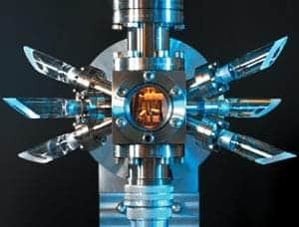
Future for time
Work is ongoing to define the second, with other stable references
  Still looking for hyperfine levels of suitable atoms or ions
  Frequency around 400 – 700 THz (red to blue light), or higher
  Clocks running less than 1 attosecond/second
  Currently 10 alternative energy transitions – how to choose?
Who needs that accuracy?
  Scientific experiments and observations
  Navigation and positioning
  Inertia calculation when external signals are missing

Slide 13

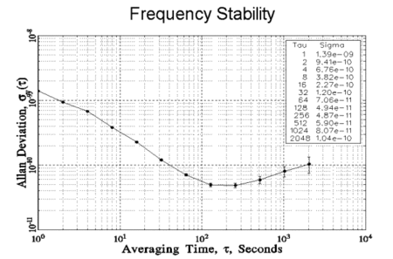
Allan variance / Allan deviation
Used to describe quality of clocks and oscillators, time or frequency transmission, transmission links etc.
Developed by David Allen for the characterization of oscillators, identifying the shortcomings of standard deviation:
Started with the M-sample variance
Set M=2, T=τ and calculate the expected value
Allan deviation (AVED) is the square root of AVAR
Plot in log-log diagram

Slide 14

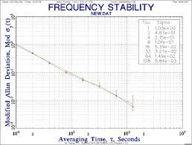
Modified Allan variance / Modified Allan deviation
Developmend of AVAR / ADEV to solve the possibility to distinguish between flicker phase noise and white phase noise.
Compare with AVAR:
MVAR is the expectation value of the average over n samples
MVAR is AVAR with a digital low pass filter.
Calculations usually solved by using software e.g. Stable32

Slide 15
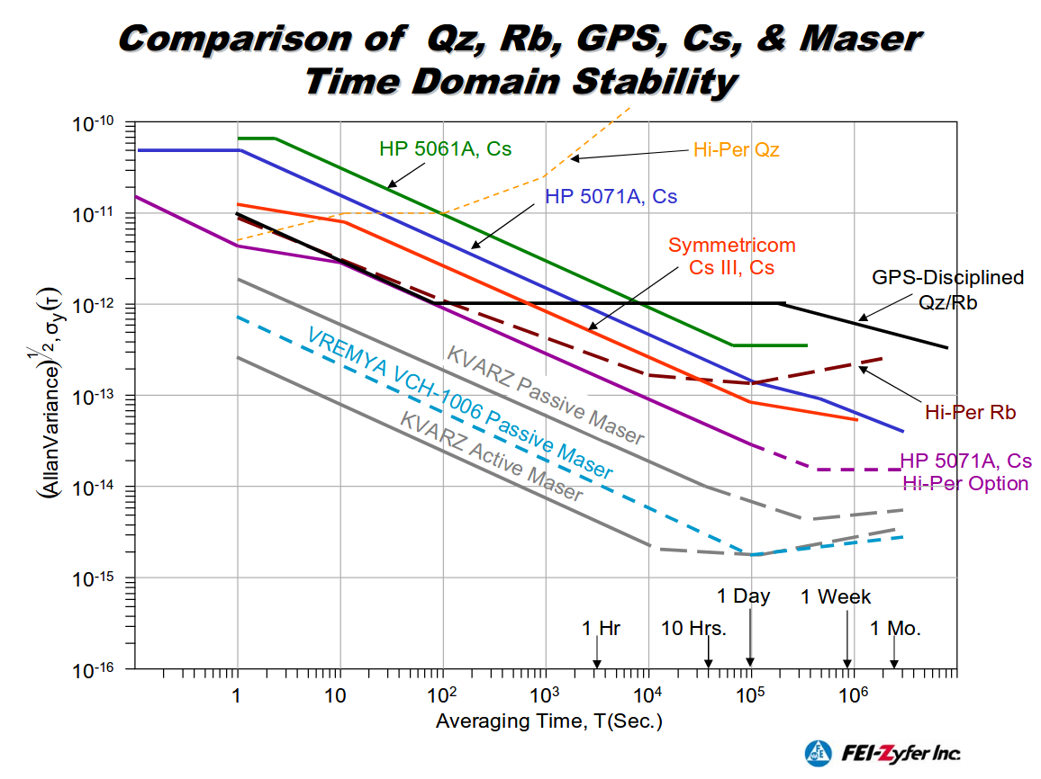

Frequency stability of common atomic clocks
JRP 17IND14 http://empir.npl.co.uk/write/
WRITE - White Rabbit Industrial Timing Enhancement

Slide 16
UTC
Universal Coordinated Time (UTC)
Weighted average of data from 400 atomic clocks on 80 institutes world wide
  UTC is a ”Paper clock”. Measurements proceed during 1 month, and the results of daily offsets are published in the middle of next
  UTCr – Rapid UTC. 62 participating labs are updated weekly (one week delay). Within nanoseconds of UTC
  UTC(k) – local realization of UTC. Available in real time, but with an uncertainty with respect to UTC. Improved by number of clocks, historical data and algorithms based on UTC information

Slide 17
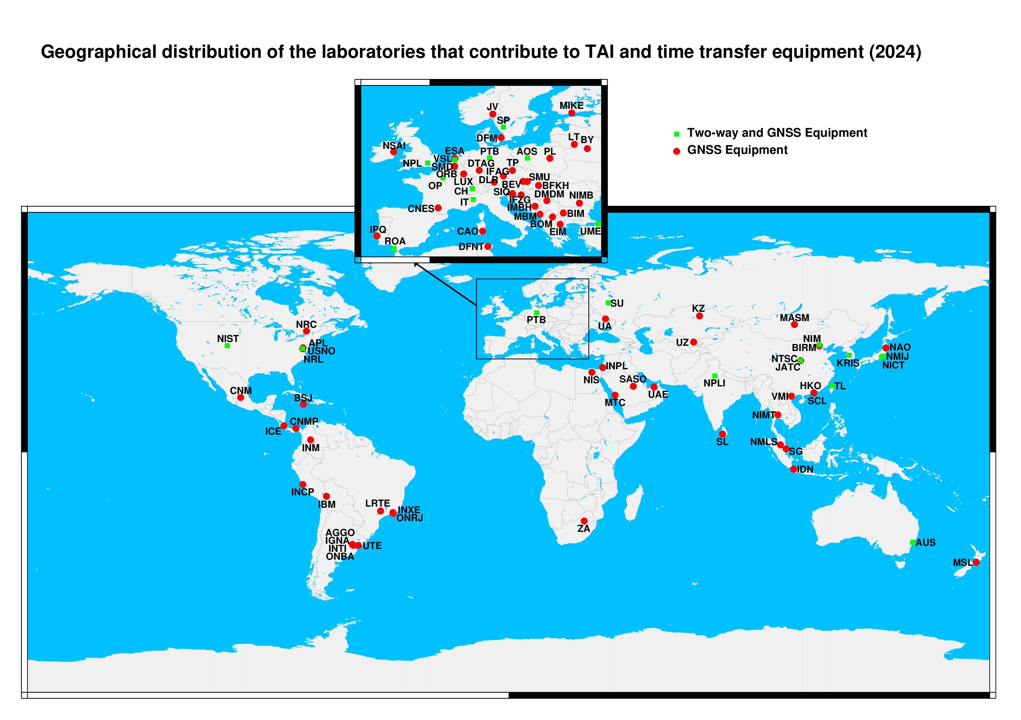
Universal Coordinated Time

Slide 18
UTC algorithms
Primary / Secondary frequency standards
Weighted average, algorithm to determine weight
Steering algorithm
TAI
UTC
Data from 400 clocks
Leap second addition
Free atomic timescale (EAL)
Data from IERS
UTC – UTC(k)
Returned to all 80 institutes

Slide 19
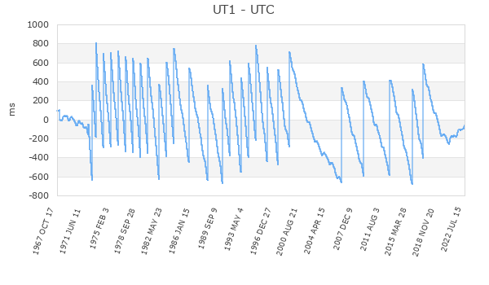
Leap seconds
|UTC-UT| <1s to keep reference to Greenwich Meridian
IERS (International Earth Rotation and Reference Systems Service) determines UT
Earth rotation less stable than atomic time
Always inserted 00:00 UTC 1/1 or 1/7.
Proposition to stop adding leapseconds.

Slide 20
Time transfer equipment
GNSS Common-View
  Both receivers observes data from the same satellite
TWSTFT
  Two-Way Satellite Time and Frequency Transfer
  Uses GEO communication satellite

Slide 21
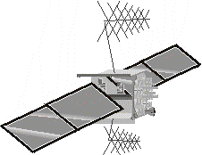
GNSS Common View
GNSS Common-View
  Both receivers observes data from the same satellite
GNSS All-in-View
  Use data from all GNSS satellites visible from both receivers.
Uncertainty ~ 1 ns
GNSS-receiver A
GNSS-receiver B
GNSS-time
Local clock A
Difference A
Difference B
Local clock B
Data transfer and calculations results in
Clock A - Clock B (GNSS-time removed)

Slide 22
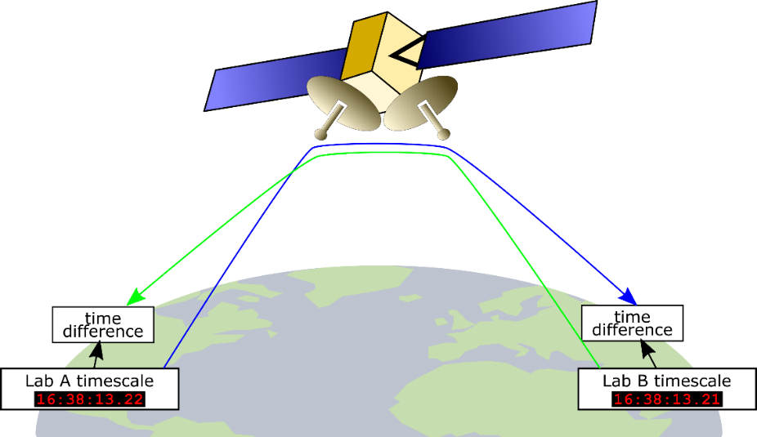
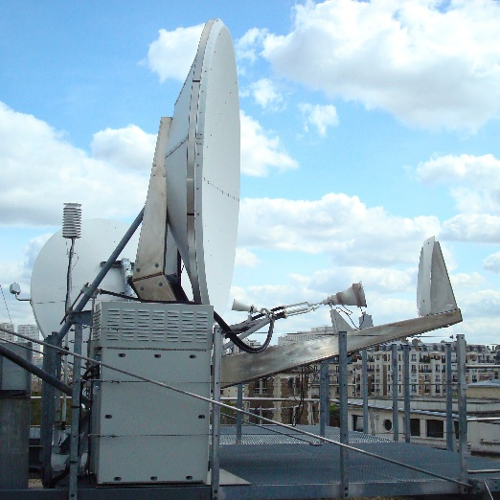
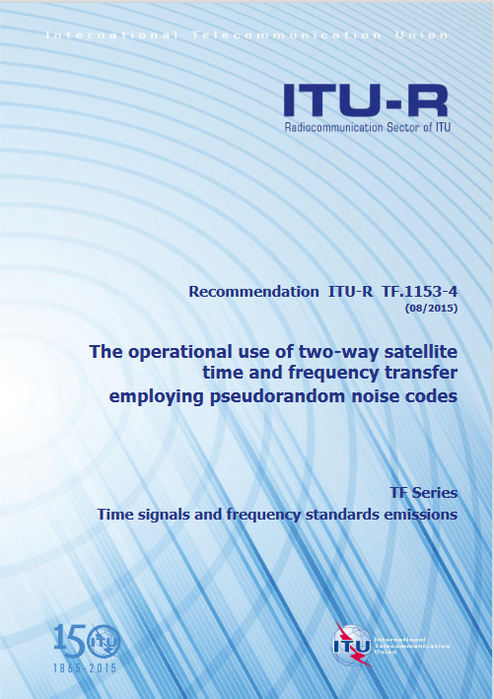
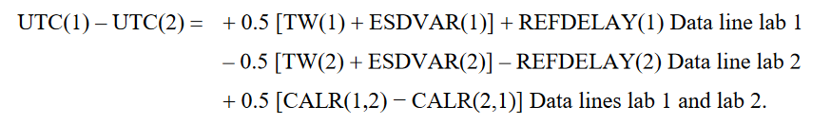
TWSTFT: Two-Way Satellite Time and Frequency Transfer
TWSTFT antenna at
SYRTE – Observatoire de Paris
From:
CCTF/2022-12 Report of the CCTF WG on TWSTFT (WG-TWSTFT )
Carsten Rieck, Miho Fujieda, Frédéric Meynadier
27/06/2022

Slide 23
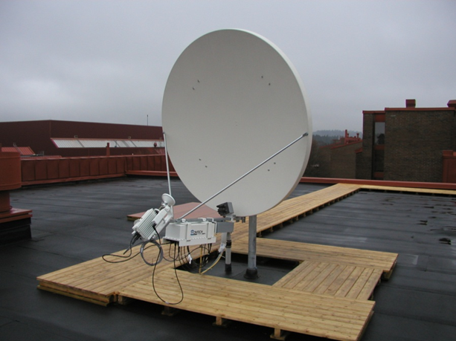
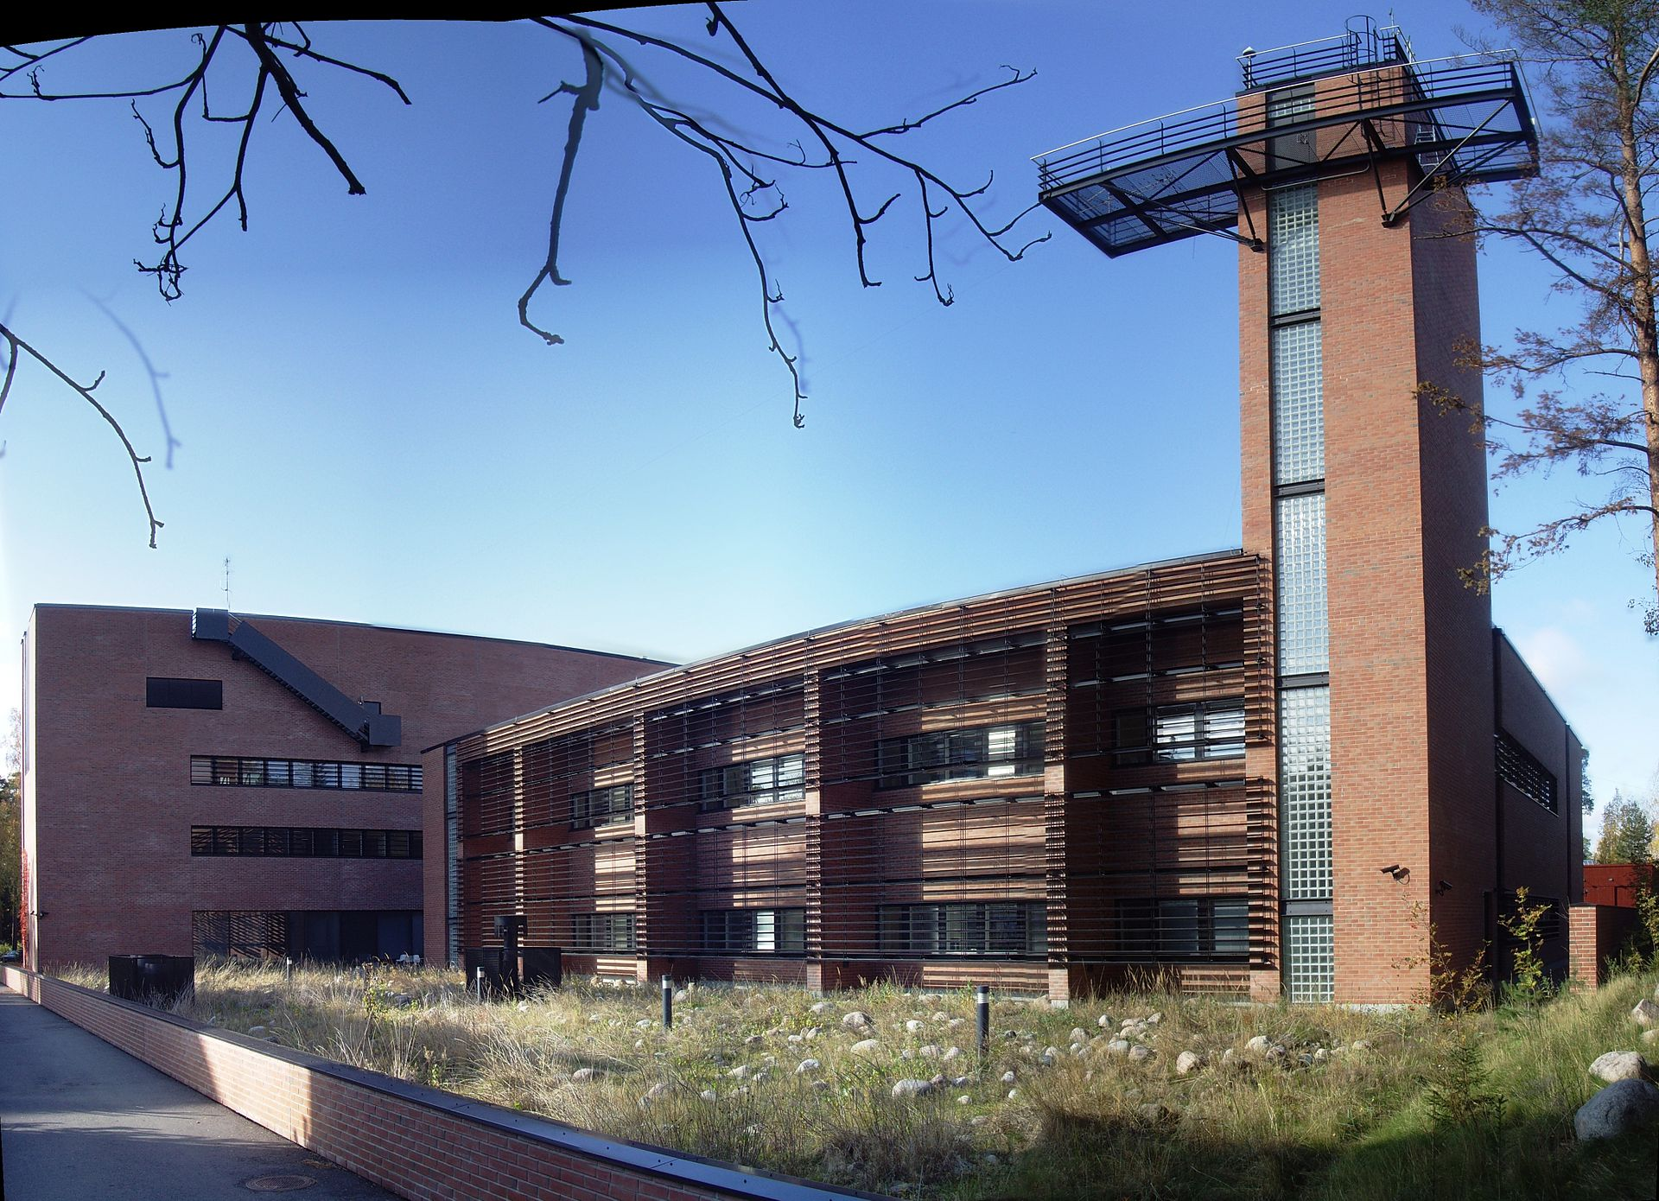
Two Way Time and Frequency Transfer
Requires satellite communication equipment
Timing signal transmitted on satellite link
Presumes symmetrical delay
PTB technical node for both east and west link
From Borås, satellite dish almost vertical, must be installed on highest building to have free line of sight
From Espoo, direction below horisontal plane?
< 1 ns uncertainty
< 10-15 frequency stability
MIKES photo by Heisot - Own work, CC BY-SA 3.0, https://commons.wikimedia.org/w/index.php?curid=18339810

Slide 24
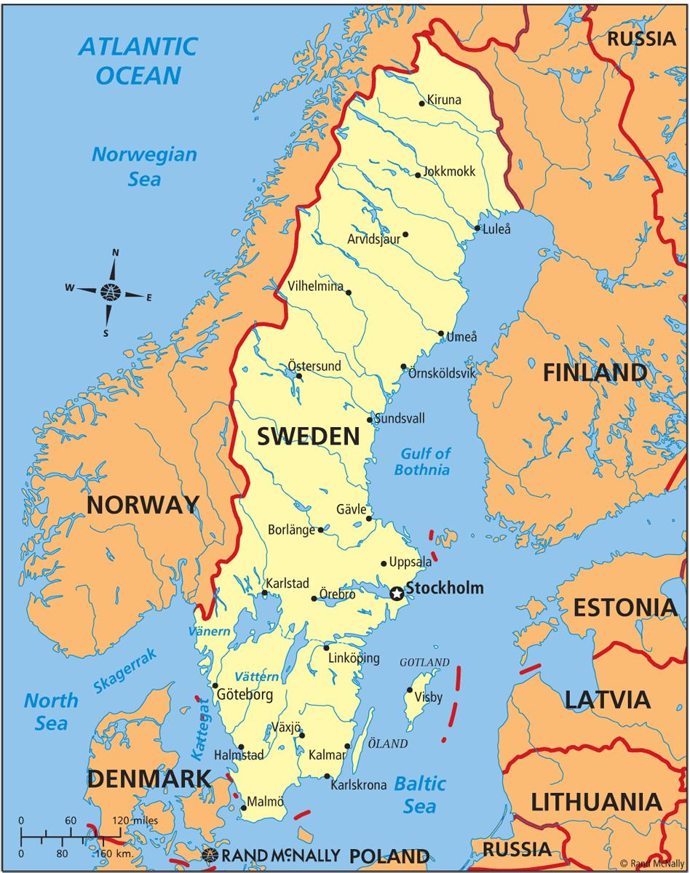
UTC participation in the North
UTC(MIKE)
UTC(JV)
UTC(SP)
UTC(SP) backup
UTC(LT)
UTC(k) in progress

Slide 25
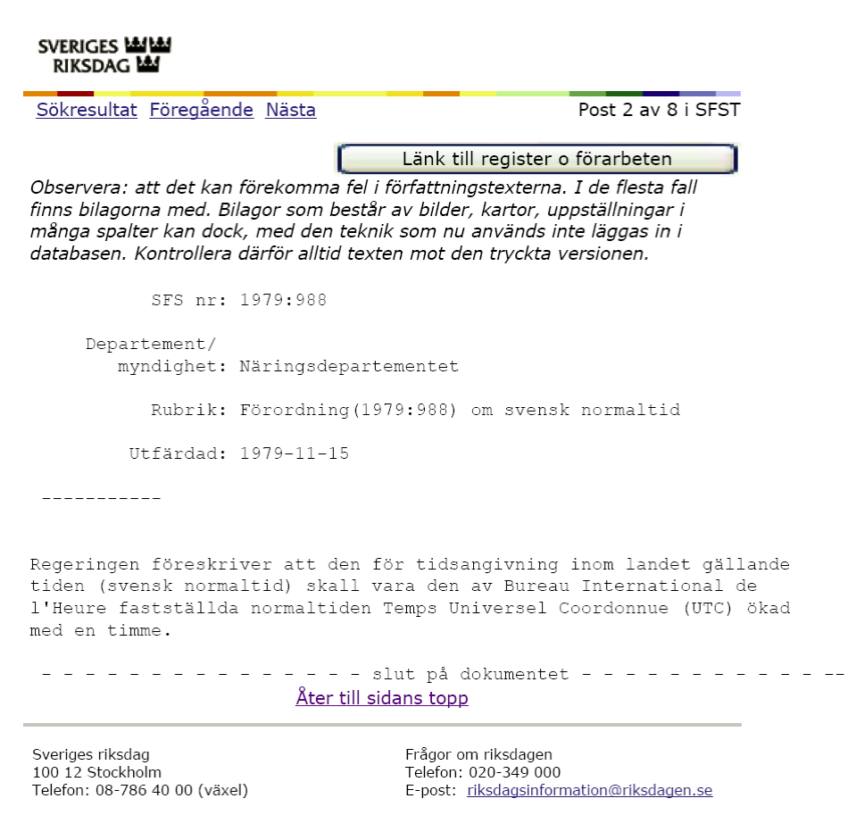
Ordinance on Swedish standard time

Slide 26
National Metrology Institute
UTC(SP)
International comparisons
UTC realization and steering +-5 ns
Timescale comparisons utilizing secure labs
Calibration to assure accurate time
x, y, z,,,,,
Governmental owner
Research for new distribution methods
Knowledge transfer
Aim of not using satellite-based connections

Slide 27
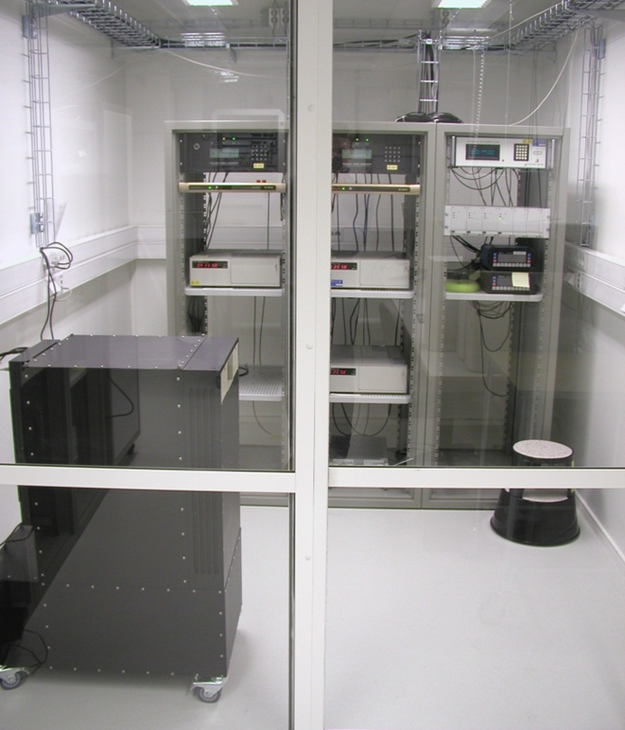
National Metrology Institute
RISE Borås
  2 High performance Cs (5071A)
  1 Standard Performance Cs (5071A)
  2 Active Hydrogen Masers
  1 Passive Hydrogen Maser - for research only
RISE Stockholm
  6 High performance Cs (5071A)
  2 Active Hydrogen Masers (SigmaTau)
Onsala space observatory
  1 Standard Performance Cs (5071A),
  2 Active Hydrogen Masers

Slide 28
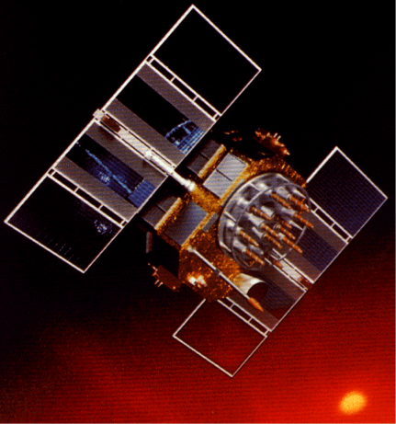
Swedish National Timescale UTC(SP)
Clock 1 SP
Correction
Clock 2 SP
Group-clock
UTC(SP)
GNSS/TWSTFT
Clock N SP
Time interval
counter
UTC(SP) - Clock
UTC(SP) – GPS/TWSTFT
UTC(SP) – UTC
f(KL) – f(TAI)

Slide 29
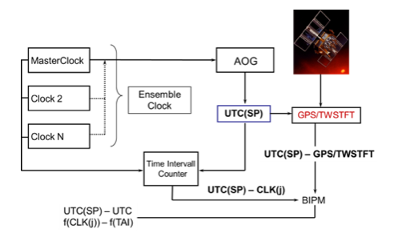
Correction of time signals
AOG (Arbitrary Output Generator
HROG (High Resolution Output Generator
Signal from Master Clock into AOG
Data from all other clocks contributes to correction
UTC(SP) – UTC data from BIPM contributes to algorithm for correction
Stability in numbers, and clock performance
17 clocks in official BIPM list

Slide 30
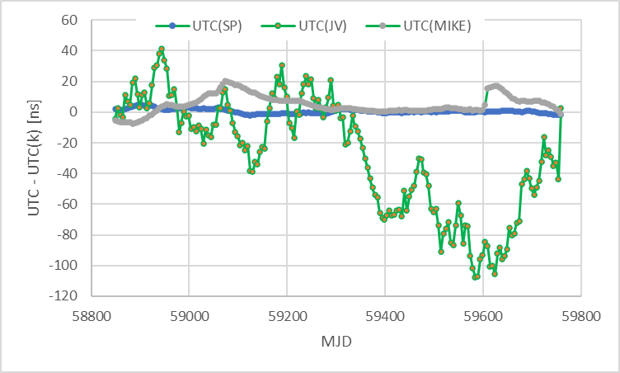
Nordic UTC(k) realizations
JV: 3 Cs, 1 HM
FMTC: 2 Cs
MIKES: 4 HM
RISE: 10 Cs, 6 HM

Slide 31
Time dissemination protocols
Network Time Protocol (ntp)
First implementation 1984
Updated since, but same principles
Useful in any network, reduced accuracy after routing.
Available for free on Internet
Self declared quality level (Stratum)
Precise Time Protocol (ptp)
Standardized through IEEE1588
First version 2002
Second version 2008, not backward compatible
Present verision, IEEE 1588-2019, compatible with 2008.
Requires special equipment for switching and routing in network

Slide 32
Additional Time dissemination protocols
White Rabbit
  PTP on SyncE system
  Developed at CERN for synchronizing detectors (clocks) around LHC (Large Hydron Collider with 27 km circumference)
  Proven performance on 1000 km scale
  Requires special equipment in all nodes or the network
  For best performance, bidirectional transmission in single fiber necessary
Customized time transfer protocols
ELSTAB
  electronically stabilized time and frequency distribution
  Research system from AGH, published in peer reviewed journals
Nimbra Time Node
  Proprietary protocol from Netinsight
  No peer reviewed paper found

Slide 33
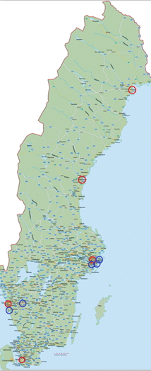
Time dissemination in Sweden
High performance clocks in three cities.
Distribution nodes using standard Cs clocks, in collaboration with Netnod IX.
Time transfer using GNSS CV
  Aim to replace / add with fiber optics
Designed to maintain sufficient accuracy for 30 days without comparison to UTC(SP)
Time dissemination formats
  ntp (free usage)
  ptp (service charge)
  GNSS CV (service charge)
Financially supported by PTS, Post and Telecom Agency of Sweden

Slide 34
Time services, international view
NPLTime™
  Fiber optic PTP transmission within London.
  Collaboration with ISP
TOP-IX TaaS
  Service in Milano and Torino
  Collaboration between Internet Exchange and INRIM
  ” an evolution of Precise Time Protocol (PTP) IEEE 1588v2, available on specific TOP-IX network devices dedicated to this service.”
NRC TimeLink™
  Rents stable clock + monitoring service
  GNSS CV (Canada is a big country)
  Also services on NTP server monitoring etc.

Slide 35
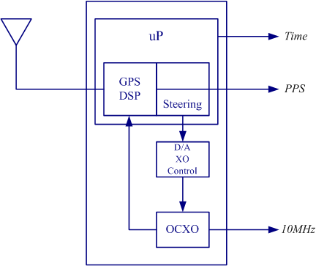
GPS Disciplined Oscillator for UTC signal?
Local oscillator (Rb or stable crystal oscillator) emits 10 MHz
Time data and 1 pps from GPS signal
Commonly used in accredited calibration laboratories for traceable time / frequency
  Questionnable traceability as defined by GUM

Slide 36
Future development
Redefinition of the second
  Several atoms / ions accepted for SRS in MeP. These are potentially 100 – 1000 x more stable than Cs.
UTC to leave steering to UT
  No more leap seconds
Traceability of GNSS timing
  Filling the missing link in traceability chain.

Slide 37
Why a national distribution system for Time and Frequency?
Citizens and critical public services depends on the availability of electronic communications
Electronic communications depend on accurate time and sync/frequency
Time and frequency distributed with GNSS can be easily disrupted and is a factor of uncertainty
Notes:
Karin
Nämna att GNSS är lätt att störa ut etc, därför är det så viktigt att “alla börjar använda stadsnätens fiber istället för att få tillförligtlig tid.

Slide 38
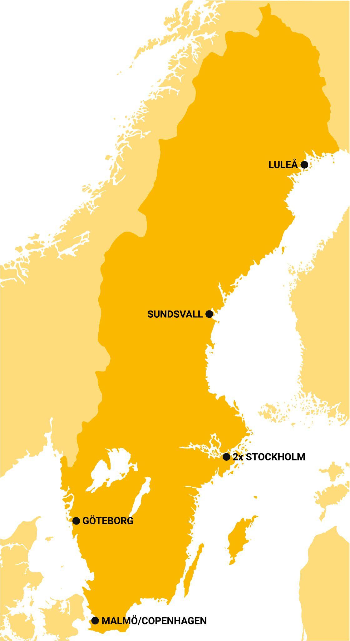
A national distribution system for Time and Frequency
A system independent of GNSS that, from a national perspective, can guarantee robust and secure time.
The system must be robust and available throughout the country on equal terms.
Services provided through the system must be affordable for operators so that price is not a stopping factor.
Regulatory authorities must be given transparency and direct access to the infrastructure, which means that it must be based in and operated in Sweden.
Notes:
Karin
Last bullet = This is a general requirement for the sector Electronic Communication in Sweden

Slide 40
The Swedish Model
Distributed by Netnod, traceable to UTC(SP)@RISE and is funded by PTS
6 time nodes located in secure rock caverns at 5 different locations around Sweden
(Stratum-1 time servers)
Time scales are steered towards UTC(SP)
Both free and commercial services with SLA
Notes:
Karin

Slide 41

Clocknodes @ Netnod Traceable to UTC(SP) @ RISE
Redundant timescale-nodes based on Microchip 5071 standard performance Cesium clocks
NTP/NTS servers are equipped with a custom-built FPGA-based hardware implementation
Notes:
Karin

Slide 42



Netnod PTP
Netnod Time Direct
Netnod Time Remote
Ensure your network nanosecond level accuracy with the most robust, reliable and accurate source of time available without running your own atomic clock.
Get the most accurate and reliable time available over an IX port with a fully-managed, secure time service that guarantees 30µs accuracy from UTC.
Get accurate and reliable time securely delivered wherever you are located in Sweden with a guaranteed accuracy of 1ms from UTC.
Notes:
Christian
PTP- premiumtjänsten, dedikerad fiber, högsta precition
Netnod time direct, om du redan har en IX-port får man tjänsten över samma port
Netnod time remote, om man befinner sig på annan ort än där vi finns kan vi beställa en kvalitessäkrad fiberförbindelse till dig och placera lämplig hårdvara hos dig

Slide 43


NTP service
NTS service
Connect for free to one of the most advanced and secure NTP services available which also includes…
Connect for free to ensure you are receiving secure and accurate time from a trusted source
Notes:
Christian
NTP- standardtjänsten, lätt smidig och gratis
NTS- om du vill vara säker att du får svar från rätt aktör
Info om NTS
Avoid a range of problems like:
authentication problems, attacks and issues with authentication security measures
issues with cryptographic signatures and establishing encrypted sessions such as Transport Layer Security (TLS)
DNS Security (DNSSEC) failing to work if the client doesn’t have accurate time
incorrect timestamps on logs and transactions

Slide 44
Where to access NTS?
Netnode hosts six nodes in five locations around Sweden with Stratum-1 NTS servers
  Stockholm x 2
  Göteborg
  Malmö
  Sundsvall
  Luleå
Notes:
karin

Slide 45

Different types of clocks
JRP 17IND14 http://empir.npl.co.uk/write/
WRITE - White Rabbit Industrial Timing Enhancement

Slide 46
Swedish National Timescale UTC(SP)
Clock 1 SP
Correction
Clock 2 SP
Group-clock
UTC(SP)
GNSS/TWSTFT
Clock N SP
Time interval
counter
UTC(SP) - Clock
UTC(SP) – GPS/TWSTFT
UTC(SP) – UTC
f(KL) – f(TAI)

Slide 47
Netnod Time and Frequency Distribution
Autonomy/
positioning
Aviation
Defense
Economy
EU-projects
Research
HPC/Storage
Research
Authorities
The energy sector

Slide 48




White Rabbit and Coherent Communications
Run AM light beside coherent 100G slots in SUNET-C
  ROADM based, no dispersion compensation
  Unidirectional, two fiber, same wave length
80 km (8 ms RTT) in southern Sweden 7SOL LEN GM/SL @RISE , 13 hops
C36, with several empty slots space to next carrier
Initial DCM+AMP, but expect less than 100 ps broadening,
works without DMC,
need about zero dBm input
High jitter, both on 1pps and
the LEN reported clock offset
Uncorrected alpha,
change in offset correlates
with RTT changes of several
hundred nanoseconds
compensated for dynamic RTT
measured offset

Slide 49
What are we planning to do now?

Slide 50

So far: aim specification
Aim specifications
10-100GBit compatible (QPSK,16QAM)
1pps
Frequency 5 to 100 MHz
19 inch rack
Bi-direct and duplex
Sub ns
PTP, WR or custom format
Redundant power
FPGA
Daisy Chain
Selective wavelength
Optical ref output
Notes:
karin

Slide 51
Initial Start of a Nordic Timing Network
Distributed by Netnod, traceable to UTC(SP) @RISE financed by Swedish Post and Telecom Authority
In black 6 time nodes placed in secure locations across Sweden steered to UTC(SP)
Work in progress of connecting UTC(k) in nordic countries
UTC(JV)
UTC(MIKE)
UTC(SP)
UTC(SP)
Notes:
Karin

Slide 52

Questions?

Slide 53








Autonomy/positioning
Why Swedish national time UTC(SP)? Who needs it?
Authorities
Aviation
The energy sector
Defense
Economy
EU project Research
MSB requirements
HPC/Storage
Research

