Slide 1
Defending the Realm: DDoS detection and mitigation
DRAFT
José Alberto Nistal
BalticNOG – September XX, 2025

Slide 2
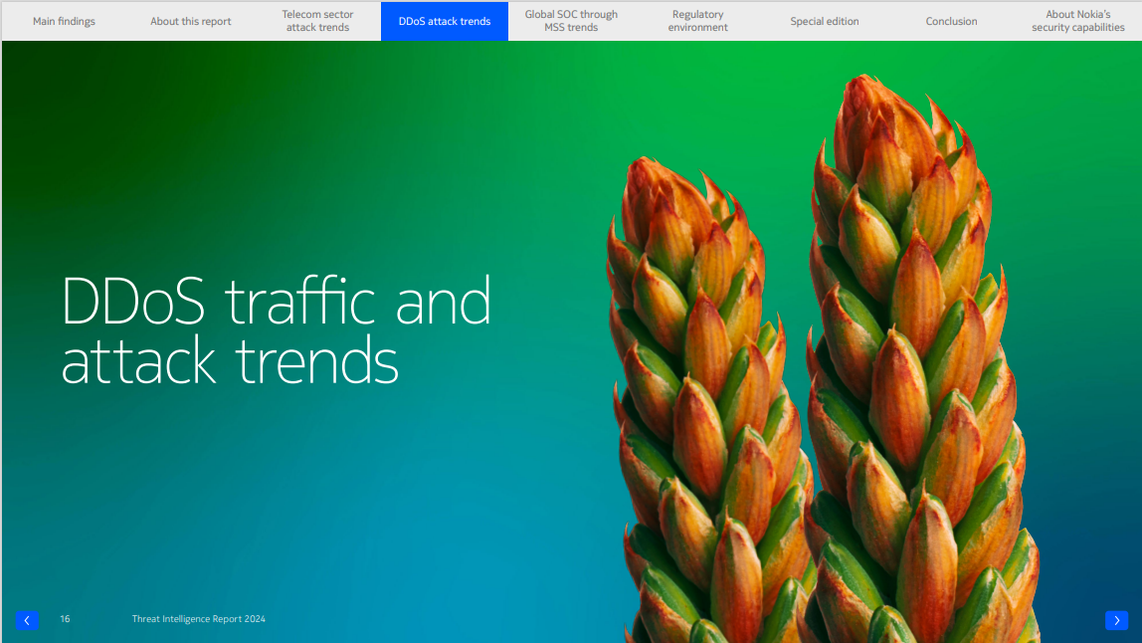

Nokia Threat Intelligence Report 2024
DDoS traffic and attack trends - 2024
New
Botnets
1M active bots
60% of attacks use < 100 bots
Residential Proxy abuse
Leveraging Millions of residential IP’s in “free” VPN services
DNS
#1 vector
36% of attacks
Carpet bombing
on the rise
13% to 256+ IPs
2.8% to >1K IPs
Largest: 16K IPs
AI & automation
Driving faster morphing attacks
Duration
44% lasts
< 5 minutes
But higher frequency

Slide 3
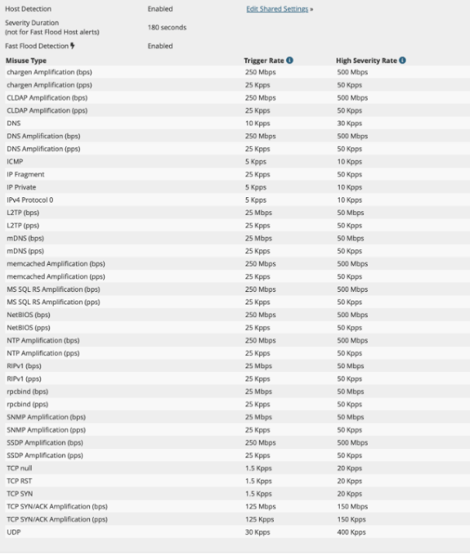
How do legacy DDoS tools detect DDoS?
Traffic is good… until it isn’t
Other DDoS tools use Flow based traffic thresholds to trigger DDoS events.
Traffic is good until it crosses some configured threshold, and then it’s suddenly bad.
Bad
DDoS threshold
Ok, so what’s the big deal?
  Flows are only identified as DDoS once an object is configured for detection, thresholds are set, and thresholds are exceeded
  Operators must maintain thresholds and configuration for every type of DDoS misuse out on the Internet
  Hard to maintain, very inaccurate
bps/pps
Good
time

Slide 4
How do you need your DDoS tool to be today?
1 | Automated
2 | Lightning-fast
3 | At scale

Slide 5
Deepfield Defender

Slide 6

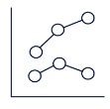





Deepfield Defender in a nutshell
Security Operations/ Network Operations
DDoS alerting
A high-scalable software platform that combines
Nokia Deepfield Genome® - a big data based Supply-Chain and Security map of the Internet
Telemetry from your routers
to provide DDoS protection
1
Genome® feed
On-prem Deepfield Defender
2
Nokia Deepfield cloud
Telemetry
Mitigation
Your
IP network
Internet
Transit
Peering
Notes:
Honey pots

Slide 7
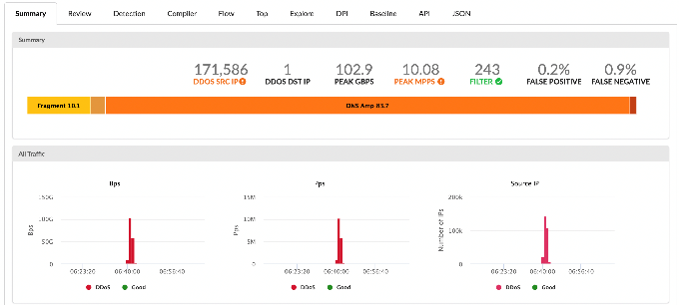
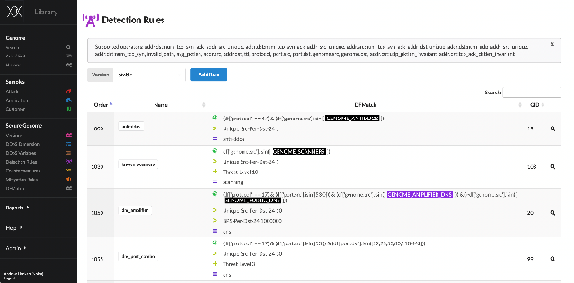
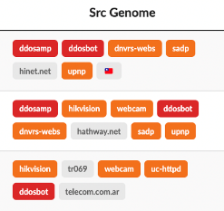

1. Automated
The Secure Genome Advantage
Deepfield
Secure Genome™
Automated
Protection
Massive real world sample library + Genome detection rules + Genome Tags = automated DDoS detection for all traffic

Slide 8
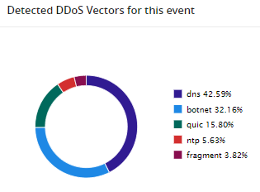
What does automated detection mean?
No need to configure or maintain thresholds → Simplified operations, improved accuracy & reliability
Immediate detection from day one → Quick initial setup & easy onboarding for new customers
Detection covers all traffic, including non-protected customers → Create opportunities to upsell protection services

Slide 9





2. Lightning-fast
Sampled Port Mirroring (SPM)
Traditional Flow (~30-60s, IP header only)
DDoS traffic
Internet
Router
Deepfield
SPM (<1s, IP header + payload)
Zero cache
Real-time DDoS detection
Header + payload telemetry: TCP SEQ & ACK numbers, DNS queries, etc.
Available on Nokia SR & Juniper MX routers

Slide 10
SPM in detail
*config mirror
mirror-dest 9999 name "SAMPLED-MIRROR" create
slice-size 128
sampling-rate 2000
encap
layer-3-encap ip-udp-shim-sampled create
gateway create
ip src 10.10.10.4 dest 172.16.201.120
udp src 9000 dest 5309
exit
exit
exit
no shutdown
exit
mirror-source 9999 name "SAMPLED-MIRROR"
port lag-4 ingress
sap lag-2:235 ingress
no shutdown
exit
Mirror ingress traffic samples, 1st slice only
1:2000 sampling rate
First 128 bytes of packet
Forward with zero delay to Deepfield
SROS: over UDP tunnel with shim-header (includes drop/forwarding stats + interface info)
Juniper MX: over GRE tunnel (no shim header – requires Netflow for reporting dropped traffic)
Supported routers:
Nokia: FP4/FP5 rtr with SROS20.7R1 or later
Juniper: JunOS 19.4 or later
Mirrored BW: typically < 0.02% of monitored BW
With sampling rate 1:1-2000, slice-size 128:
  100 Gbps traffic → <20 Mbps
Internet peering links to be monitored
Notes:
JunOS configuration: see Documentation: Router Configuration Examples — Deepfield Customer Documentation documentation

Slide 11
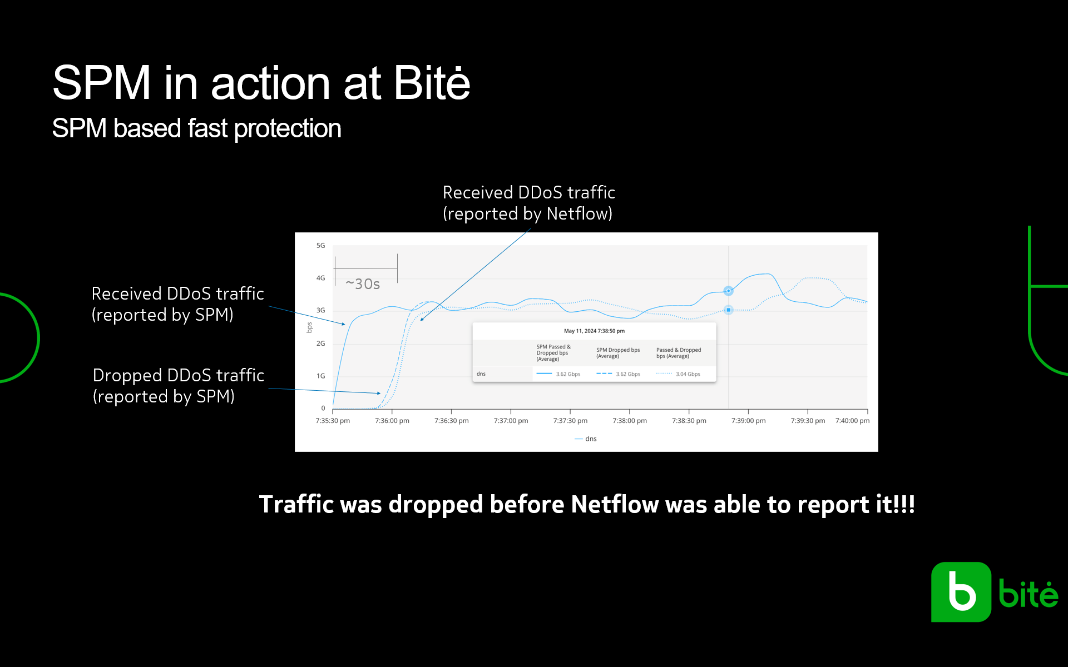

Slide 12
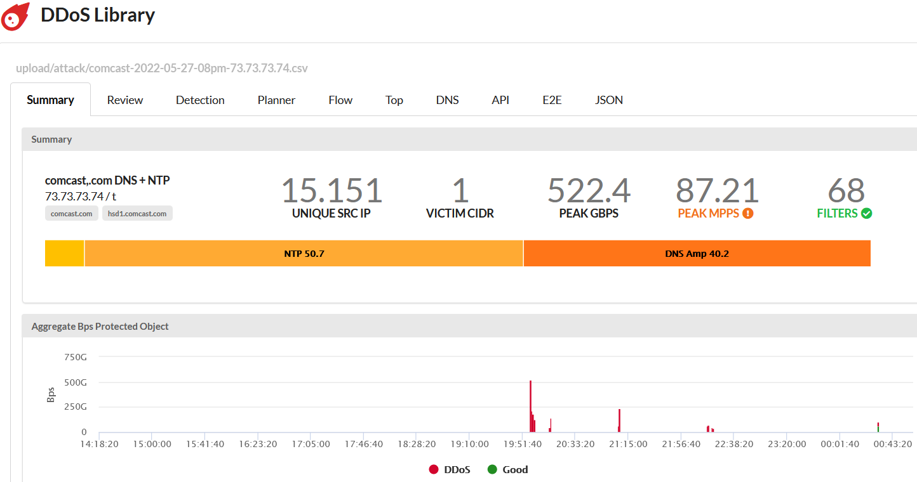
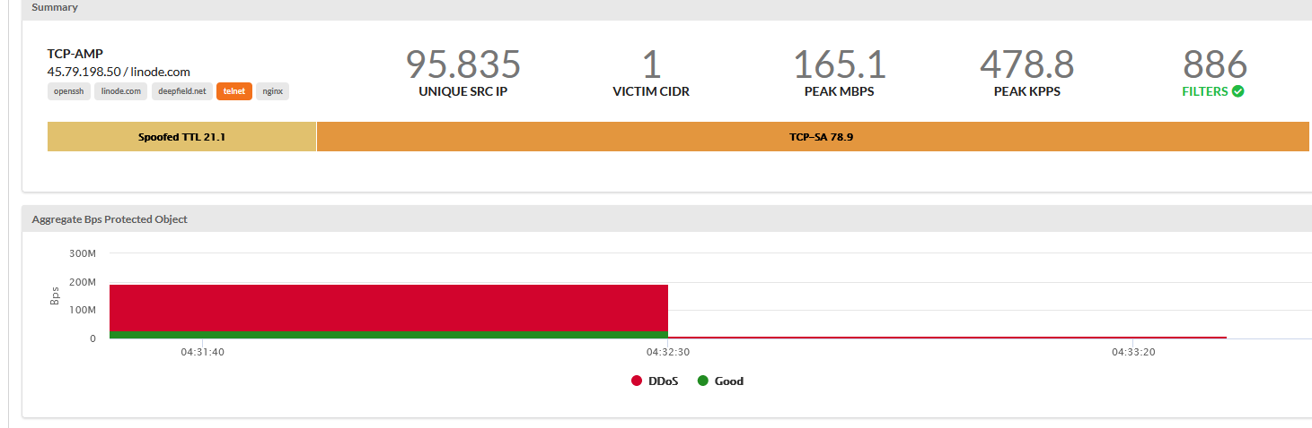
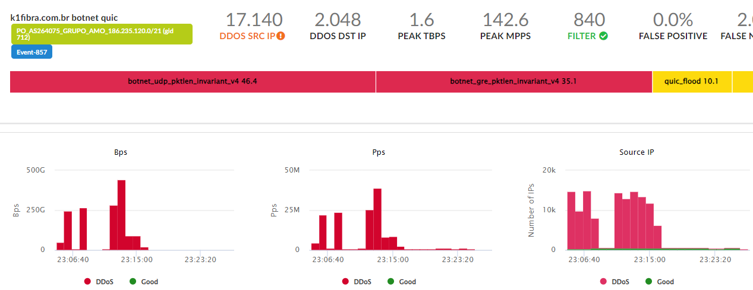
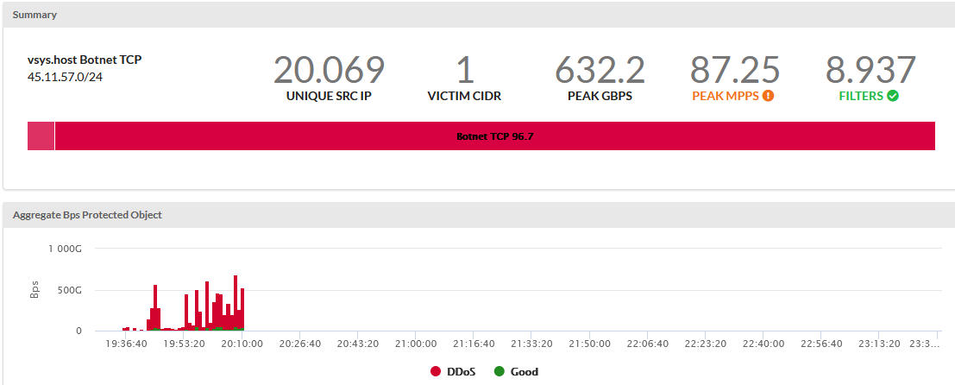
Mitigate the attack using the most efficient strategy
multi-vector amplification
Mitigation Compiler Engine (MCE):
ML engine that compiles optimal surgical filter-list for each attack
Filter match criteria for surgical filters:
Filter installation using Netconf or BGP FlowSpec
Other supported mitigation Options:
  RTBH
  BGP or FlowSPec divert to on-net scrubber
  Attack advertisement to cloud-DDoS service
TCP SA
reflection
dst/src IP match-lists
dst/src Port
Protocol
Packet length
Fragment
TCP flags
TTL
Carpet bomb
FP4/FP5 ASIC is purpose-built to filter at Tbps line-rate!
botnet + spoofed TCP
Notes:
Why pay $$$ for server cards to apply long lists of filters, while Router ASIC is built to do this at much higher scale?

Slide 13

Deepfield DDoS mitigation – implementation options
Edge router-based mitigation
Off-ramp to Defender Mitigation System (DMS)
Peering gateway
IP core
Mitigation at the edge:
Use existing routers to drop DDoS traffic at the edge.
Off-ramp approach:
Deploy dedicated DMS for off-ramp, terabit-level DDoS mitigation.
7750
DMS-1
Both options can be combined

Slide 14
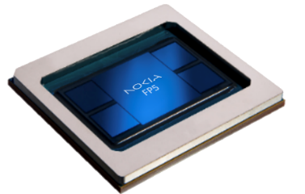
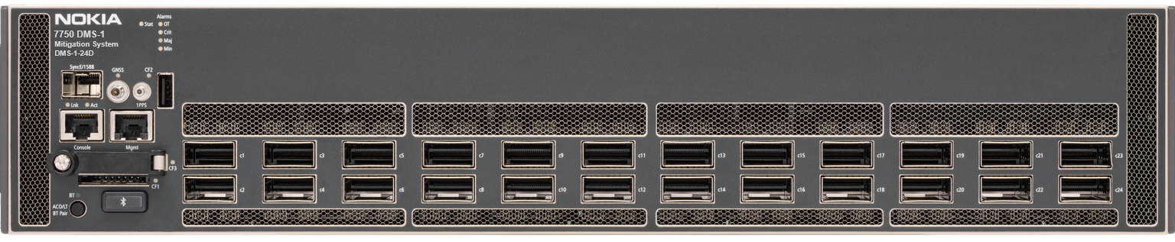
3. At scale
Nokia Service Routers
Large filter-scale: 256K filter-entries
Predictable terabit-scale performance: surgical filtering, without impacting Router-scaling and performance
Fast programming of filters
Purpose-built DDoS mitigation appliance for offramp scrubbing
  FP5 powered with Advanced Countermeasures Engine
  Optimized SROS software variant for DDoS mitigation (only)
2.8 Tbps mitigation capacity
  24 x QFSP-DD ports supporting 10G/40G/100G/800G per port
  with Nx100Gbps Pay-as-You-Go licenses
Fully Managed and controlled by Deepfield Defender
Deepfield Defender Mitigation System (DMS)
7750 DMS-1-24D

Slide 15
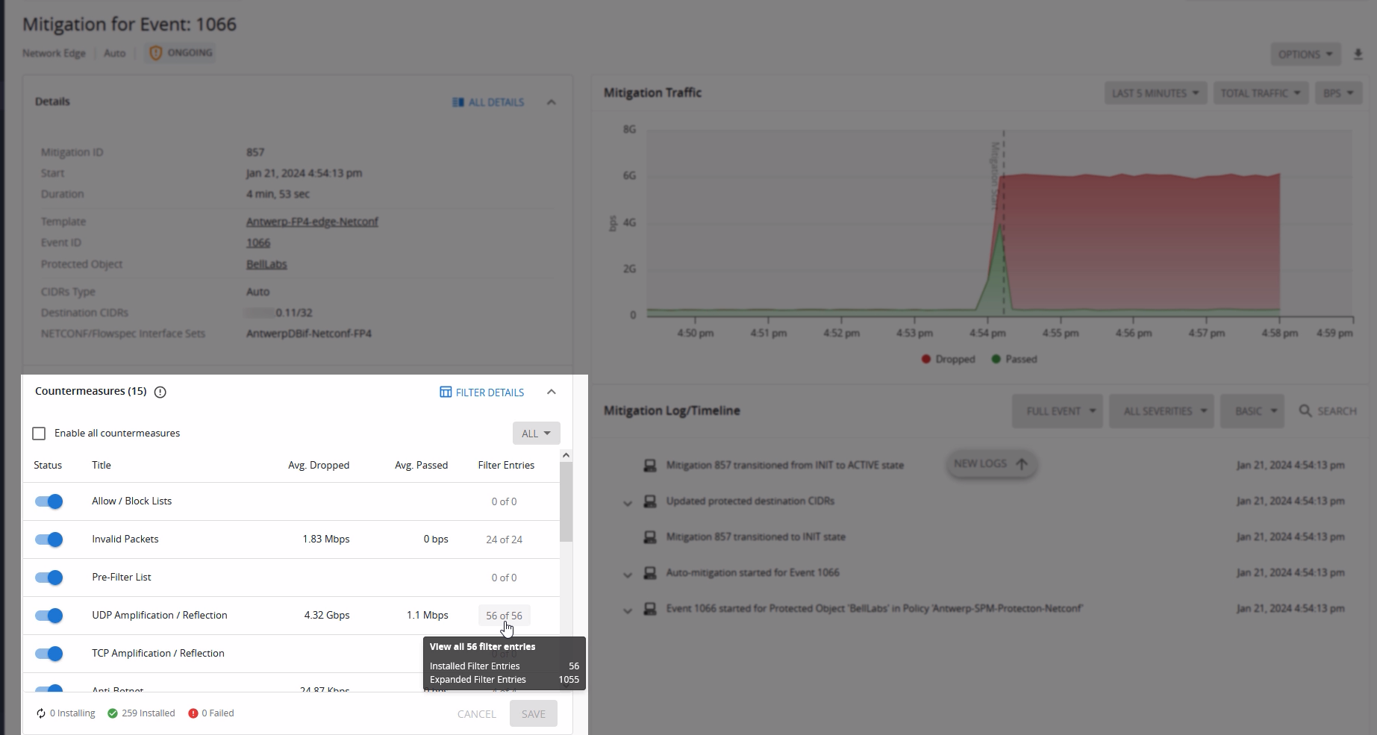
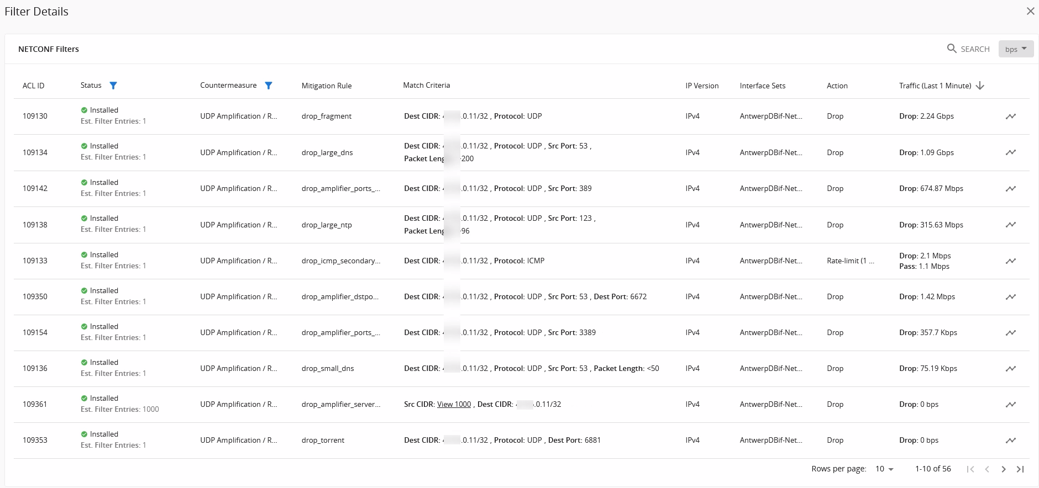
Mitigation filters visible in UI
Notes:
We will also monitor the Deepfield Defender console which lists all ongoing and past DDoS events. When the attack is detected, the event count will turn red and a new DDoS incident entry will be added in the console.

Slide 16
How do you need your DDoS tool to be today?
1 | Automated
 | Secure Genome
2 | Lightning-fast
 | Sampled Port Mirroring
3 | At scale
 | FP5 (edge/DMS)

Slide 18
Copyright and confidentiality
The contents of this document are proprietary
and confidential property of Nokia. This document
is provided subject to confidentiality obligations of
the applicable agreement(s).
This document is intended for use by Nokia’s customers and collaborators only for the purpose for which this document is submitted by Nokia. No part of this document may be reproduced or made available to the public or to any third party in any form or means without the prior written permission of Nokia. This document is to be used by properly trained professional personnel. Any use of the contents in this document is limited strictly to the use(s) specifically created in the applicable agreement(s) under which the document is submitted. The user of this document may voluntarily provide suggestions, comments or
other feedback to Nokia in respect of the
contents of this document ("Feedback").
Such Feedback may be used in Nokia products and related specifications or other documentation. Accordingly, if the user of this document gives
Nokia Feedback on the contents of this document, Nokia may freely use, disclose, reproduce, license, distribute and otherwise commercialize the feedback in any Nokia product, technology, service, specification or other documentation.
Nokia operates a policy of ongoing development. Nokia reserves the right to make changes and improvements to any of the products and/or services described in this document or withdraw
this document at any time without prior notice.
The contents of this document are provided
"as is". Except as required by applicable law, no warranties of any kind, either express or implied, including, but not limited to, the implied warranties of merchantability and fitness for a particular purpose, are made in relation to the accuracy, reliability or contents of this document. NOKIA SHALL NOT BE RESPONSIBLE IN ANY EVENT FOR ERRORS IN THIS DOCUMENT or for any loss of data or income or any special, incidental, consequential, indirect or direct damages howsoever caused, that might arise from the use of this document or any contents of this document.
This document and the product(s) it describes
are protected by copyright according to the
applicable laws.
Nokia is a registered trademark of Nokia Corporation. Other product and company names mentioned herein may be trademarks or trade names of their respective owners.

